Slide 1


Global Initiative for Asthma (GINA) Teaching slide set 2017 update
This slide set is restricted for academic and educational purposes only. Use of the slide set, or of individual slides, for commercial or promotional purposes requires approval from GINA
© Global Initiative for Asthma

Slide 2

G IN A
lobal
itiative for
sthma
© Global Initiative for Asthma

Slide 3
Peer-reviewed articles about GINA
A summary of the new GINA strategy: a roadmap to asthma control
Reddel HK et al. Eur Respir J 2015; 46: 622-39 (free full text)
Summarizes key changes in GINA 2014-15, with their rationale
We recommend that this article should be read as a companion piece to the GINA report itself
The GINA asthma strategy report: what's new for primary care?
Reddel HK, Levy ML. NPJ Prim Care Respir Med 2015; 25: 15050 (free full text)
Summary of key changes in the GINA report for primary care
GINA 2014: a global asthma strategy for a global problem
Reddel HK et al. Int J Tuberc Lung Dis 2014; 18: 505-6 (free full text)
Emphasizing the distinction between population-level and individualized patient-level decisions
The revised 2014 GINA strategy report: opportunities for change
Boulet LP et al. Curr Opin Pulm Med 2015; 21: 1-7
Describes the context that prompted key changes in the GINA report
GINA 2017

Slide 4
The burden of asthma

Slide 5
Burden of asthma
Asthma is one of the most common chronic diseases worldwide with an estimated 300 million affected individuals
Prevalence is increasing in many countries, especially in children
Asthma is a major cause of school and work absence
Health care expenditure on asthma is very high
Developed economies might expect to spend 1-2 percent of total health care expenditures on asthma.
Developing economies likely to face increased demand due to increasing prevalence of asthma
Poorly controlled asthma is expensive
However, investment in prevention medication is likely to yield cost savings in emergency care
GINA 2017

Slide 6
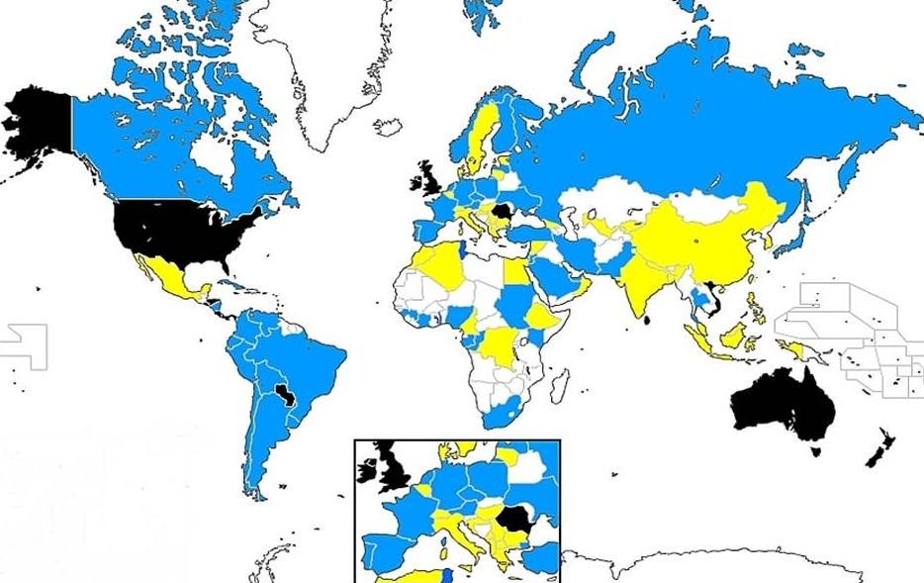

Prevalence of asthma in children aged 13-14 years
© Global Initiative for Asthma
GINA 2017 Appendix Box A1-1; figure provided by R Beasley

Slide 7
Burden of asthma
Countries should enter their own data on burden of asthma

Slide 8
The GINA program

Slide 9
GINA Program Objectives
To increase appreciation of asthma as a global public health problem
To present key recommendations for diagnosis and management of asthma
To provide strategies to adapt recommendations to varying health needs, services, and resources
To identify areas for future investigation of particular significance to the global community
GINA 2017

Slide 10
GINA structure
Board of Directors
Chair: Søren Pedersen, MD
Dissemination & Implementation Committee
Chair: L-P Boulet, MD
Science Committee
Chair: Helen Reddel, MBBS PhD
GINA ASSEMBLY
GINA 2017

Slide 11
GINA Board of Directors 2016
Søren Pedersen, Denmark, Chair
Eric Bateman, South Africa
Louis-Philippe Boulet, Canada
Alvaro Cruz, Brazil
J Mark FitzGerald, Canada
Hiromasa Inoue, Japan
Mark Levy, United Kingdom
Jiangtao Lin, China
Paul O'Byrne, Canada
Helen Reddel, Australia
Stanley Szefler, USA
Arzu Yorgancioglu, Turkey
GINA 2017

Slide 12
GINA Science Committee 2016
Helen Reddel, Australia, Chair
Leonard Bacharier, USA
Eric Bateman, South Africa
Allan Becker, Canada
Roland Buhl, Germany
Johan de Jongste, The Netherlands
J. Mark FitzGerald, Canada
Hiromasa Inoue, Japan
Fanny Wai-san Ko, Hong Kong
Jerry Krishnan, USA
Paul O'Byrne, Canada
Soren Pedersen, Denmark
Emilio Pizzichini, Brazil
Stanley J. Szefler, USA
GINA 2017

Slide 13
GINA Science Committee
Members serve in a voluntary capacity
Twice-yearly meetings before ATS and ERS conferences
Routine review of new scientific literature about asthma, including clinical trials, pragmatic studies and observational studies, together with reviews/meta-analyses
Other peer-reviewed material that has been submitted for review
Discussion of any paper considered to impact on the GINA report
Recommendations about therapies for which at least two good quality clinical trials are available, and that have been approved for asthma by a major regulator
Annual update of GINA report, appendix and Pocket Guides
GINA 2017

Slide 14
GINA Assembly
A network of individuals participating in the dissemination and implementation of asthma management programs at the local, national and regional level
GINA Assembly members are invited to meet with the GINA Executive Committee during the ATS and ERS meetings
45 countries are currently represented in the GINA Assembly
GINA 2017

Slide 15
Slovenia
Germany
Ireland
Saudi Arabia
Bangladesh
Australia
Yugoslavia
Croatia
Canada
Brazil
United States
Austria
Taiwan
Portugal
Thailand
Philippines
Malta
Moldova
Mexico
Greece
China
Syria
Egypt
South Africa
United Kingdom
Hong Kong ROC
Chile
Italy
New Zealand
Venezuela
Cambodia
Argentina
Israel
Lebanon
Pakistan
Mongolia
Japan
Poland
GINA Assembly
Korea
Netherlands
Switzerland
Russia
Georgia
Macedonia
France
Turkey
Czech Republic
Denmark
Slovakia
Belgium
Ukraine
Singapore
Spain
India
Romania
Colombia
Sweden
Albania
Kyrgyzstan
Vietnam

Slide 16
GINA resources - 2017
Global Strategy for Asthma Management and Prevention 2017
Full report with many clinical tools/flow-charts, and Online Appendix
Fully revised in 2014, updated 2015, 201, 2017
Diagnosis of asthma-COPD overlap syndrome (ACOS): a project of GINA and GOLD. Published within GINA report and separately
Pocket Guides 2017
Asthma Management and Prevention, adults and children >5 years
Asthma Management and Prevention, children ≤5 years
Dissemination and Implementation Strategies
All materials available on the GINA web site www.ginasthma.org can also be ordered in hard copy
Use ‘Contact us’ link at bottom of webpage to order materials
Additional dissemination and implementation tools will be added to the website during 2017
GINA 2017

Slide 17
GINA Global Strategy for Asthma Management and Prevention
Not a guideline, but a practical approach to managing asthma in clinical practice
A global strategy, relevant to both low and high resource countries
Evidence-based and clinically-oriented
Provides clinical tools and measurable outcomes
GINA 2017

Slide 18
Global Strategy for Asthma Management & Prevention 2017
Evidence category | Sources of evidence
A | Well-designed RCTs or meta-analyses Consistent pattern of findings in the population for which the recommendation is made Substantial numbers of large studies
B | Limited number of patients, post hoc or sub-group analyses of RCTs or meta-analyses Few RCTs, or small in size, or differing population, or results somewhat inconsistent
C | Uncontrolled or non-randomized studies Observational studies
D | Panel consensus based on clinical experience or knowledge
GINA 2017

Slide 19
Key changes in GINA 2017 - ‘Asthma-COPD overlap’
The word ‘syndrome’ has been removed from the previous term ‘asthma-COPD overlap syndrome (ACOS)’ because:
This term was being commonly used in the respiratory community as if it was a single disease (‘the asthma-COPD overlap syndrome’)
There are two medically-accepted definitions of ‘syndrome’
This distracted from the key messages for clinicians and regulators
The aim is to focus attention back on the original issues
These patients are commonly seen in clinical practice
They are almost always excluded from the RCTs that provide the evidence base for treatment recommendations, and from studies of underlying mechanisms
Current guidelines have opposite safety recommendations
Asthma: never use LABA without ICS
COPD: start treatment with LABA and/or LAMA, without ICS
Pragmatic interim advice is needed for clinical practice
What’s new in GINA 2017?

Slide 20
Key changes in GINA 2017 - lung function
Clarification about ‘periodical’ assessment of lung function
Most adults: lung function should be recorded at least every 1-2 yrs
More frequently in higher risk patients
More frequently in children based on severity and clinical course
Lung function trajectories
Children with persistent asthma may have reduced growth in lung function, and some are at risk of accelerated decline in lung function in early adult life [McGeachie, NEJMed 2016]
Low resource areas
Poverty is commonly associated with spirometric restriction, so where possible, both FEV₁ and FVC should be recorded
What’s new in GINA 2017?

Slide 21
Key changes in GINA 2017 – FeNO
Diagnosis of asthma
Additional factors that increase or decrease FENO are listed
FENO is not helpful in ruling in or ruling out asthma as defined by GINA
Assessment of future risk
Elevated FENO in allergic patients has been added to the list of independent predictors of exacerbations [Zeiger JACI 2011]
Single measurements
Results of FENO measurement at a single point in time should be interpreted with caution
Controller treatment
Given the lack of long-term safety studies, FENO cannot be recommended at present for deciding against treatment with ICS in patients with a diagnosis or suspected diagnosis of asthma.
Based on current evidence, GINA recommends treatment with low-dose ICS for most patients with asthma, even those with infrequent symptoms, to reduce the risk of serious exacerbations.
What’s new in GINA 2017?

Slide 22


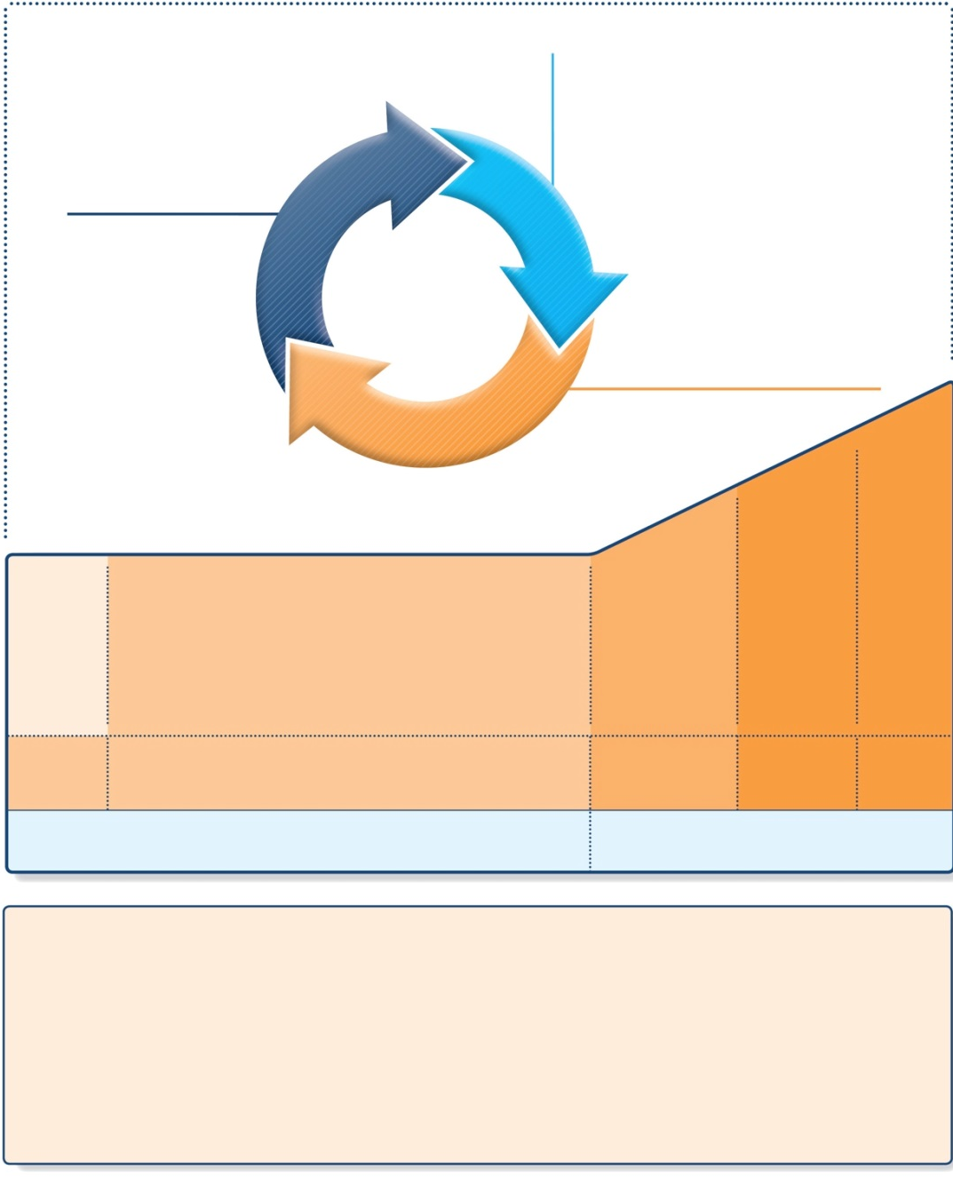
Stepwise approach to control asthma symptoms and reduce risk
Diagnosis
Symptom control & risk factors (including lung function)
Inhaler technique & adherence
Patient preference
ASSESS
REVIEW RESPONSE
Symptoms
Exacerbations
Side-effects
Patient satisfaction
Lung function
ADJUST TREATMENT
Asthma medications
Non-pharmacological strategies
Treat modifiable risk factors
STEP 5
STEP 4
PREFERRED CONTROLLER CHOICE
STEP 1
STEP 2
STEP 3
Refer for add-on treatment
e.g.
tiotropium,* anti-IgE, anti-IL5*
Med/high ICS/LABA
Low dose ICS
Low dose ICS/LABA**
Other controller options
Consider low dose ICS
Leukotriene receptor antagonists (LTRA)
Low dose theophylline*
Med/high dose ICS
Low dose ICS+LTRA
(or + theoph*)
Add tiotropium*
High dose ICS + LTRA (or + theoph*)
Add low dose OCS
RELIEVER
As-needed short-acting beta₂-agonist (SABA)
As-needed SABA or low dose ICS/formoterol#
REMEMBER TO...
• Provide guided self-management education (self-monitoring + written action plan + regular review)
• Treat modifiable risk factors and comorbidities, e.g. smoking, obesity, anxiety
• Advise about non-pharmacological therapies and strategies, e.g. physical activity, weight loss, avoidance of sensitizers where appropriate
• Consider stepping up if … uncontrolled symptoms, exacerbations or risks, but check diagnosis, inhaler technique and adherence first
• Consider adding SLIT in adult HDM-sensitive patients with allergic rhinitis who have exacerbations despite ICS treatment, provided FEV1 is >70% predicted
• Consider stepping down if … symptoms controlled for 3 months + low risk for exacerbations. Ceasing ICS is not advised.
SLIT added as an option
GINA 2017, Box 3-5 (1/8)
© Global Initiative for Asthma

Slide 23

Key changes in GINA 2017 – role of SLIT
• Provide guided self-management education
• Treat modifiable risk factors and comorbidities
• Advise about non-pharmacological therapies and strategies
• Consider stepping up if … uncontrolled symptoms, exacerbations or risks, but check diagnosis, inhaler technique and adherence first
• Consider adding SLIT in adult HDM-sensitive patients with allergic rhinitis who have exacerbations despite ICS treatment, provided FEV₁ is 70% predicted
• Consider stepping down if … symptoms controlled for 3 months + low risk for exacerbations. Ceasing ICS is not advised.
REMEMBER TO...
SLIT: sublingual immunotherapy
GINA 2017, Box 3-5 (3/8) (lower part)

Slide 24
Key changes in GINA 2017 – other treatment
Step 5 treatment for severe asthma
Anti-IL5: reslizumab (IV) added to mepolizumab (SC) for ≥18 years
Step-down from low-dose ICS (Box 3-7)
Add-on LTRA may help
Insufficient evidence for step-down to as-needed ICS with SABA
Side-effects of oral corticosteroids
When prescribing short-term OCS, remember to advise patients about common side-effects (sleep disturbance, increased appetite, reflux, mood changes); references added
Vitamin D
To date, no good quality evidence that Vitamin D supplementation leads to improved asthma control or fewer exacerbations
Chronic sinonasal disease
Treatment with nasal corticosteroids improves sinonasal symptoms but not asthma outcomes
What’s new in GINA 2017?

Slide 25
Key changes in GINA 2017 - ICS and growth in children
This topic previously covered in detail in the online Appendix
Information now also added to main report for accessibility
Assessment of future risk
Height should be checked at least yearly, as poorly-controlled asthma can affect growth [Pedersen 2001], and growth velocity may be lower in the first 1-2 years of ICS treatment [Loke, 2015].
Consider referral if there is growth delay
Choice of controller treatment
Discuss relative benefits and risks with parents or carers, including the importance of maintaining normal physical activity
Effects of ICS on growth velocity are not progressive or cumulative [Kelly 2012, Loke 2015].
The one study that examined long-term outcomes showed a difference of only 0.7% in adult height [Kelly 2012, Loke 2015]
What’s new in GINA 2017?

Slide 26
Key changes in GINA 2017 - other changes
Cough in infancy
Prolonged cough in infancy, and cough without cold symptoms, are associated with later parent-reported physician-diagnosed asthma, independent of infant wheeze [Oren 2015]
Primary prevention of asthma
No consistent effects of maternal dietary intake of fish or long-chain polyunsaturated fatty acids during pregnancy on the risk of wheeze, asthma or atopy in the child (based on RCTs and epidemiological studies) [Best, 2016]
Effective implementation studies
Update of adherence strategies effective in real-life settings
Examples of high impact interventions (from appendix)
What’s new in GINA 2017?

Slide 27
Definition and diagnosis of asthma

Slide 28
What is known about asthma?
Asthma is a common and potentially serious chronic disease that can be controlled but not cured
Asthma causes symptoms such as wheezing, shortness of breath, chest tightness and cough that vary over time in their occurrence, frequency and intensity
Symptoms are associated with variable expiratory airflow, i.e. difficulty breathing air out of the lungs due to
Bronchoconstriction (airway narrowing)
Airway wall thickening
Increased mucus
Symptoms may be triggered or worsened by factors such as viral infections, allergens, tobacco smoke, exercise and stress
GINA 2017

Slide 29
What is known about asthma?
Asthma can be effectively treated
When asthma is well-controlled, patients can
Avoid troublesome symptoms during the day and night
Need little or no reliever medication
Have productive, physically active lives
Have normal or near-normal lung function
Avoid serious asthma flare-ups (also called exacerbations, or severe attacks)
GINA 2017

Slide 30
Definition of asthma
Asthma is a heterogeneous disease, usually characterized by chronic airway inflammation.
It is defined by the history of respiratory symptoms such as wheeze, shortness of breath, chest tightness and cough that vary over time and in intensity, together with variable expiratory airflow limitation.
GINA 2017

Slide 31
Diagnosis of asthma
The diagnosis of asthma should be based on:
A history of characteristic symptom patterns
Evidence of variable airflow limitation, from bronchodilator reversibility testing or other tests
Document evidence for the diagnosis in the patient’s notes, preferably before starting controller treatment
It is often more difficult to confirm the diagnosis after treatment has been started
Asthma is usually characterized by airway inflammation and airway hyperresponsiveness, but these are not necessary or sufficient to make the diagnosis of asthma.
GINA 2017

Slide 32
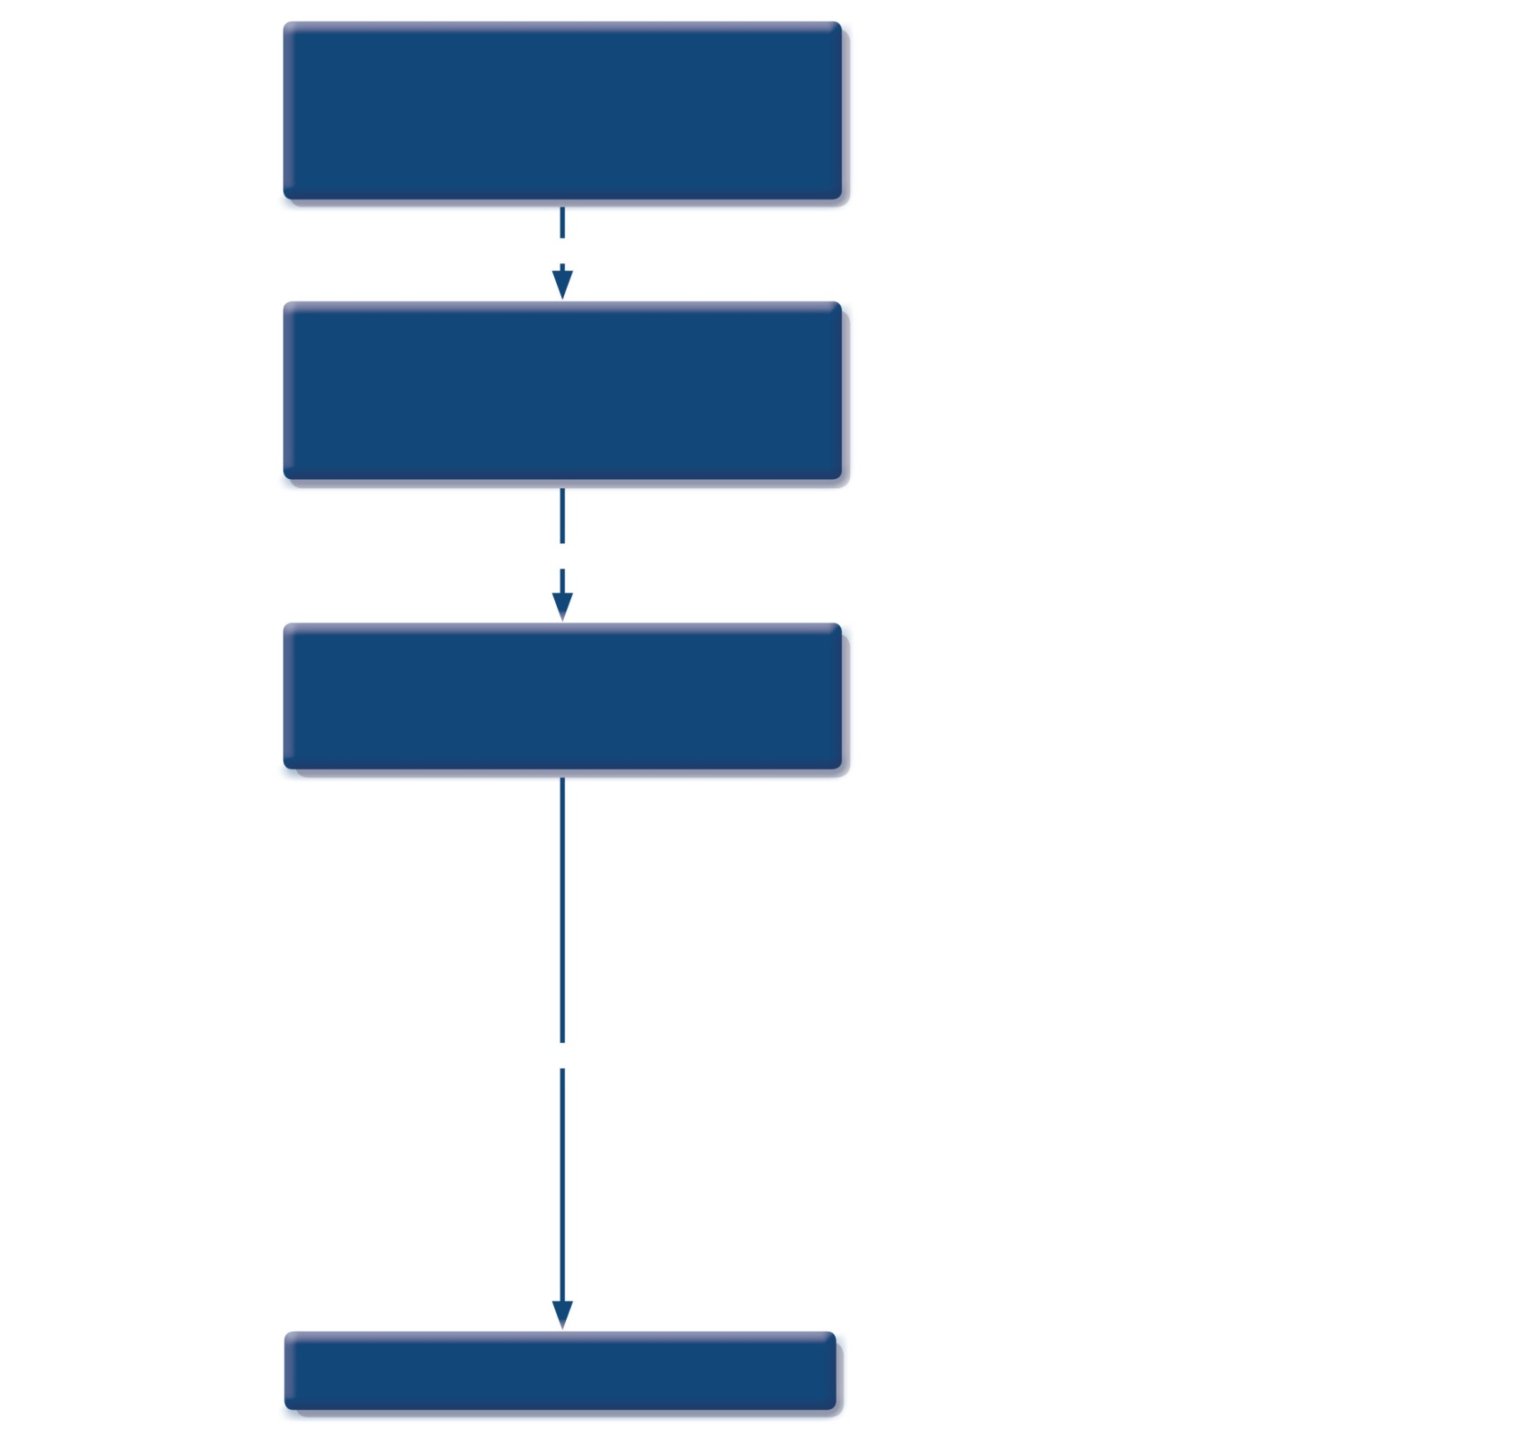
Patient with respiratory symptoms
Are the symptoms typical of asthma?
YES
Detailed history/examination for asthma
History/examination supports asthma diagnosis?
YES
Perform spirometry/PEF with reversibility test
Results support asthma diagnosis?
YES
Treat for ASTHMA
GINA 2017, Box 1-1 (1/4)
© Global Initiative for Asthma

Slide 33

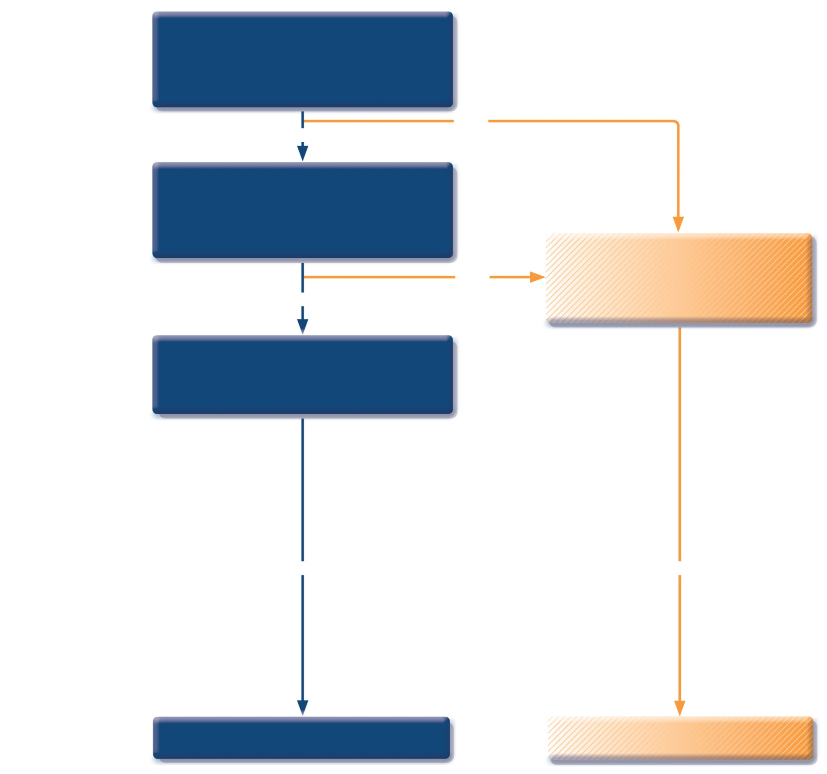
Patient with respiratory symptoms
Are the symptoms typical of asthma?
YES
NO
Detailed history/examination for asthma
History/examination supports asthma diagnosis?
Further history and tests for alternative diagnoses
Alternative diagnosis confirmed?
NO
YES
Perform spirometry/PEF with reversibility test
Results support asthma diagnosis?
YES
YES
Treat for ASTHMA
Treat for alternative diagnosis
GINA 2017, Box 1-1 (2/4)
© Global Initiative for Asthma

Slide 34
Patient with respiratory symptoms
Are the symptoms typical of asthma?
YES
NO
Detailed history/examination for asthma
History/examination supports asthma diagnosis?
Further history and tests for alternative diagnoses
Alternative diagnosis confirmed?
NO
YES
Perform spirometry/PEF with reversibility test
Results support asthma diagnosis?
Repeat on another occasion or arrange other tests
Confirms asthma diagnosis?
NO
YES
NO
YES
NO
YES
Consider trial of treatment for most likely diagnosis, or refer for further investigations
Treat for ASTHMA
Treat for alternative diagnosis
GINA 2017, Box 1-1 (3/4)
© Global Initiative for Asthma

Slide 35
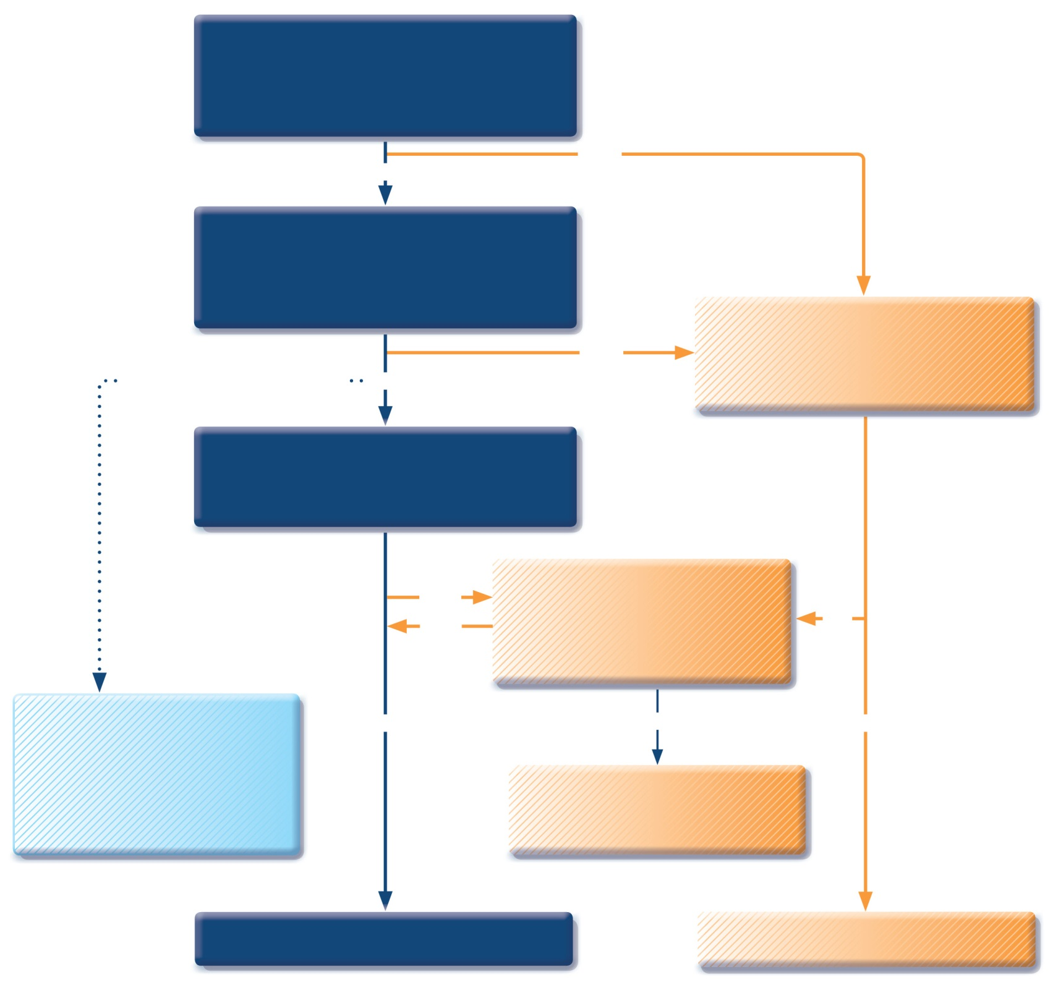
Patient with respiratory symptoms
Are the symptoms typical of asthma?
YES
NO
Detailed history/examination for asthma
History/examination supports asthma diagnosis?
Further history and tests for alternative diagnoses
Alternative diagnosis confirmed?
Clinical urgency, and other diagnoses unlikely
NO
YES
Perform spirometry/PEF with reversibility test
Results support asthma diagnosis?
Repeat on another occasion or arrange other tests
Confirms asthma diagnosis?
NO
YES
NO
Empiric treatment with ICS and prn SABA
Review response
Diagnostic testing within 1-3 months
YES
NO
YES
Consider trial of treatment for most likely diagnosis, or refer for further investigations
Treat for ASTHMA
Treat for alternative diagnosis
GINA 2017, Box 1-1 (4/4)
© Global Initiative for Asthma

Slide 36
Diagnosis of asthma – symptoms
Increased probability that symptoms are due to asthma if:
More than one type of symptom (wheeze, shortness of breath, cough, chest tightness)
Symptoms often worse at night or in the early morning
Symptoms vary over time and in intensity
Symptoms are triggered by viral infections, exercise, allergen exposure, changes in weather, laughter, irritants such as car exhaust fumes, smoke, or strong smells
Decreased probability that symptoms are due to asthma if:
Isolated cough with no other respiratory symptoms
Chronic production of sputum
Shortness of breath associated with dizziness, light-headedness or peripheral tingling
Chest pain
Exercise-induced dyspnea with noisy inspiration (stridor)
GINA 2017

Slide 37
Diagnosis of asthma – variable airflow limitation
Confirm presence of airflow limitation
Document that FEV₁/FVC is reduced (at least once, when FEV₁ is low)
FEV₁/ FVC ratio is normally >0.75 – 0.80 in healthy adults, and >0.90 in children
Confirm variation in lung function is greater than in healthy individuals
The greater the variation, or the more times variation is seen, the greater probability that the diagnosis is asthma
Excessive bronchodilator reversibility (adults: increase in FEV₁ >12% and >200mL; children: increase >12% predicted)
Excessive diurnal variability from 1-2 weeks’ twice-daily PEF monitoring (daily amplitude x 100/daily mean, averaged)
Significant increase in FEV₁ or PEF after 4 weeks of controller treatment
If initial testing is negative:
Repeat when patient is symptomatic, or after withholding bronchodilators
Refer for additional tests (especially children ≤5 years, or the elderly)
GINA 2017, Box 1-2

Slide 38
Typical spirometric tracings
Flow
Volume
Normal
FEV₁
Asthma (after BD)
Normal
Asthma (before BD)
Asthma (after BD)
Asthma (before BD)
1
2
3
4
5
6
Volume
Time (seconds)
Note: Each FEV₁ represents the highest of three reproducible measurements
GINA 2017

Slide 39
Diagnosis of asthma – physical examination
Physical examination in people with asthma
Often normal
The most frequent finding is wheezing on auscultation, especially on forced expiration
Wheezing is also found in other conditions, for example:
Respiratory infections
COPD
Upper airway dysfunction
Endobronchial obstruction
Inhaled foreign body
Wheezing may be absent during severe asthma exacerbations (‘silent chest’)
GINA 2017

Slide 40
Assessment of asthma

Slide 41
Assessment of asthma
Asthma control - two domains
Assess symptom control over the last 4 weeks
Assess risk factors for poor outcomes, including low lung function
Treatment issues
Check inhaler technique and adherence
Ask about side-effects
Does the patient have a written asthma action plan?
What are the patient’s attitudes and goals for their asthma?
Comorbidities
Think of rhinosinusitis, GERD, obesity, obstructive sleep apnea, depression, anxiety
These may contribute to symptoms and poor quality of life
GINA 2017, Box 2-1

Slide 42
GINA assessment of symptom control
A. Symptom control
In the past 4 weeks, has the patient had: | Well-controlled | Partly controlled | Uncontrolled
Daytime asthma symptoms more than twice a week? Yes No | None of these | 1-2 of these | 3-4 of these
Any night waking due to asthma? Yes No
Reliever needed for symptoms* more than twice a week? Yes No
Any activity limitation due to asthma? Yes No
Level of asthma symptom control
*Excludes reliever taken before exercise, because many people take this routinely
GINA 2017, Box 2-2A

Slide 43
GINA assessment of asthma control
A. Symptom control
In the past 4 weeks, has the patient had: | Well-controlled | Partly controlled | Uncontrolled
Daytime asthma symptoms more than twice a week? Yes No | None of these | 1-2 of these | 3-4 of these
Any night waking due to asthma? Yes No
Reliever needed for symptoms* more than twice a week? Yes No
Any activity limitation due to asthma? Yes No
B. Risk factors for poor asthma outcomes
Assess risk factors at diagnosis and periodically Measure FEV₁ at start of treatment, after 3 to 6 months of treatment to record the patient’s personal best, then periodically for ongoing risk assessment ASSESS PATIENT’S RISKS FOR: Exacerbations Fixed airflow limitation Medication side-effects
Level of asthma symptom control
GINA 2017 Box 2-2B (1/4)

Slide 44
Assessment of risk factors for poor asthma outcomes
Risk factors for exacerbations include:
Ever intubated for asthma Uncontrolled asthma symptoms Having ≥1 exacerbation in last 12 months Low FEV₁ (measure lung function at start of treatment, at 3-6 months to assess personal best, and periodically thereafter) Incorrect inhaler technique and/or poor adherence Smoking Obesity, pregnancy, blood eosinophilia
Independent* risk factors for exacerbations include:
Ever intubated for asthma Uncontrolled asthma symptoms Having ≥1 exacerbation in last 12 months Low FEV₁ (measure lung function at start of treatment, at 3-6 months to assess personal best, and periodically thereafter) Incorrect inhaler technique and/or poor adherence Smoking Elevated FeNO in adults with allergic asthma Obesity, pregnancy, blood eosinophilia
UPDATED 2017
* Independent of the level of symptom control
GINA 2017, Box 2-2B (2/4)

Slide 45
Assessment of risk factors for poor asthma outcomes
Risk factors for exacerbations include:
Ever intubated for asthma Uncontrolled asthma symptoms Having ≥1 exacerbation in last 12 months Low FEV₁ (measure lung function at start of treatment, at 3-6 months to assess personal best, and periodically thereafter) Incorrect inhaler technique and/or poor adherence Smoking Elevated FeNO in adults with allergic asthma Obesity, pregnancy, blood eosinophilia
Risk factors for fixed airflow limitation include:
No ICS treatment, smoking, occupational exposure, mucus hypersecretion, blood eosinophilia
GINA 2017, Box 2-2B (3/4)

Slide 46
Assessment of risk factors for poor asthma outcomes
Risk factors for exacerbations include:
Ever intubated for asthma Uncontrolled asthma symptoms Having ≥1 exacerbation in last 12 months Low FEV₁ (measure lung function at start of treatment, at 3-6 months to assess personal best, and periodically thereafter) Incorrect inhaler technique and/or poor adherence Smoking Elevated FeNO in adults with allergic asthma Obesity, pregnancy, blood eosinophilia
Risk factors for fixed airflow limitation include:
No ICS treatment, smoking, occupational exposure, mucus hypersecretion, blood eosinophilia
Risk factors for medication side-effects include:
Frequent oral steroids, high dose/potent ICS, P450 inhibitors
GINA 2017, Box 2-2B (4/4)

Slide 47
The role of lung function in asthma
UPDATED 2017
Diagnosis
Demonstrate variable expiratory airflow limitation
Reconsider diagnosis if symptoms and lung function are discordant
Frequent symptoms but normal FEV₁: cardiac disease; lack of fitness?
Few symptoms but low FEV₁: poor perception; restriction of lifestyle?
Risk assessment
Low FEV₁ is an independent predictor of exacerbation risk
Measure lung function to monitor progress
At diagnosis and 3-6 months after starting treatment (to identify personal best)
Periodically thereafter, at least every 1-2 years for most adults; more often for high risk patients and for children, depending on age and asthma severity
Consider long-term PEF monitoring for patients with severe asthma or impaired perception of airflow limitation
Adjusting treatment?
Utility of lung function for adjusting treatment is limited by between-visit variability of FEV₁ (15% year-to-year)
GINA 2017

Slide 48
Assessing asthma severity
How?
Asthma severity is assessed retrospectively from the level of treatment required to control symptoms and exacerbations
When?
Assess asthma severity after patient has been on controller treatment for several months
Severity is not static – it may change over months or years, or as different treatments become available
Categories of asthma severity
Mild asthma: well-controlled with Steps 1 or 2 (as-needed SABA or low dose ICS)
Moderate asthma: well-controlled with Step 3 (low-dose ICS/LABA)
Severe asthma: requires Step 4/5 (moderate or high dose ICS/LABA ± add-on), or remains uncontrolled despite this treatment
GINA 2017

Slide 49
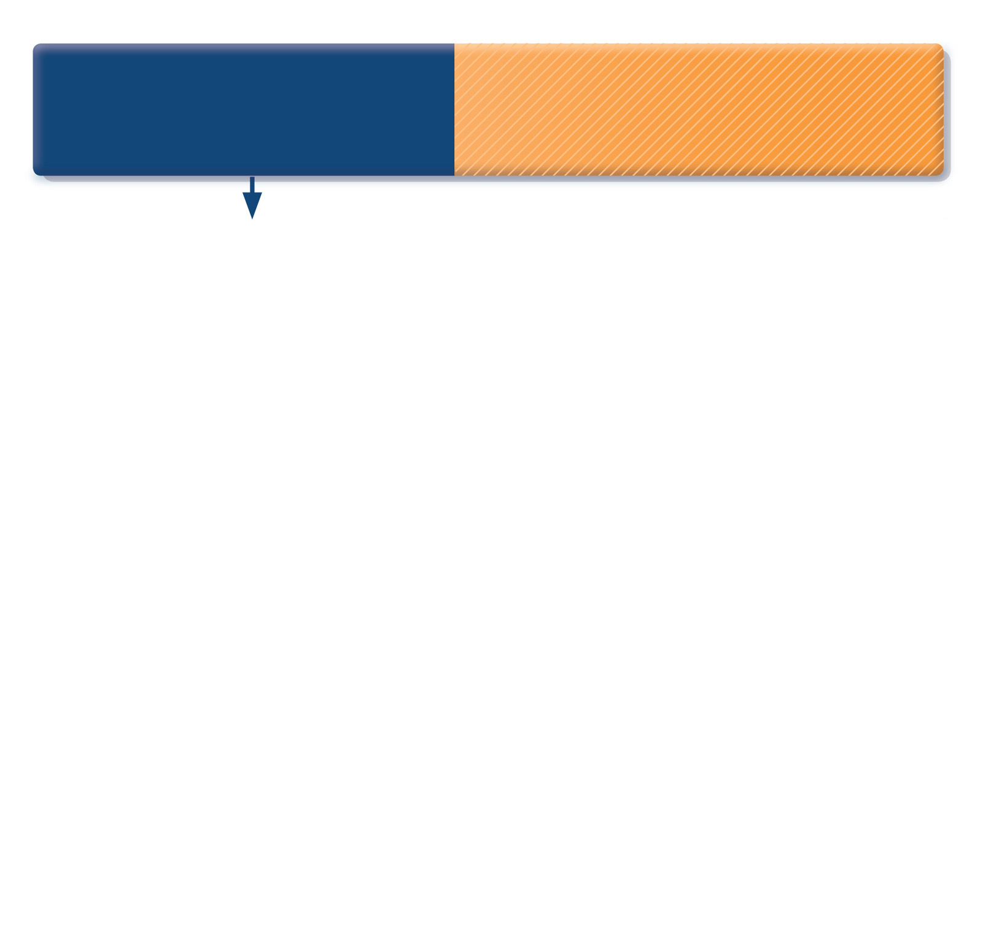
How to distinguish between uncontrolled and severe asthma
Watch patient using their inhaler. Discuss adherence and barriers to use
Compare inhaler technique with a device-specific checklist, and correct errors; recheck frequently. Have an empathic discussion about barriers to adherence.
Remove potential risk factors. Assess and manage comorbidities
Consider treatment step-up
Refer to a specialist or severe asthma clinic
GINA 2017, Box 2-4 (1/5)
© Global Initiative for Asthma

Slide 50
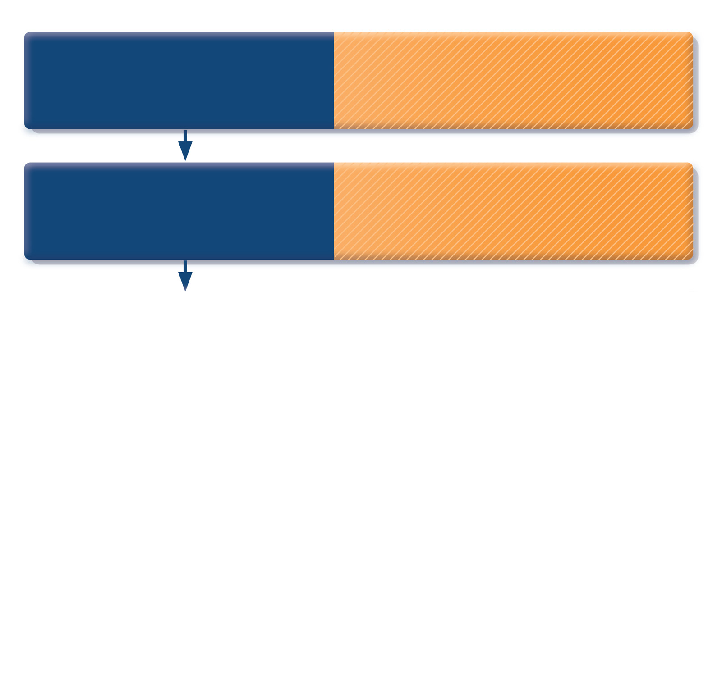
How to distinguish between uncontrolled and severe asthma
Watch patient using their inhaler. Discuss adherence and barriers to use
Compare inhaler technique with a device-specific checklist, and correct errors; recheck frequently. Have an empathic discussion about barriers to adherence.
Confirm the diagnosis of asthma
If lung function normal during symptoms, consider halving ICS dose and repeating lung function after 2–3 weeks.
Refer to a specialist or severe asthma clinic
GINA 2017, Box 2-4 (2/5)
© Global Initiative for Asthma

Slide 51
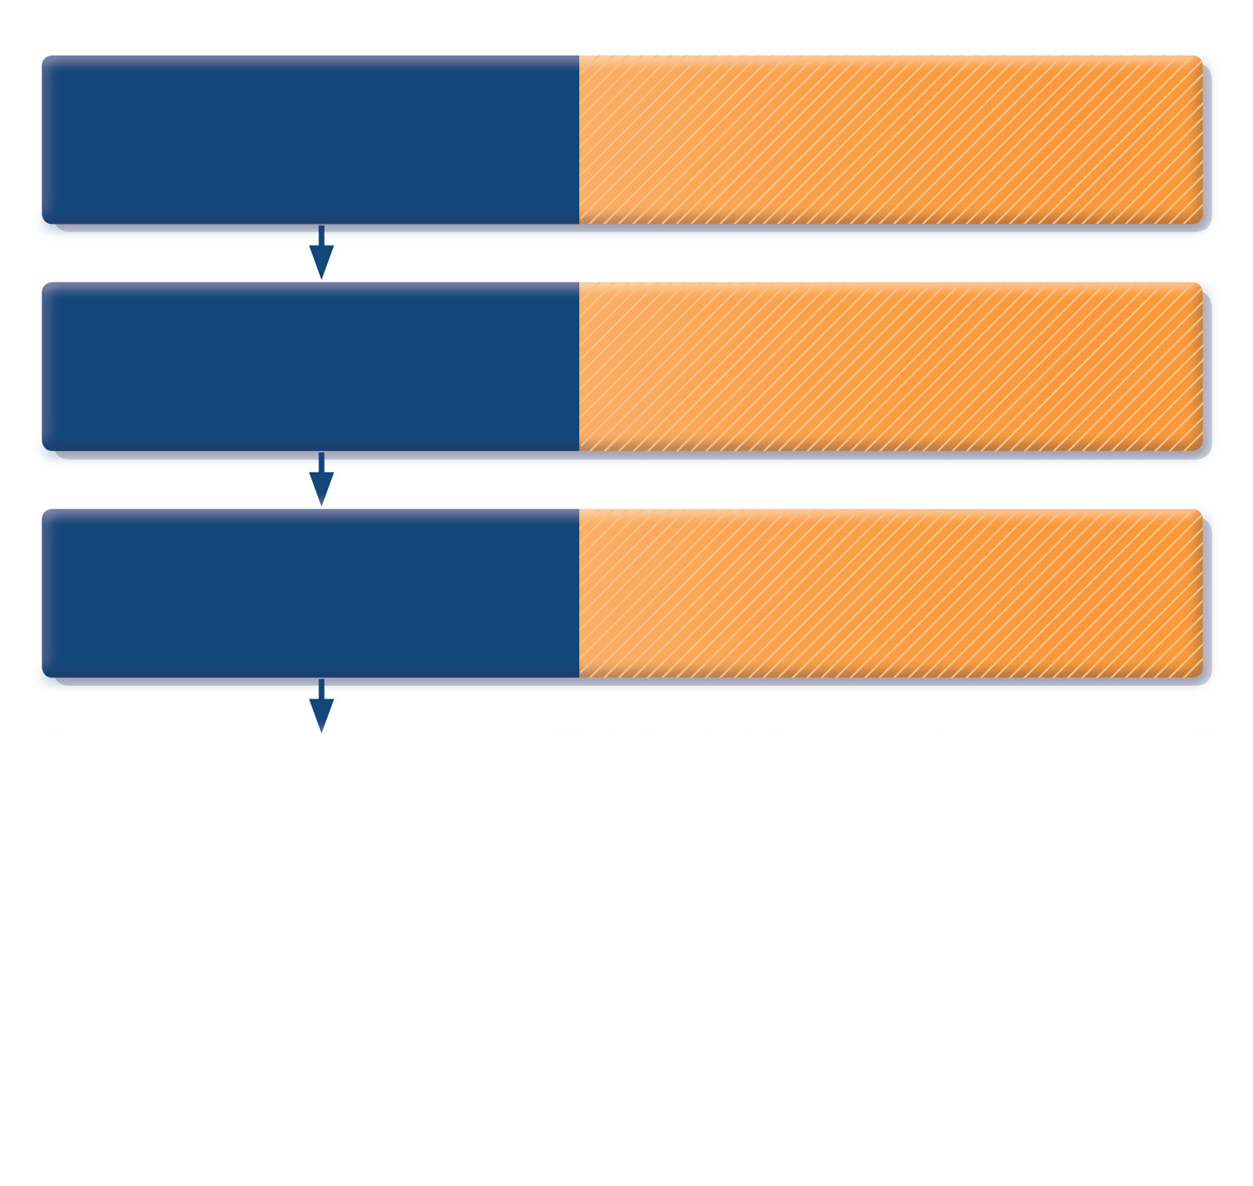
How to distinguish between uncontrolled and severe asthma
Watch patient using their inhaler. Discuss adherence and barriers to use
Compare inhaler technique with a device-specific checklist, and correct errors; recheck frequently. Have an empathic discussion about barriers to adherence.
Confirm the diagnosis of asthma
If lung function normal during symptoms, consider halving ICS dose and repeating lung function after 2–3 weeks.
Remove potential risk factors. Assess and manage comorbidities
Check for risk factors or inducers such as smoking, beta-blockers, NSAIDs, allergen exposure. Check for comorbidities such as rhinitis, obesity, GERD, depression/anxiety.
Consider treatment step-up
Refer to a specialist or severe asthma clinic
GINA 2017, Box 2-4 (3/5)
© Global Initiative for Asthma

Slide 52
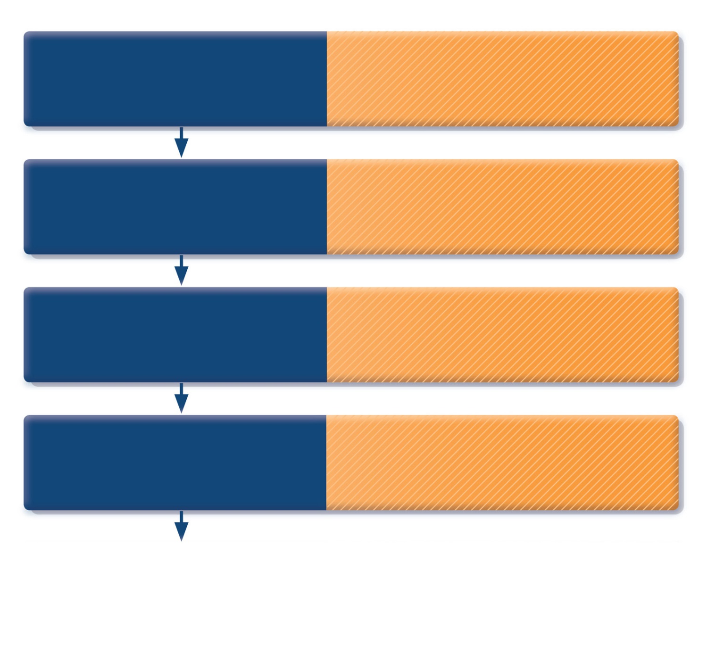
How to distinguish between uncontrolled and severe asthma
Watch patient using their inhaler. Discuss adherence and barriers to use
Compare inhaler technique with a device-specific checklist, and correct errors; recheck frequently. Have an empathic discussion about barriers to adherence.
Confirm the diagnosis of asthma
If lung function normal during symptoms, consider halving ICS dose and repeating lung function after 2–3 weeks.
Remove potential risk factors. Assess and manage comorbidities
Check for risk factors or inducers such as smoking, beta-blockers, NSAIDs, allergen exposure. Check for comorbidities such as rhinitis, obesity, GERD, depression/anxiety.
Consider treatment step-up
Consider step up to next treatment level. Use shared decision-making, and balance potential benefits and risks.
Refer to a specialist or severe asthma clinic
GINA 2017, Box 2-4 (4/5)
© Global Initiative for Asthma

Slide 53
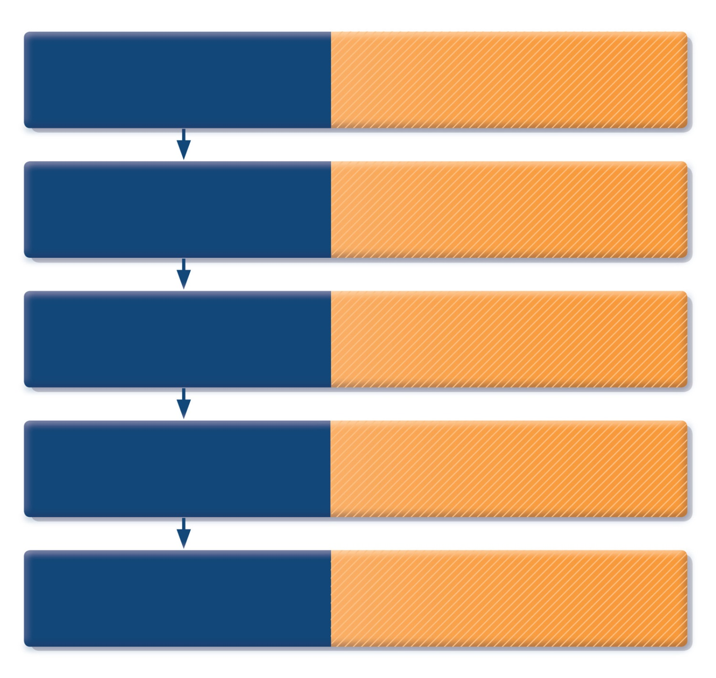
How to distinguish between uncontrolled and severe asthma
Watch patient using their inhaler. Discuss adherence and barriers to use
Compare inhaler technique with a device-specific checklist, and correct errors; recheck frequently. Have an empathic discussion about barriers to adherence.
Confirm the diagnosis of asthma
If lung function normal during symptoms, consider halving ICS dose and repeating lung function after 2–3 weeks.
Remove potential risk factors. Assess and manage comorbidities
Check for risk factors or inducers such as smoking, beta-blockers, NSAIDs, allergen exposure. Check for comorbidities such as rhinitis, obesity, GERD, depression/anxiety.
Consider treatment step-up
Consider step up to next treatment level. Use shared decision-making, and balance potential benefits and risks.
Refer to a specialist or severe asthma clinic
If asthma still uncontrolled after 3–6 months on Step 4 treatment, refer for expert advice. Refer earlier if asthma symptoms severe, or doubts about diagnosis.
GINA 2017, Box 2-4 (5/5)
© Global Initiative for Asthma

Slide 54
Treating asthma to control symptoms and minimize risk

Slide 55
Goals of asthma management
The long-term goals of asthma management are
Symptom control: to achieve good control of symptoms and maintain normal activity levels
Risk reduction: to minimize future risk of exacerbations, fixed airflow limitation and medication side-effects
Achieving these goals requires a partnership between patient and their health care providers
Ask the patient about their own goals regarding their asthma
Good communication strategies are essential
Consider the health care system, medication availability, cultural and personal preferences and health literacy
GINA 2017

Slide 56
Key strategies to facilitate good communication
Improve communication skills
Friendly manner
Allow the patient to express their goals, beliefs and concerns
Empathy and reassurance
Encouragement and praise
Provide appropriate (personalized) information
Feedback and review
Benefits include:
Increased patient satisfaction
Better health outcomes
Reduced use of health care resources
GINA 2017, Box 3-1

Slide 57
Reducing the impact of impaired health literacy
Health literacy affects health outcomes, including in asthma
‘The degree to which individuals have the capacity to obtain, process and understand basic health information and services to make appropriate health decisions’ (Rosas-Salazar, JACI 2012)
Strategies for reducing the impact of impaired health literacy
Prioritize information (most important to least important)
Speak slowly, avoid medical language, simplify numeric concepts
Use anecdotes, drawings, pictures, tables and graphs
Use the ‘teach-back’ method – ask patients to repeat instructions
Ask a second person to repeat the main messages
Pay attention to non-verbal communication
GINA 2017, Box 3-1

Slide 58

Treating to control symptoms and minimize risk
Establish a patient-doctor partnership
Manage asthma in a continuous cycle:
Assess
Adjust treatment (pharmacological and non-pharmacological)
Review the response
Teach and reinforce essential skills
Inhaler skills
Adherence
Guided self-management education
Written asthma action plan
Self-monitoring
Regular medical review
ASSESS
REVIEW RESPONSE
ADJUST TREATMENT
GINA 2017

Slide 59

The control-based asthma management cycle
Diagnosis
Symptom control & risk factors (including lung function)
Inhaler technique & adherence
Patient preference
ASSESS
REVIEW RESPONSE
Symptoms
Exacerbations
Side-effects
Patient satisfaction
Lung function
ADJUST TREATMENT
Asthma medications
Non-pharmacological strategies
Treat modifiable risk factors
GINA 2017, Box 3-2

Slide 60
Choosing between controller options – population-level decisions
Choosing between treatment options at a population level e.g. national formularies, health maintenance organisations, national guidelines
The ‘preferred treatment’ at each step is based on: Efficacy Effectiveness Safety Availability and cost at the population level
based on group mean data for symptoms, exacerbations and lung function (from RCTs, pragmatic studies and observational data)
GINA 2017, Box 3-3 (1/2)

Slide 61
Choosing between controller options – individual patient decisions
Decisions for individual patients Use shared decision-making with the patient/parent/carer to discuss the following:
Preferred treatment for symptom control and for risk reduction Patient characteristics (phenotype) Does the patient have any known predictors of risk or response? (e.g. smoker, history of exacerbations, blood eosinophilia) Patient preference What are the patient’s goals and concerns for their asthma? Practical issues Inhaler technique - can the patient use the device correctly after training? Adherence: how often is the patient likely to take the medication? Cost: can the patient afford the medication?
GINA 2017, Box 3-3 (2/2)

Slide 62
Initial controller treatment for adults, adolescents and children 6–11 years
Start controller treatment early
For best outcomes, initiate controller treatment as early as possible after making the diagnosis of asthma
Indications for regular low-dose ICS - any of:
Asthma symptoms more than twice a month
Waking due to asthma more than once a month
Any asthma symptoms plus any risk factors for exacerbations
Consider starting at a higher step if:
Troublesome asthma symptoms on most days
Waking from asthma once or more a week, especially if any risk factors for exacerbations
If initial asthma presentation is with an exacerbation:
Give a short course of oral steroids and start regular controller treatment (e.g. high dose ICS or medium dose ICS/LABA, then step down)
GINA 2017, Box 3-4 (1/2)

Slide 63
Initial controller treatment
Before starting initial controller treatment
Record evidence for diagnosis of asthma, if possible
Record symptom control and risk factors, including lung function
Consider factors affecting choice of treatment for this patient
Ensure that the patient can use the inhaler correctly
Schedule an appointment for a follow-up visit
After starting initial controller treatment
Review response after 2-3 months, or according to clinical urgency
Adjust treatment (including non-pharmacological treatments)
Consider stepping down when asthma has been well-controlled for 3 months
GINA 2017, Box 3-4 (2/2)

Slide 64
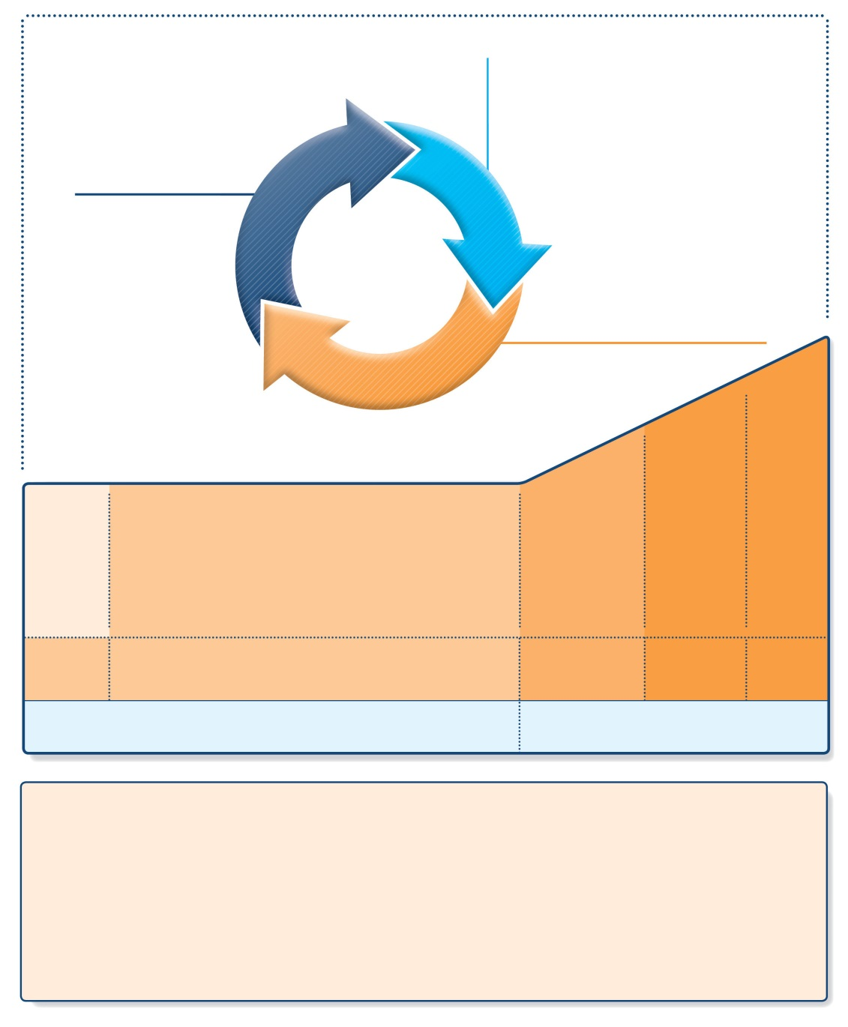
Stepwise approach to control asthma symptoms and reduce risk
UPDATED 2017
Diagnosis
Symptom control & risk factors (including lung function)
Inhaler technique & adherence
Patient preference
ASSESS
REVIEW RESPONSE
Symptoms
Exacerbations
Side-effects
Patient satisfaction
Lung function
ADJUST TREATMENT
Asthma medications
Non-pharmacological strategies
Treat modifiable risk factors
STEP 5
STEP 4
PREFERRED CONTROLLER CHOICE
STEP 1
STEP 2
STEP 3
Refer for add-on treatment
e.g.
tiotropium,* anti-IgE, anti-IL5*
Med/high ICS/LABA
Low dose ICS
Low dose ICS/LABA**
Other controller options
Consider low dose ICS
Leukotriene receptor antagonists (LTRA)
Low dose theophylline*
Med/high dose ICS
Low dose ICS+LTRA
(or + theoph*)
Add tiotropium*
High dose ICS + LTRA (or + theoph*)
Add low dose OCS
RELIEVER
As-needed short-acting beta₂-agonist (SABA)
As-needed SABA or low dose ICS/formoterol#
REMEMBER TO...
• Provide guided self-management education (self-monitoring + written action plan + regular review)
• Treat modifiable risk factors and comorbidities, e.g. smoking, obesity, anxiety
• Advise about non-pharmacological therapies and strategies, e.g. physical activity, weight loss, avoidance of sensitizers where appropriate
• Consider stepping up if … uncontrolled symptoms, exacerbations or risks, but check diagnosis, inhaler technique and adherence first
• Consider adding SLIT in adult HDM-sensitive patients with allergic rhinitis who have exacerbations despite ICS treatment, provided FEV1 is >70% predicted
• Consider stepping down if … symptoms controlled for 3 months + low risk for exacerbations. Ceasing ICS is not advised.
GINA 2017, Box 3-5 (1/8)
© Global Initiative for Asthma

Slide 65
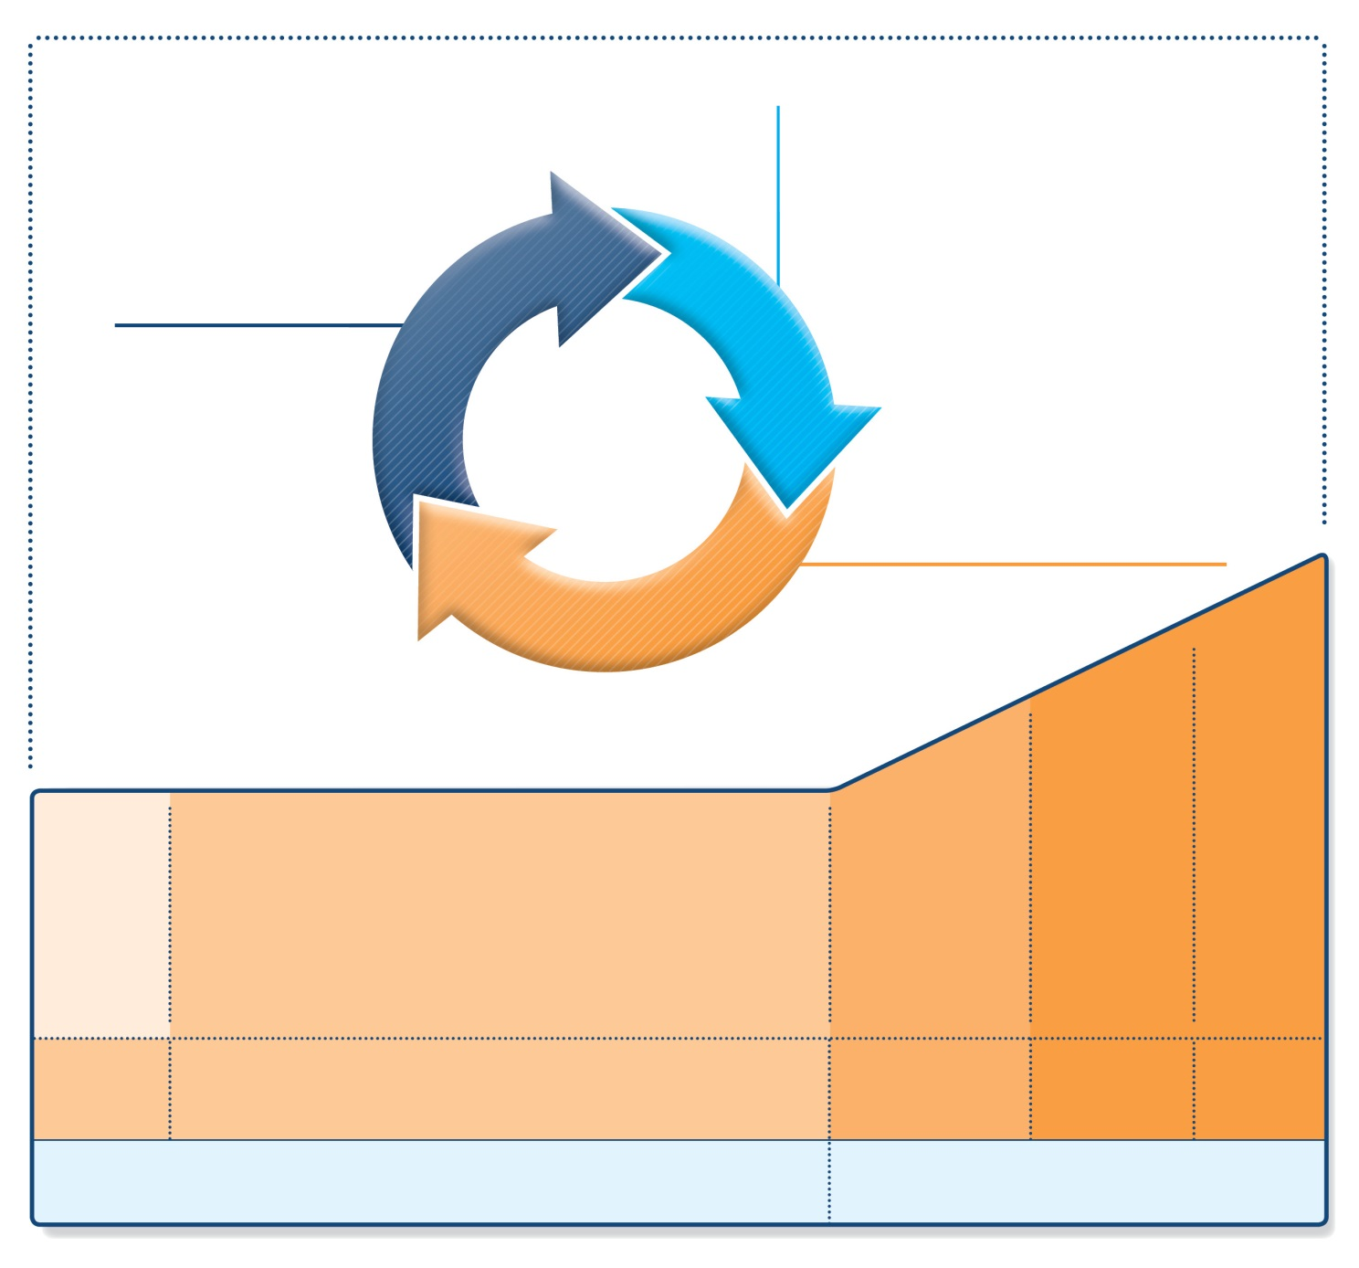
Stepwise management - pharmacotherapy
UPDATED 2017
Diagnosis
Symptom control & risk factors (including lung function)
Inhaler technique & adherence
Patient preference
ASSESS
REVIEW RESPONSE
Symptoms
Exacerbations
Side-effects
Patient satisfaction
Lung function
ADJUST TREATMENT
Asthma medications
Non-pharmacological strategies
Treat modifiable risk factors
STEP 5
STEP 4
STEP 1
STEP 2
STEP 3
Refer for add-on treatment
e.g.
tiotropium,* anti-IgE, anti-IL5*
*Not for children <12 years
**For children 6-11 years, the preferred Step 3 treatment is medium dose ICS
#For patients prescribed BDP/formoterol or BUD/ formoterol maintenance and reliever therapy
 Tiotropium by mist inhaler is an add-on treatment for patients ≥12 years with a history of exacerbations
PREFERRED CONTROLLER CHOICE
Med/high ICS/LABA
Low dose ICS
Low dose ICS/LABA**
Other controller options
Consider low dose ICS
Leukotriene receptor antagonists (LTRA)
Low dose theophylline*
Med/high dose ICS
Low dose ICS+LTRA
(or + theoph*)
Add tiotropium*
High dose ICS + LTRA (or + theoph*)
Add low dose OCS
RELIEVER
As-needed short-acting beta²-agonist (SABA)
As-needed SABA or low dose ICS/formoterol#
GINA 2017, Box 3-5 (2/8) (upper part)

Slide 66

Stepwise management – additional components
UPDATED 2017
• Provide guided self-management education
• Treat modifiable risk factors and comorbidities
• Advise about non-pharmacological therapies and strategies
• Consider stepping up if … uncontrolled symptoms, exacerbations or risks, but check diagnosis, inhaler technique and adherence first
• Consider adding SLIT in adult HDM-sensitive patients with allergic rhinitis who have exacerbations despite ICS treatment, provided FEV₁ is 70% predicted
• Consider stepping down if … symptoms controlled for 3 months + low risk for exacerbations. Ceasing ICS is not advised.
REMEMBER TO...
SLIT: sublingual immunotherapy
GINA 2017, Box 3-5 (3/8) (lower part)

Slide 67
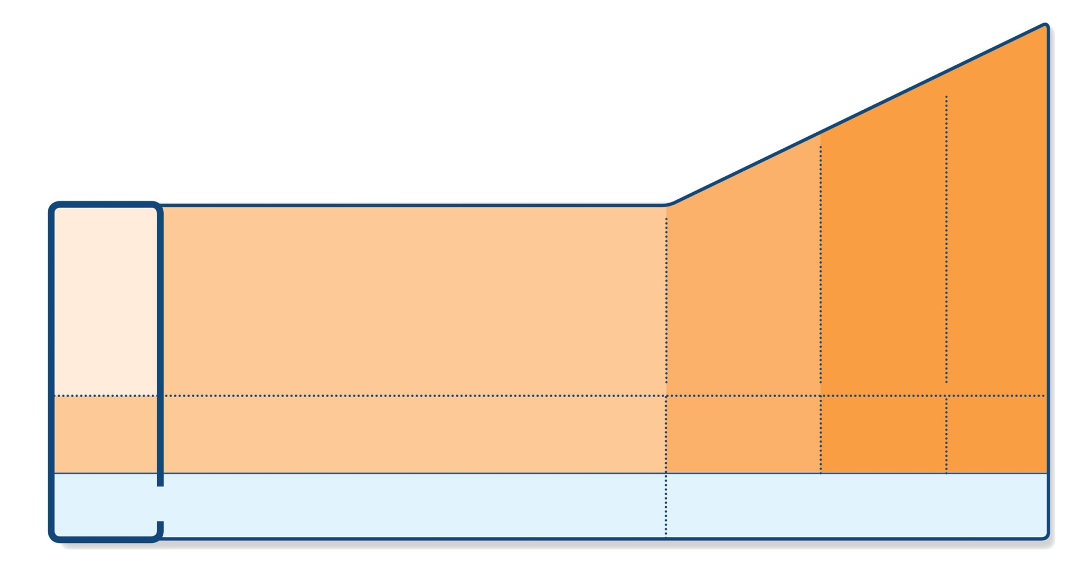
Step 1 – as-needed inhaled short-acting beta₂-agonist (SABA)
STEP 5
STEP 4
PREFERRED CONTROLLER CHOICE
STEP 1
STEP 2
STEP 3
Refer for add-on treatment
e.g.
tiotropium,* anti-IgE, anti-IL5*
Med/high ICS/LABA
Low dose ICS/LABA**
Low dose ICS
Other controller options
Consider low dose ICS
Leukotriene receptor antagonists (LTRA)
Low dose theophylline*
Med/high dose ICS
Low dose ICS+LTRA
(or + theoph*)
Add tiotropium*
High dose ICS + LTRA (or + theoph*)
Add low dose OCS
As-needed short-acting beta₂-agonist (SABA)
As-needed SABA or low dose ICS/formoterol#
RELIEVER
*Not for children <12 years
**For children 6-11 years, the preferred Step 3 treatment is medium dose ICS
#For patients prescribed BDP/formoterol or BUD/ formoterol maintenance and reliever therapy
 Tiotropium by mist inhaler is an add-on treatment for patients ≥12 years with a history of exacerbations
GINA 2017, Box 3-5, Step 1 (4/8)

Slide 68
Step 1 – as-needed reliever inhaler
Preferred option: as-needed inhaled short-acting beta₂-agonist (SABA)
SABAs are highly effective for relief of asthma symptoms
However …. there is insufficient evidence about the safety of treating asthma with SABA alone
This option should be reserved for patients with infrequent symptoms (less than twice a month) of short duration, and with no risk factors for exacerbations
Other options
Consider adding regular low dose inhaled corticosteroid (ICS) for patients at risk of exacerbations
GINA 2017

Slide 69
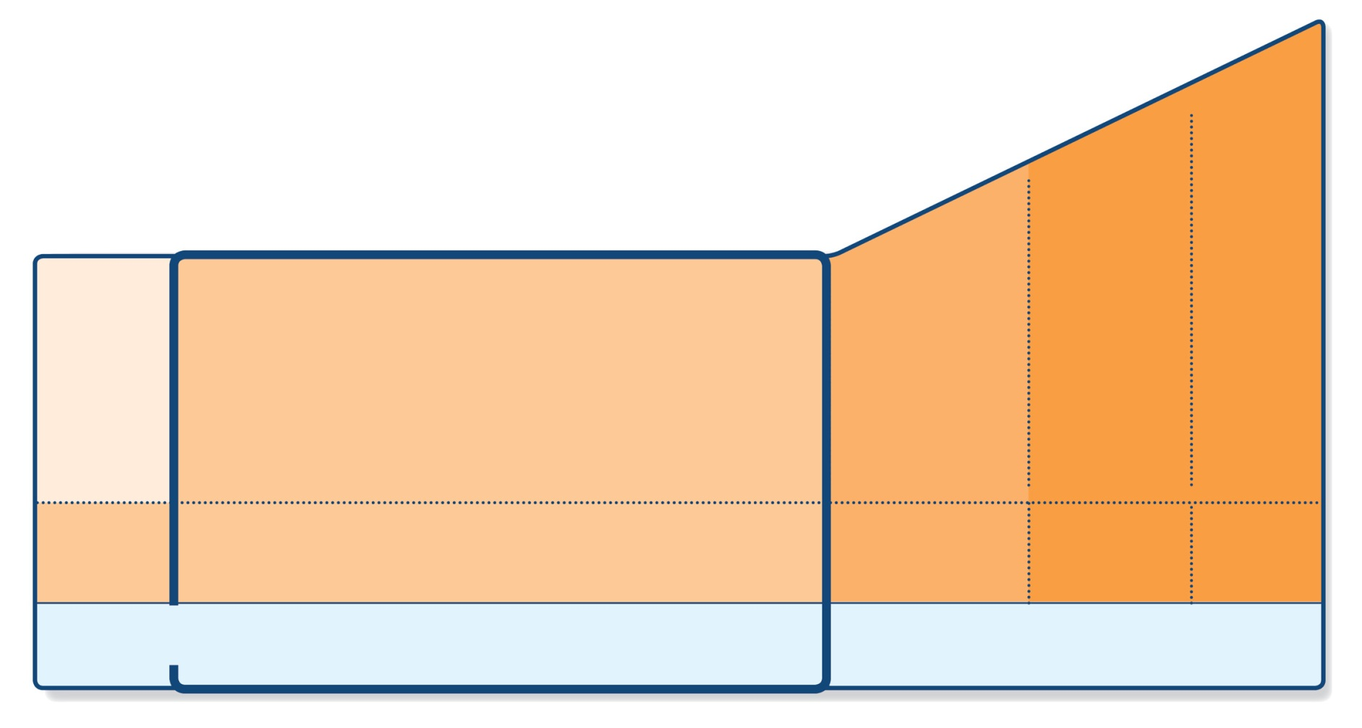
Step 2 – low-dose controller + as-needed inhaled SABA
STEP 5
STEP 4
PREFERRED CONTROLLER CHOICE
STEP 1
STEP 2
STEP 3
Refer for add-on treatment
e.g.
tiotropium,* anti-IgE, anti-IL5*
Med/high ICS/LABA
Low dose ICS/LABA**
Low dose ICS
Other controller options
Consider low dose ICS
Leukotriene receptor antagonists (LTRA)
Low dose theophylline*
Med/high dose ICS
Low dose ICS+LTRA
(or + theoph*)
Add tiotropium*
High dose ICS + LTRA (or + theoph*)
Add low dose OCS
As-needed short-acting beta₂-agonist (SABA)
As-needed SABA or low dose ICS/formoterol#
RELIEVER
*Not for children <12 years
**For children 6-11 years, the preferred Step 3 treatment is medium dose ICS
#For patients prescribed BDP/formoterol or BUD/ formoterol maintenance and reliever therapy
 Tiotropium by mist inhaler is an add-on treatment for patients ≥12 years with a history of exacerbations
GINA 2017, Box 3-5, Step 2 (5/8)

Slide 70
Step 2 – Low dose controller + as-needed SABA
Preferred option: regular low dose ICS with as-needed inhaled SABA
Low dose ICS reduces symptoms and reduces risk of exacerbations and asthma-related hospitalization and death
Other options
Leukotriene receptor antagonists (LTRA) with as-needed SABA
Less effective than low dose ICS
May be used for some patients with both asthma and allergic rhinitis, or if patient will not use ICS
Combination low dose ICS/long-acting beta₂-agonist (LABA) with as-needed SABA
Reduces symptoms and increases lung function compared with ICS
More expensive, and does not further reduce exacerbations
Intermittent ICS with as-needed SABA for purely seasonal allergic asthma with no interval symptoms
Start ICS immediately symptoms commence, and continue for 4 weeks after pollen season ends
GINA 2017

Slide 71
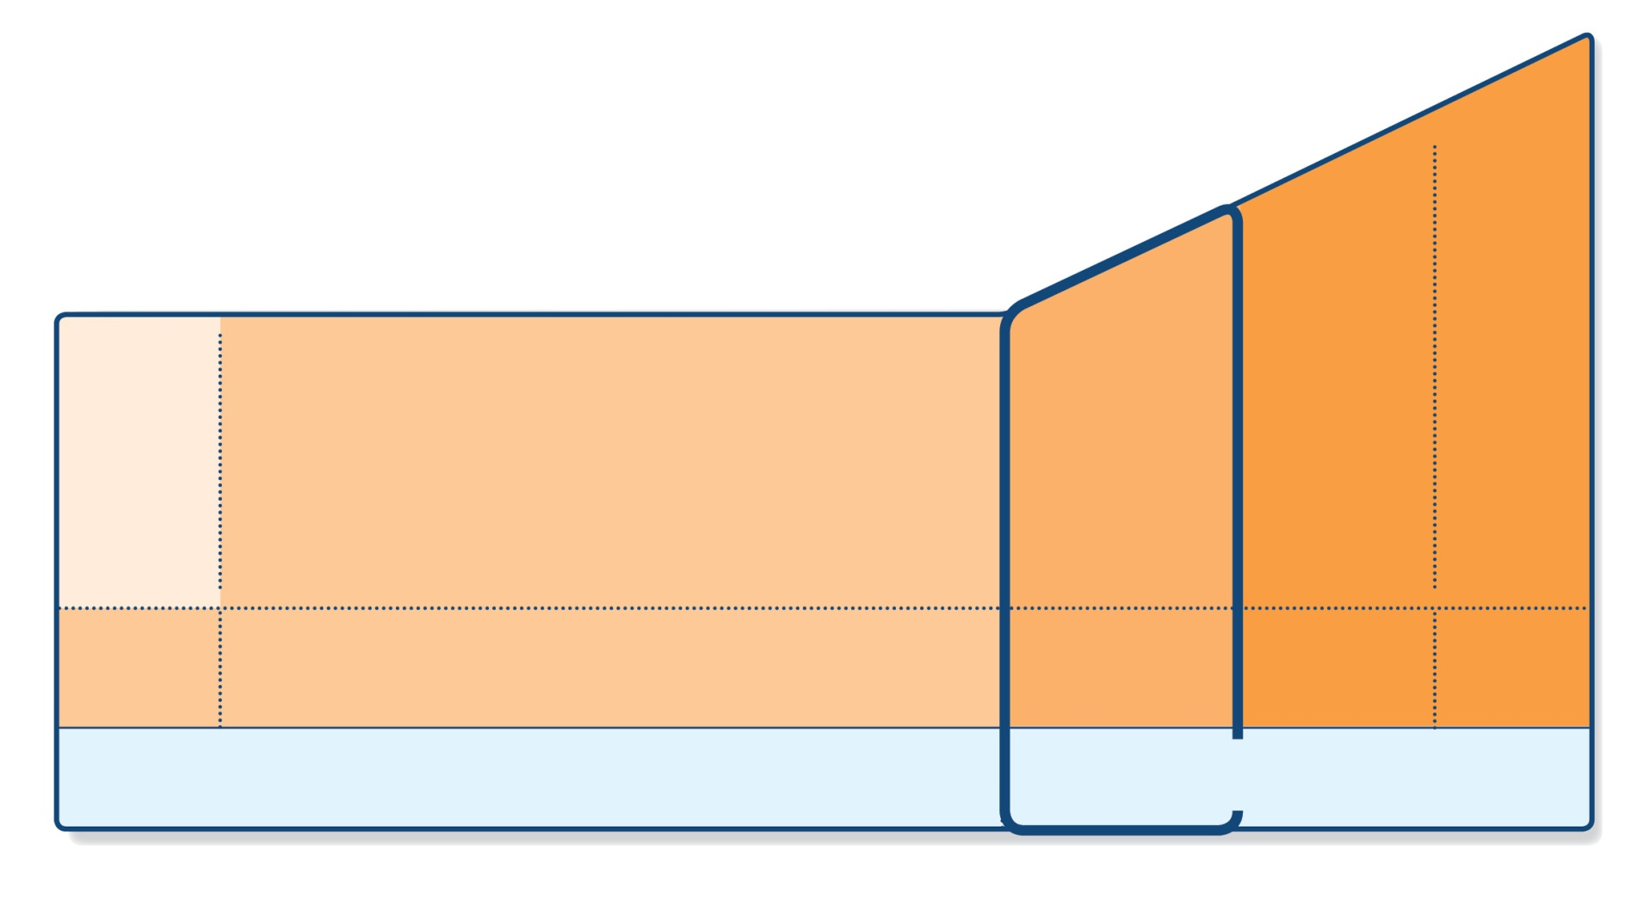
Step 3 – one or two controllers + as-needed inhaled reliever
STEP 5
STEP 4
PREFERRED CONTROLLER CHOICE
STEP 1
STEP 2
STEP 3
Refer for add-on treatment
e.g.
tiotropium,* anti-IgE, anti-IL5*
Med/high ICS/LABA
Low dose ICS/LABA**
Low dose ICS
Other controller options
Consider low dose ICS
Leukotriene receptor antagonists (LTRA)
Low dose theophylline*
Med/high dose ICS
Low dose ICS+LTRA
(or + theoph*)
Add tiotropium*
High dose ICS + LTRA (or + theoph*)
Add low dose OCS
As-needed short-acting beta₂-agonist (SABA)
As-needed SABA or low dose ICS/formoterol#
RELIEVER
*Not for children <12 years
**For children 6-11 years, the preferred Step 3 treatment is medium dose ICS
#For patients prescribed BDP/formoterol or BUD/ formoterol maintenance and reliever therapy
 Tiotropium by mist inhaler is an add-on treatment for patients ≥12 years with a history of exacerbations
GINA 2017, Box 3-5, Step 3 (6/8)
© Global Initiative for Asthma

Slide 72
Step 3 – one or two controllers + as-needed inhaled reliever
Before considering step-up
Check inhaler technique and adherence, confirm diagnosis
Adults/adolescents: preferred options are either combination low dose ICS/LABA maintenance with as-needed SABA, OR combination low dose ICS/formoterol maintenance and reliever regimen*
Adding LABA reduces symptoms and exacerbations and increases FEV₁, while allowing lower dose of ICS
In at-risk patients, maintenance and reliever regimen significantly reduces exacerbations with similar level of symptom control and lower ICS doses compared with other regimens
Children 6-11 years: preferred option is medium dose ICS with as-needed SABA
Other options
Adults/adolescents: Increase ICS dose or add LTRA or theophylline (less effective than ICS/LABA)
Adults: consider adding SLIT (see Non-pharmacological interventions)
Children 6-11 years – add LABA (similar effect as increasing ICS)
UPDATED 2017
*Approved only for low dose beclometasone/formoterol and low dose budesonide/formoterol
GINA 2017

Slide 73
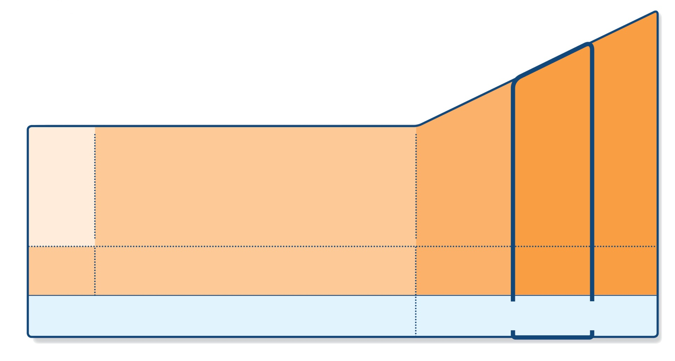
Step 4 – two or more controllers + as-needed inhaled reliever
STEP 5
STEP 4
PREFERRED CONTROLLER CHOICE
STEP 1
STEP 2
STEP 3
Refer for add-on treatment
e.g.
tiotropium,* anti-IgE, anti-IL5*
Med/high ICS/LABA
Low dose ICS/LABA**
Low dose ICS
Other controller options
Consider low dose ICS
Leukotriene receptor antagonists (LTRA)
Low dose theophylline*
Med/high dose ICS
Low dose ICS+LTRA
(or + theoph*)
Add tiotropium*
High dose ICS + LTRA (or + theoph*)
Add low dose OCS
As-needed short-acting beta₂-agonist (SABA)
As-needed SABA or low dose ICS/formoterol#
RELIEVER
*Not for children <12 years
**For children 6-11 years, the preferred Step 3 treatment is medium dose ICS
#For patients prescribed BDP/formoterol or BUD/ formoterol maintenance and reliever therapy
 Tiotropium by mist inhaler is an add-on treatment for patients ≥12 years with a history of exacerbations
GINA 2017, Box 3-5, Step 4 (7/8)
© Global Initiative for Asthma

Slide 74
Step 4 – two or more controllers + as-needed inhaled reliever
Before considering step-up
Check inhaler technique and adherence
Adults or adolescents: preferred option is combination low dose ICS/formoterol as maintenance and reliever regimen*, OR combination medium dose ICS/LABA with as-needed SABA
Children 6–11 years: preferred option is to refer for expert advice
Other options (adults or adolescents)
Tiotropium by mist inhaler may be used as add-on therapy for patients aged ≥12 years with a history of exacerbations
Adults: consider adding SLIT (see Non-pharmacological therapy)
Trial of high dose combination ICS/LABA, but little extra benefit and increased risk of side-effects
Increase dosing frequency (for budesonide-containing inhalers)
Add-on LTRA or low dose theophylline
UPDATED 2017
*Approved only for low dose beclometasone/formoterol and low dose budesonide/formoterol
GINA 2017

Slide 75
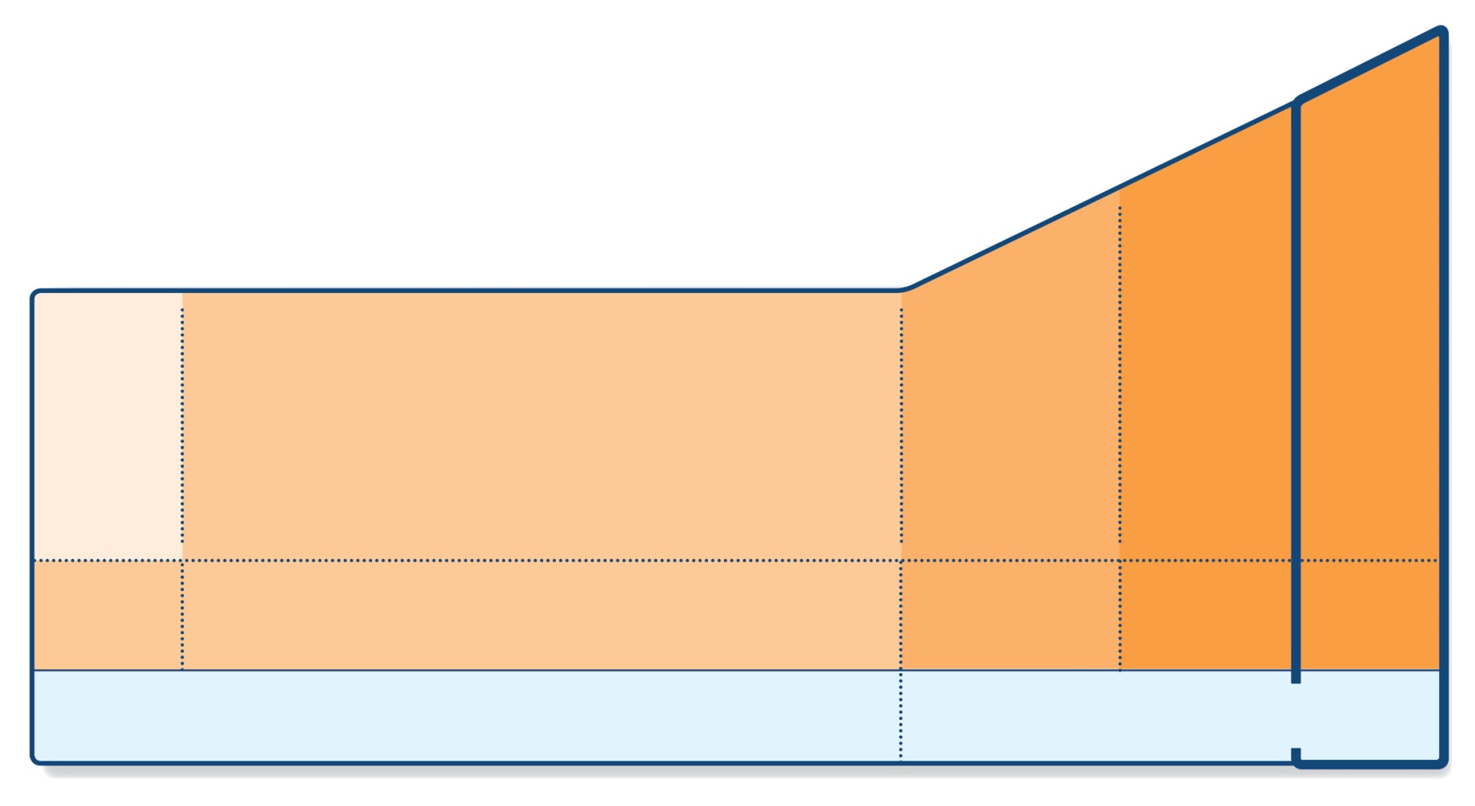
Step 5 – higher level care and/or add-on treatment
UPDATED 2017
STEP 5
STEP 4
PREFERRED CONTROLLER CHOICE
STEP 1
STEP 2
STEP 3
Refer for add-on treatment
e.g.
tiotropium,* anti-IgE, anti-IL5*
Med/high ICS/LABA
Low dose ICS/LABA**
Low dose ICS
Other controller options
Consider low dose ICS
Leukotriene receptor antagonists (LTRA)
Low dose theophylline*
Med/high dose ICS
Low dose ICS+LTRA
(or + theoph*)
Add tiotropium*
High dose ICS + LTRA (or + theoph*)
Add low dose OCS
As-needed short-acting beta₂-agonist (SABA)
As-needed SABA or low dose ICS/formoterol#
RELIEVER
*Not for children <12 years
**For children 6-11 years, the preferred Step 3 treatment is medium dose ICS
#For patients prescribed BDP/formoterol or BUD/ formoterol maintenance and reliever therapy
 Tiotropium by mist inhaler is an add-on treatment for patients ≥12 years with a history of exacerbations
GINA 2017, Box 3-5, Step 5 (8/8)

Slide 76
Step 5 – higher level care and/or add-on treatment
Preferred option is referral for specialist investigation and consideration of add-on treatment
If symptoms uncontrolled or exacerbations persist despite Step 4 treatment, check inhaler technique and adherence before referring
Add-on tiotropium for patients ≥12 years with history of exacerbations
Add-on anti-IgE (omalizumab) for patients with severe allergic asthma
Add-on anti-IL5 (mepolizumab (SC) or reslizumab (IV)) for severe eosinophilic asthma (≥12 yrs)
Other add-on treatment options at Step 5 include:
Sputum-guided treatment: this is available in specialized centers; reduces exacerbations and/or corticosteroid dose
Add-on low dose oral corticosteroids (≤7.5mg/day prednisone equivalent): this may benefit some patients, but has significant systemic side-effects. Assess and monitor for osteoporosis
See ERS/ATS Severe Asthma Guidelines (Chung et al, ERJ 2014) for more detail
UPDATED 2017
GINA 2017

Slide 77
Low, medium and high dose inhaled corticosteroids Adults and adolescents (≥12 years)
Inhaled corticosteroid | Total daily dose (mcg)
 | Low | Medium | High
Beclometasone dipropionate (CFC) | 200–500 | >500–1000 | >1000
Beclometasone dipropionate (HFA) | 100–200 | >200–400 | >400
Budesonide (DPI) | 200–400 | >400–800 | >800
Ciclesonide (HFA) | 80–160 | >160–320 | >320
Fluticasone furoate (DPI) | 100 | n.a. | 200
Fluticasone propionate (DPI or HFA) | 100–250 | >250–500 | >500
Mometasone furoate | 110–220 | >220–440 | >440
Triamcinolone acetonide | 400–1000 | >1000–2000 | >2000
This is not a table of equivalence, but of estimated clinical comparability
Most of the clinical benefit from ICS is seen at low doses
High doses are arbitrary, but for most ICS are those that, with prolonged use, are associated with increased risk of systemic side-effects
GINA 2017, Box 3-6 (1/2)

Slide 78
Low, medium and high dose inhaled corticosteroids Children 6–11 years
Inhaled corticosteroid | Total daily dose (mcg)
 | Low | Medium | High
Beclometasone dipropionate (CFC) | 100–200 | >200–400 | >400
Beclometasone dipropionate (HFA) | 50–100 | >100–200 | >200
Budesonide (DPI) | 100–200 | >200–400 | >400
Budesonide (nebules) | 250–500 | >500–1000 | >1000
Ciclesonide (HFA) | 80 | >80–160 | >160
Fluticasone furoate (DPI) | n.a. | n.a. | n.a.
Fluticasone propionate (DPI) | 100–200 | >200–400 | >400
Fluticasone propionate (HFA) | 100–200 | >200–500 | >500
Mometasone furoate | 110 | ≥220–<440 | ≥440
Triamcinolone acetonide | 400–800 | >800–1200 | >1200
This is not a table of equivalence, but of estimated clinical comparability
Most of the clinical benefit from ICS is seen at low doses
High doses are arbitrary, but for most ICS are those that, with prolonged use, are associated with increased risk of systemic side-effects
GINA 2017, Box 3-6 (2/2)

Slide 79

Reviewing response and adjusting treatment
How often should asthma be reviewed?
1-3 months after treatment started, then every 3-12 months
During pregnancy, every 4-6 weeks
After an exacerbation, within 1 week
Stepping up asthma treatment
Sustained step-up, for at least 2-3 months if asthma poorly controlled
Important: first check for common causes (symptoms not due to asthma, incorrect inhaler technique, poor adherence)
Short-term step-up, for 1-2 weeks, e.g. with viral infection or allergen
May be initiated by patient with written asthma action plan
Day-to-day adjustment
For patients prescribed low-dose ICS/formoterol maintenance and reliever regimen*
Stepping down asthma treatment
Consider step-down after good control maintained for 3 months
Find each patient’s minimum effective dose, that controls both symptoms and exacerbations
ASSESS
REVIEW RESPONSE
ADJUST TREATMENT
*Approved only for low dose beclometasone/formoterol and low dose budesonide/formoterol
GINA 2017

Slide 80
General principles for stepping down controller treatment
Aim
To find the lowest dose that controls symptoms and exacerbations, and minimizes the risk of side-effects
When to consider stepping down
When symptoms have been well controlled and lung function stable for ≥3 months
No respiratory infection, patient not travelling, not pregnant
Prepare for step-down
Record the level of symptom control and consider risk factors
Make sure the patient has a written asthma action plan
Book a follow-up visit in 1-3 months
Step down through available formulations
Stepping down ICS doses by 25–50% at 3 month intervals is feasible and safe for most patients (Hagan et al, Allergy 2014)
See GINA 2017 report Box 3-7 for specific step-down options
Stopping ICS is not recommended in adults with asthma because of risk of exacerbations (Rank et al, JACI 2013)
GINA 2017, Box 3-7

Slide 81
Treating modifiable risk factors
Provide skills and support for guided asthma self-management
This comprises self-monitoring of symptoms and/or PEF, a written asthma action plan and regular medical review
Prescribe medications or regimen that minimize exacerbations
ICS-containing controller medications reduce risk of exacerbations
For patients with ≥1 exacerbations in previous year, consider low-dose ICS/formoterol maintenance and reliever regimen*
Encourage avoidance of tobacco smoke (active or ETS)
Provide smoking cessation advice and resources at every visit
For patients with severe asthma
Refer to a specialist center, if available, for consideration of add-on medications and/or sputum-guided treatment
For patients with confirmed food allergy:
Appropriate food avoidance
Ensure availability of injectable epinephrine for anaphylaxis
*Approved only for low dose beclometasone/formoterol and low dose budesonide/formoterol
GINA 2017, Box 3-8

Slide 82
Non-pharmacological interventions
Avoidance of tobacco smoke exposure
Provide advice and resources at every visit; advise against exposure of children to environmental tobacco smoke (house, car)
Physical activity
Encouraged because of its general health benefits. Provide advice about exercise-induced bronchoconstriction
Occupational asthma
Ask patients with adult-onset asthma about work history. Remove sensitizers as soon as possible. Refer for expert advice, if available
Avoid medications that may worsen asthma
Always ask about asthma before prescribing NSAIDs or beta-blockers
Remediation of dampness or mold in homes
Reduces asthma symptoms and medication use in adults
Sublingual immunotherapy (SLIT)
Consider as add-on therapy in adult HDM-sensitive patients with allergic rhinitis who have exacerbations despite ICS treatment, provided FEV1 is 70% predicted
See GINA Box 3-9 and online Appendix for details
UPDATED 2017
This slide shows examples of interventions with high quality evidence
GINA 2017, Box 3-9

Slide 83
Indications for considering referral, where available
Difficulty confirming the diagnosis of asthma
Symptoms suggesting chronic infection, cardiac disease etc
Diagnosis unclear even after a trial of treatment
Features of both asthma and COPD, if in doubt about treatment
Suspected occupational asthma
Refer for confirmatory testing, identification of sensitizing agent, advice about eliminating exposure, pharmacological treatment
Persistent uncontrolled asthma or frequent exacerbations
Uncontrolled symptoms or ongoing exacerbations or low FEV₁ despite correct inhaler technique and good adherence with Step 4
Frequent asthma-related health care visits
Risk factors for asthma-related death
Near-fatal exacerbation in past
Anaphylaxis or confirmed food allergy with asthma
GINA 2017, Box 3-10 (1/2)

Slide 84
Indications for considering referral, where available
Significant side-effects (or risk of side-effects)
Significant systemic side-effects
Need for oral corticosteroids long-term or as frequent courses
Symptoms suggesting complications or sub-types of asthma
Nasal polyposis and reactions to NSAIDS (may be aspirin exacerbated respiratory disease)
Chronic sputum production, fleeting shadows on CXR (may be allergic bronchopulmonary aspergillosis)
Additional reasons for referral in children 6-11 years
Doubts about diagnosis, e.g. symptoms since birth
Symptoms or exacerbations remain uncontrolled
Suspected side-effects of treatment, e.g. growth delay
Asthma with confirmed food allergy
GINA 2017, Box 3-10 (2/2)

Slide 85
Guided asthma self-management and skills training
Essential components are:
Skills training to use inhaler devices correctly
Encouraging adherence with medications, appointments
Asthma information
Guided self-management support
Self-monitoring of symptoms and/or PEF
Written asthma action plan
Regular review by a health care provider
GINA 2017

Slide 86
Provide hands-on inhaler skills training
Choose
Choose an appropriate device before prescribing. Consider medication options, arthritis, patient skills and cost. For ICS by pMDI, prescribe a spacer Avoid multiple different inhaler types if possible
GINA 2017, Box 3-11 (1/4)

Slide 87
Provide hands-on inhaler skills training
Choose
Choose an appropriate device before prescribing. Consider medication options, arthritis, patient skills and cost. For ICS by pMDI, prescribe a spacer Avoid multiple different inhaler types if possible
Check
Check technique at every opportunity – “Can you show me how you use your inhaler at present?” Identify errors with a device-specific checklist
GINA 2017, Box 3-11 (2/4)

Slide 88
Provide hands-on inhaler skills training
Choose
Choose an appropriate device before prescribing. Consider medication options, arthritis, patient skills and cost. For ICS by pMDI, prescribe a spacer Avoid multiple different inhaler types if possible
Check
Check technique at every opportunity – “Can you show me how you use your inhaler at present?” Identify errors with a device-specific checklist
Correct
Give a physical demonstration to show how to use the inhaler correctly Check again (up to 2-3 times) Re-check inhaler technique frequently, as errors often recur within 4-6 weeks
GINA 2017, Box 3-11 (3/4)

Slide 89
Provide hands-on inhaler skills training
Choose
Choose an appropriate device before prescribing. Consider medication options, arthritis, patient skills and cost. For ICS by pMDI, prescribe a spacer Avoid multiple different inhaler types if possible
Check
Check technique at every opportunity – “Can you show me how you use your inhaler at present?” Identify errors with a device-specific checklist
Correct
Give a physical demonstration to show how to use the inhaler correctly Check again (up to 2-3 times) Re-check inhaler technique frequently, as errors often recur within 4-6 weeks
Confirm
Can you demonstrate correct technique for the inhalers you prescribe? Brief inhaler technique training improves asthma control
GINA 2017, Box 3-11 (4/4)

Slide 90
Check adherence with asthma medications
Poor adherence:
Is very common: it is estimated that 50% of adults and children do not take controller medications as prescribed
Contributes to uncontrolled asthma symptoms and risk of exacerbations and asthma-related death
Contributory factors
Unintentional (e.g. forgetfulness, cost, confusion) and/or
Intentional (e.g. no perceived need, fear of side-effects, cultural issues, cost)
How to identify patients with low adherence:
Ask an empathic question, e.g. “Do you find it easier to remember your medication in the morning or the evening?”, or “Would you say you are taking it 3 days a week, or less, or more?”
Check prescription date, label date and dose counter
Ask patient about their beliefs and concerns about the medication
GINA 2017, Box 3-12

Slide 91
Strategies to improve adherence in asthma
Only a few interventions have been studied closely in asthma and found to be effective for improving adherence
Shared decision-making
Comprehensive asthma education with nurse home visits
Inhaler reminders for missed doses
Reviewing patients’ detailed dispensing records
UPDATED 2017
GINA 2017

Slide 92
‘Guided self-management education’
Highly effective in improving asthma outcomes
Reduced hospitalizations, ED visits, symptoms, night waking, time off work, improved lung function and quality of life
Three essential components
Self-monitoring of symptoms and/or PEF
Written asthma action plan
Describe how to recognize and respond to worsening asthma
Individualize the plan for the patient’s health literacy and autonomy
Provide advice about a change in ICS and how/when to add OCS
If using PEF, base action plan on personal best rather than predicted
Regular medical review
GINA 2017

Slide 93
Investigations in patients with severe asthma
Confirm the diagnosis of asthma
Consider alternative diagnoses or contributors to symptoms, e.g. upper airway dysfunction, COPD, recurrent respiratory infections
Investigate for comorbidities
Chronic sinusitis, obesity, GERD, obstructive sleep apnea, psychological or psychiatric disorders
Check inhaler technique and medication adherence
Investigate for persistent environmental exposure
Allergens or toxic substances (domestic or occupational)
GINA 2017, Box 3-14 (1/2)

Slide 94
Management of severe asthma
Optimize dose of ICS/LABA
Complete resistance to ICS is rare
Consider therapeutic trial of higher dose
Consider low dose maintenance oral corticosteroids
Monitor for and manage side-effects, including osteoporosis
Add-on treatments without phenotyping
Tiotropium - reduces exacerbations (history of exacerbations, age ≥12 years)
Theophylline, LTRA – limited benefit
Phenotype-guided treatment
Severe allergic asthma: add-on omalizumab (anti-IgE)
Severe eosinophilic asthma: add-on mepolizumab or reslizumab (anti-IL5)
Sputum-guided treatment to reduce exacerbations and/or steroid dose
Aspirin-exacerbated respiratory disease: consider add-on LTRA
Non-pharmacological interventions
Consider bronchial thermoplasty for selected patients
Comprehensive adherence-promoting program
For detailed guidelines, see Chung et al, ERJ 2014
UPDATED 2017
GINA 2017, Box 3-14 (2/2)

Slide 95
Management of asthma in low-resource settings
UPDATED 2017
Where?
Low-resource settings may be found not only in low and middle income countries (LMIC), but also in affluent nations
Diagnosis in low-resource settings
Up to 50% asthma undiagnosed, up to 34% over-diagnosed (José 2014)
Ask about symptoms suggestive of chronic respiratory infections e.g. TB
Check FVC as well as FEV₁, as spirometric restriction is common
Peak flow meters recommended by WHO as essential tools for Package of Essential Non-communicable Diseases Interventions (WHO-PEN)
Management of asthma in low-resource settings
GINA strategy for stepwise treatment includes options for low-resource settings
Prioritize the most cost-effective approach; include ICS and SABA
Build capacity of primary health care teams, including nurses and pharmacist
WHO-PEN recommends inclusion of peak flow meters as essential tools, and oximeters if resources permit
GINA 2017

Slide 96
Asthma flare-ups (exacerbations)

Slide 97
Definition and terminology
A flare-up or exacerbation is an acute or sub-acute worsening of symptoms and lung function compared with the patient’s usual status
Terminology
‘Flare-up’ is the preferred term for discussion with patients
‘Exacerbation’ is a difficult term for patients
‘Attack’ has highly variable meanings for patients and clinicians
‘Episode’ does not convey clinical urgency
Consider management of worsening asthma as a continuum
Self-management with a written asthma action plan
Management in primary care
Management in the emergency department and hospital
Follow-up after any exacerbation
GINA 2017

Slide 98
Identify patients at risk of asthma-related death
Patients at increased risk of asthma-related death should be identified
Any history of near-fatal asthma requiring intubation and ventilation
Hospitalization or emergency care for asthma in last 12 months
Not currently using ICS, or poor adherence with ICS
Currently using or recently stopped using OCS
(indicating the severity of recent events)
Over-use of SABAs, especially if more than 1 canister/month
Lack of a written asthma action plan
History of psychiatric disease or psychosocial problems
Confirmed food allergy in a patient with asthma
Flag these patients for more frequent review
GINA 2017, Box 4-1

Slide 99
Written asthma action plans
All patients should have a written asthma action plan
The aim is to show the patient how to recognize and respond to worsening asthma
It should be individualized for the patient’s medications, level of asthma control and health literacy
Based on symptoms and/or PEF (children: only symptoms)
The action plan should include:
The patient’s usual asthma medications
When/how to increase reliever and controller or start OCS
How to access medical care if symptoms fail to respond
Why?
When combined with self-monitoring and regular medical review, action plans are highly effective in reducing asthma mortality and morbidity
GINA 2017

Slide 100
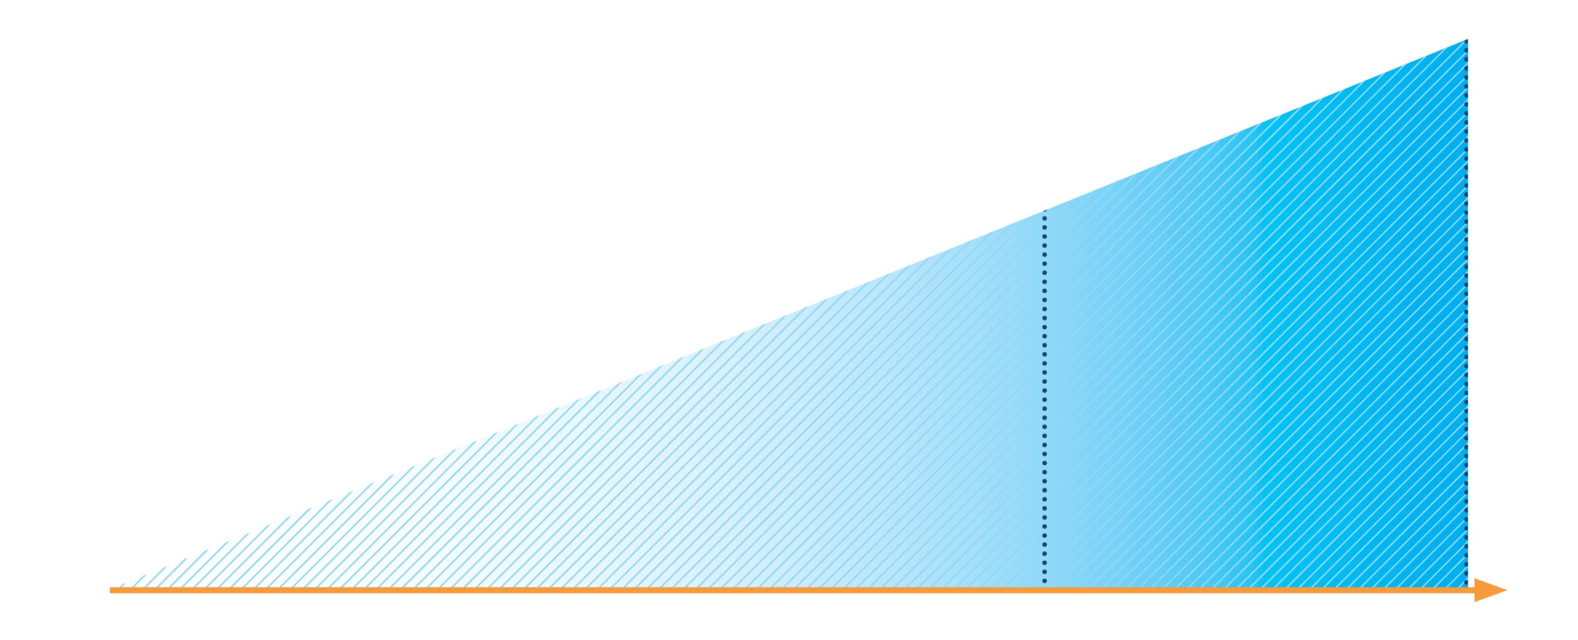
Written asthma action plans
Effective asthma self-management education requires:
• Self-monitoring of symptoms and/or lung function
• Written asthma action plan
• Regular medical review
If PEF or FEV1 <60% best, or not improving after 48 hours
Continue reliever
Continue controller
Add prednisolone 40–50 mg/day
Contact doctor
All patients
Increase reliever
Early increase in controller as below
Review response
EARLY OR MILD
LATE OR SEVERE
GINA 2017, Box 4-2 (1/2)

Slide 101
Written asthma action plans – medication options
Increase inhaled reliever
Increase frequency as needed
Adding spacer for pMDI may be helpful
Early and rapid increase in inhaled controller
Up to maximum ICS of 2000mcg BDP/day or equivalent
Options depend on usual controller medication and type of LABA
See GINA 2017 report Box 4-2 for details
Add oral corticosteroids if needed
Adults: prednisolone 1mg/kg/day up to 50mg, usually 5-7 days
Children: 1-2mg/kg/day up to 40mg, usually 3-5 days
Morning dosing preferred to reduce side-effects
Tapering not needed if taken for less than 2 weeks
Remember to advise patients about common side-effects (sleep disturbance, increased appetite, reflux, mood changes)
UPDATED 2017
GINA 2017, Box 4-2 (2/2)

Slide 102
Rationale for change in recommendation about controller therapy in asthma action plans
For the last 10 years, most guidelines recommended treating worsening asthma with SABA alone until OCS were needed, but ...
Most exacerbations are characterised by increased inflammation
Most evidence for self-management involved doubling ICS dose
Outcomes were consistently better if the action plan prescribed both increased ICS, and OCS
Lack of generalisability of placebo-controlled RCTs of doubling ICS
Participants were required to be highly adherent
Study inhalers were not started, on average, until symptoms and airflow limitation had been worsening for 4-5 days.
Severe exacerbations are reduced by short-term treatment with
Quadrupled dose of ICS
Quadrupled dose of budesonide/formoterol
Early small increase in ICS/formoterol (maintenance & reliever regimen)
Adherence by community patients is poor
Patients commonly take only 25-35% of prescribed controller dose
Patients often delay seeking care for fear of being given OCS
GINA 2017

Slide 103
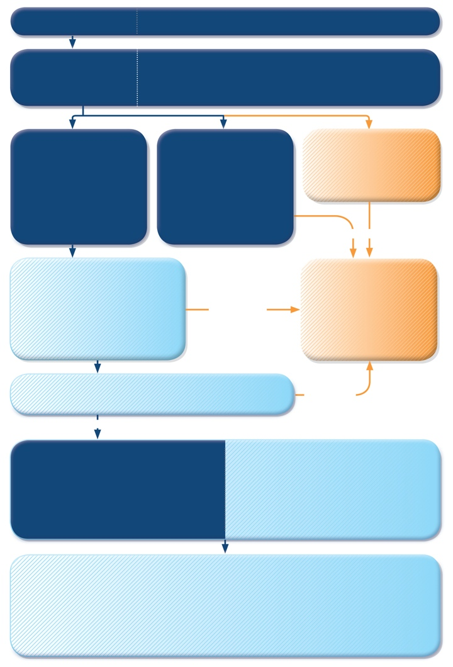
Managing exacerbations in primary care
PRIMARY CARE
Patient presents with acute or sub-acute asthma exacerbation
ASSESS the PATIENT
Is it asthma?
Risk factors for asthma-related death?
Severity of exacerbation?
MILD or MODERATE
Talks in phrases, prefers sitting to lying, not agitated
Respiratory rate increased
Accessory muscles not used
Pulse rate 100–120 bpm
O2 saturation (on air) 90–95%
PEF >50% predicted or best
SEVERE
Talks in words, sits hunched forwards, agitated
Respiratory rate >30/min
Accessory muscles in use
Pulse rate >120 bpm
O2 saturation (on air) <90%
PEF ≤50% predicted or best
LIFE-THREATENING
Drowsy, confused or silent chest
URGENT
START TREATMENT
SABA 4–10 puffs by pMDI + spacer, repeat every 20 minutes for 1 hour
Prednisolone: adults 1 mg/kg, max. 50 mg, children 1–2 mg/kg, max. 40 mg
Controlled oxygen (if available): target saturation 93–95% (children: 94-98%)
TRANSFER TO ACUTE CARE FACILITY
While waiting: give inhaled SABA and ipratropium bromide, O₂, systemic corticosteroid
WORSENING
CONTINUE TREATMENT with SABA as needed
ASSESS RESPONSE AT 1 HOUR (or earlier)
WORSENING
IMPROVING
ASSESS FOR DISCHARGE
Symptoms improved, not needing SABA
PEF improving, and >60-80% of personal best or predicted
Oxygen saturation >94% room air
Resources at home adequate
ARRANGE at DISCHARGE
Reliever: continue as needed
Controller: start, or step up. Check inhaler technique, adherence
Prednisolone: continue, usually for 5–7 days (3-5 days for children)
Follow up: within 2–7 days
FOLLOW UP
Reliever: reduce to as-needed
Controller: continue higher dose for short term (1–2 weeks) or long term (3 months), depending on background to exacerbation
Risk factors: check and correct modifiable risk factors that may have contributed to exacerbation, including inhaler technique and adherence
Action plan: Is it understood? Was it used appropriately? Does it need modification?
GINA 2017, Box 4-3 (1/7)

Slide 104
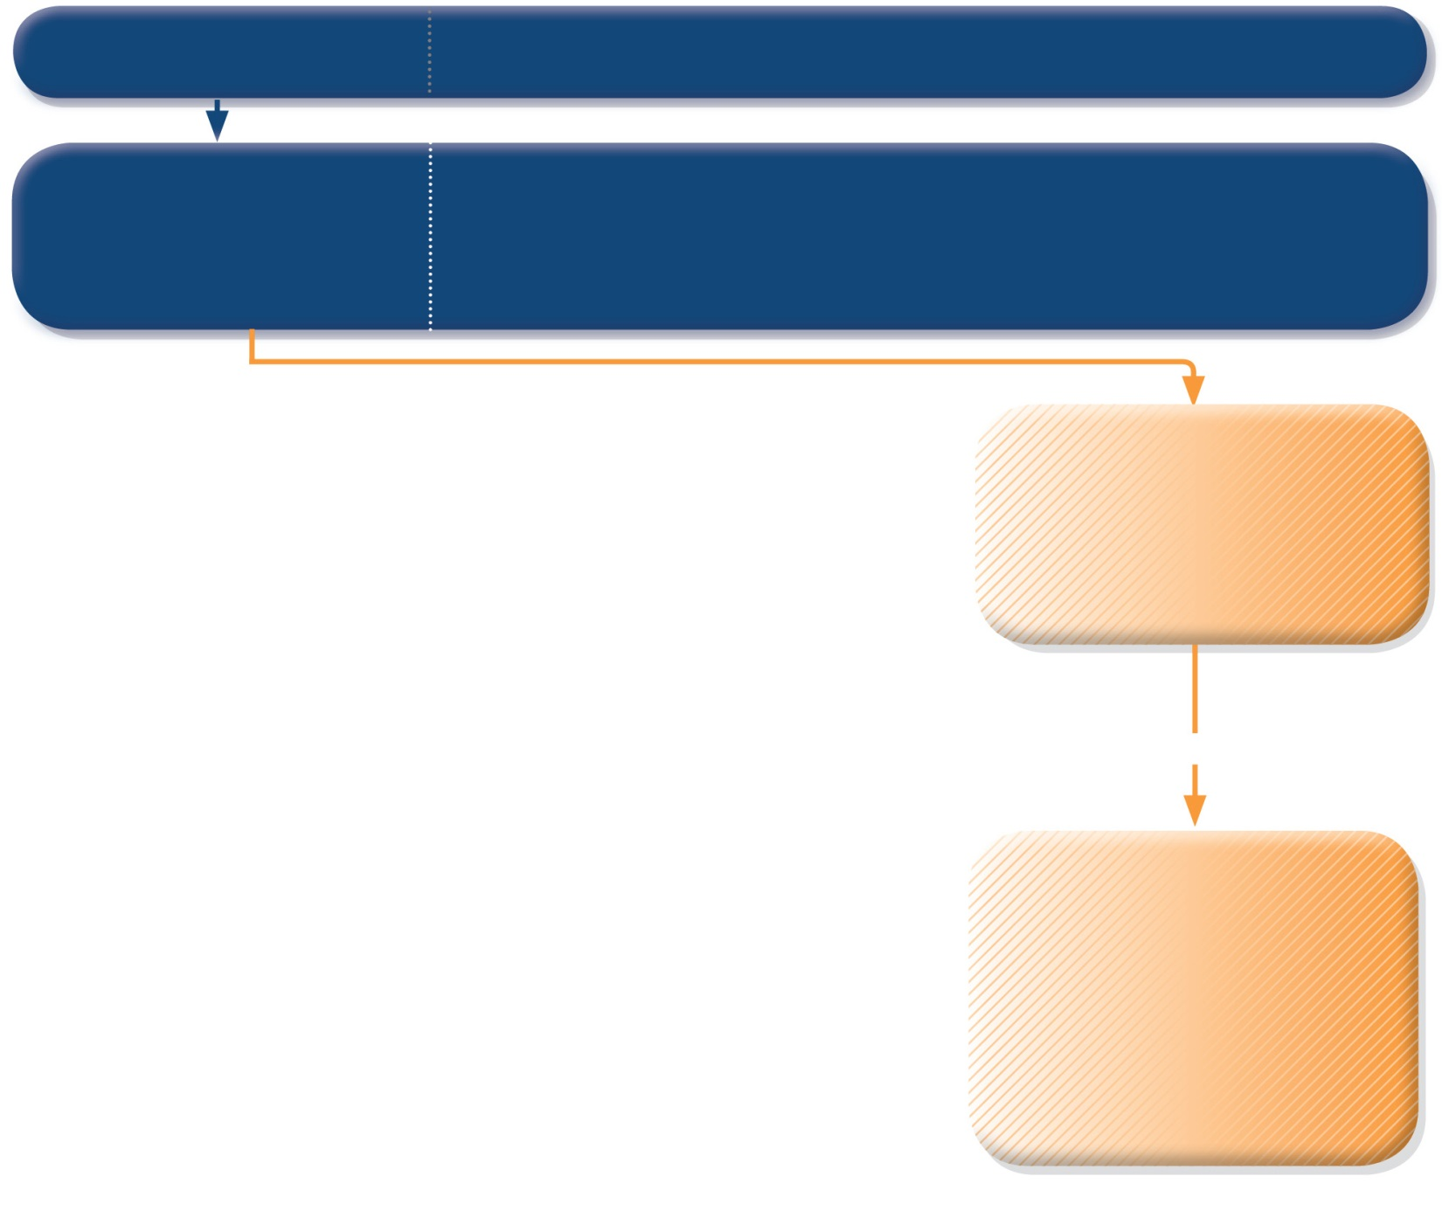
PRIMARY CARE
Patient presents with acute or sub-acute asthma exacerbation
ASSESS the PATIENT
Is it asthma?
Risk factors for asthma-related death?
Severity of exacerbation?
LIFE-THREATENING
Drowsy, confused or silent chest
URGENT
TRANSFER TO ACUTE CARE FACILITY
While waiting: give inhaled SABA and ipratropium bromide, O₂, systemic corticosteroid
GINA 2017, Box 4-3 (2/7)
© Global Initiative for Asthma

Slide 105
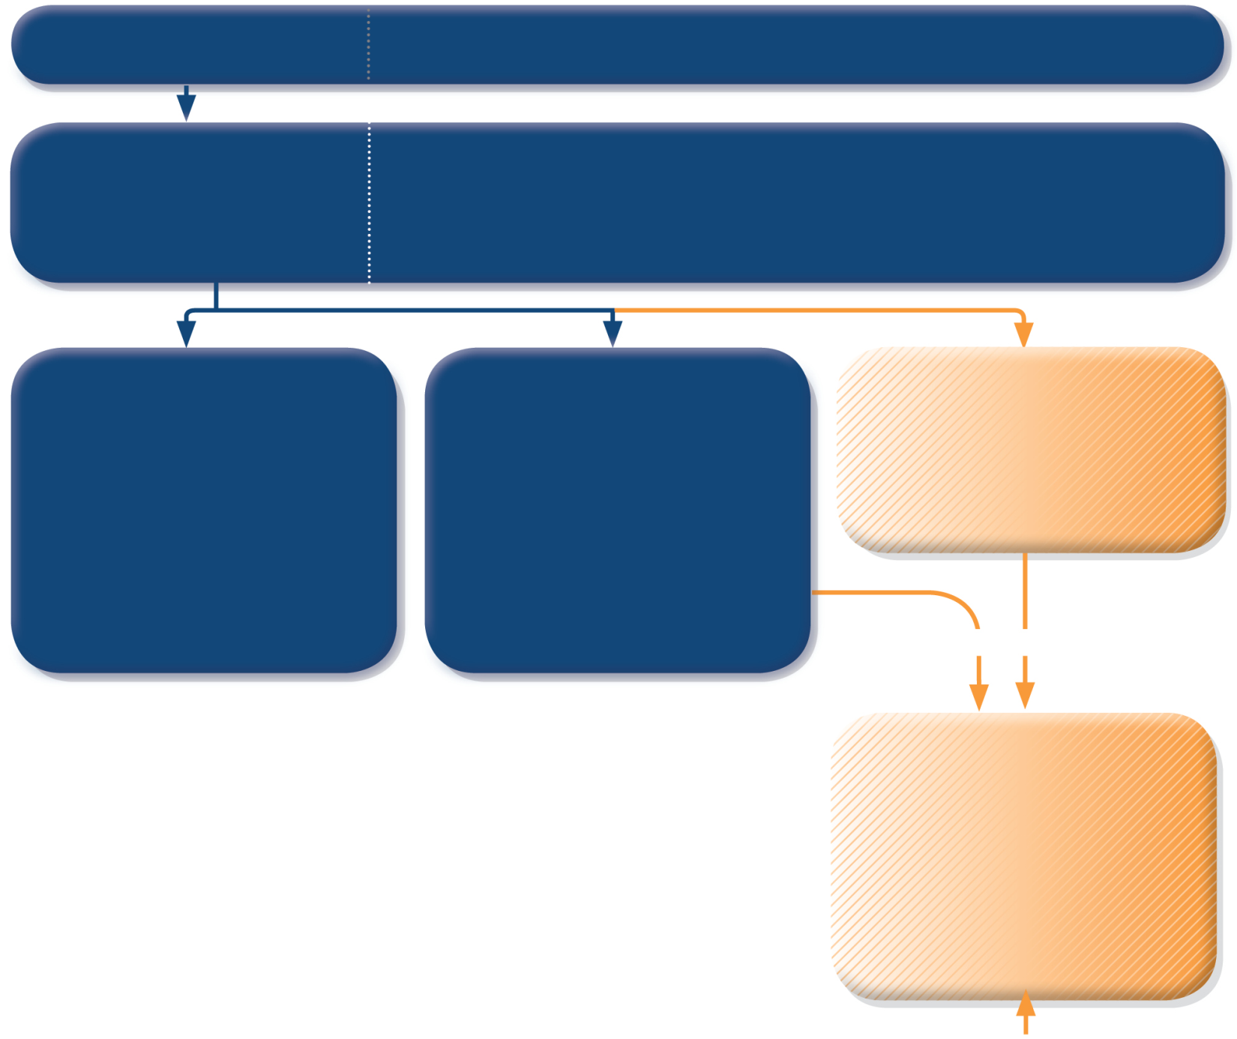
PRIMARY CARE
Patient presents with acute or sub-acute asthma exacerbation
ASSESS the PATIENT
Is it asthma?
Risk factors for asthma-related death?
Severity of exacerbation?
MILD or MODERATE
Talks in phrases, prefers sitting to lying, not agitated
Respiratory rate increased
Accessory muscles not used
Pulse rate 100–120 bpm
O₂ saturation (on air) 90–95%
PEF >50% predicted or best
SEVERE
Talks in words, sits hunched forwards, agitated
Respiratory rate >30/min
Accessory muscles in use
Pulse rate >120 bpm
O₂ saturation (on air) <90%
PEF ≤50% predicted or best
LIFE-THREATENING
Drowsy, confused or silent chest
URGENT
TRANSFER TO ACUTE CARE FACILITY
While waiting: give inhaled SABA and ipratropium bromide, O₂, systemic corticosteroid
GINA 2017, Box 4-3 (3/7)
© Global Initiative for Asthma

Slide 106
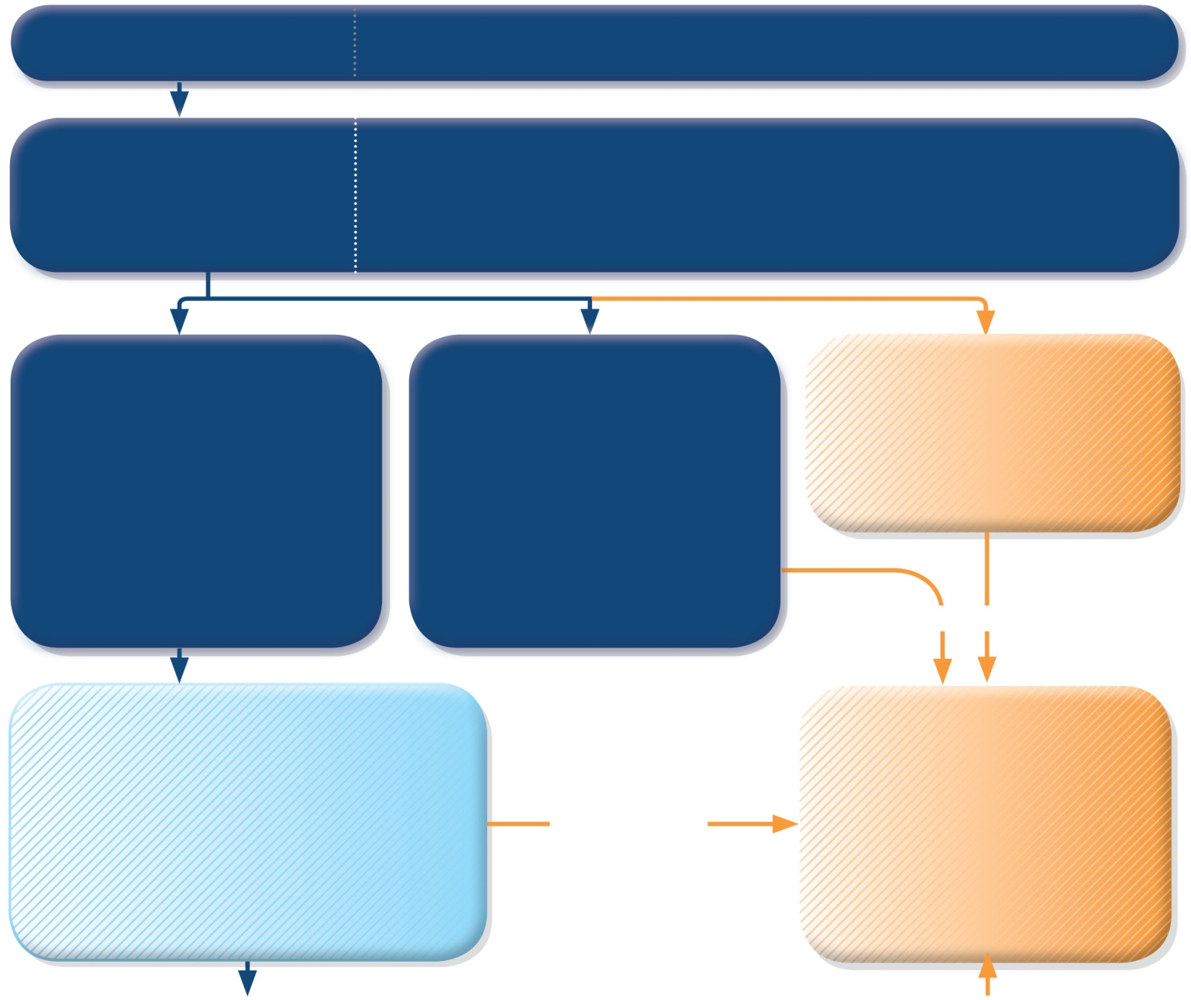
PRIMARY CARE
Patient presents with acute or sub-acute asthma exacerbation
ASSESS the PATIENT
Is it asthma?
Risk factors for asthma-related death?
Severity of exacerbation?
MILD or MODERATE
Talks in phrases, prefers sitting to lying, not agitated
Respiratory rate increased
Accessory muscles not used
Pulse rate 100–120 bpm
O₂ saturation (on air) 90–95%
PEF >50% predicted or best
SEVERE
Talks in words, sits hunched forwards, agitated
Respiratory rate >30/min
Accessory muscles in use
Pulse rate >120 bpm
O₂ saturation (on air) <90%
PEF ≤50% predicted or best
LIFE-THREATENING
Drowsy, confused or silent chest
URGENT
START TREATMENT
SABA 4–10 puffs by pMDI + spacer, repeat every 20 minutes for 1 hour
Prednisolone: adults 1 mg/kg, max. 50 mg, children 1–2 mg/kg, max. 40 mg
Controlled oxygen (if available): target saturation 93–95% (children: 94-98%)
TRANSFER TO ACUTE CARE FACILITY
While waiting: give inhaled SABA and ipratropium bromide, O₂, systemic corticosteroid
WORSENING
GINA 2017, Box 4-3 (4/7)
© Global Initiative for Asthma

Slide 107
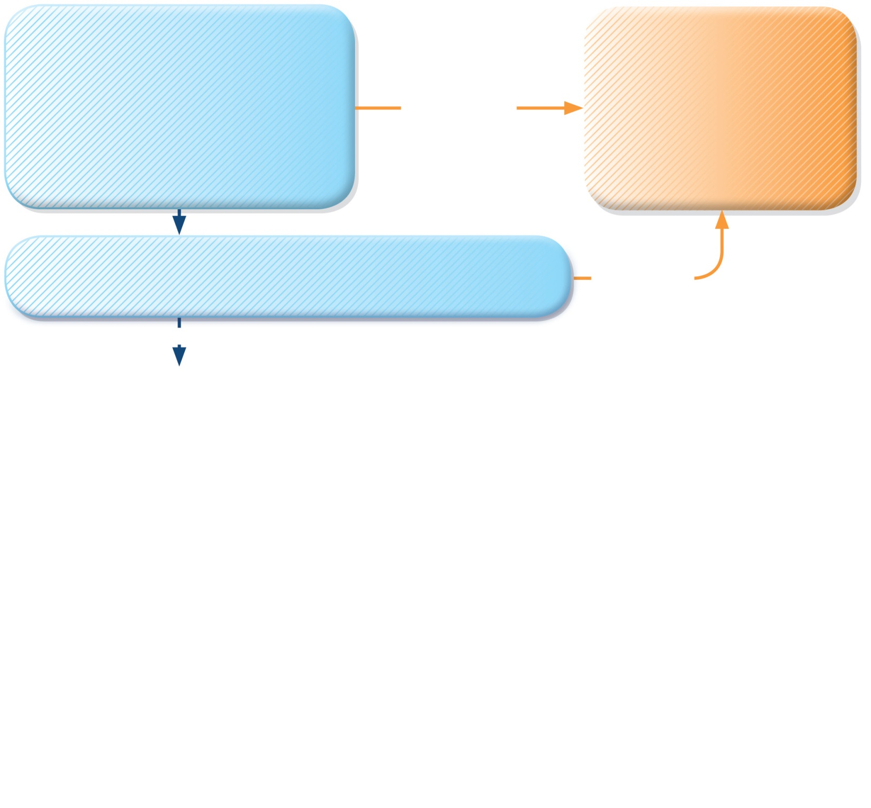
START TREATMENT
SABA 4–10 puffs by pMDI + spacer, repeat every 20 minutes for 1 hour
Prednisolone: adults 1 mg/kg, max. 50 mg, children 1–2 mg/kg, max. 40 mg
Controlled oxygen (if available): target saturation 93–95% (children: 94-98%)
TRANSFER TO ACUTE CARE FACILITY
While waiting: give inhaled SABA and ipratropium bromide, O₂, systemic corticosteroid
WORSENING
CONTINUE TREATMENT with SABA as needed
ASSESS RESPONSE AT 1 HOUR (or earlier)
WORSENING
IMPROVING
ASSESS FOR DISCHARGE
Symptoms improved, not needing SABA
PEF improving, and >60-80% of personal best or predicted
Oxygen saturation >94% room air
Resources at home adequate
GINA 2017, Box 4-3 (5/7)

Slide 108
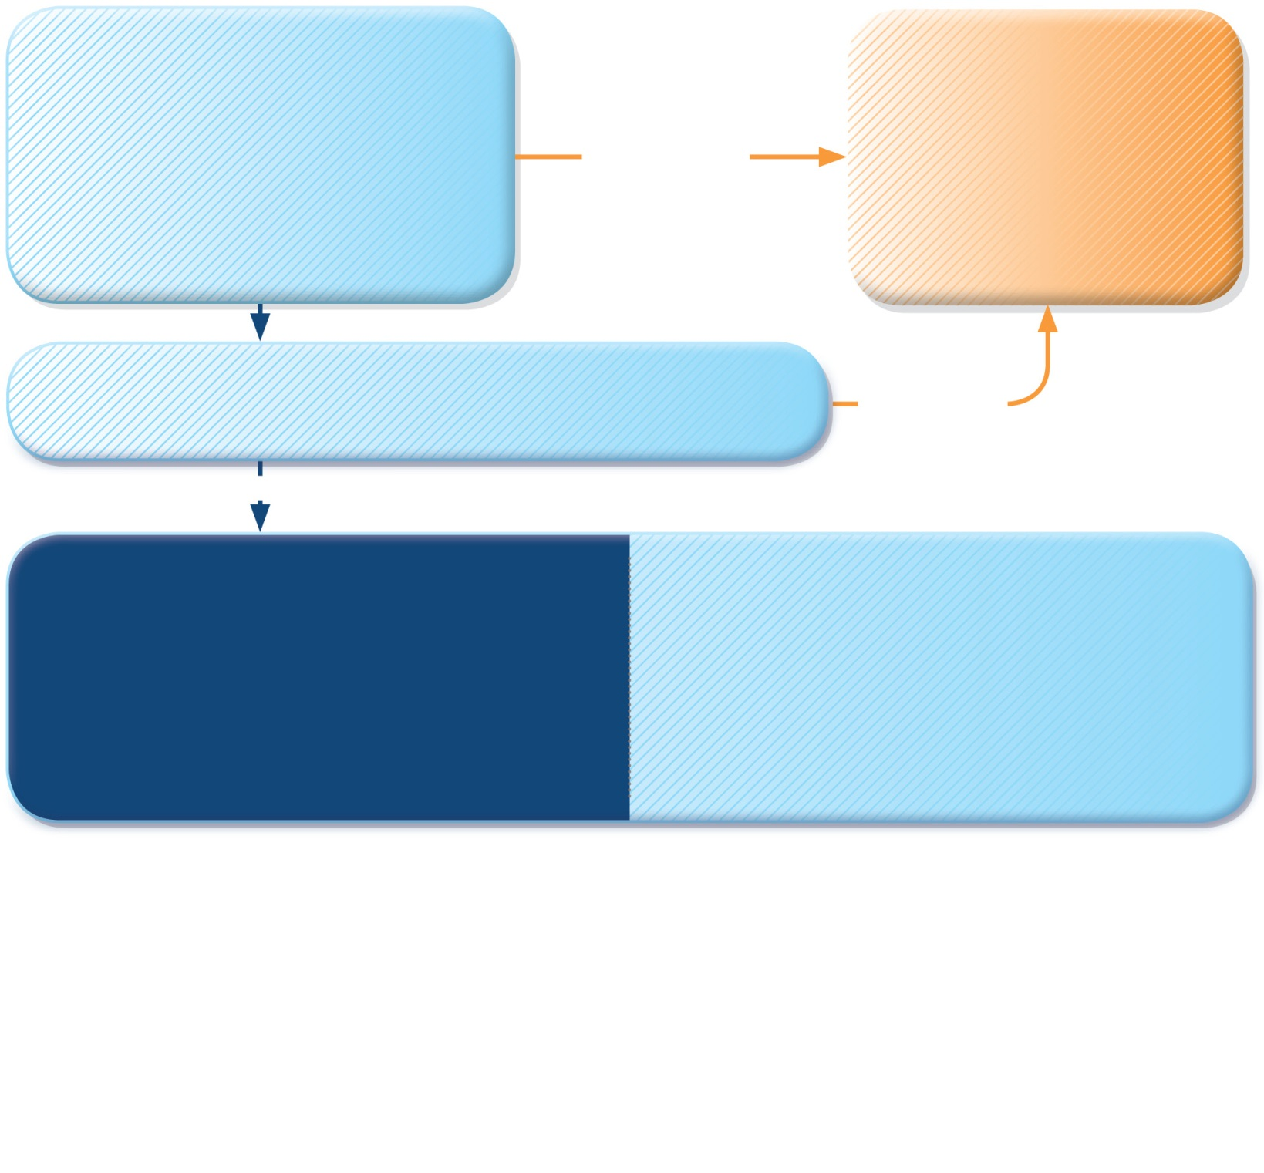
START TREATMENT
SABA 4–10 puffs by pMDI + spacer, repeat every 20 minutes for 1 hour
Prednisolone: adults 1 mg/kg, max. 50 mg, children 1–2 mg/kg, max. 40 mg
Controlled oxygen (if available): target saturation 93–95% (children: 94-98%)
TRANSFER TO ACUTE CARE FACILITY
While waiting: give inhaled SABA and ipratropium bromide, O₂, systemic corticosteroid
WORSENING
CONTINUE TREATMENT with SABA as needed
ASSESS RESPONSE AT 1 HOUR (or earlier)
WORSENING
IMPROVING
ASSESS FOR DISCHARGE
Symptoms improved, not needing SABA
PEF improving, and >60-80% of personal best or predicted
Oxygen saturation >94% room air
Resources at home adequate
ARRANGE at DISCHARGE
Reliever: continue as needed
Controller: start, or step up. Check inhaler technique, adherence
Prednisolone: continue, usually for 5–7 days (3-5 days for children)
Follow up: within 2–7 days
GINA 2017, Box 4-3 (6/7)

Slide 109
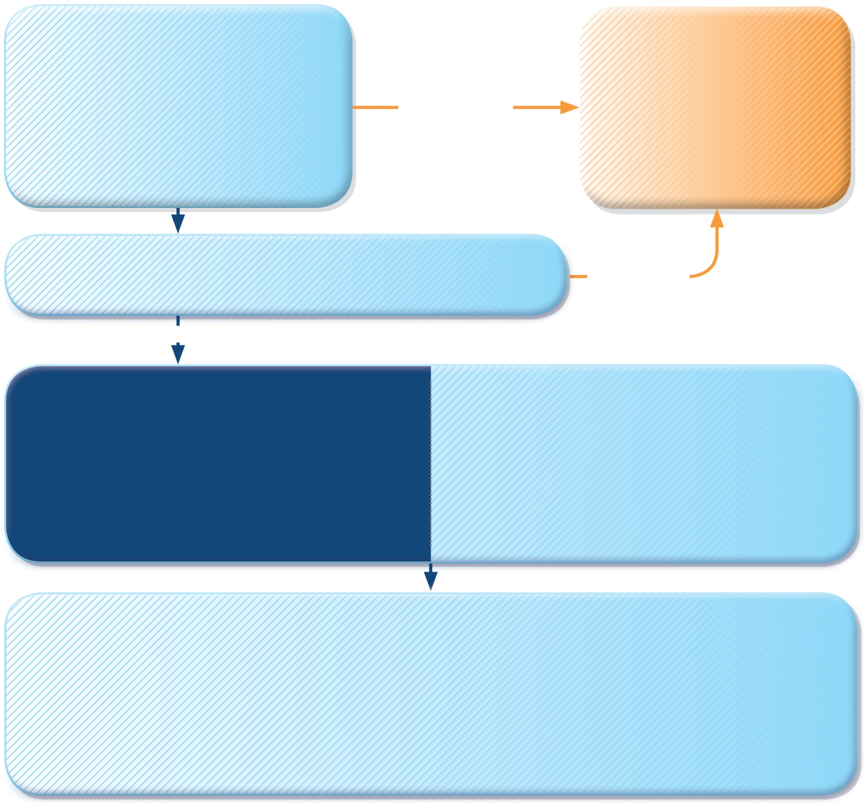
START TREATMENT
SABA 4–10 puffs by pMDI + spacer, repeat every 20 minutes for 1 hour
Prednisolone: adults 1 mg/kg, max. 50 mg, children 1–2 mg/kg, max. 40 mg
Controlled oxygen (if available): target saturation 93–95% (children: 94-98%)
TRANSFER TO ACUTE CARE FACILITY
While waiting: give inhaled SABA and ipratropium bromide, O₂, systemic corticosteroid
WORSENING
CONTINUE TREATMENT with SABA as needed
ASSESS RESPONSE AT 1 HOUR (or earlier)
WORSENING
IMPROVING
ASSESS FOR DISCHARGE
Symptoms improved, not needing SABA
PEF improving, and >60-80% of personal best or predicted
Oxygen saturation >94% room air
Resources at home adequate
ARRANGE at DISCHARGE
Reliever: continue as needed
Controller: start, or step up. Check inhaler technique, adherence
Prednisolone: continue, usually for 5–7 days (3-5 days for children)
Follow up: within 2–7 days
FOLLOW UP
Reliever: reduce to as-needed
Controller: continue higher dose for short term (1–2 weeks) or long term (3 months), depending on background to exacerbation
Risk factors: check and correct modifiable risk factors that may have contributed to exacerbation, including inhaler technique and adherence
Action plan: Is it understood? Was it used appropriately? Does it need modification?
GINA 2017, Box 4-3 (7/7)

Slide 110
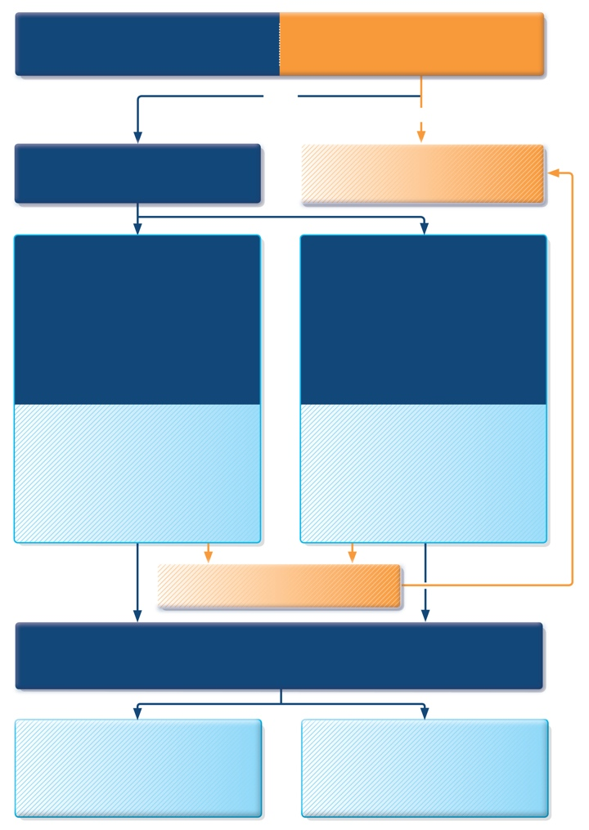
Managing exacerbations in acute care settings
INITIAL ASSESSMENT
A: airway B: breathing C: circulation
Are any of the following present?
Drowsiness, Confusion, Silent chest
NO
YES
Further TRIAGE BY CLINICAL STATUS according to worst feature
Consult ICU, start SABA and O₂, and prepare patient for intubation
MILD or MODERATE
Talks in phrases
Prefers sitting to lying
Not agitated
Respiratory rate increased
Accessory muscles not used
Pulse rate 100–120 bpm
O₂ saturation (on air) 90–95%
PEF >50% predicted or best
SEVERE
Talks in words
Sits hunched forwards
Agitated
Respiratory rate >30/min
Accessory muscles being used
Pulse rate >120 bpm
O₂ saturation (on air) < 90%
PEF ≤50% predicted or best
Short-acting beta₂-agonists
Consider ipratropium bromide
Controlled O₂ to maintain saturation 93–95% (children 94-98%)
Oral corticosteroids
Short-acting beta₂-agonists
Ipratropium bromide
Controlled O₂ to maintain saturation 93–95% (children 94-98%)
Oral or IV corticosteroids
Consider IV magnesium
Consider high dose ICS
If continuing deterioration, treat as severe and re-aassess for ICU
ASSESS CLINICAL PROGRESS FREQUENTLY
MEASURE LUNG FUNCTION in all patients one hour after initial treatment
FEV1 or PEF 60-80% of predicted or personal best and symptoms improved
MODERATE
Consider for discharge planning
FEV1 or PEF <60% of predicted or personal best,or lack of clinical response
SEVERE
Continue treatment as above and reassess frequently
GINA 2017, Box 4-4 (1/4)

Slide 111
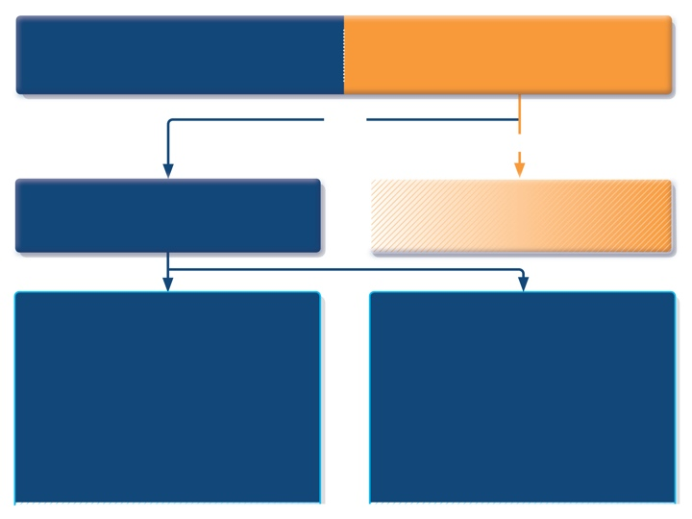
INITIAL ASSESSMENT
A: airway B: breathing C: circulation
Are any of the following present?
Drowsiness, Confusion, Silent chest
^{NO}
^{YES}
Further TRIAGE BY CLINICAL STATUS according to worst feature
Consult ICU, start SABA and O₂, and prepare patient for intubation
MILD or MODERATE
Talks in phrases
Prefers sitting to lying
Not agitated
Respiratory rate increased
Accessory muscles not used
Pulse rate 100–120 bpm
O₂ saturation (on air) 90–95%
PEF >50% predicted or best
SEVERE
Talks in words
Sits hunched forwards
Agitated
Respiratory rate >30/min
Accessory muscles being used
Pulse rate >120 bpm
O₂ saturation (on air) < 90%
PEF ≤50% predicted or best
GINA 2017, Box 4-4 (2/4)

Slide 112

MILD or MODERATE
Talks in phrases
Prefers sitting to lying
Not agitated
Respiratory rate increased
Accessory muscles not used
Pulse rate 100–120 bpm
O₂ saturation (on air) 90–95%
PEF >50% predicted or best
SEVERE
Talks in words
Sits hunched forwards
Agitated
Respiratory rate >30/min
Accessory muscles being used
Pulse rate >120 bpm
O₂ saturation (on air) < 90%
PEF ≤50% predicted or best
Short-acting beta₂-agonists
Consider ipratropium bromide
Controlled O₂ to maintain saturation 93–95% (children 94-98%)
Oral corticosteroids
Short-acting beta₂-agonists
Ipratropium bromide
Controlled O₂ to maintain saturation 93–95% (children 94-98%)
Oral or IV corticosteroids
Consider IV magnesium
Consider high dose ICS
GINA 2017, Box 4-4 (3/4)

Slide 113
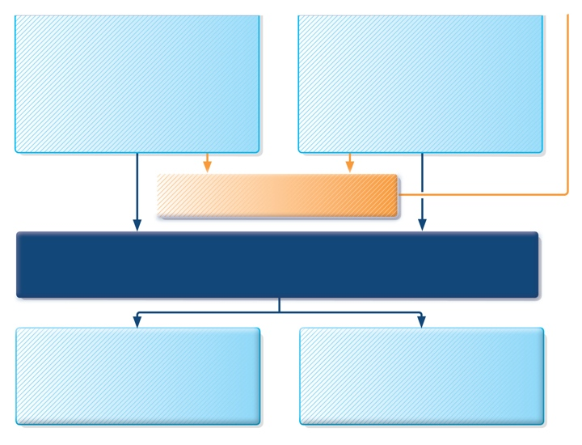
Short-acting beta₂-agonists
Consider ipratropium bromide
Controlled O₂ to maintain saturation 93–95% (children 94-98%)
Oral corticosteroids
Short-acting beta₂-agonists
Ipratropium bromide
Controlled O₂ to maintain saturation 93–95% (children 94-98%)
Oral or IV corticosteroids
Consider IV magnesium
Consider high dose ICS
If continuing deterioration, treat as severe and re-assess for ICU
ASSESS CLINICAL PROGRESS FREQUENTLY
MEASURE LUNG FUNCTION in all patients one hour after initial treatment
FEV₁ or PEF 60-80% of predicted or personal best and symptoms improved
MODERATE
Consider for discharge planning
FEV₁ or PEF <60% of predicted or personal best,or lack of clinical response
SEVERE
Continue treatment as above and reassess frequently
GINA 2017, Box 4-4 (4/4)

Slide 114
Follow-up after an exacerbation
Follow up all patients regularly after an exacerbation, until symptoms and lung function return to normal
Patients are at increased risk during recovery from an exacerbation
The opportunity
Exacerbations often represent failures in chronic asthma care, and they provide opportunities to review the patient’s asthma management
At follow-up visit(s), check:
The patient’s understanding of the cause of the flare-up
Modifiable risk factors, e.g. smoking
Adherence with medications, and understanding of their purpose
Inhaler technique skills
Written asthma action plan
GINA 2017, Box 4-5

Slide 115
Diagnosis and initial treatment of asthma, COPD and asthma-COPD overlap (ACO) A joint project of GINA and GOLD
UPDATED 2017
GINA 2017

Slide 116
Background
For patients with respiratory symptoms, infectious diseases and non-pulmonary conditions need to be distinguished from chronic airways disease
In patients with chronic airways disease, the differential diagnosis differs by age
Children and young adults: most likely to be asthma
Adults >40 years: COPD becomes more common, and distinguishing asthma from COPD becomes more difficult
Many patients with symptoms of chronic airways disease have features of both asthma and COPD
This has been called asthma-COPD overlap (ACO)
ACOS is not a single disease
It is likely that a range of different underlying mechanisms and origins will be identified
UPDATED 2017
GINA 2017

Slide 117
Background
Patients with features of both asthma and COPD have worse outcomes than those with asthma or COPD alone
Frequent exacerbations
Poor quality of life
More rapid decline in lung function
Higher mortality
Greater health care utilization
Reported prevalence of overlap varies by definitions used
Concurrent doctor-diagnosed asthma and COPD are found in 15–20% of patients with chronic airways disease
Reported rates of overlap are between15–55% of patients with chronic airways disease, depending on the definitions used for ‘asthma’ and ‘COPD’, and the population studied
Prevalence varies by age and gender
UPDATED 2017
GINA 2017

Slide 118
Asthma-COPD overlap – change in terminology
Distinguishing asthma from COPD can be problematic
Particularly in smokers and older adults
Some patients may have clinical features of both asthma and COPD
Most clinical trials and guidelines are about asthma or COPD alone
The descriptive term asthma-COPD overlap (ACO) is useful
It maintains awareness by clinicians, researchers and regulators of the needs of these patients
“Asthma-COPD overlap” is not a single disease entity
As for asthma and COPD, it includes patients with several different forms of airways disease (phenotypes)...
These features are caused by a range of different underlying mechanisms
To avoid the impression that this is a single disease, the previous term Asthma COPD Overlap Syndrome (ACOS) is no longer advised.
UPDATED 2017
What’s new in GINA 2017?

Slide 119
Objectives of the asthma-COPD overlap chapter
To provide interim advice to assist clinicians (especially in primary care and non-pulmonary specialties):
To identify patients with a disease of chronic airflow limitation
To distinguish asthma from COPD and identify patients who have features of both
To decide on safe initial treatment and/or need for referral
To stimulate research into asthma-COPD overlap, by promoting:
Study of characteristics and outcomes in broad populations of patients with chronic airflow limitation
Research into underlying mechanisms that might allow development of specific interventions for prevention and management in this population
UPDATED 2017
GINA 2017

Slide 120
Definitions
Asthma
Asthma is a heterogeneous disease, usually characterized by chronic airway inflammation. It is defined by the history of respiratory symptoms such as wheeze, shortness of breath, chest tightness and cough that vary over time and in intensity, together with variable expiratory airflow limitation. [GINA 2017]
GINA 2017, Box 5-1 (1/3)

Slide 121
Definitions
UPDATED 2017
Asthma
Asthma is a heterogeneous disease, usually characterized by chronic airway inflammation. It is defined by the history of respiratory symptoms such as wheeze, shortness of breath, chest tightness and cough that vary over time and in intensity, together with variable expiratory airflow limitation. [GINA 2017]
COPD
Chronic obstructive pulmonary disease (COPD) is a common, preventable and treatable disease that is characterized by persistent respiratory symptoms and airflow limitation that is due to airway and/or alveolar abnormalities usually caused by significant exposure to noxious particles or gases. [GOLD 2017]
GINA 2017, Box 5-1 (2/3)

Slide 122
Definitions
UPDATED 2017
Asthma
Asthma is a heterogeneous disease, usually characterized by chronic airway inflammation. It is defined by the history of respiratory symptoms such as wheeze, shortness of breath, chest tightness and cough that vary over time and in intensity, together with variable expiratory airflow limitation. [GINA 2017]
COPD
Chronic obstructive pulmonary disease (COPD) is a common, preventable and treatable disease that is characterized by persistent respiratory symptoms and airflow limitation that is due to airway and/or alveolar abnormalities usually caused by significant exposure to noxious particles or gases. [GOLD 2017]
Asthma-COPD overlap [not a definition, but a description for clinical use]
Asthma-COPD overlap (ACO) is characterized by persistent airflow limitation with several features usually associated with asthma and several features usually associated with COPD. Asthma-COPD overlap is therefore identified in clinical practice by the features that it shares with both asthma and COPD. This is not a definition, but a description for clinical use, as asthma-COPD overlap includes several different clinical phenotypes and there are likely to be several different underlying mechanisms.
GINA 2017, Box 5-1 (3/3)

Slide 123
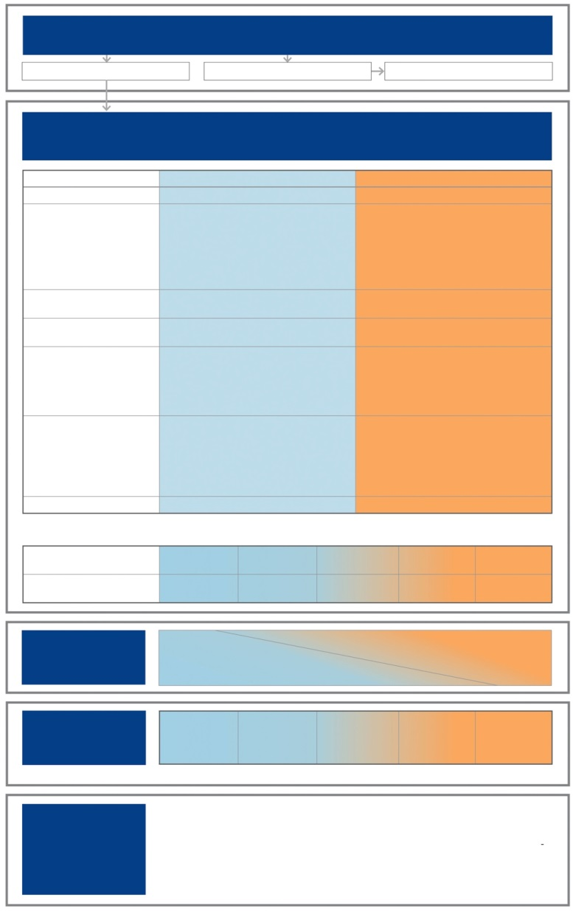
Stepwise approach to diagnosis and initial treatment
UPDATED 2017
STEP 1
DIAGNOSE CHRONIC AIRWAYS DISEASE
Do symptoms suggest chronic airways disease?
Yes
No
Consider other diseases first
STEP 2
SYNDROMIC DIAGNOSIS IN ADULTS
(i) Assemble the features for asthma and for COPD that best describe the patient.
(ii) Compare number of features in favour of each diagnosis and select a diagnosis
For an adult who presents with respiratory symptoms:
Does the patient have chronic airways disease?
Syndromic diagnosis of asthma, COPD and overlap
Spirometry
Commence initial therapy
Referral for specialized investigations (if necessary)
Features: if present suggest
ASTHMA
COPD
Age of onset
Before age 20 years
After age 40 years
Pattern of symptoms
Variation over minutes, hours or days
Worse during the night or early morning. Triggered by exercise, emotions including laughter, dust or exposure to allergens
Persistent despite treatment
Good and bad days but always daily symptoms and exertional dyspnea
Chronic cough & sputum preceded onset of dyspnea, unrelated to triggers
Lung function
Record of variable airflow limitation (spirometry or peak flow)
Record of persistent airflow limitation (FEV₁/FVC < 0.7 post-BD)
Lung function between symptoms
Normal
Abnormal
Past history or family history
Previous doctor diagnosis of asthma
Family history of asthma, and other allergic conditions (allergic rhinitis or eczema)
Previous doctor diagnosis of COPD, chronic bronchitis or emphysema
Heavy exposure to risk factor: tobacco smoke, biomass fuels
Time course
No worsening of symptoms over time. Variation in symptoms either seasonally, or from year to year
May improve spontaneously or have an immediate response to bronchodilators or to ICS over weeks
Symptoms slowly worsening over time (progressive course over years)
Rapid-acting bronchodilator treatment provides only limited relief
Chest X-ray
Normal
Severe hyperinflation
NOTE: • These features best distinguish between asthma and COPD. • Several positive features (3 or more) for either asthma or COPD suggest that diagnosis. • If there are a similar number for both asthma and COPD, consider diagnosis of ACO
DIAGNOSIS
Asthma
Some features
of asthma
Features of both
Some features
of COPD
COPD
CONFIDENCE IN
DIAGNOSIS
Asthma
Asthma
Could be ACO
Possibly COPD
COPD
STEP 3
PERFORM
SPIROMETRY
Marked
reversible airflow limitation
(pre-post bronchodilator) or other
proof of variable airflow limitation
FEV₁/FVC < 0.7
post-BD
STEP 4
INITIAL
TREATMENT*
Asthma drugs
No LABA
monotherapy
Asthma drugs
No LABA
monotherapy
ICS, and usually LABA
+/or LAMA
COPD drugs
COPD drugs
*Consult GINA and GOLD documents for recommended treatments.
STEP 5
SPECIALISED
INVESTIGATIONS
or REFER IF:
• Persistent symptoms and/or exacerbations despite treatment.
• Diagnostic uncertainty (e.g. suspected pulmonary hypertension, cardiovascular diseases and other causes of respiratory symptoms).
• Suspected asthma or COPD with atypical or additional symptoms or signs (e.g. haemoptysis, weight loss, night sweats, fever, signs of bronchiectasis or other structural lung disease).
• Few features of either asthma or COPD.
• Comorbidities present.
• Reasons for referral for either diagnosis as outlined in the GINA and GOLD strategy reports.
GINA 2017, Box 5-4

Slide 124
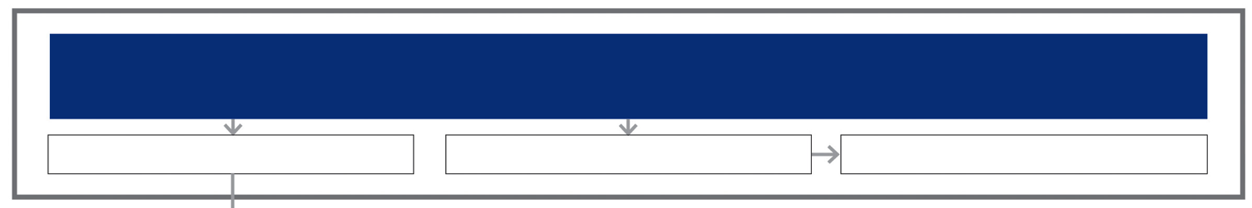
Step 1 – Does the patient have chronic airways disease?
STEP 1
DIAGNOSE CHRONIC AIRWAYS DISEASE
Do symptoms suggest chronic airways disease?
Yes
No
Consider other diseases first
GINA 2017

Slide 125
Step 1 – Does the patient have chronic airways disease?
Clinical history: consider chronic airways disease if
Chronic or recurrent cough, sputum, dyspnea or wheezing, or repeated acute lower respiratory tract infections
Previous doctor diagnosis of asthma and/or COPD
Previous treatment with inhaled medications
History of smoking tobacco and/or other substances
Exposure to environmental hazards, e.g. airborne pollutants
Physical examination
May be normal
Evidence of hyperinflation or respiratory insufficiency
Wheeze and/or crackles
GINA 2017

Slide 126
Step 1 – Does the patient have chronic airways disease?
Radiology (CXR or CT scan performed for other reasons)
May be normal, especially in early stages
Hyperinflation, airway wall thickening, hyperlucency, bullae
May identify or suggest an alternative or additional diagnosis, e.g. bronchiectasis, tuberculosis, interstitial lung disease, cardiac failure
Screening questionnaires
Designed to assist in identification of patients at risk of chronic airways disease
May not be generalizable to all countries, practice settings or patients
See GINA and GOLD reports for examples
GINA 2017

Slide 127
Step 2 – Syndromic diagnosis of asthma, COPD and asthma-COPD overlap
Assemble the features that, when present, most favor a diagnosis of typical asthma or typical COPD
Compare the number of features on each side
If the patient has ≥3 features of either asthma or COPD, there is a strong likelihood that this is the correct diagnosis
Consider the level of certainty around the diagnosis
Diagnoses are made on the weight of evidence
The absence of any of these features does not rule out either diagnosis, e.g. absence of atopy does not rule out asthma
When a patient has a similar number of features of both asthma and COPD, consider the diagnosis of asthma-COPD overlap
UPDATED 2017
GINA 2017

Slide 128
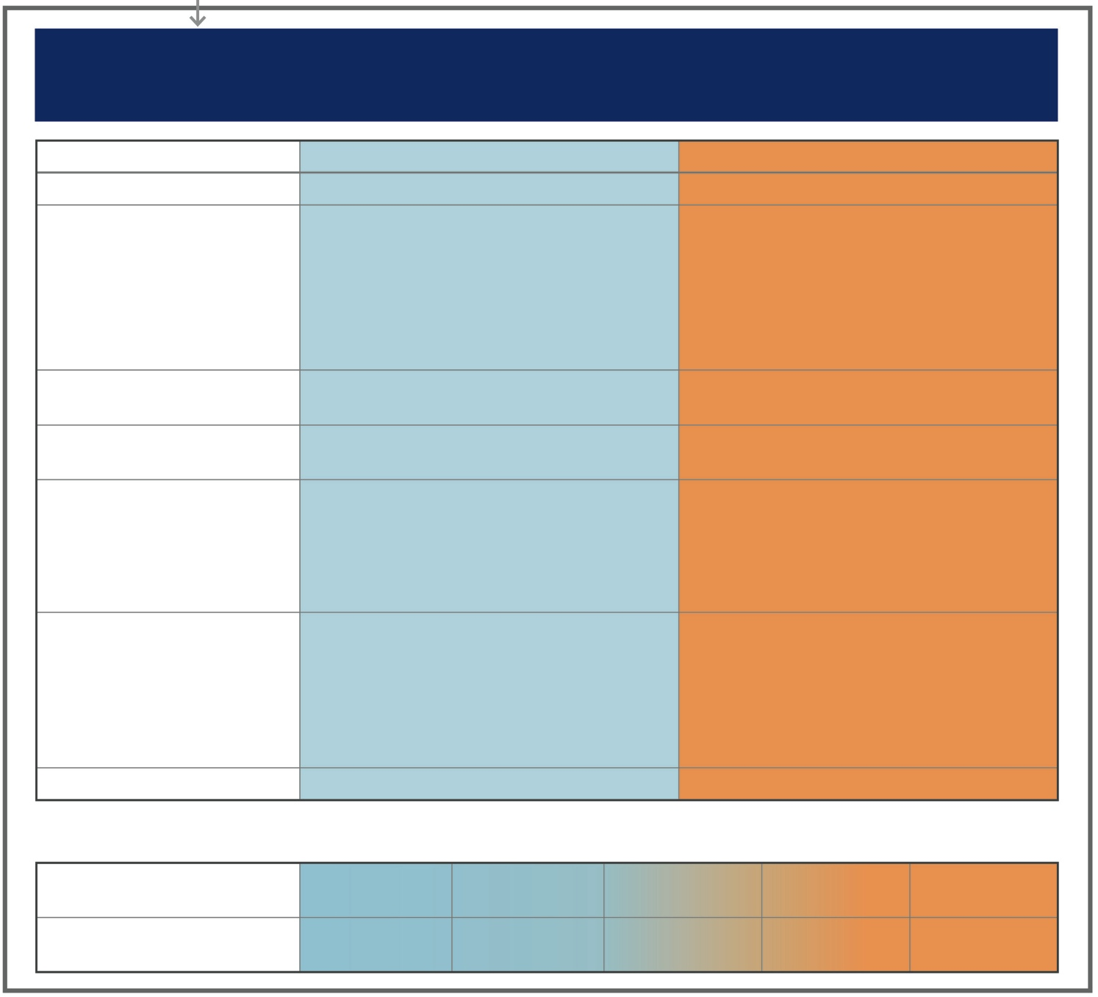
STEP 2
SYNDROMIC DIAGNOSIS IN ADULTS
(i) Assemble the features for asthma and for COPD that best describe the patient.
(ii) Compare number of features in favour of each diagnosis and select a diagnosis
Features: if present suggest -
ASTHMA
COPD
Age of onset
Before age 20 years
After age 40 years
Pattern of symptoms
Variation over minutes, hours or days
Worse during the night or early morning
Triggered by exercise, emotions including laughter, dust or exposure to allergens
Persistent despite treatment
Good and bad days but always daily symptoms and exertional dyspnea
Chronic cough & sputum preceded onset of dyspnea, unrelated to triggers
Lung function
Record of variable airflow limitation (spirometry or peak flow)
Record of persistent airflow limitation (FEV₁/FVC < 0.7 post-BD)
Lung function between symptoms
Normal
Abnormal
Past history or family history
Previous doctor diagnosis of asthma
Family history of asthma, and other allergic conditions (allergic rhinitis or eczema)
Previous doctor diagnosis of COPD, chronic bronchitis or emphysema
Heavy exposure to risk factor: tobacco smoke, biomass fuels
Time course
No worsening of symptoms over time. Variation in symptoms either seasonally, or from year to year
May improve spontaneously or have an immediate response to bronchodilators or to ICS over weeks
Symptoms slowly worsening over time (progressive course over years)
Rapid-acting bronchodilator treatment provides only limited relief
Chest X-ray
Normal
Severe hyperinflation
NOTE: • These features best distinguish between asthma and COPD. • Several positive features (3 or more) for either asthma or COPD suggest
that diagnosis. • If there are a similar number for both asthma and COPD, consider diagnosis of ACO
DIAGNOSIS
Asthma
Some features
of asthma
Features of both
Some features
of COPD
COPD
UPDATED 2017
CONFIDENCE IN
DIAGNOSIS
Asthma
Asthma
Could be ACO
Possibly COPD
COPD
GINA 2017, Box 5-4
GINA 2014
© Global Initiative for Asthma

Slide 129

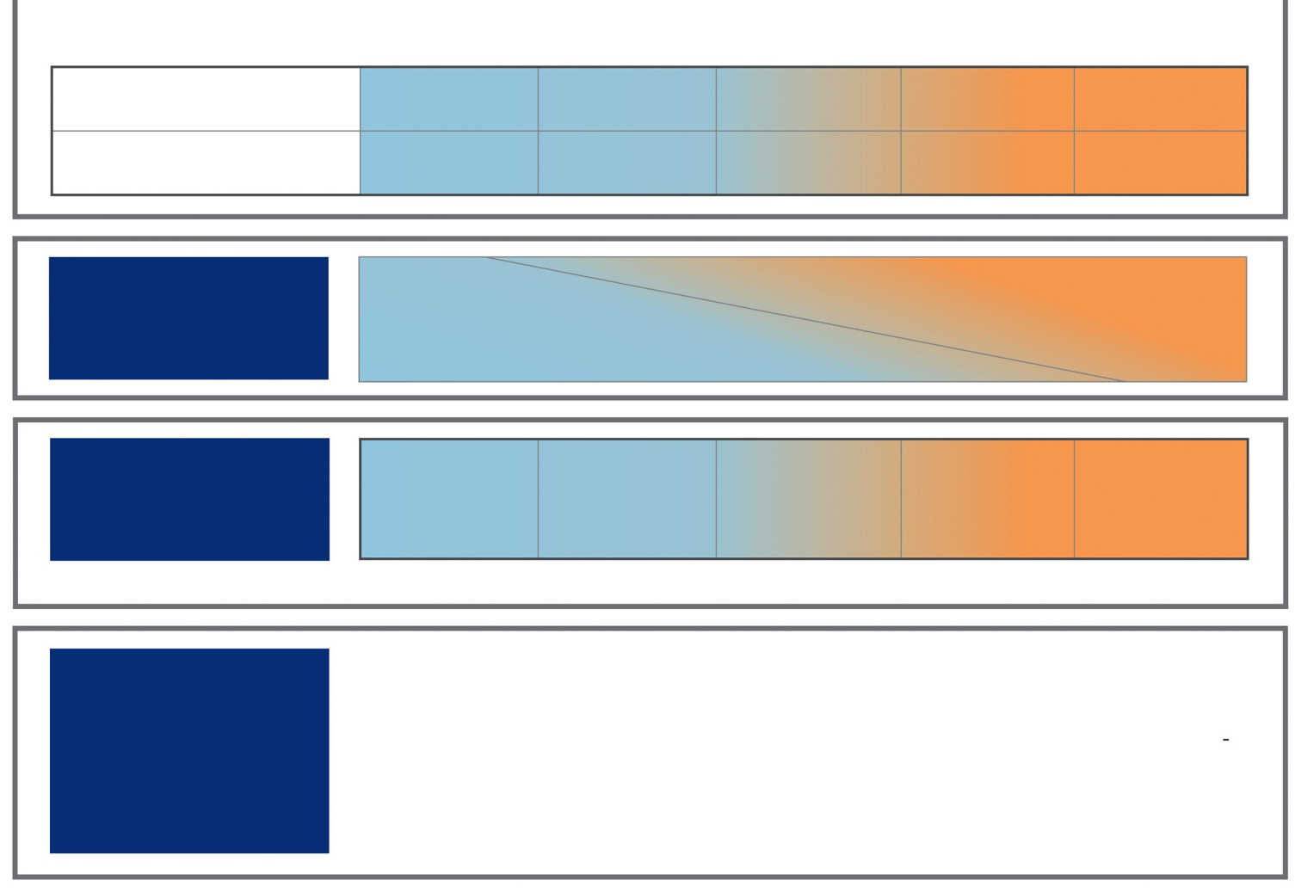
STEP 3
PERFORM
SPIROMETRY
Marked
reversible airflow limitation
(pre-post bronchodilator) or other
proof of variable airflow limitation
FEV₁/FVC < 0.7
post-BD
GINA 2017

Slide 130
Step 3 - Spirometry
Essential if chronic airways disease is suspected
Confirms chronic airflow limitation
More limited value in distinguishing between asthma with fixed airflow limitation, COPD and asthma-COPD overlap
Measure at the initial visit or subsequent visit
If possible measure before and after a trial of treatment
Medications taken before testing may influence results
Peak expiratory flow (PEF)
Not a substitute for spirometry
Normal PEF does not rule out asthma or COPD
Repeated measurement may confirm excessive variability, found in asthma or in some patients with asthma-COPD overlap
GINA 2017, Box 5-3

Slide 131
Step 3 - Spirometry
UPDATED 2017
Spirometric variable
Asthma
COPD
Overlap
Normal FEV₁/FVC pre- or post-BD
Compatible with asthma
Not compatible with diagnosis (GOLD)
Not compatible unless other evidence of chronic airflow limitation
Post-BD FEV₁/FVC <0.7
-
Indicates airflow limitation; may improve
Required for diagnosis by GOLD criteria
Usual in asthma-COPD overlap (ACO)
FEV₁ ≥80% predicted
Compatible with asthma (good control, or interval between symptoms)
C
ompatible with GOLD category A or B if post- BD FEV₁/FVC <0.7
Compatible with mild ACO
FEV₁<80% predicted
Compatible with asthma. A risk factor for exacerbations
Indicates severity of airflow limitation and risk of exacerbations and mortality
Indicates severity of airflow limitation and risk of exacerbations and mortality
Post-BD increase in FEV₁ >12% and 200mL from baseline (reversible airflow limitation)
-
Usual at some time in course of asthma; not always present
Common in COPD and more likely when FEV₁ is low
Common in ACO, and more likely when FEV₁ is low
Post-BD increase in FEV₁ >12% and 400mL from baseline
-
High probability of asthma
Unusual in COPD. Consider ACO
Compatible with diagnosis of ACO
GINA 2017, Box 5-3

Slide 132
STEP 4
INITIAL
TREATMENT*
Asthma drugs
No LABA
monotherapy
Asthma drugs
No LABA
monotherapy
ICS and
consider LABA
+/or LAMA
COPD drugs
COPD drugs
*Consult GINA and GOLD documents for recommended treatments.
GINA 2017

Slide 133
Step 4 – Commence initial therapy
UPDATED 2017
Initial pharmacotherapy choices are based on both efficacy and safety
If syndromic assessment suggests asthma as single diagnosis
Start with low-dose ICS
Add LABA and/or LAMA if needed for poor control despite good adherence and correct technique
Do not give LABA alone without ICS
If syndromic assessment suggests COPD as single diagnosis
Start with bronchodilators or combination therapy
Do not give ICS alone without LABA and/or LAMA
If differential diagnosis is equally balanced between asthma and COPD, i.e. asthma-COPD overlap
Start treatment as for asthma, pending further investigations
Start with ICS at low or moderate dose
Usually also add LABA and/or LAMA, or continue if already prescribed
GINA 2017

Slide 134
Step 4 – Commence initial therapy
For all patients with chronic airflow limitation:
Treat modifiable risk factors including advice about smoking cessation
Treat comorbidities
Advise about non-pharmacological strategies including physical activity, and, for COPD or asthma-COPD overlap, pulmonary rehabilitation and vaccinations
Provide appropriate self-management strategies
Arrange regular follow-up
See GINA and GOLD reports for details
UPDATED 2017
GINA 2017

Slide 135
STEP 3
PERFORM
SPIROMETRY
STEP 5
SPECIALISED
INVESTIGATIONS
or REFER IF:
Persistent symptoms and/or exacerbations despite treatment.
Diagnostic uncertainty (e.g. suspected pulmonary hypertension, cardiovascular diseases and other causes of respiratory symptoms).
Suspected asthma or COPD with atypical or additional symptoms or signs (e.g. haemoptysis,
weight loss, night sweats, fever, signs of bronchiectasis or other structural lung disease).
Few features of either asthma or COPD.
Comorbidities present.
Reasons for referral for either diagnosis as outlined in the GINA and GOLD strategy reports.
GINA 2017

Slide 136
Step 5 – Refer for specialized investigations if needed
Refer for expert advice and extra investigations if patient has:
Persistent symptoms and/or exacerbations despite treatment
Diagnostic uncertainty, especially if alternative diagnosis (e.g. TB, cardiovascular disease) needs to be excluded
Suspected airways disease with atypical or additional symptoms or signs (e.g. hemoptysis, weight loss, night sweats, fever, chronic purulent sputum). Do not wait for a treatment trial before referring
Suspected chronic airways disease but few features of asthma, COPD or asthma-COPD overlap
Comorbidities that may interfere with their management
Issues arising during on-going management of asthma, COPD or asthma-COPD overlap
GINA 2017

Slide 137
Step 5 – Refer for specialized investigations if needed
Investigation | Asthma | COPD
DLCO | Normal or slightly elevated | Often reduced
Arterial blood gases | Normal between exacerbations | In severe COPD, may be abnormal between exacerbations
Airway hyperresponsiveness | Not useful on its own in distinguishing asthma and COPD. Higher levels favor asthma
High resolution CT scan | Usually normal; may show air trapping and increased airway wall thickness | Air trapping or emphysema; may show bronchial wall thickening and features of pulmonary hypertension
Tests for atopy (sIgE and/or skin prick tests) | Not essential for diagnosis; increases probability of asthma | Conforms to background prevalence; does not rule out COPD
FENO | If high (>50ppb) supports eosinophilic inflammation | Usually normal. Low in current smokers
Blood eosinophilia | Supports asthma diagnosis | May be found during exacerbations
Sputum inflammatory cell analysis | Role in differential diagnosis not established in large populations
GINA 2017, Box 5-5

Slide 138
Diagnosis and management of asthma in children 5 years and younger
GINA 2017

Slide 139
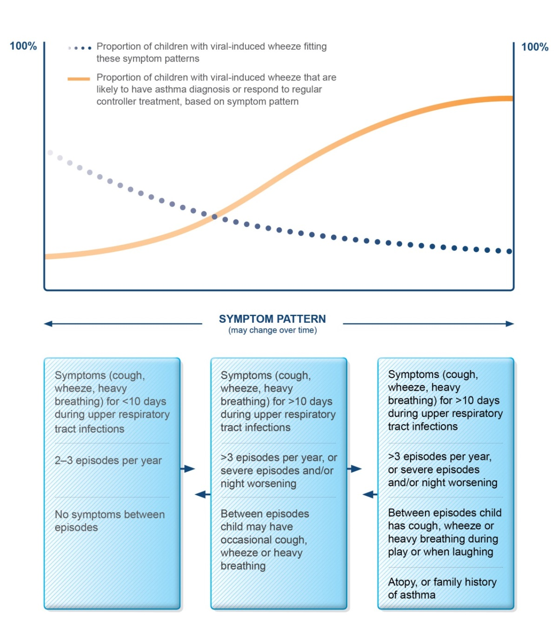
Probability of asthma diagnosis or response to asthma treatment in children ≤5 years
GINA 2017, Box 6-1 (1/2)

Slide 140
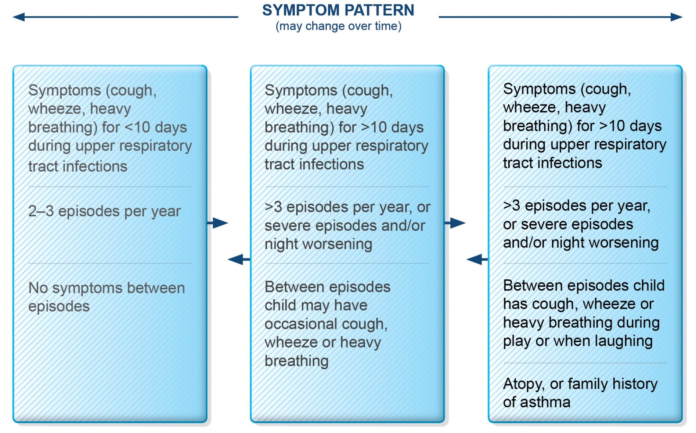
Symptom patterns in children ≤5 years
GINA 2017, Box 6-1 (2/2)

Slide 141
Features suggesting asthma in children ≤5 years
Feature | Characteristics suggesting asthma
Cough | Recurrent or persistent non-productive cough that may be worse at night or accompanied by some wheezing and breathing difficulties. Cough occurring with exercise, laughing, crying or exposure to tobacco smoke in the absence of an apparent respiratory infection Prolonged cough in infancy, and cough without cold symptoms, are associated with later parent-reported physician-diagnosed asthma, independent of infant wheeze
Wheezing | Recurrent wheezing, including during sleep or with triggers such as activity, laughing, crying or exposure to tobacco smoke or air pollution
Difficult or heavy breathing or shortness of breath | Occurring with exercise, laughing, or crying
Reduced activity | Not running, playing or laughing at the same intensity as other children; tires earlier during walks (wants to be carried)
Past or family history | Other allergic disease (atopic dermatitis or allergic rhinitis) Asthma in first-degree relatives
Therapeutic trial with low dose ICS and as-needed SABA | Clinical improvement during 2–3 months of controller treatment and worsening when treatment is stopped
UPDATED 2017
GINA 2017, Box 6-2

Slide 142
Common differential diagnoses of asthma in children ≤5 years
Condition | Typical features
Recurrent viral respiratory infections | Mainly cough, runny congested nose for <10 days; wheeze usually mild; no symptoms between infections
Gastroesophageal reflux | Cough when feeding; recurrent chest infections; vomits easily especially after large feeds; poor response to asthma medications
Foreign body aspiration | Episode of abrupt severe cough and/or stridor during eating or play; recurrent chest infections and cough; focal lung signs
Tracheomalacia or bronchomalacia | Noisy breathing when crying or eating, or during URTIs; harsh cough; inspiratory or expiratory retraction; symptoms often present since birth; poor response to asthma treatment
Tuberculosis | Persistent noisy respirations and cough; fever unresponsive to normal antibiotics; enlarged lymph nodes; poor response to BD or ICS; contact with someone with TB
Congenital heart disease | Cardiac murmur; cyanosis when eating; failure to thrive; tachycardia; tachypnea or hepatomegaly; poor response to asthma medications
GINA 2017, Box 6-3 (1/2)

Slide 143
Common differential diagnoses of asthma in children ≤5 years (continued)
Condition | Typical features
Cystic fibrosis | Cough starting shortly after birth; recurrent chest infections; failure to thrive (malabsorption); loose greasy bulky stools
Primary ciliary dyskinesia | Cough and recurrent mild chest infections; chronic ear infections and purulent nasal discharge; poor response to asthma medications; situs inversus (in ~50% children with this condition)
Vascular ring | Respirations often persistently noisy; poor response to asthma medications
Bronchopulmonary dysplasia | Infant born prematurely; very low birth weight; needed prolonged mechanical ventilation or supplemental oxygen; difficulty with breathing present from birth
Immune deficiency | Recurrent fever and infections (including non-respiratory); failure to thrive
GINA 2017, Box 6-3 (2/2)

Slide 144
GINA assessment of asthma control in children ≤5 years
A. Symptom control
In the past 4 weeks, has the child had: | Well-controlled | Partly controlled | Uncontrolled
Daytime asthma symptoms for more than few minutes, more than once/week? Yes No | None of these | 1-2 of these | 3-4 of these
Any activity limitation due to asthma? (runs/plays less than other children, tires easily during walks/playing) Yes No
Reliever needed* more than once a week? Yes No
Any night waking or night coughing due to asthma? Yes No
B. Risk factors for poor asthma outcomes
ASSESS CHILD’S RISK FOR: Exacerbations within the next few months Fixed airflow limitation Medication side-effects
Level of asthma symptom control
GINA 2017, Box 6-4A

Slide 145
Risk factors for poor asthma outcomes in children ≤5 years
Risk factors for exacerbations in the next few months
Uncontrolled asthma symptoms One or more severe exacerbation in previous year The start of the child’s usual ‘flare-up’ season (especially if autumn/fall) Exposures: tobacco smoke; indoor or outdoor air pollution; indoor allergens (e.g. house dust mite, cockroach, pets, mold), especially in combination with viral infection Major psychological or socio-economic problems for child or family Poor adherence with controller medication, or incorrect inhaler technique
GINA 2017, Box 6-4B (1/3)

Slide 146
Risk factors for poor asthma outcomes in children ≤5 years
Risk factors for exacerbations in the next few months
Uncontrolled asthma symptoms One or more severe exacerbation in previous year The start of the child’s usual ‘flare-up’ season (especially if autumn/fall) Exposures: tobacco smoke; indoor or outdoor air pollution; indoor allergens (e.g. house dust mite, cockroach, pets, mold), especially in combination with viral infection Major psychological or socio-economic problems for child or family Poor adherence with controller medication, or incorrect inhaler technique
Risk factors for fixed airflow limitation
Severe asthma with several hospitalizations History of bronchiolitis
GINA 2017, Box 6-4B (2/3)

Slide 147
Risk factors for poor asthma outcomes in children ≤5 years
Risk factors for exacerbations in the next few months
Uncontrolled asthma symptoms One or more severe exacerbation in previous year The start of the child’s usual ‘flare-up’ season (especially if autumn/fall) Exposures: tobacco smoke; indoor or outdoor air pollution; indoor allergens (e.g. house dust mite, cockroach, pets, mold), especially in combination with viral infection Major psychological or socio-economic problems for child or family Poor adherence with controller medication, or incorrect inhaler technique
Risk factors for fixed airflow limitation
Severe asthma with several hospitalizations History of bronchiolitis
Risk factors for medication side-effects
Systemic: Frequent courses of OCS; high-dose and/or potent ICS Local: moderate/high-dose or potent ICS; incorrect inhaler technique; failure to protect skin or eyes when using ICS by nebulizer or spacer with face mask
GINA 2017, Box 6-4B (3/3)

Slide 148
Control-based asthma management cycle in children ≤5 years
Diagnosis
Symptom control & risk factors
Inhaler technique & adherence
Parent preference
ASSESS
REVIEW RESPONSE
Symptoms
Exacerbations
Side-effects
Parent satisfaction
ADJUST TREATMENT
Asthma medications
Non-pharmacological strategies
Treat modifiable risk factors
GINA 2017, Box 6-5 (1/8)

Slide 149
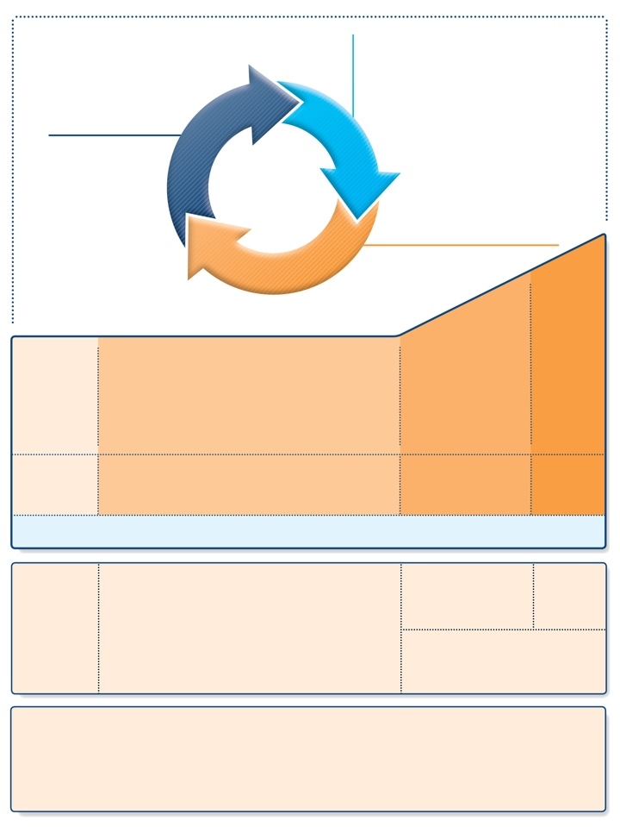
Stepwise approach to control symptoms and reduce risk (children ≤5 years)
Diagnosis
Symptom control & risk factors
Inhaler technique & adherence
Parent preference
ASSESS
REVIEW RESPONSE
Symptoms
Exacerbations
Side-effects
Parent satisfaction
ADJUST TREATMENT
Asthma medications
Non-pharmacological strategies
Treat modifiable risk factors
STEP 4
PREFERRED CONTROLLER CHOICE
STEP 1
STEP 2
STEP 3
Continue controller & refer for specialist assessment
Double ‘low dose’ ICS
Daily low dose ICS
Other controller options
Leukotriene receptor antagonist (LTRA)
Intermittent ICS
Low dose ICS + LTRA
Add LTRA
Inc. ICS frequency
Add intermitt ICS
RELIEVER
As-needed short-acting beta₂-agonist (all children)
CONSIDER THIS STEP FOR CHILDREN WITH:
Infrequent viral wheezing and no or few interval symptoms
Symptom pattern consistent with asthma and asthma symptoms not well-controlled, or ≥3 exacerbations per year
Symptom pattern not consistent with asthma but wheezing episodes occur frequently, e.g. every 6–8 weeks. Give diagnostic trial for 3 months.
Asthma diagnosis, and not well-controlled on low dose ICS
Not well- controlled on double ICS
First check diagnosis, inhaler skills, adherence, exposures
KEY ISSUES
ALL CHILDREN
• Assess symptom control, future risk, comorbidities
• Self-management: education, inhaler skills, written asthma action plan, adherence
• Regular review: assess response, adverse events, establish minimal effective treatment
• (Where relevant): environmental control for smoke, allergens, indoor/outdoor air pollution
GINA 2017, Box 6-5 (2/8)

Slide 150
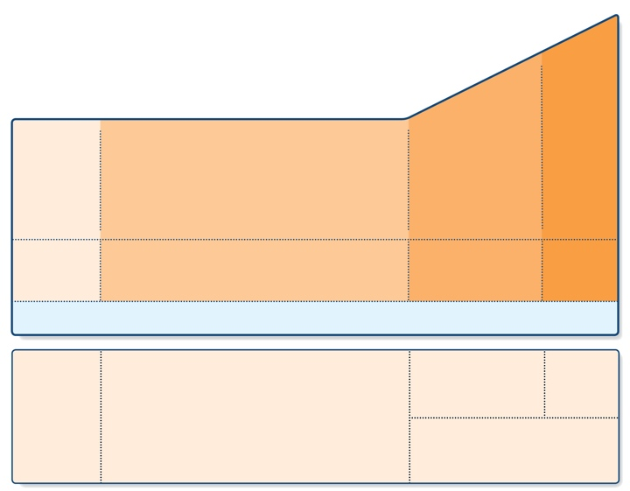
Stepwise approach – pharmacotherapy (children ≤5 years)
STEP 4
PREFERRED CONTROLLER CHOICE
STEP 3
STEP 1
STEP 2
Continue controller & refer for specialist assessment
Double ‘low dose’ ICS
Daily low dose ICS
Other controller options
Leukotriene receptor antagonist (LTRA)
Intermittent ICS
Low dose ICS + LTRA
Add LTRA
Inc. ICS frequency
Add intermitt ICS
RELIEVER
As-needed short-acting beta₂-agonist (all children)
CONSIDER THIS STEP FOR CHILDREN WITH:
Infrequent viral wheezing and no or few interval symptoms
Symptom pattern consistent with asthma and asthma symptoms not well-controlled, or ≥3 exacerbations per year
Symptom pattern not consistent with asthma but wheezing episodes occur frequently, e.g. every 6–8 weeks. Give diagnostic trial for 3 months.
Asthma diagnosis, and not well-controlled on low dose ICS
Not well-controlled on double ICS
First check diagnosis, inhaler skills, adherence, exposures
GINA 2017, Box 6-5 (3/8)

Slide 151

Stepwise approach – key issues (children ≤5 years)
UPDATED 2017
KEY ISSUES
ALL CHILDREN
• Assess symptom control, future risk, comorbidities
• Self-management: education, inhaler skills, written asthma action plan, adherence
• Regular review: assess response, adverse events, establish minimal effective treatment
• (Where relevant): environmental control for smoke, allergens, indoor/outdoor air pollution
Assess asthma control
Symptom control, future risk, comorbidities
Self-management
Education, inhaler skills, written asthma action plan, adherence
Regular review
Assess response, adverse events, establish minimal effective treatment
Record height each year, as poorly-controlled asthma may influence growth, and ICS may be associated with growth delay in first 1-2 years
Other
(Where relevant): environmental control for smoke, allergens, indoor or outdoor air pollution
GINA 2017, Box 6-5 (4/8)

Slide 152
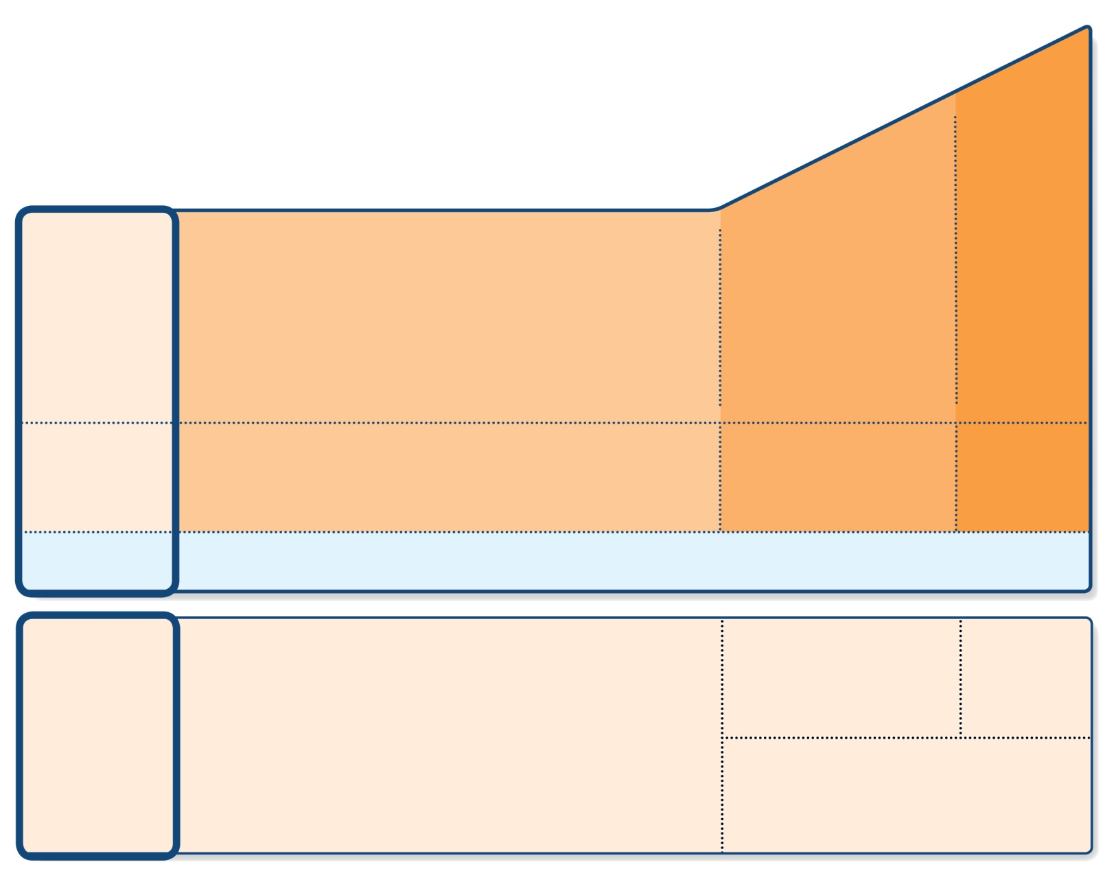
Step 1 (children ≤5 years) – as-needed inhaled SABA
STEP 4
PREFERRED CONTROLLER CHOICE
STEP 3
STEP 1
STEP 2
Continue controller & refer for specialist assessment
Double ‘low dose’ ICS
Daily low dose ICS
Other controller options
Leukotriene receptor antagonist (LTRA)
Intermittent ICS
Low dose ICS + LTRA
Add LTRA
Inc. ICS frequency
Add intermitt ICS
RELIEVER
As-needed short-acting beta₂-agonist (all children)
CONSIDER THIS STEP FOR CHILDREN WITH:
Infrequent viral wheezing and no or few interval symptoms
Symptom pattern consistent with asthma and asthma symptoms not well-controlled, or ≥3 exacerbations per year
Symptom pattern not consistent with asthma but wheezing episodes occur frequently, e.g. every 6–8 weeks. Give diagnostic trial for 3 months.
Asthma diagnosis, and not well-controlled on low dose ICS
Not well-controlled on double ICS
First check diagnosis, inhaler skills, adherence, exposures
GINA 2017, Box 6-5 (5/8)

Slide 153
Step 1 (children ≤5 years) – as-needed inhaled SABA
Preferred option: as-needed inhaled SABA
Provide inhaled SABA to all children who experience wheezing episodes
Not effective in all children
Other options
Oral bronchodilator therapy is not recommended (slower onset of action, more side-effects)
For children with intermittent viral-induced wheeze and no interval symptoms, if as-needed SABA is not sufficient, consider intermittent ICS. Because of the risk of side-effects, this should only be considered if the physician is confident that the treatment will be used appropriately.
GINA 2017

Slide 154
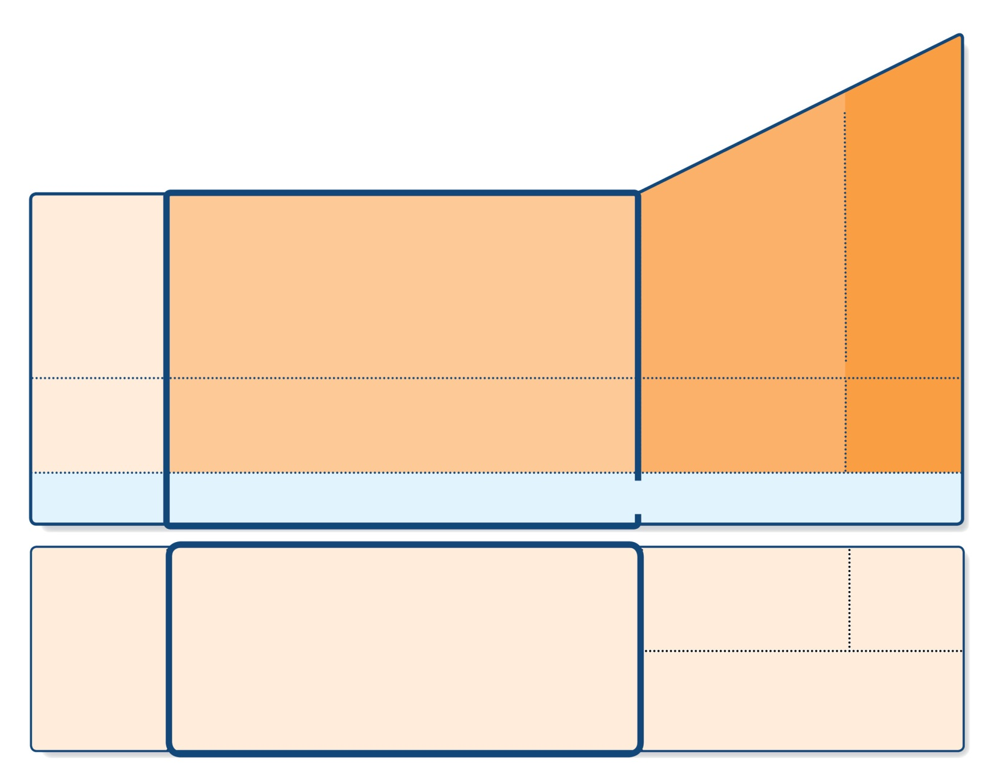
Step 2 (children ≤5 years) – initial controller + as-needed SABA
STEP 4
PREFERRED CONTROLLER CHOICE
STEP 3
STEP 1
STEP 2
Continue controller & refer for specialist assessment
Double ‘low dose’ ICS
Daily low dose ICS
Other controller options
Leukotriene receptor antagonist (LTRA)
Intermittent ICS
Low dose ICS + LTRA
Add LTRA
Inc. ICS frequency
Add intermitt ICS
As-needed short-acting beta₂-agonist (all children)
RELIEVER
CONSIDER THIS STEP FOR CHILDREN WITH:
Infrequent viral wheezing and no or few interval symptoms
Symptom pattern consistent with asthma and asthma symptoms not well-controlled, or ≥3 exacerbations per year
Symptom pattern not consistent with asthma but wheezing episodes occur frequently, e.g. every 6–8 weeks. Give diagnostic trial for 3 months.
Asthma diagnosis, and not well-controlled on low dose ICS
Not well-controlled on double ICS
First check diagnosis, inhaler skills, adherence, exposures
GINA 2017, Box 6-5 (6/8)

Slide 155
Step 2 (children ≤5 years) – initial controller + as-needed SABA
Indication
Child with symptom pattern consistent with asthma, and symptoms not well-controlled, or ≥3 exacerbations per year
May also be used as a diagnostic trial for children with frequent wheezing episodes
Preferred option: regular daily low dose ICS + as-needed inhaled SABA
Give for ≥3 months to establish effectiveness, and review response
Other options depend on symptom pattern
(Persistent asthma) – regular leukotriene receptor antagonist (LTRA) leads to modest reduction in symptoms and need for OCS compared with placebo
(Intermittent viral-induced wheeze) – regular LTRA improves some outcomes but does not reduce risk of exacerbations
(Frequent viral-induced wheeze with interval symptoms) – consider episodic or as-needed ICS, but give a trial of regular ICS first
GINA 2017

Slide 156
Checking height in children with asthma
NEW 2017
Check height at least yearly, because:
Poorly-controlled asthma can affect growth [Pedersen 2001]
Growth velocity may be lower in the first 1-2 years of ICS treatment but this is not progressive or cumulative [Kelly 2012, Loke 2015].
The one study that examined long-term outcomes showed a difference of only 0.7% in adult height [Kelly 2012, Loke 2015]
If decreased growth velocity is seen, also consider:
Poorly-controlled asthma
Frequent use of OCS
Poor nutrition

Slide 157
Inhaled corticosteroids and growth in children
NEW SLIDE 2017
Discuss decisions about controller treatment with parents/carers
Discuss the relative benefits and risks of treatment/no treatment
Emphasize the importance of maintaining normal activity levels for normal physical and social development
ICS can have a small but usually temporary effect on growth
An effect of ICS on growth velocity is seen in pre-pubertal children in the first 1-2 years of treatment
This is not progressive or cumulative [Kelly 2012, Loke 2015].
The one study that examined long-term outcomes showed a difference of only 0.7% in adult height [Kelly 2012, Loke 2015]
Poorly-controlled asthma itself adversely affects adult height [Pedersen 2001]
For more detail see GINA 2017 Appendix Chapter 5B

Slide 158
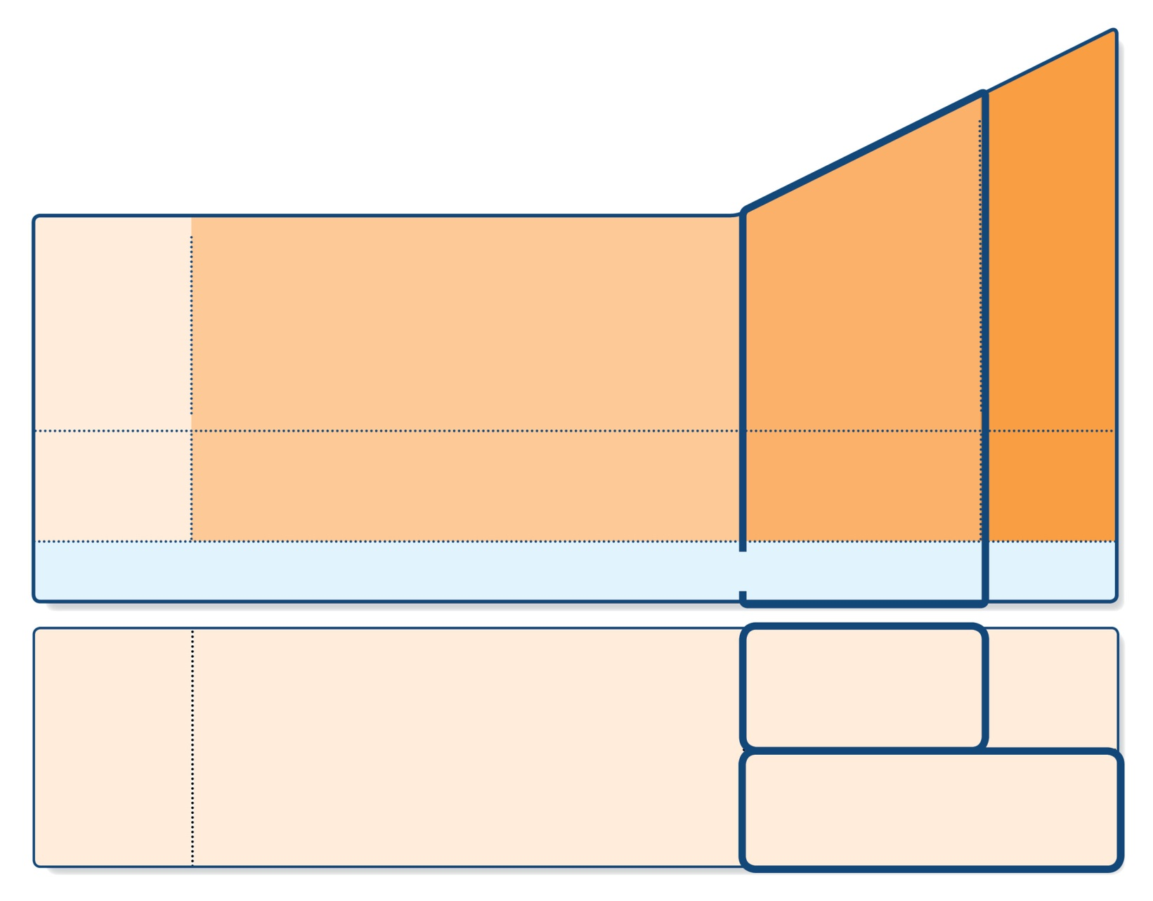
Step 3 (children ≤5 years) – medium dose ICS + as-needed inhaled SABA
STEP 4
PREFERRED CONTROLLER CHOICE
STEP 3
STEP 1
STEP 2
Continue controller & refer for specialist assessment
Double ‘low dose’ ICS
Daily low dose ICS
Other controller options
Leukotriene receptor antagonist (LTRA)
Intermittent ICS
Low dose ICS + LTRA
Add LTRA
Inc. ICS frequency
Add intermitt ICS
As-needed short-acting beta₂-agonist (all children)
RELIEVER
CONSIDER THIS STEP FOR CHILDREN WITH:
Infrequent viral wheezing and no or few interval symptoms
Symptom pattern consistent with asthma and asthma symptoms not well-controlled, or ≥3 exacerbations per year
Symptom pattern not consistent with asthma but wheezing episodes occur frequently, e.g. every 6–8 weeks. Give diagnostic trial for 3 months.
Asthma diagnosis, and not well-controlled on low dose ICS
Not well-controlled on double ICS
First check diagnosis, inhaler skills, adherence, exposures
GINA 2017, Box 6-5 (7/8)

Slide 159
Step 3 (children ≤5 years) – medium dose ICS + as-needed inhaled SABA
Indication
Asthma diagnosis, and symptoms not well-controlled on low dose ICS
First check symptoms are due to asthma, and check adherence, inhaler technique and environmental exposures
Preferred option: medium dose ICS with as-needed inhaled SABA
Review response after 3 months
Other options
Consider adding LTRA to low dose ICS (based on data from older children)
GINA 2017

Slide 160
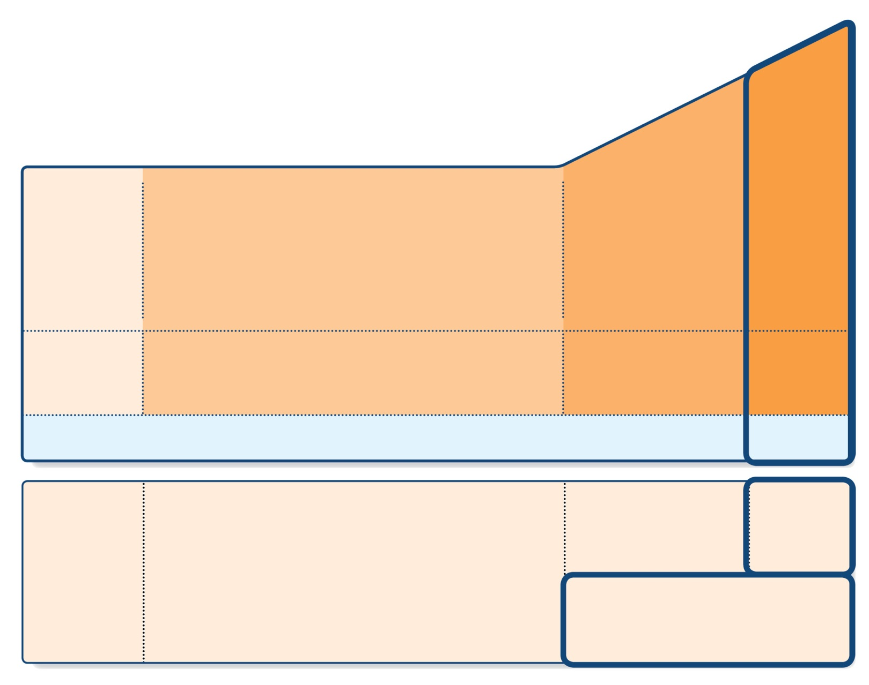
Step 4 (children ≤5 years) – refer for expert assessment
STEP 4
PREFERRED CONTROLLER CHOICE
STEP 3
STEP 1
STEP 2
Continue controller & refer for specialist assessment
Double ‘low dose’ ICS
Daily low dose ICS
Other controller options
Leukotriene receptor antagonist (LTRA)
Intermittent ICS
Low dose ICS + LTRA
Add LTRA
Inc. ICS frequency
Add intermitt ICS
As-needed short-acting beta₂-agonist (all children)
RELIEVER
CONSIDER THIS STEP FOR CHILDREN WITH:
Infrequent viral wheezing and no or few interval symptoms
Symptom pattern consistent with asthma and asthma symptoms not well-controlled, or ≥3 exacerbations per year
Symptom pattern not consistent with asthma but wheezing episodes occur frequently, e.g. every 6–8 weeks. Give diagnostic trial for 3 months.
Asthma diagnosis, and not well-controlled on low dose ICS
Not well-controlled on double ICS
First check diagnosis, inhaler skills, adherence, exposures
GINA 2017, Box 6-5 (8/8)

Slide 161
Step 4 (children ≤5 years) – refer for expert assessment
Indication
Asthma diagnosis, and symptoms not well-controlled on medium dose ICS
First check symptoms are due to asthma, and check adherence, inhaler technique and environmental exposures
Preferred option: continue controller treatment and refer for expert assessment
Other options (preferably with specialist advice)
Higher dose ICS and/or more frequent dosing (for a few weeks)
Add LTRA, theophylline or low dose OCS (for a few weeks only)
Add intermittent ICS to regular daily ICS if exacerbations are the main problem
ICS/LABA not recommended in this age group
GINA 2017

Slide 162
‘Low dose’ inhaled corticosteroids (mcg/day) for children ≤5 years
Inhaled corticosteroid | Low daily dose (mcg)
Beclometasone dipropionate (HFA) | 100
Budesonide (pMDI + spacer) | 200
Budesonide (nebulizer) | 500
Fluticasone propionate (HFA) | 100
Ciclesonide | 160
Mometasone furoate | Not studied below age 4 years
Triamcinolone acetonide | Not studied in this age group
This is not a table of equivalence
A low daily dose is defined as the dose that has not been associated with clinically adverse effects in trials that included measures of safety
GINA 2017, Box 6-6
GINA 2017, Box 6-6

Slide 163
Choosing an inhaler device for children ≤5 years
Age | Preferred device | Alternate device
0–3 years | Pressurized metered dose inhaler plus dedicated spacer with face mask | Nebulizer with face mask
4–5 years | Pressurized metered dose inhaler plus dedicated spacer with mouthpiece | Pressurized metered dose inhaler plus dedicated spacer with face mask, or nebulizer with mouthpiece or face mask
GINA 2017, Box 6-6
GINA 2017, Box 6-7

Slide 164
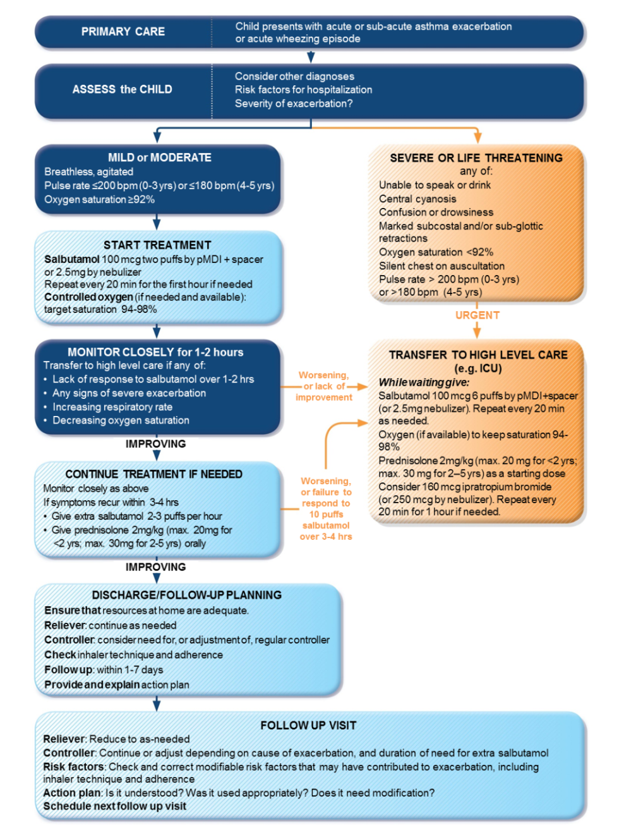
Primary care management of acute asthma or wheezing in pre-schoolers
GINA 2017, Box 6-8 (1/3)

Slide 165
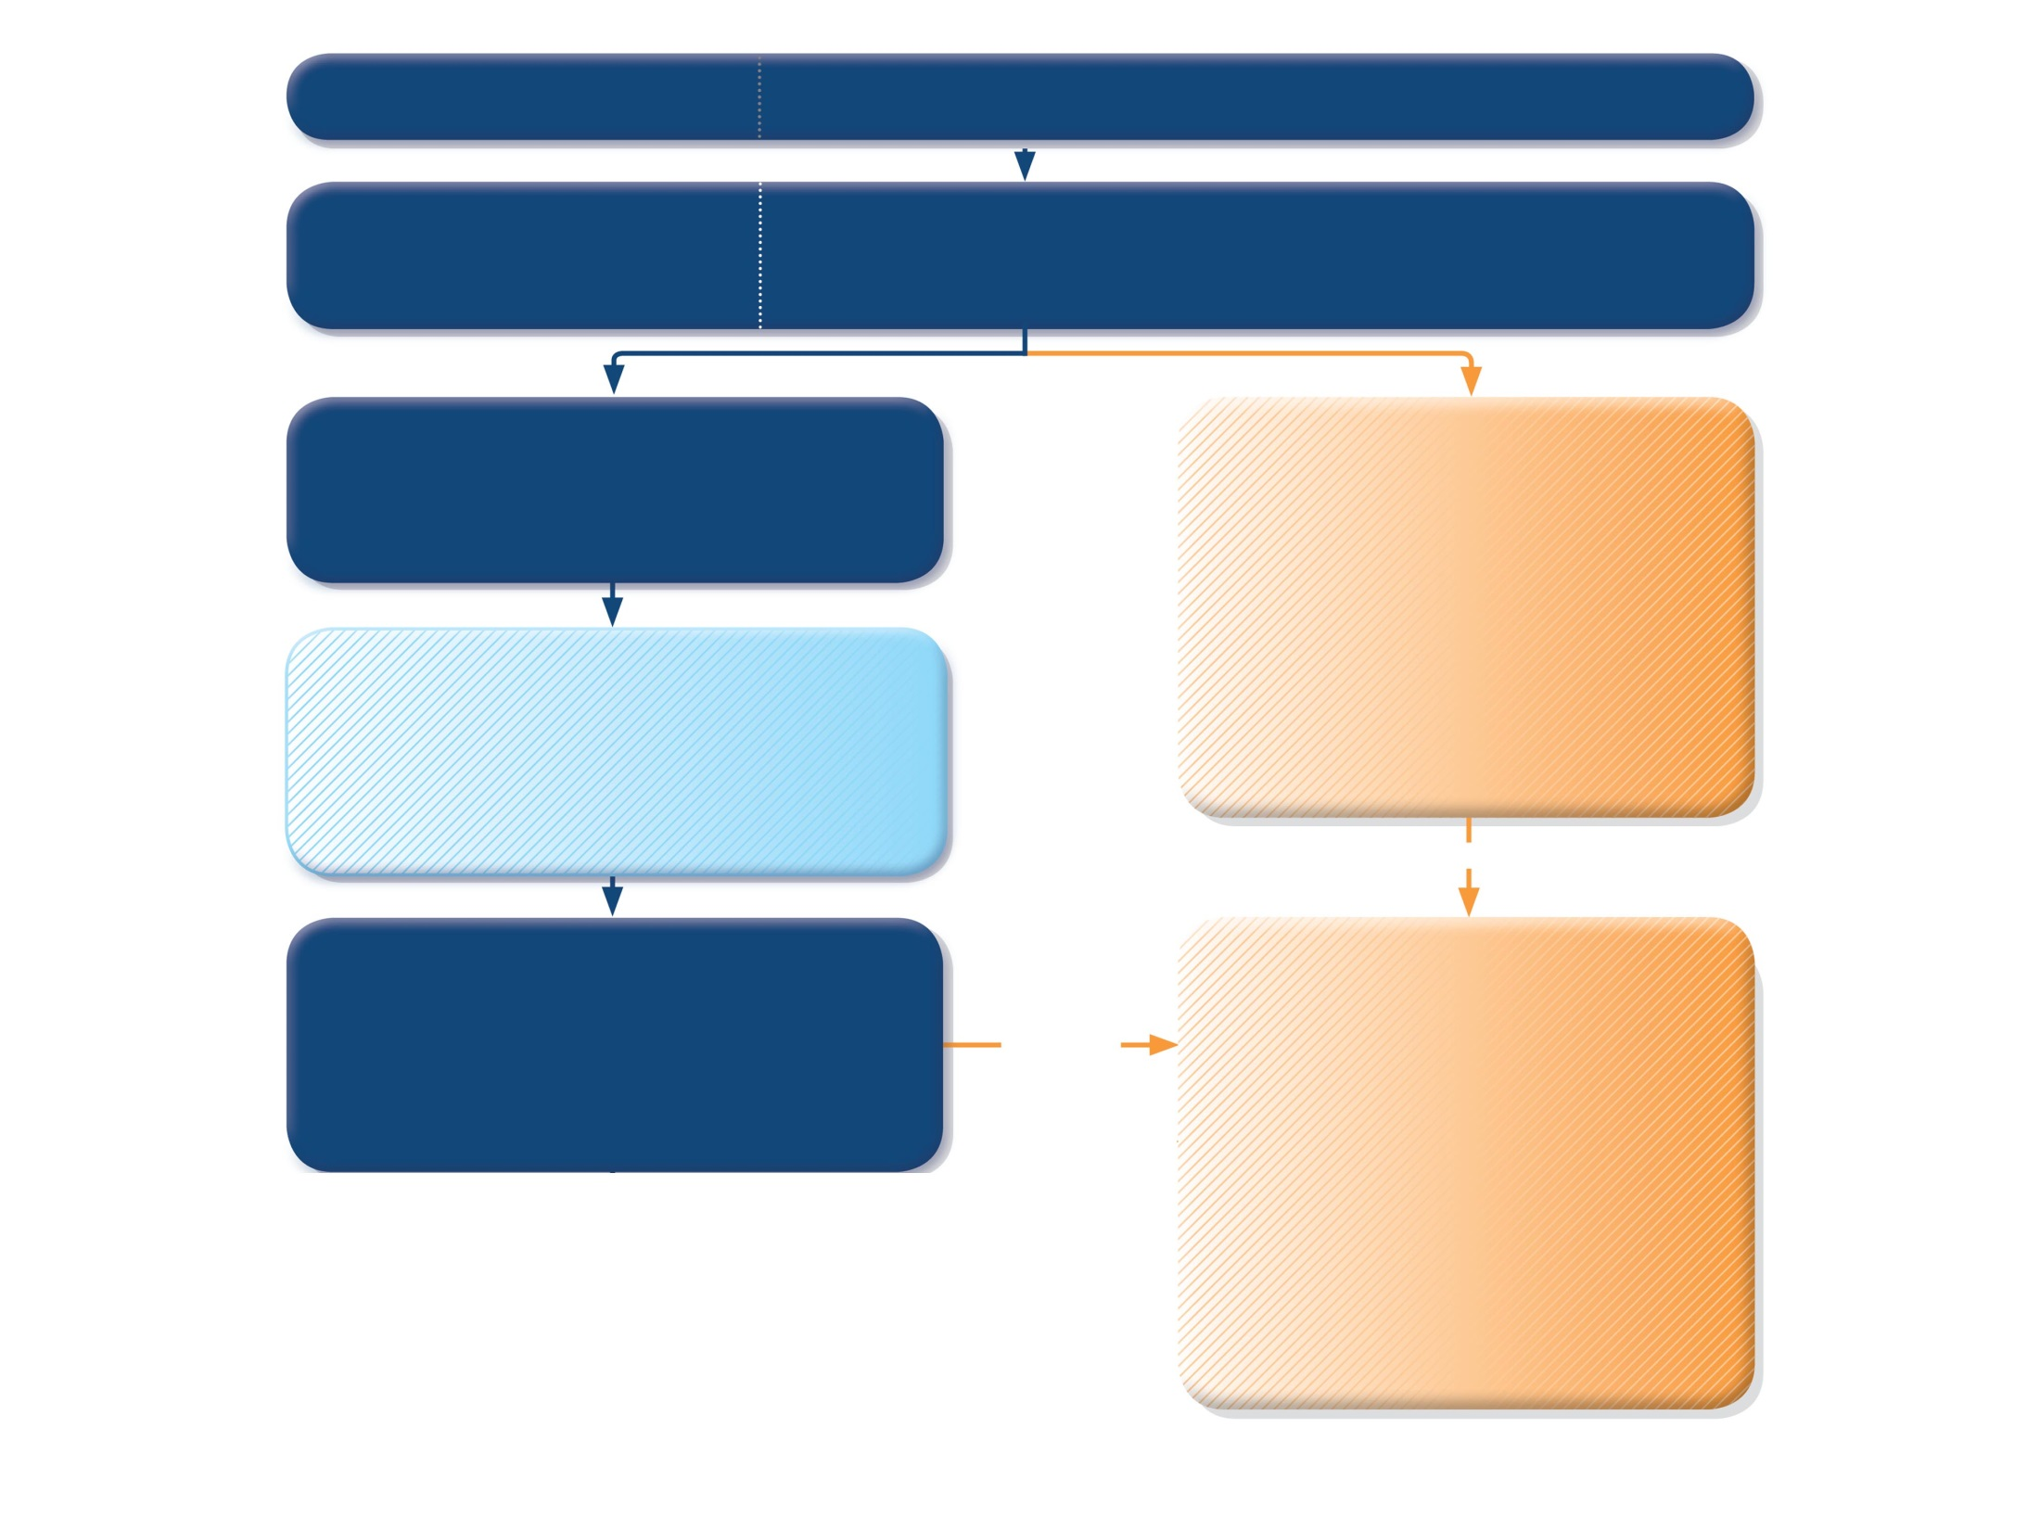
PRIMARY CARE
Child presents with acute or sub-acute asthma exacerbation or acute wheezing episode
ASSESS the CHILD
Consider other diagnoses
Risk factors for hospitalization
Severity of exacerbation?
MILD or MODERATE
Breathless, agitated
Pulse rate ≤200 bpm (0-3 yrs) or ≤180 bpm (4-5 yrs)
Oxygen saturation ≥92%
SEVERE OR LIFE THREATENING
any of:
Unable to speak or drink
Central cyanosis
Confusion or drowsiness
Marked subcostal and/or sub-glottic retractions
Oxygen saturation <92%
Silent chest on auscultation
Pulse rate > 200 bpm (0-3 yrs) or >180 bpm (4-5 yrs)
START TREATMENT
Salbutamol 100 mcg two puffs by pMDI + spacer or 2.5mg by nebulizer
Repeat every 20 min for the first hour if needed
Controlled oxygen (if needed and available): target saturation 94-98%
URGENT
MONITOR CLOSELY for 1-2 hours
Transfer to high level care if any of:
• Lack of response to salbutamol over 1-2 hrs
• Any signs of severe exacerbation
• Increasing respiratory rate
• Decreasing oxygen saturation
TRANSFER TO HIGH LEVEL CARE (e.g. ICU)
While waiting give:
Salbutamol 100 mcg 6 puffs by pMDI+spacer (or 2.5mg nebulizer). Repeat every 20 min as needed.
Oxygen (if available) to keep saturation 94-98%
Prednisolone 2mg/kg (max. 20 mg for <2 yrs; max. 30 mg for 2–5 yrs) as a starting dose
Consider 160 mcg ipratropium bromide (or 250 mcg by nebulizer). Repeat every 20 min for 1 hour if needed.
Worsening, or lack of improvement
GINA 2017, Box 6-8 (2/3)

Slide 166
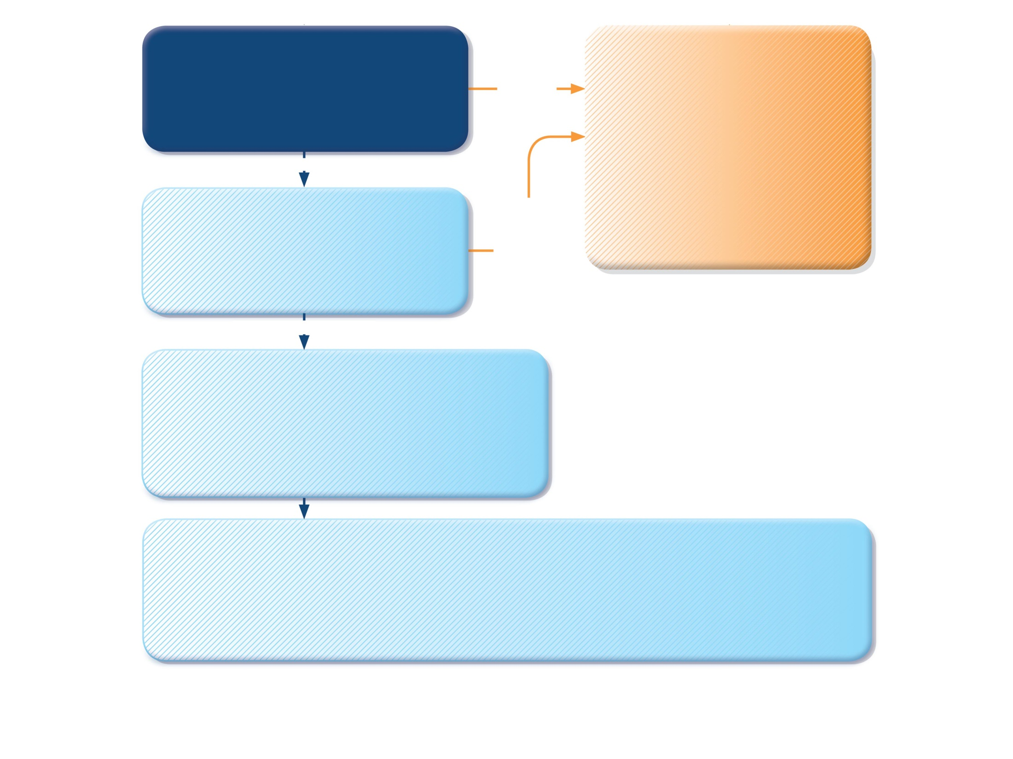
MONITOR CLOSELY for 1-2 hours
Transfer to high level care if any of:
• Lack of response to salbutamol over 1-2 hrs
• Any signs of severe exacerbation
• Increasing respiratory rate
• Decreasing oxygen saturation
TRANSFER TO HIGH LEVEL CARE (e.g. ICU)
While waiting give:
Salbutamol 100 mcg 6 puffs by pMDI+spacer (or 2.5mg nebulizer). Repeat every 20 min as needed.
Oxygen (if available) to keep saturation 94-98%
Prednisolone 2mg/kg (max. 20 mg for <2 yrs; max. 30 mg for 2–5 yrs) as a starting dose
Consider 160 mcg ipratropium bromide (or 250 mcg by nebulizer). Repeat every 20 min for 1 hour if needed.
Worsening, or lack of improvement
IMPROVING
CONTINUE TREATMENT IF NEEDED
Monitor closely as above
If symptoms recur within 3-4 hrs
• Give extra salbutamol 2-3 puffs per hour
• Give prednisolone 2mg/kg (max. 20mg for <2 yrs; max. 30mg for 2-5 yrs) orally
Worsening, or failure to respond to 10 puffs salbutamol over 3-4 hrs
IMPROVING
DISCHARGE/FOLLOW-UP PLANNING
Ensure that resources at home are adequate.
Reliever: continue as needed
Controller: consider need for, or adjustment of, regular controller
Check inhaler technique and adherence
Follow up: within 1-7 days
Provide and explain action plan
FOLLOW UP VISIT
Reliever: Reduce to as-needed
Controller: Continue or adjust depending on cause of exacerbation, and duration of need for extra salbutamol
Risk factors: Check and correct modifiable risk factors that may have contributed to exacerbation, including inhaler technique and adherence
Action plan: Is it understood? Was it used appropriately? Does it need modification?
Schedule next follow up visit
GINA 2017, Box 6-8 (3/3)

Slide 167
Initial assessment of acute asthma exacerbations in children ≤5 years
Symptoms | Mild | Severe*
Altered consciousness | No | Agitated, confused or drowsy
Oximetry on presentation (SaO₂)** | >95% | <92%
Speech† | Sentences | Words
Pulse rate | <100 beats/min | >200 beats/min (0–3 years) >180 beats/min (4–5 years)
Central cyanosis | Absent | Likely to be present
Wheeze intensity | Variable | Chest may be quiet
*Any of these features indicates a severe exacerbation
**Oximetry before treatment with oxygen or bronchodilator
† Take into account the child’s normal developmental capability
GINA 2017, Box 6-9

Slide 168
Indications for immediate transfer to hospital for children ≤5 years
Transfer immediately to hospital if ANY of the following are present:
Features of severe exacerbation at initial or subsequent assessment Child is unable to speak or drink Cyanosis Subcostal retraction Oxygen saturation <92% when breathing room air Silent chest on auscultation
Lack of response to initial bronchodilator treatment Lack of response to 6 puffs of inhaled SABA (2 separate puffs, repeated 3 times) over 1-2 hours Persisting tachypnea* despite 3 administrations of inhaled SABA, even if the child shows other clinical signs of improvement
Unable to be managed at home Social environment that impairs delivery of acute treatment Parent/carer unable to manage child at home
*Normal respiratory rates (breaths/minute): 0-2 months: <60; 2-12 months: <50; 1-5 yrs: <40
GINA 2017, Box 6-10

Slide 169
Initial management of asthma exacerbations in children ≤5 years
Therapy | Dose and administration
Supplemental oxygen | 24% delivered by face mask (usually 1L/min) to maintain oxygen saturation 94-98%
Inhaled SABA | 2–6 puffs of salbutamol by spacer, or 2.5mg by nebulizer, every 20 min for first hour, then reassess severity. If symptoms persist or recur, give an additional 2-3 puffs per hour. Admit to hospital if >10 puffs required in 3-4 hours.
Systemic corticosteroids | Give initial dose of oral prednisolone (1-2mg/kg up to maximum of 20mg for children <2 years; 30 mg for 2-5 years)
GINA 2017, Box 6-11 (1/2)

Slide 170
Initial management of asthma exacerbations in children ≤5 years
Therapy | Dose and administration
Supplemental oxygen | 24% delivered by face mask (usually 1L/min) to maintain oxygen saturation 94-98%
Inhaled SABA | 2–6 puffs of salbutamol by spacer, or 2.5mg by nebulizer, every 20 min for first hour, then reassess severity. If symptoms persist or recur, give an additional 2-3 puffs per hour. Admit to hospital if >10 puffs required in 3-4 hours.
Systemic corticosteroids | Give initial dose of oral prednisolone (1-2mg/kg up to maximum of 20mg for children <2 years; 30 mg for 2-5 years)
Additional options in the first hour of treatment
Ipratropium bromide |  | For moderate/severe exacerbations, give 2 puffs of ipratropium bromide 80mcg (or 250mcg by nebulizer) every 20 minutes for one hour only
Magnesium sulfate |  | Consider nebulized isotonic MgSO₄ (150mg) 3 doses in first hour for children ≥2 years with severe exacerbation
GINA 2017, Box 6-11 (2/2)

Slide 171
Primary prevention of asthma
GINA 2017

Slide 172
Primary prevention of asthma
The development and persistence of asthma are driven by gene-environment interactions
For children, a ‘window of opportunity’ exists in utero and in early life, but intervention studies are limited
For intervention strategies including allergen avoidance
Strategies directed at a single allergen have not been effective
Multifaceted strategies may be effective, but the essential components have not been identified
Current recommendations are
Avoid exposure to tobacco smoke in pregnancy and early life
Encourage vaginal delivery
Advise breast-feeding for its general health benefits
Where possible, avoid use of paracetamol (acetaminophen) and broad-spectrum antibiotics in the first year of life
GINA 2017, Box 7-1

Slide 173
Implementing asthma management strategies into health systems

Slide 174
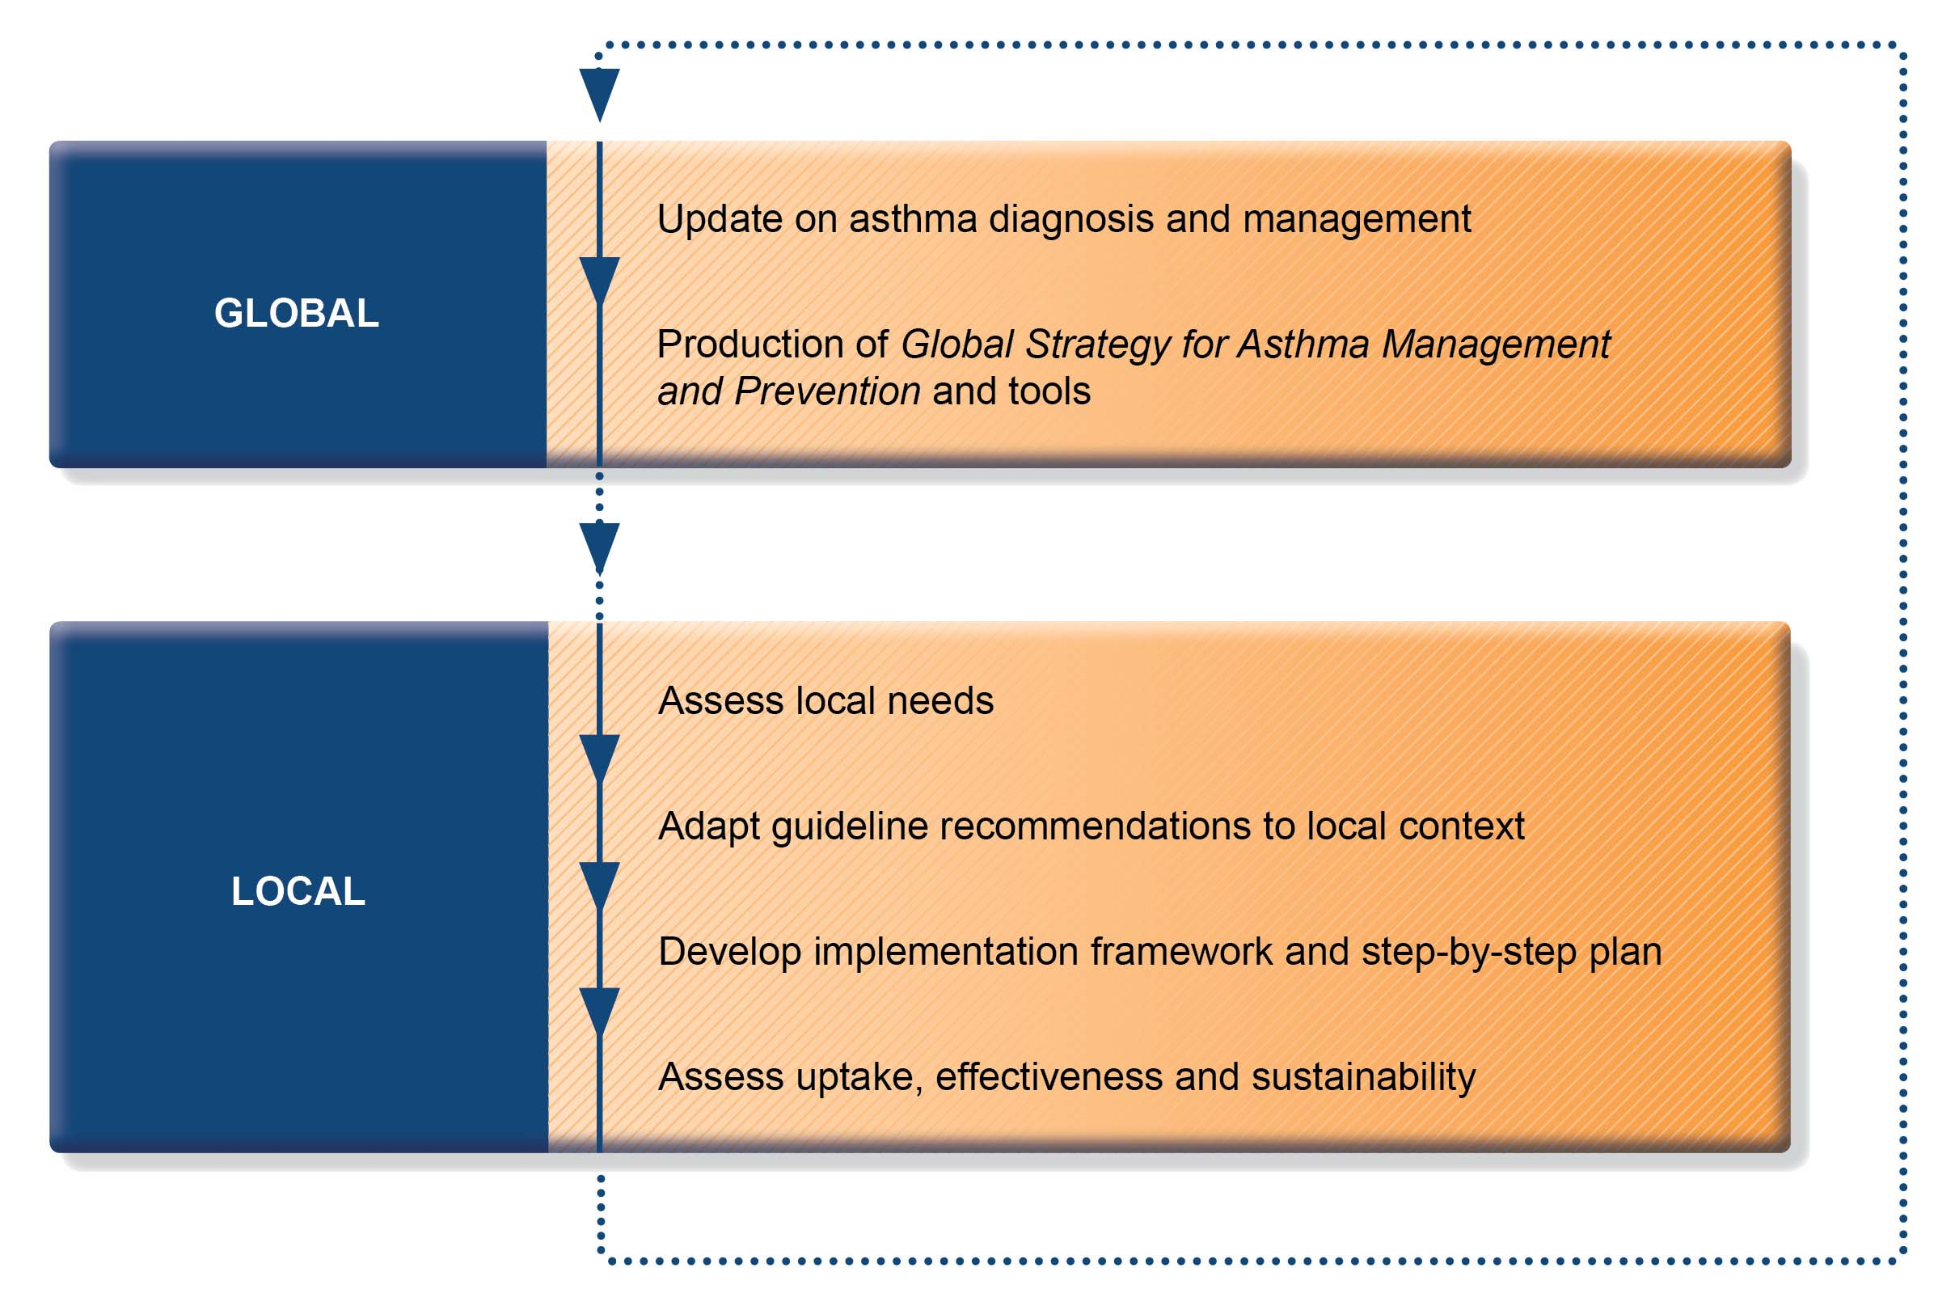
Approach to implementation of the Global Strategy for Asthma Management and Prevention
GINA 2017, Box 8-1

Slide 175
Essential elements to implement a health-related strategy
Develop a multidisciplinary working group
Assess current status of asthma care delivery, care gaps, needs
Prepare materials for implementation
Choose materials, agree on main goals, identify key recommendations, adapt to local context
Identify barriers to, and facilitators for, implementation
Develop a step-by-step implementation plan
Select target population and evaluable outcomes
Identify local resources to support implementation
Set timelines
Distribute tasks to members
Evaluate outcomes
Continuously review progress, modify strategy if needed
GINA 2017, Box 8-2

Slide 176
Examples of barriers to implementation
Health care providers
Insufficient knowledge of recommendations
Lack of agreement with or confidence in recommendations
Resistance to change
External barriers (organizational, policies, cost)
Lack of time and resources
Medico-legal issues
Patients
Low health literacy
Insufficient understanding of asthma and its management
Lack of agreement with recommendations
Cultural and economic barriers
Peer influence
Attitudes, beliefs, preferences, fears and misconceptions
GINA 2017, Box 8-3

Slide 177
Examples of high-impact interventions in asthma management
Free ICS for patients with a recent hospital admission and/or severe asthma (Brazil)
Early treatment with ICS, guided self-management, reduction in exposure to tobacco smoke, improved access to asthma education (Finnish asthma program)
Self-inking stamp prompting assessment of asthma control and treatment strategies (Canadian primary care)
Use of individualized written asthma action plans as part of self-management education (Cochrane review, 2004)
An evidence-based care process model for acute and chronic pediatric asthma management, implemented at multiple hospitals (USA)
GINA 2017, Box 8-4

Slide 178
www.ginasthma.org
GINA 2017

