Slide 1
Global Initiative for Asthma (GINA)
What’s new in GINA 2017?

Slide 2
‘Asthma-COPD overlap’
The word ‘syndrome’ has been removed from the previous term ‘asthma-COPD overlap syndrome (ACOS)’ because:
  This term was being commonly used in the respiratory community as if it was a single disease (‘the asthma-COPD overlap syndrome’)
  There are two medically-accepted definitions of ‘syndrome’
  This distracted from the key messages for clinicians and regulators
The aim is to focus attention back on the original issues
  These patients are commonly seen in clinical practice
  They are almost always excluded from the RCTs that provide the evidence base for treatment recommendations, and from studies of underlying mechanisms
  Current guidelines have opposite safety-based recommendations
    Asthma: never use LABA without ICS
    COPD: start treatment with LABA and/or LAMA, without ICS
What’s new in GINA 2017?

Slide 3
Asthma-COPD overlap – new ‘Key Points’
Distinguishing asthma from COPD can be problematic, particularly in smokers and older adults. Some patients may have clinical features of both asthma and COPD
The descriptive term asthma-COPD overlap (ACO) is useful to maintain awareness by clinicians, researchers and regulators of the needs of these patients, since most guidelines and clinical trials are about asthma alone or COPD alone.
However, the term asthma-COPD overlap does not describe a single disease entity. Instead, as for asthma and COPD, it likely includes patients with several different forms of airways disease (phenotypes) caused by a range of different underlying mechanisms.
What’s new in GINA 2017?

Slide 4
Asthma-COPD overlap – new ‘Key Points’
Thus, in order to avoid the impression that this is a single disease, the term Asthma COPD Overlap Syndrome (ACOS), used in previous versions of this document, is no longer advised.
This consensus-based description of asthma-COPD overlap is intended to provide interim advice to clinicians, while stimulating further study of the characteristics, underlying mechanisms and treatments for this common clinical problem
What’s new in GINA 2017?

Slide 5
Measurement of lung function - changes
Frequency of measurement of lung function
  “Lung function should be assessed at diagnosis or start of treatment; after 3–6 months of controller treatment to assess the patient’s personal best FEV₁; and periodically thereafter”
‘Periodically’ has been clarified
  Most adults: lung function should be recorded at least every 1-2 yrs
  More frequently in higher risk patients
  More frequently in children based on severity and clinical course
Lung function trajectories
  Children with persistent asthma may have reduced growth in lung function, and some are at risk of accelerated decline in lung function in early adult life [McGeachie, NEJMed 2016]
Low resource areas
  Poverty is commonly associated with spirometric restriction, so where possible, both FEV₁ and FVC should be recorded
What’s new in GINA 2017?

Slide 6
Fraction of exhaled nitric oxide (FENO) - changes
Diagnosis of asthma
  Additional factors that increase or decrease FENO are listed
  FENO is not helpful in ruling in or ruling out asthma as defined by GINA
Assessment of future risk
  Elevated FENO in allergic patients has been added to the list of independent predictors of exacerbations [Zeiger JACI 2011]
Single measurements
  Results of FENO measurement at a single point in time should be interpreted with caution
Controller treatment
  Given the lack of long-term safety studies, FENO cannot be recommended at present for deciding against treatment with ICS in patients with a diagnosis or suspected diagnosis of asthma.
  Based on current evidence, GINA recommends treatment with low-dose ICS for most patients with asthma, even those with infrequent symptoms, to reduce the risk of serious exacerbations.
What’s new in GINA 2017?

Slide 7
Treatment – other changes in 2017
Step 5 treatment for severe asthma
  Anti-IL5: reslizumab (IV) added to mepolizumab (SC) for ≥18 years
Step-down from low-dose ICS (Box 3-7)
  Add-on LTRA may help
  Insufficient evidence for step-down to as-needed ICS with SABA
Side-effects of oral corticosteroids
  When prescribing short-term OCS, remember to advise patients about common side-effects (sleep disturbance, increased appetite, reflux, mood changes); references added
Vitamin D
  To date, no good quality evidence that Vitamin D supplementation leads to improved asthma control or fewer exacerbations
Chronic sinonasal disease
  Treatment with nasal corticosteroids improves sinonasal symptoms but not asthma outcomes
What’s new in GINA 2017?

Slide 8

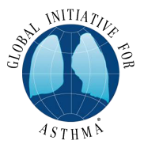
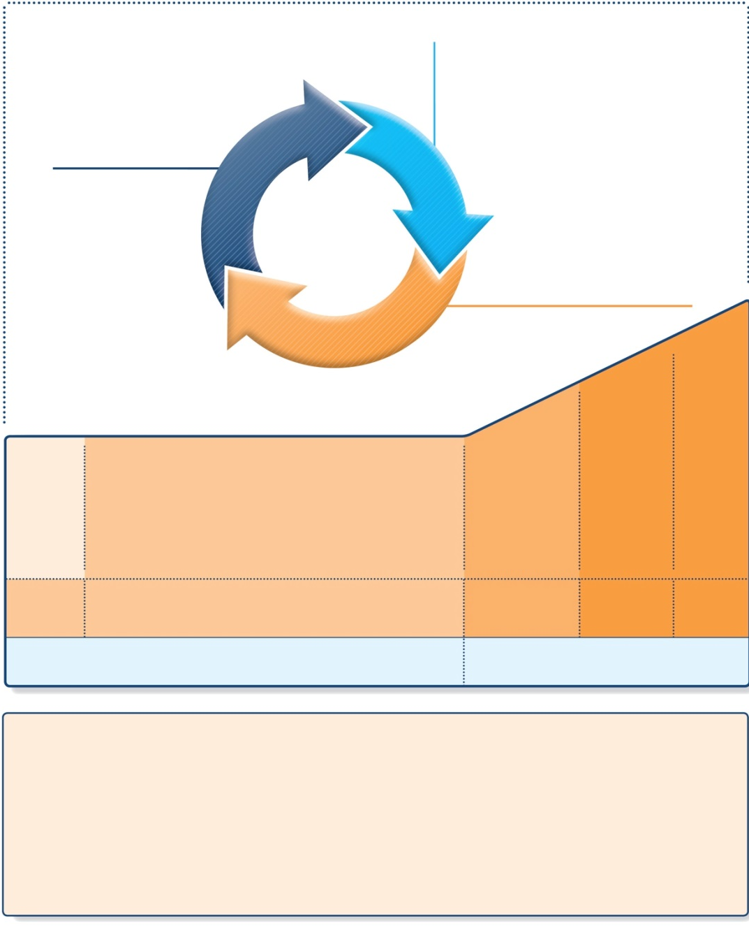
Stepwise approach to control asthma symptoms and reduce risk
Diagnosis
Symptom control & risk factors
(including lung function)
Inhaler technique & adherence
Patient preference
ASSESS
REVIEW RESPONSE
Symptoms
Exacerbations
Side-effects
Patient satisfaction
Lung function
ADJUST TREATMENT
Asthma medications
Non-pharmacological strategies
Treat modifiable risk factors
STEP 5
STEP 4
PREFERRED
CONTROLLER
CHOICE
STEP 1
STEP 2
STEP 3
Refer for add-on treatment
e.g.
tiotropium,*
anti-IgE,
anti-IL5*
Med/high
ICS/LABA
Low dose ICS
Low dose
ICS/LABA**
Other
controller
options
Consider low dose ICS
Leukotriene receptor antagonists (LTRA)
Low dose theophylline*
Med/high dose ICS
Low dose ICS+LTRA
(or + theoph*)
Add tiotropium*
High dose ICS
+ LTRA
(or + theoph*)
Add low dose
OCS
RELIEVER
As-needed short-acting beta₂-agonist (SABA)
As-needed SABA or
low dose ICS/formoterol#
REMEMBER
TO...
• Provide guided self-management education (self-monitoring + written action plan + regular review)
• Treat modifiable risk factors and comorbidities, e.g. smoking, obesity, anxiety
• Advise about non-pharmacological therapies and strategies, e.g. physical activity, weight loss, avoidance of sensitizers where appropriate
• Consider stepping up if … uncontrolled symptoms, exacerbations or risks, but check diagnosis, inhaler
technique and adherence first
• Consider adding SLIT in adult HDM-sensitive patients with allergic rhinitis who have exacerbations despite ICS treatment, provided FEV1 is >70% predicted
• Consider stepping down if … symptoms controlled for 3 months + low risk for exacerbations.
Ceasing ICS is not advised.
SLIT added as an option
GINA 2017, Box 3-5 (1/8)
© Global Initiative for Asthma

Slide 9

Stepwise management, SLIT as an add-on option for some patients
• Provide guided self-management education
• Treat modifiable risk factors and comorbidities
• Advise about non-pharmacological therapies and strategies
• Consider stepping up if … uncontrolled symptoms, exacerbations or risks,
but check diagnosis, inhaler technique and adherence first
• Consider adding SLIT in adult HDM-sensitive patients with allergic rhinitis who have exacerbations despite ICS treatment, provided FEV₁ is 70% predicted
• Consider stepping down if … symptoms controlled for 3 months
+ low risk for exacerbations. Ceasing ICS is not advised.
REMEMBER
TO...
SLIT: sublingual immunotherapy
GINA 2017, Box 3-5 (3/8) (lower part)

Slide 10
ICS and growth in children
This topic previously covered in detail in the online Appendix
  Information now also added to main report for accessibility
Ch 2, assessment of future risk in children 6-11 yrs
  Recommended to check height at least yearly
  The reason has been added: “…as poorly-controlled asthma can affect growth [Pedersen 2001], and growth velocity may be lower in the first 1-2 years of ICS treatment [Loke, 2015].”
Ch 6, assessment of future risk in children ≤5 yrs
  Extra text as above
  Advice also added about factors that should be considered if decreased growth velocity is seen (e.g. poorly-controlled asthma, frequent use of OCS, and poor nutrition). Consider referral
What’s new in GINA 2017?

Slide 11
ICS and growth in children
Ch 6, choice of controller treatment, children ≤5 yrs
  Discuss decisions about controller treatment with parents or carers
    Relative benefits and risks of treatments
    Importance of maintaining normal activity levels for normal physical and social development
  Although effects of ICS on growth velocity are seen in pre-pubertal children in the first 1-2 years of treatment, this is not progressive or cumulative [Kelly 2012, Loke 2015].
  The one study that examined long-term outcomes showed a difference of only 0.7% in adult height [Kelly 2012, Loke 2015]
  Poorly-controlled asthma itself adversely affects adult height [Pedersen 2001]
  For more detail see Appendix Chapter 5B.
What’s new in GINA 2017?

Slide 12
Other changes
Cough in infancy
  Prolonged cough in infancy, and cough without cold symptoms, are associated with later parent-reported physician-diagnosed asthma, independent of infant wheeze [Oren 2015]
Primary prevention of asthma
  No consistent effects of maternal dietary intake of fish or long-chain polyunsaturated fatty acids during pregnancy on the risk of wheeze, asthma or atopy in the child (based on RCTs and epidemiological studies) [Best, 2016]
Effective implementation studies
  Update of adherence strategies effective in real-life settings
  Examples of high impact interventions (from appendix)
What’s new in GINA 2017?

