Slide 1
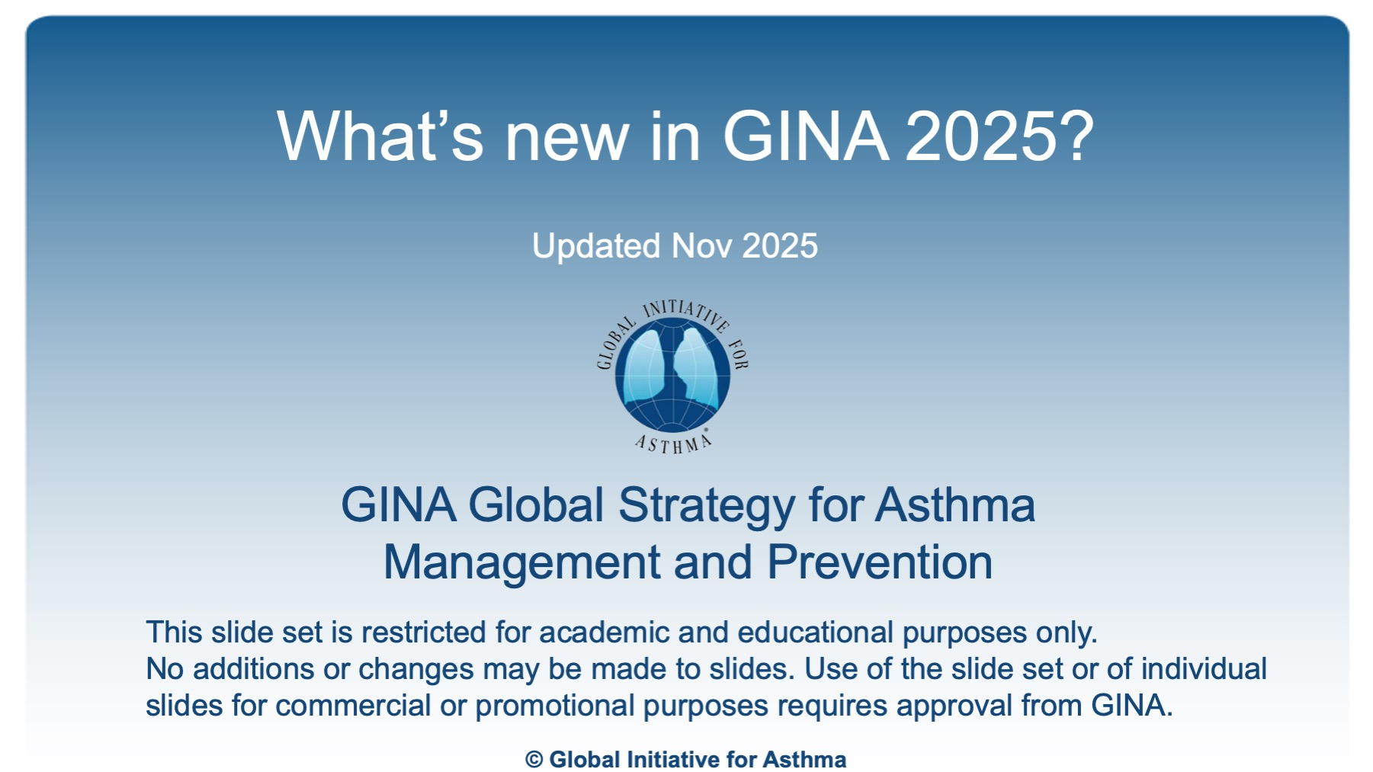
What’s new in GINA 2025?
Updated Nov 2025
Notes:
See speaker notes for details of minor updates in November 2025

Slide 2
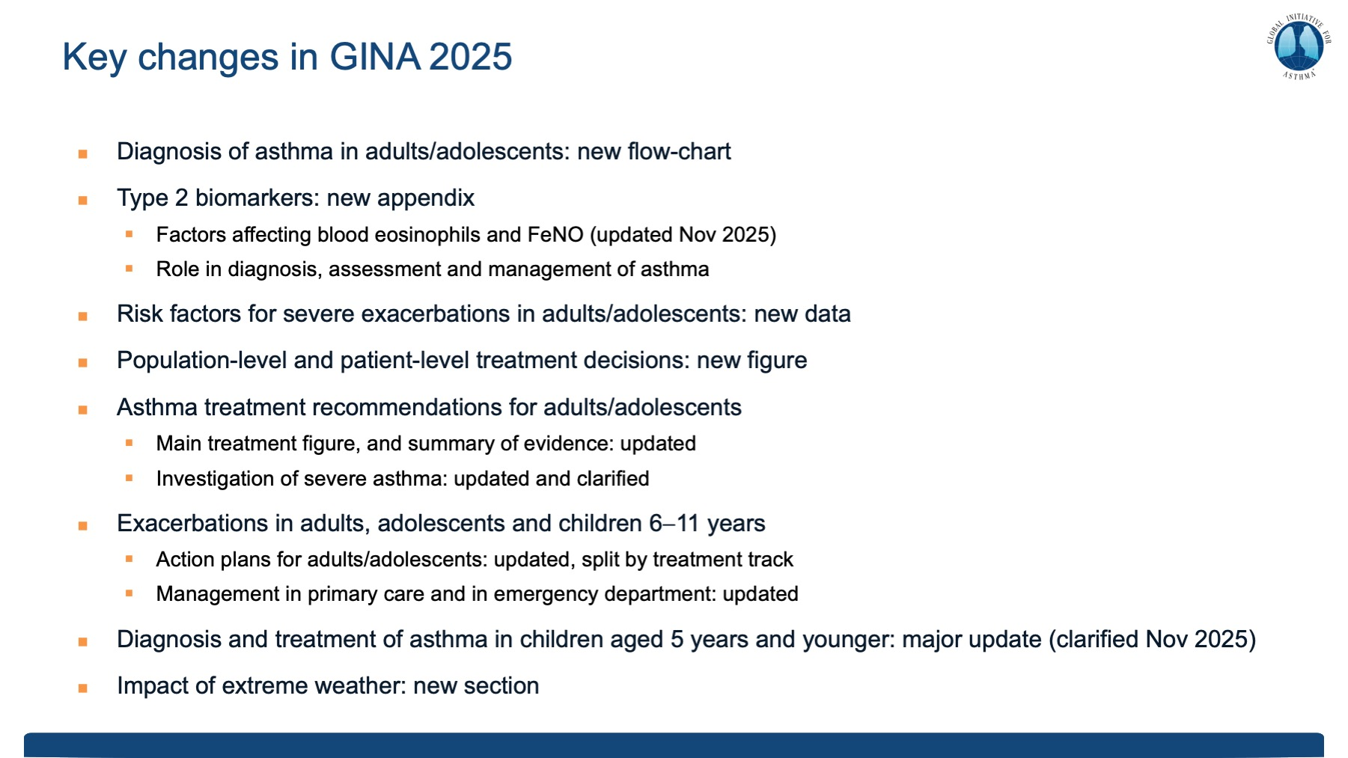

Slide 3
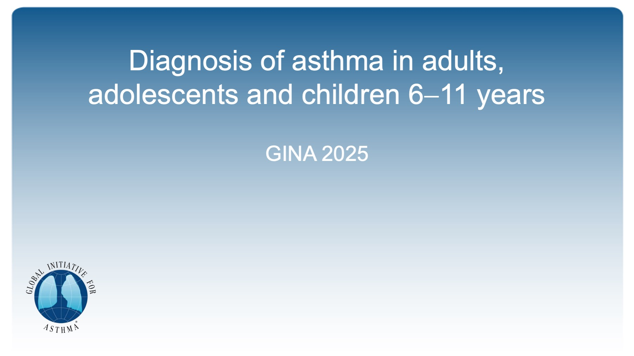
Diagnosis of asthma in adults, adolescents and children 6−11 years

Slide 4
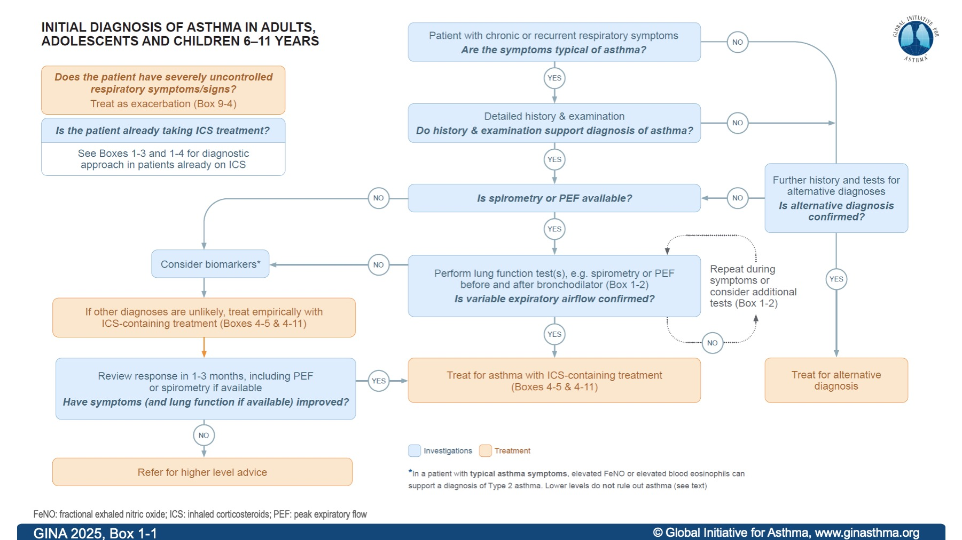
GINA 2025, Box 1-1

Slide 5
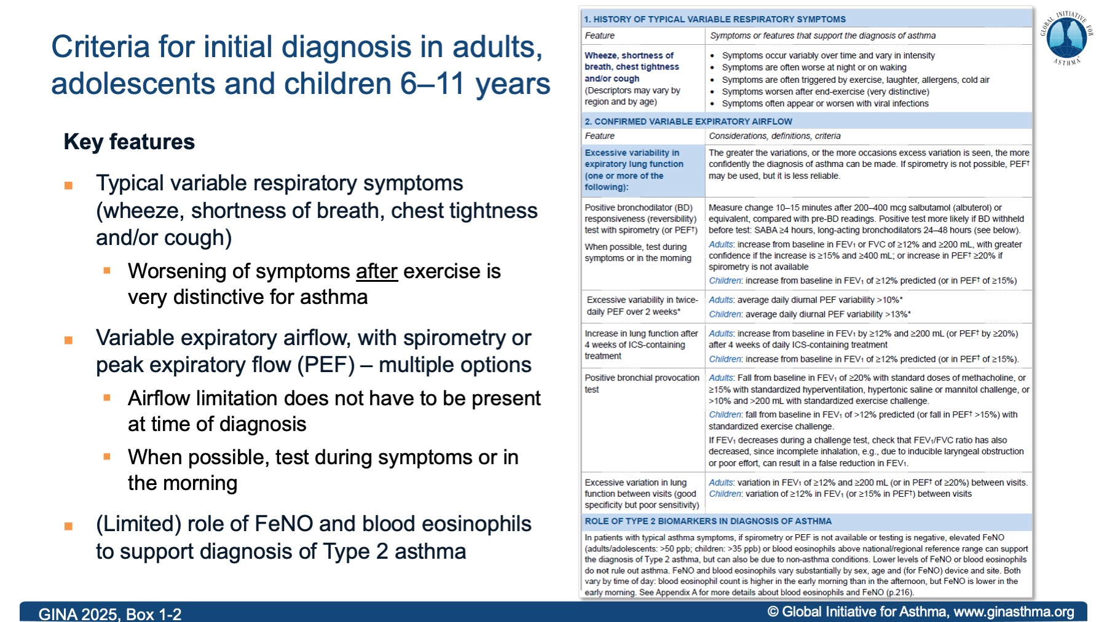
GINA 2025, Box 1-2
Notes:
November 2025: Box 1-2 updated (see slide 13 for detail of change)

Slide 6
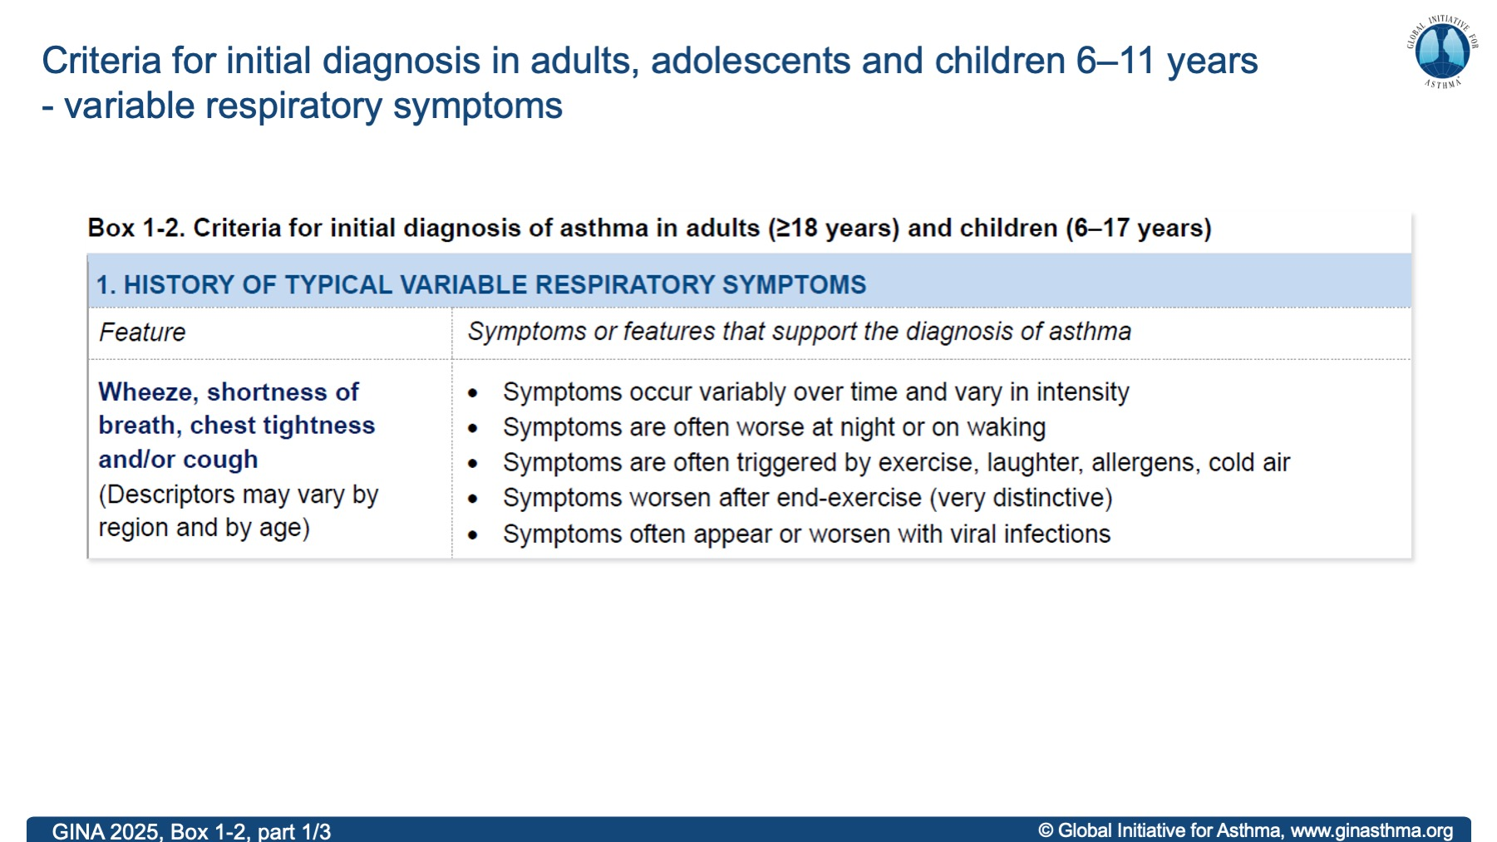
GINA 2025, Box 1-2, part 1/3

Slide 7
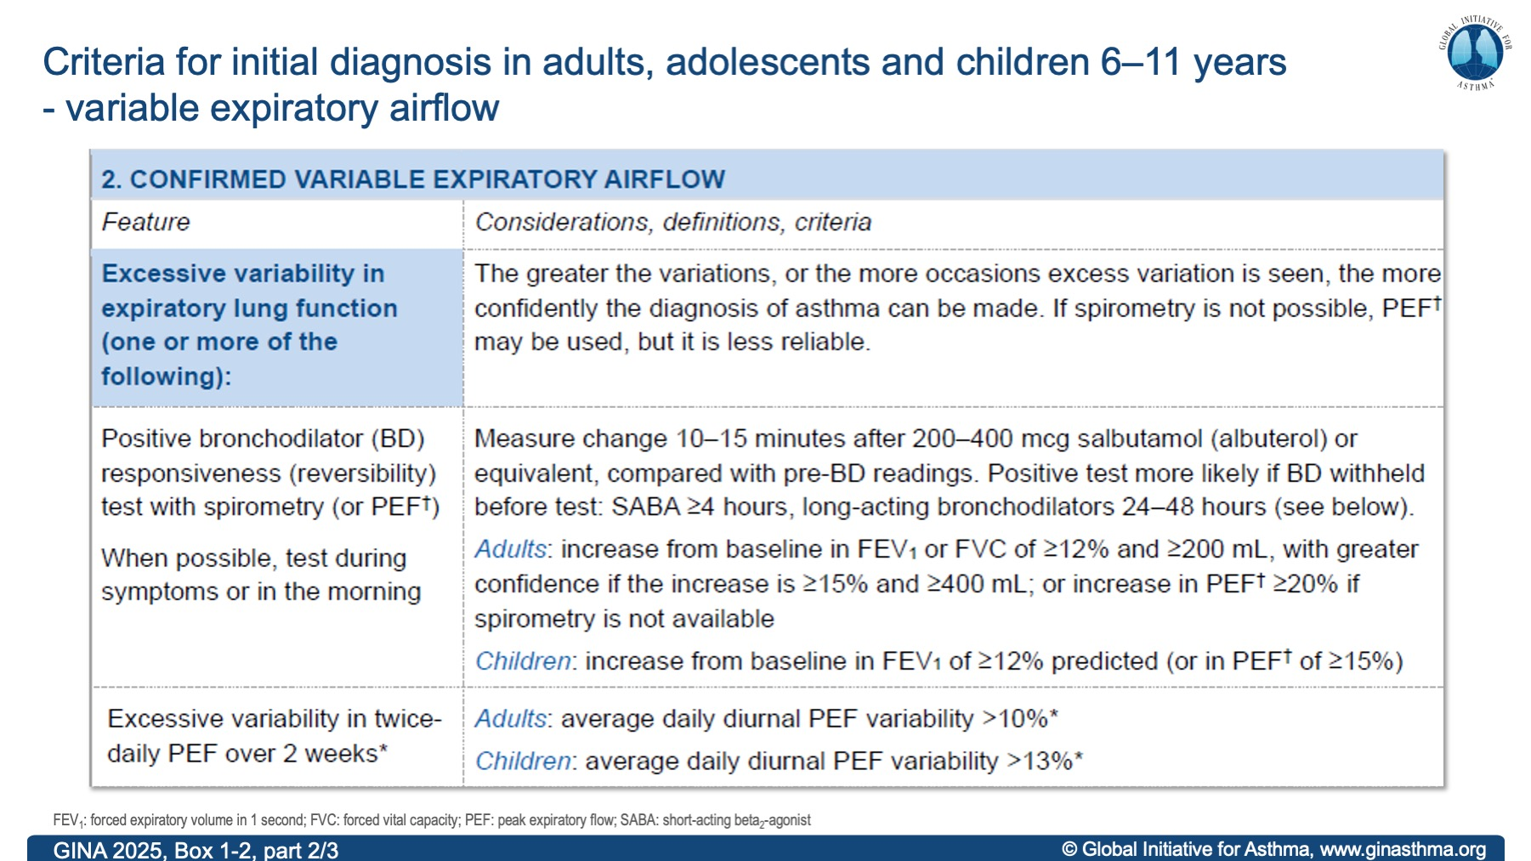
GINA 2025, Box 1-2, part 2/3

Slide 8
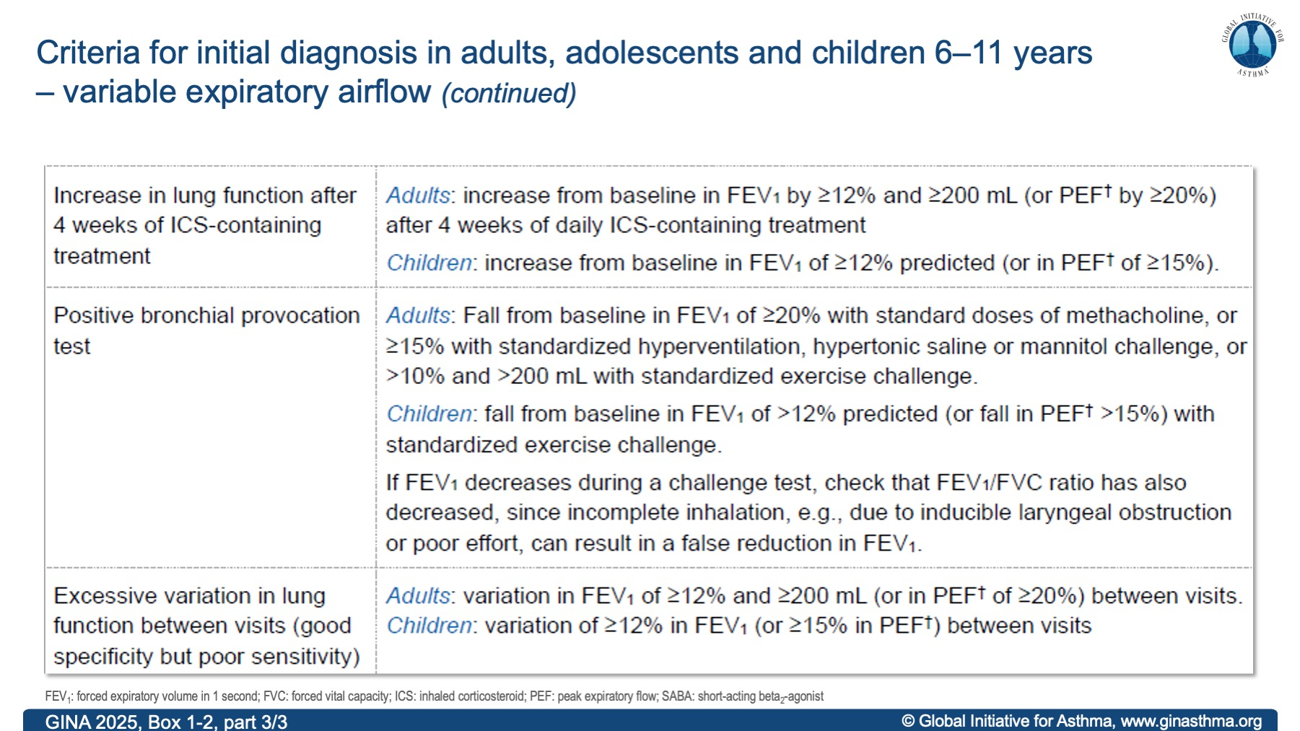
GINA 2025, Box 1-2, part 3/3

Slide 9
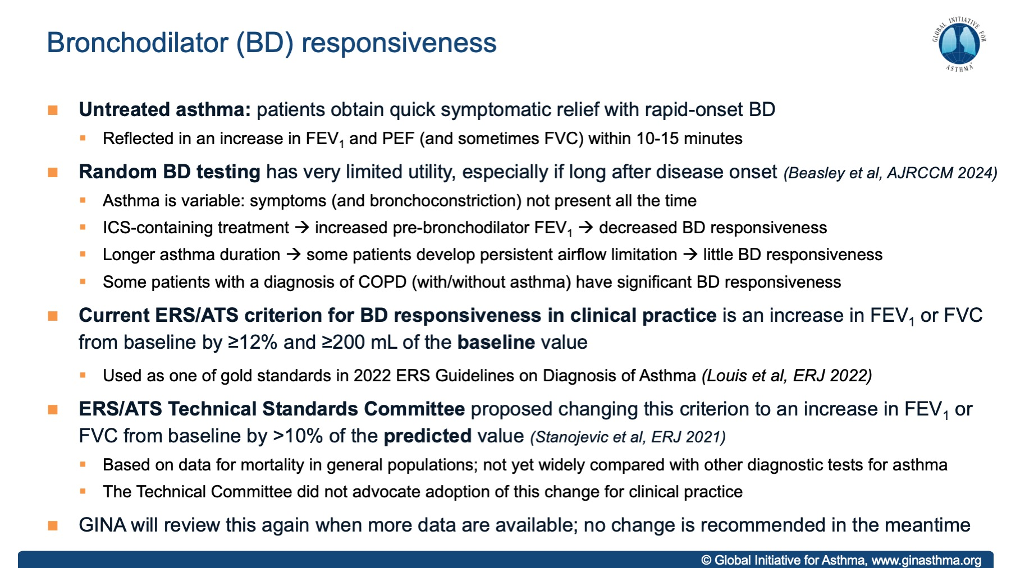
Notes:
November 2025: this slide has been added from the GINA 2024 slide set, as there may be ongoing questions about these criteria.

Slide 10
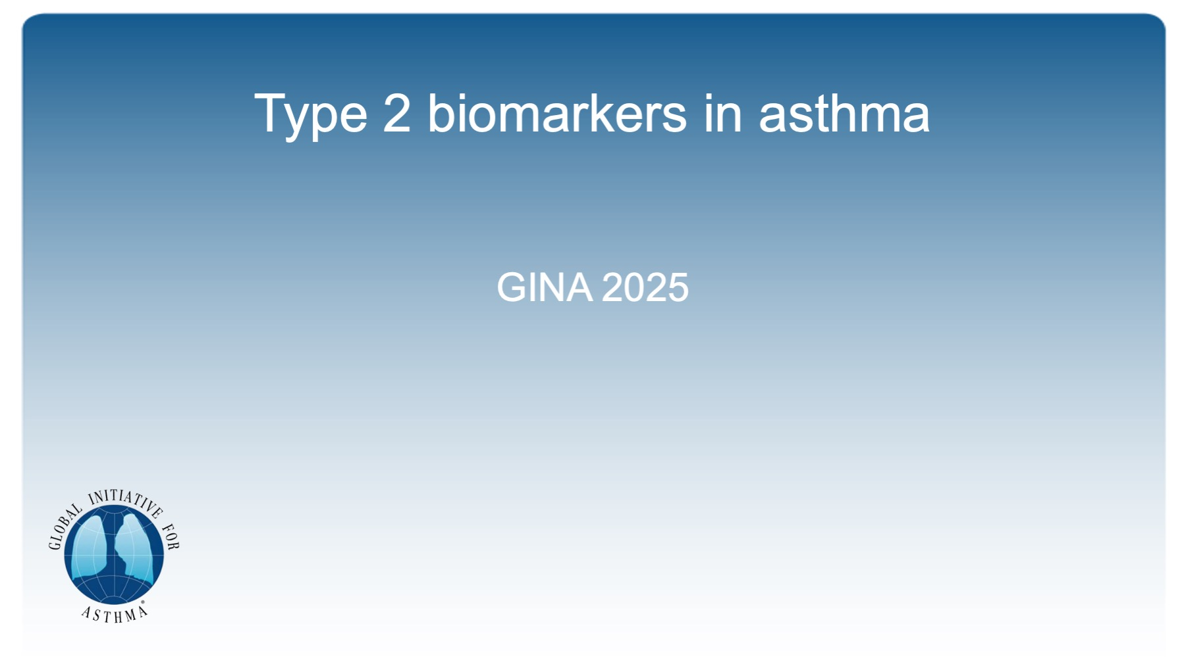
Type 2 biomarkers in asthma

Slide 11
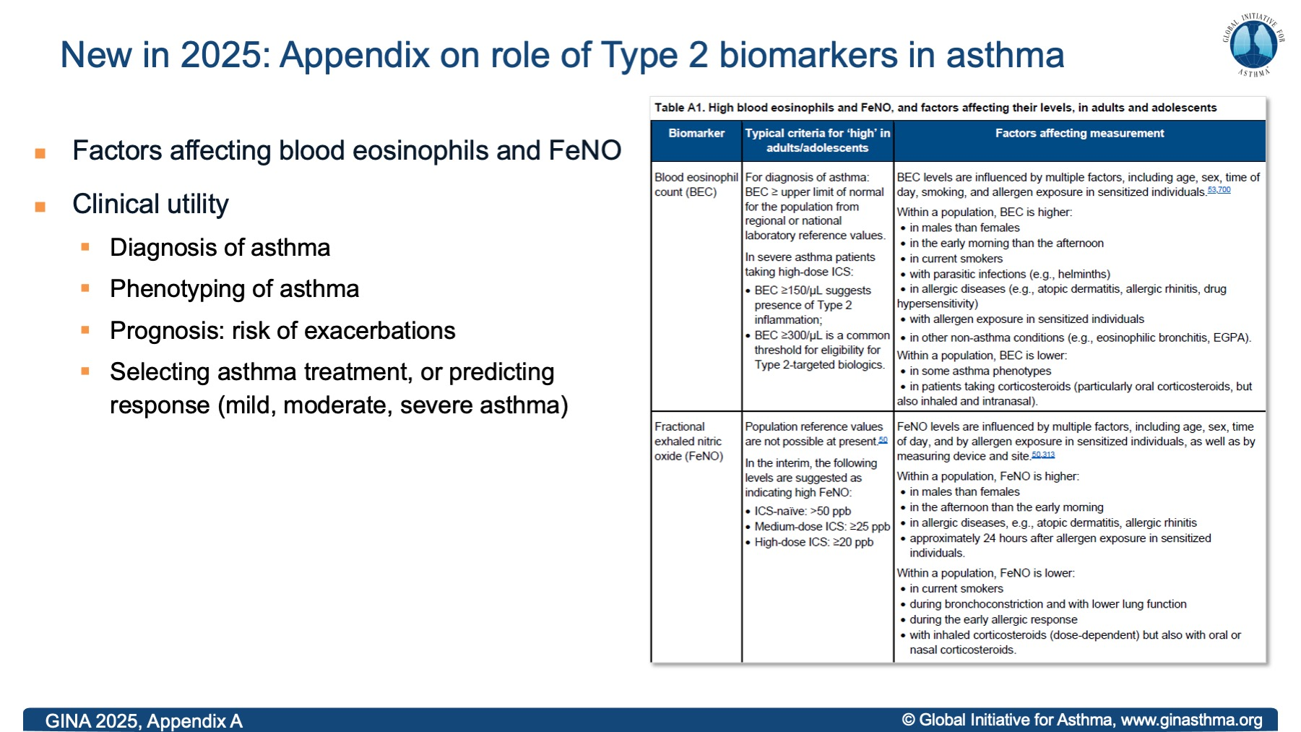
GINA 2025, Appendix A
Notes:
November 25: table updated with edit to time of day for blood eos (higher in the early morning than the afternoon) and FeNO (higher in the afternoon than the early morning)

Slide 12
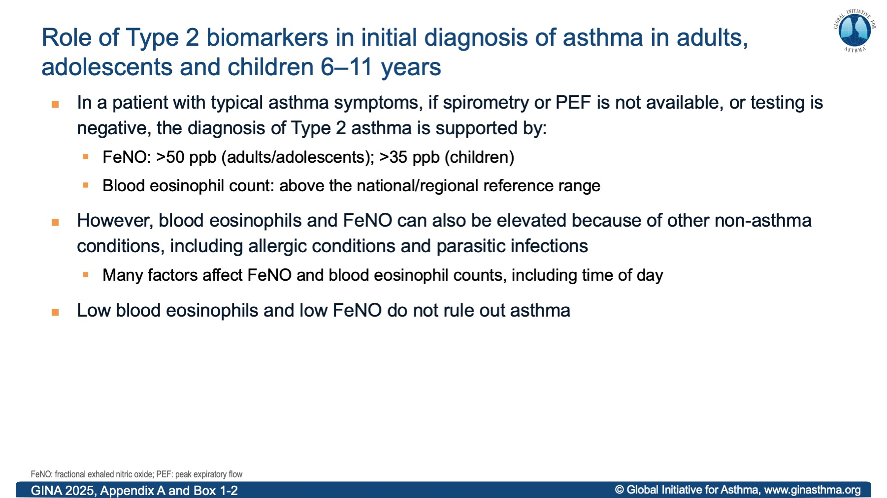
GINA 2025, Appendix A and Box 1-2

Slide 13
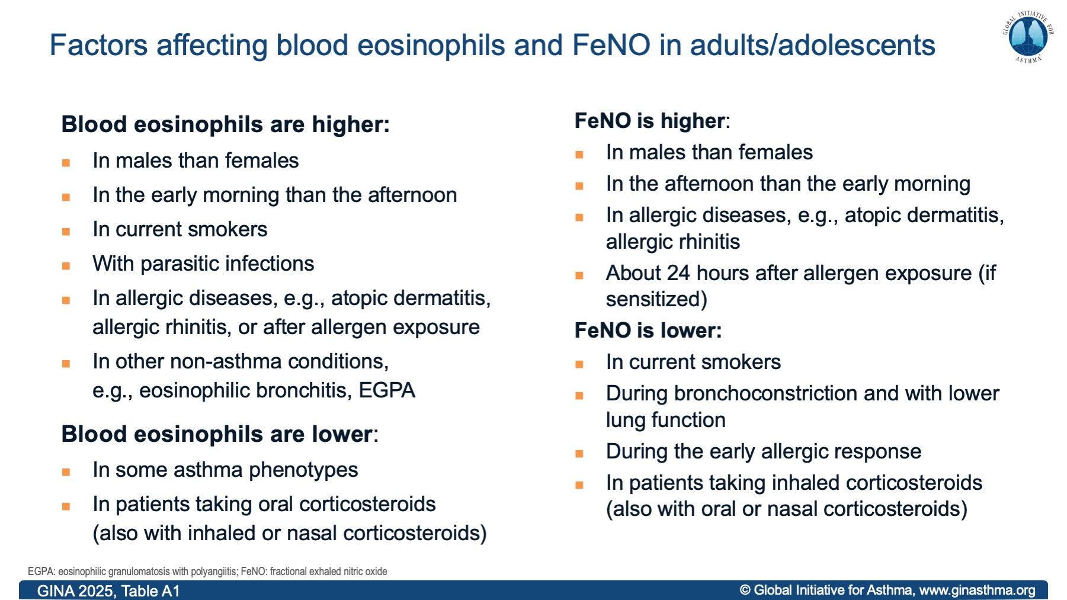
Notes:
November 25: edit to time of day for blood eos (higher in the early morning than the afternoon) and FeNO (higher in the afternoon than the early morning)

Slide 14
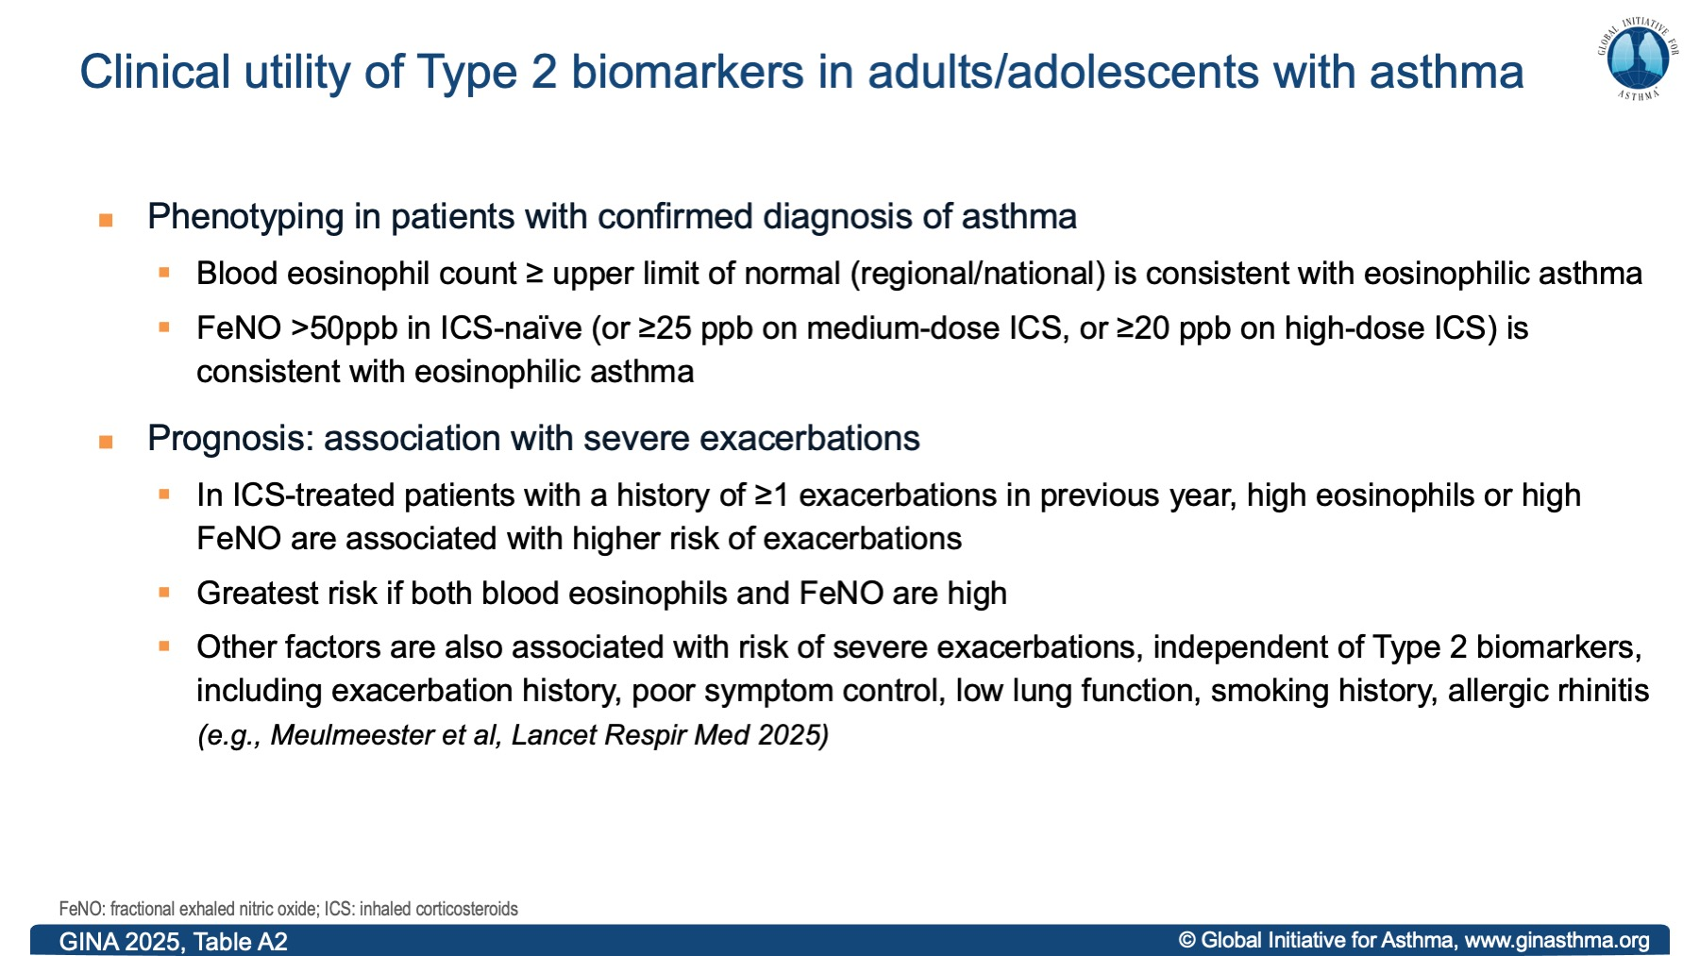

Slide 15
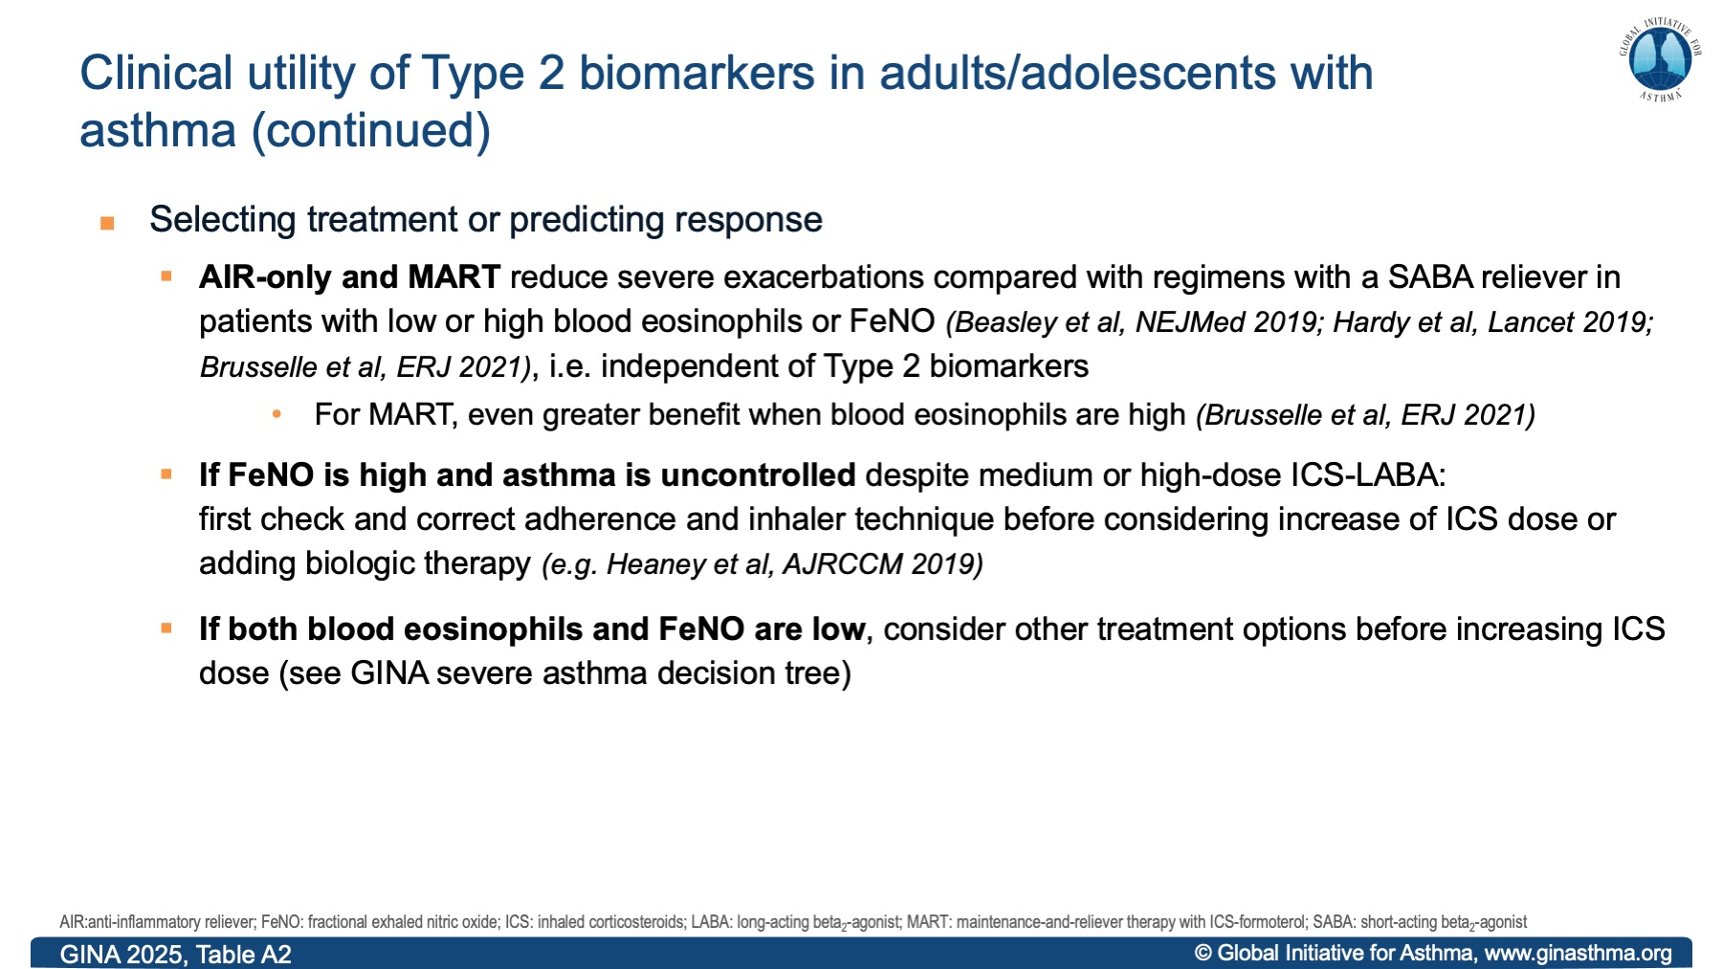

Slide 16
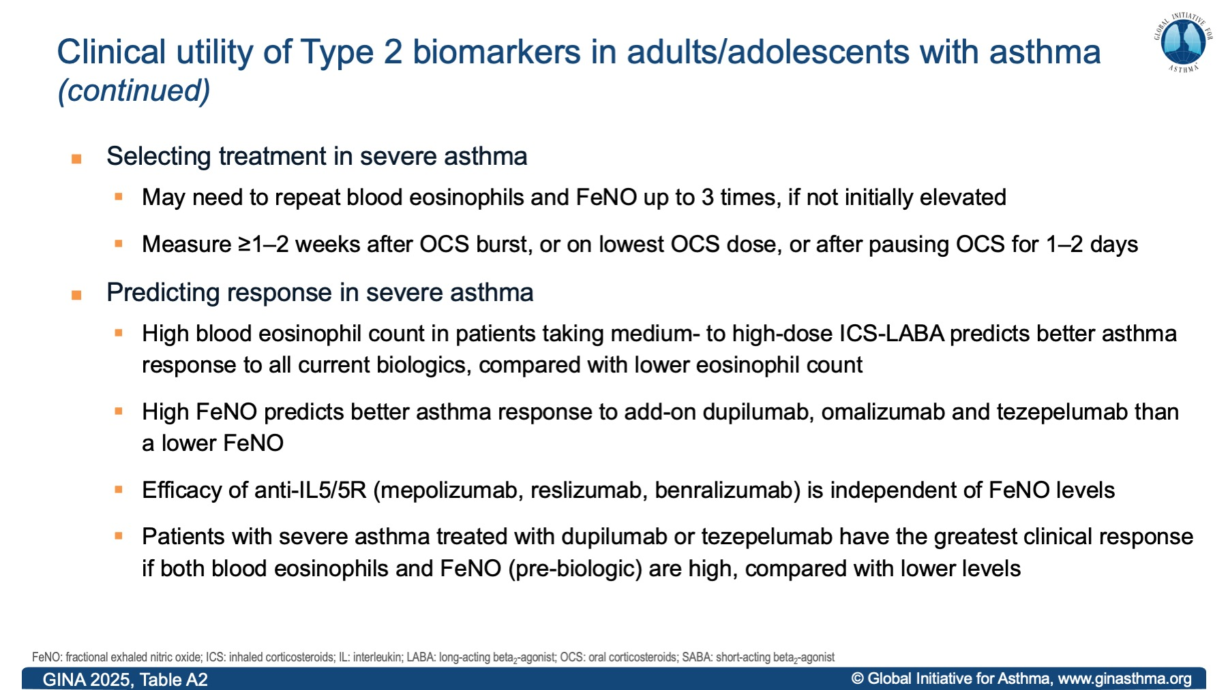

Slide 17
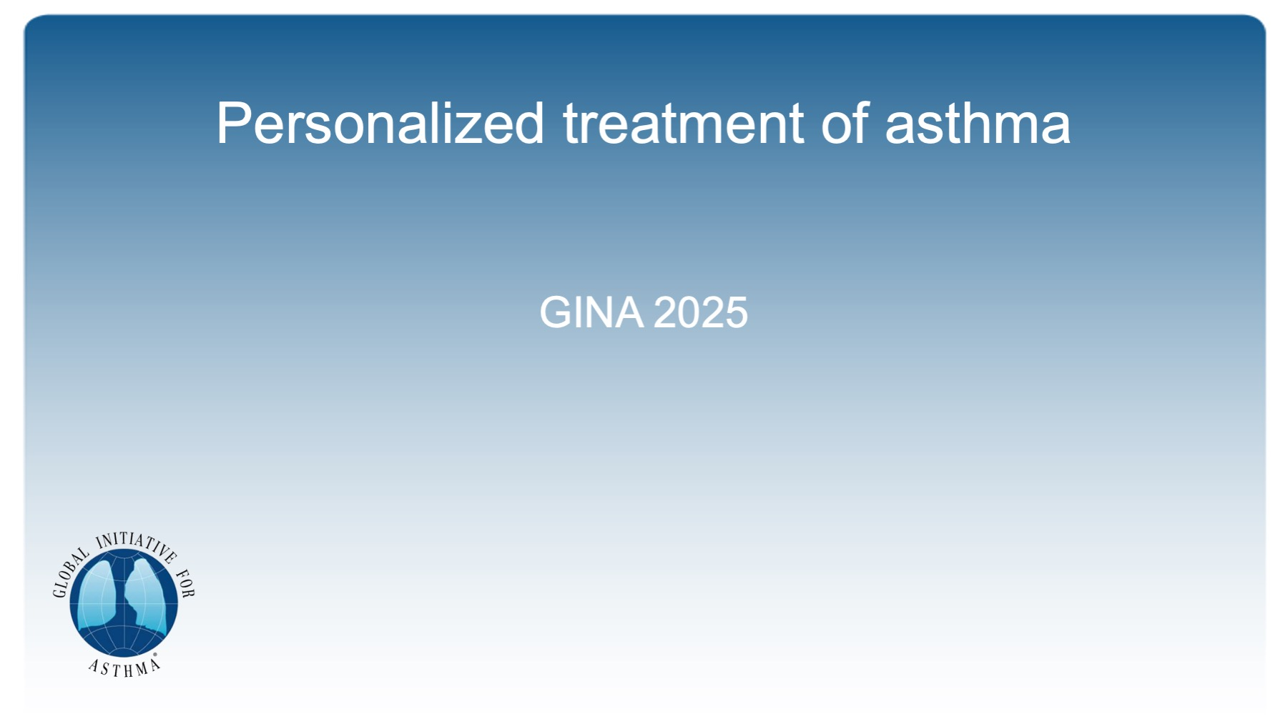
Personalized treatment of asthma

Slide 18
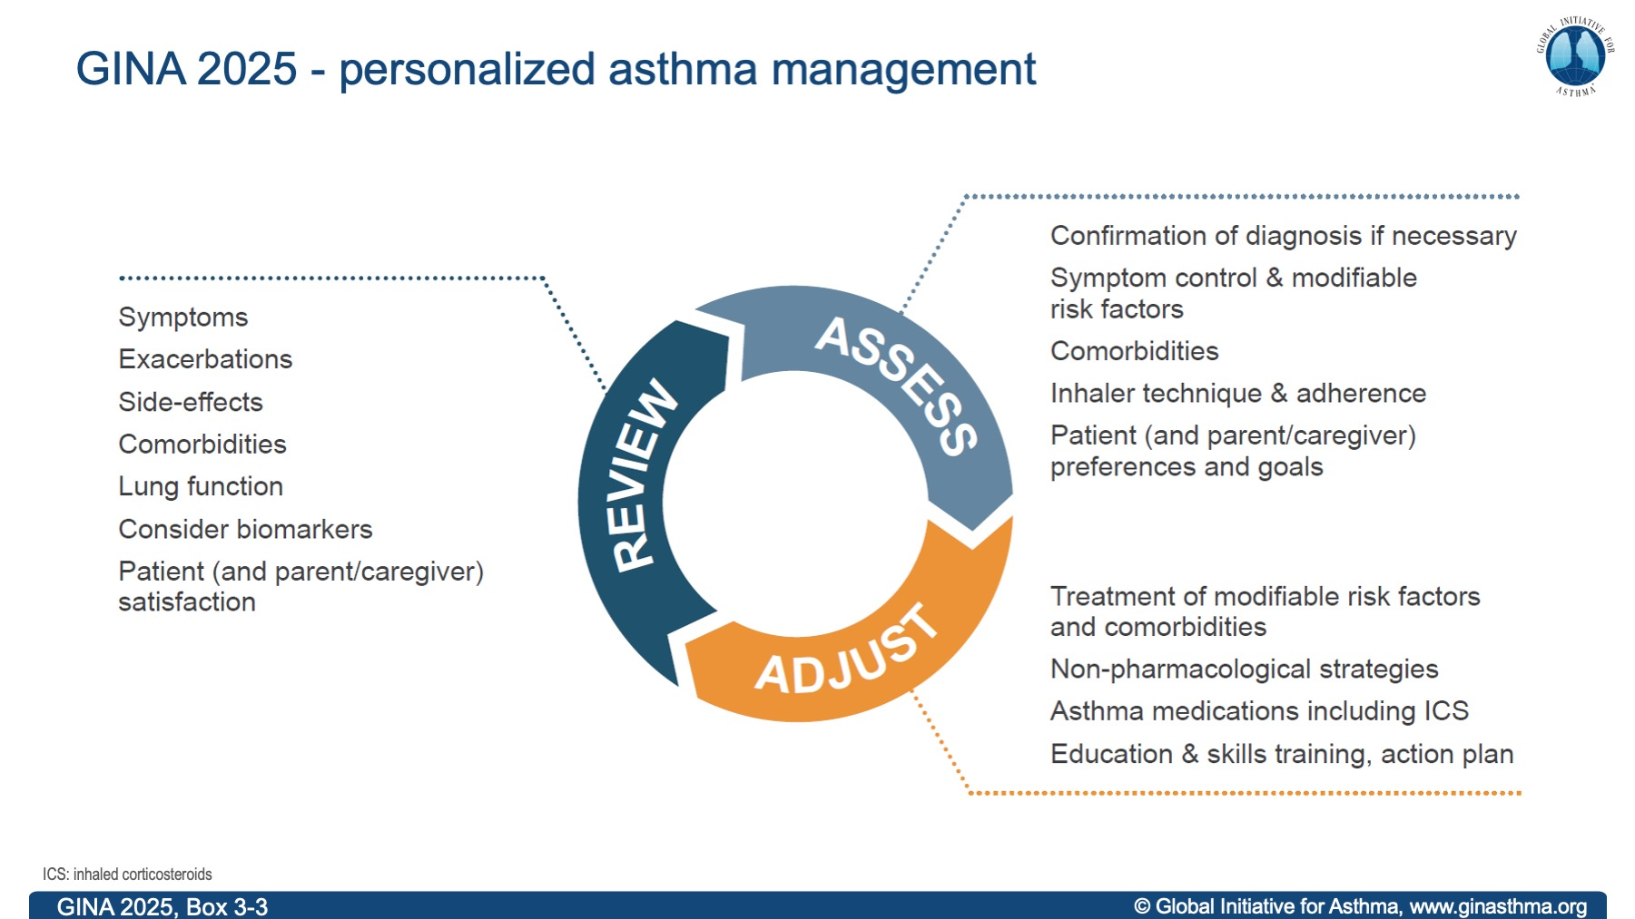
Notes:
Asthma treatment is not one-size-fits-all, and not just about medications
Explain that biomarkers are included in ‘Review response’ rather than earlier in the cycle, because they are most commonly elevated due to poor adherence and/or incorrect inhaler technique with ICS-containing medications; these problems are very common, and should be addressed first

Slide 19
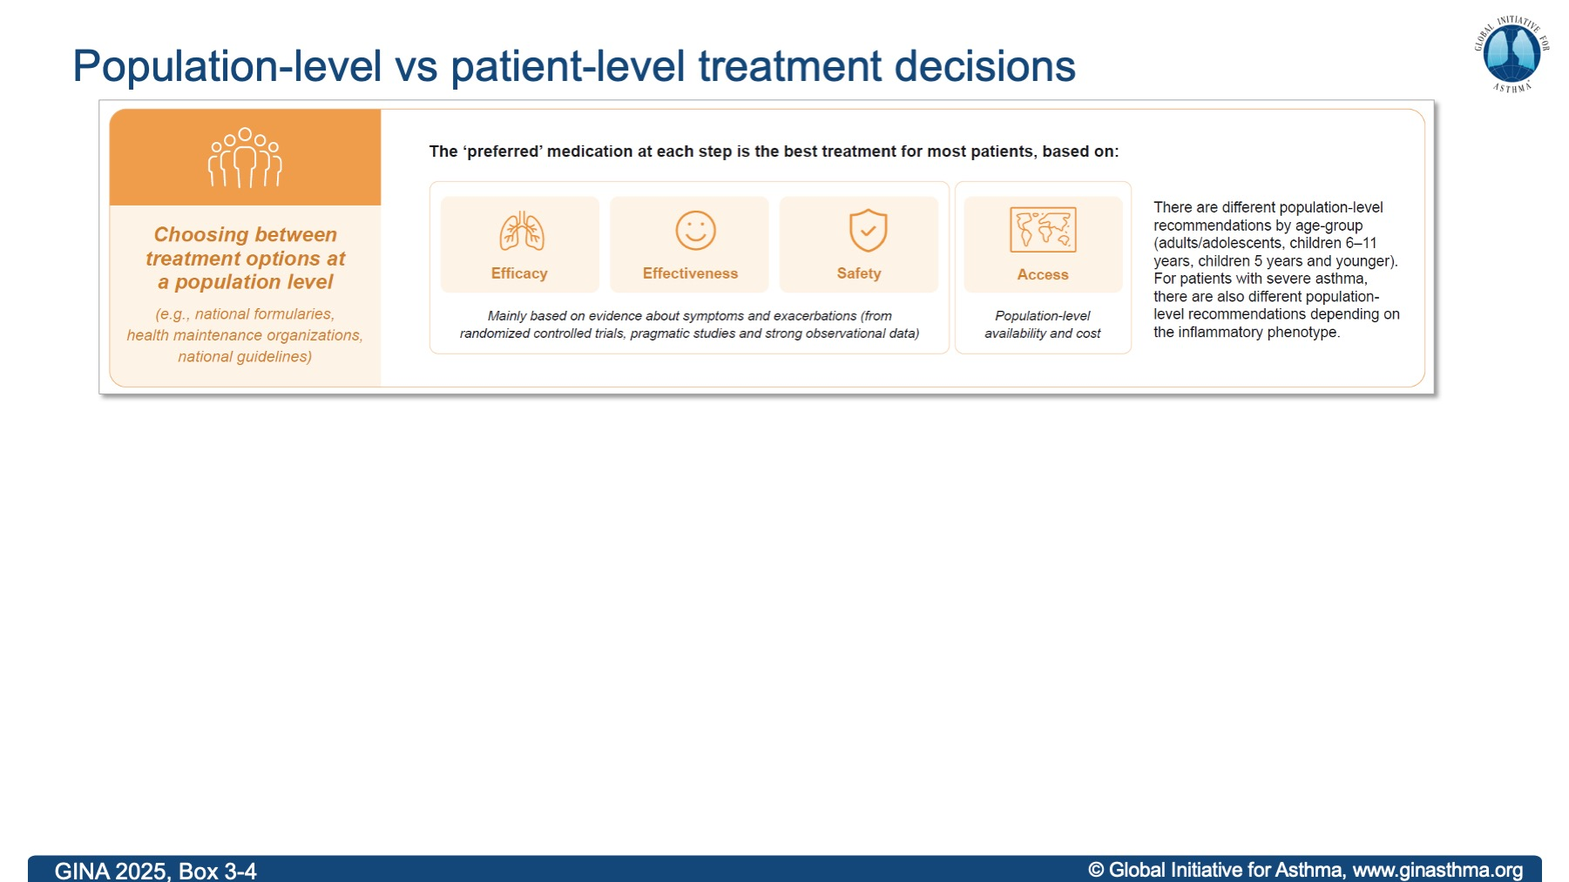

Slide 20
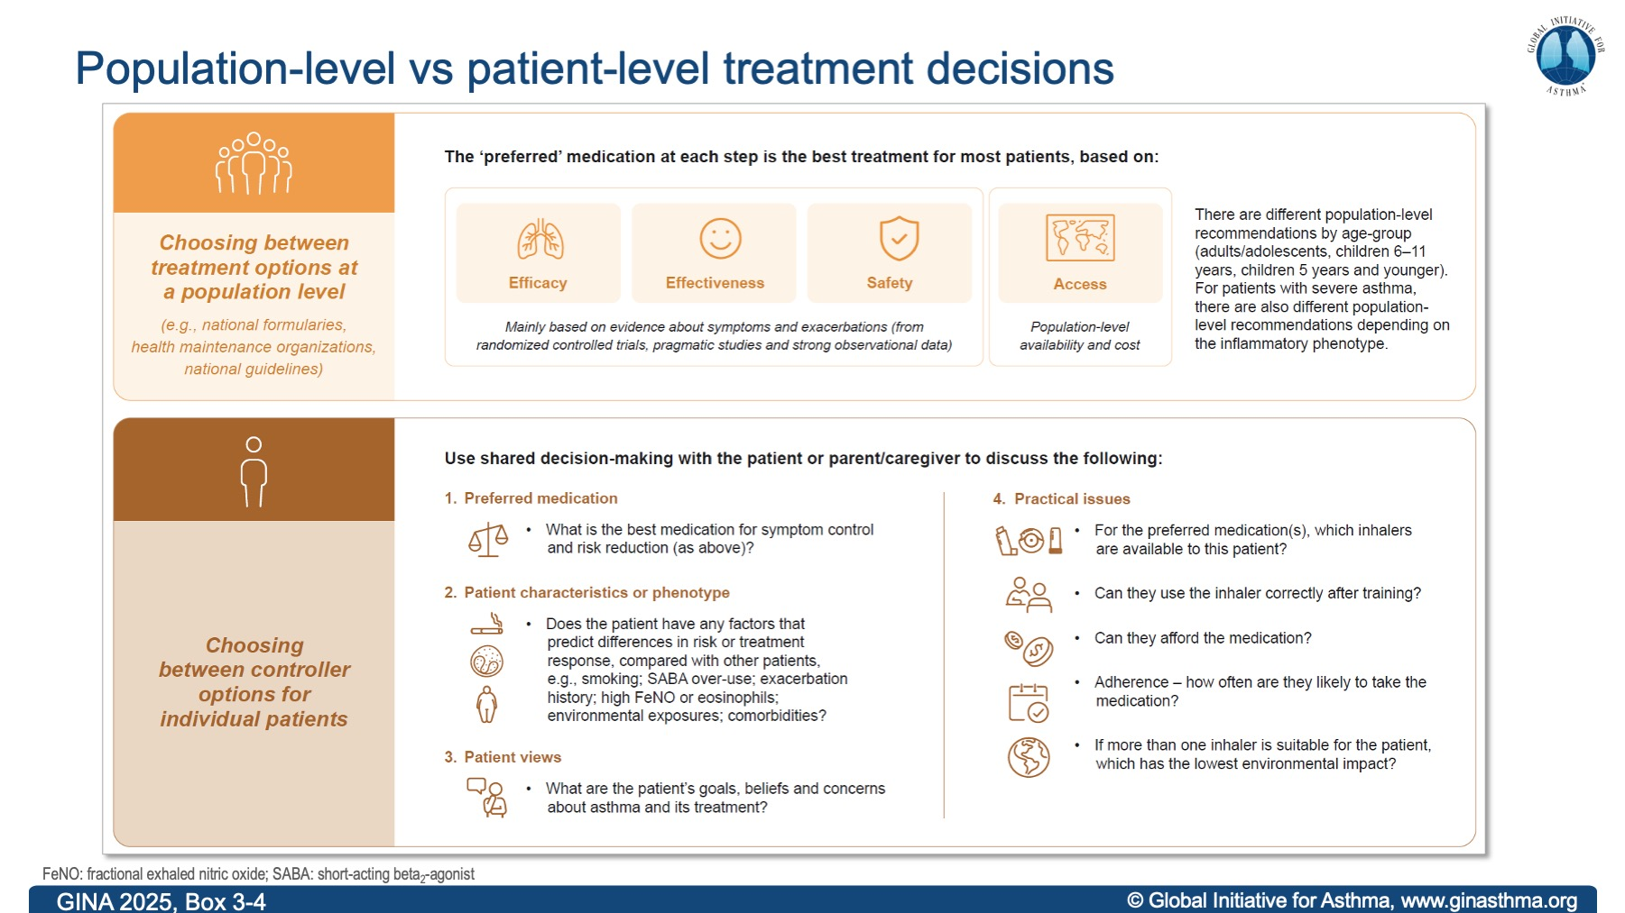

Slide 21
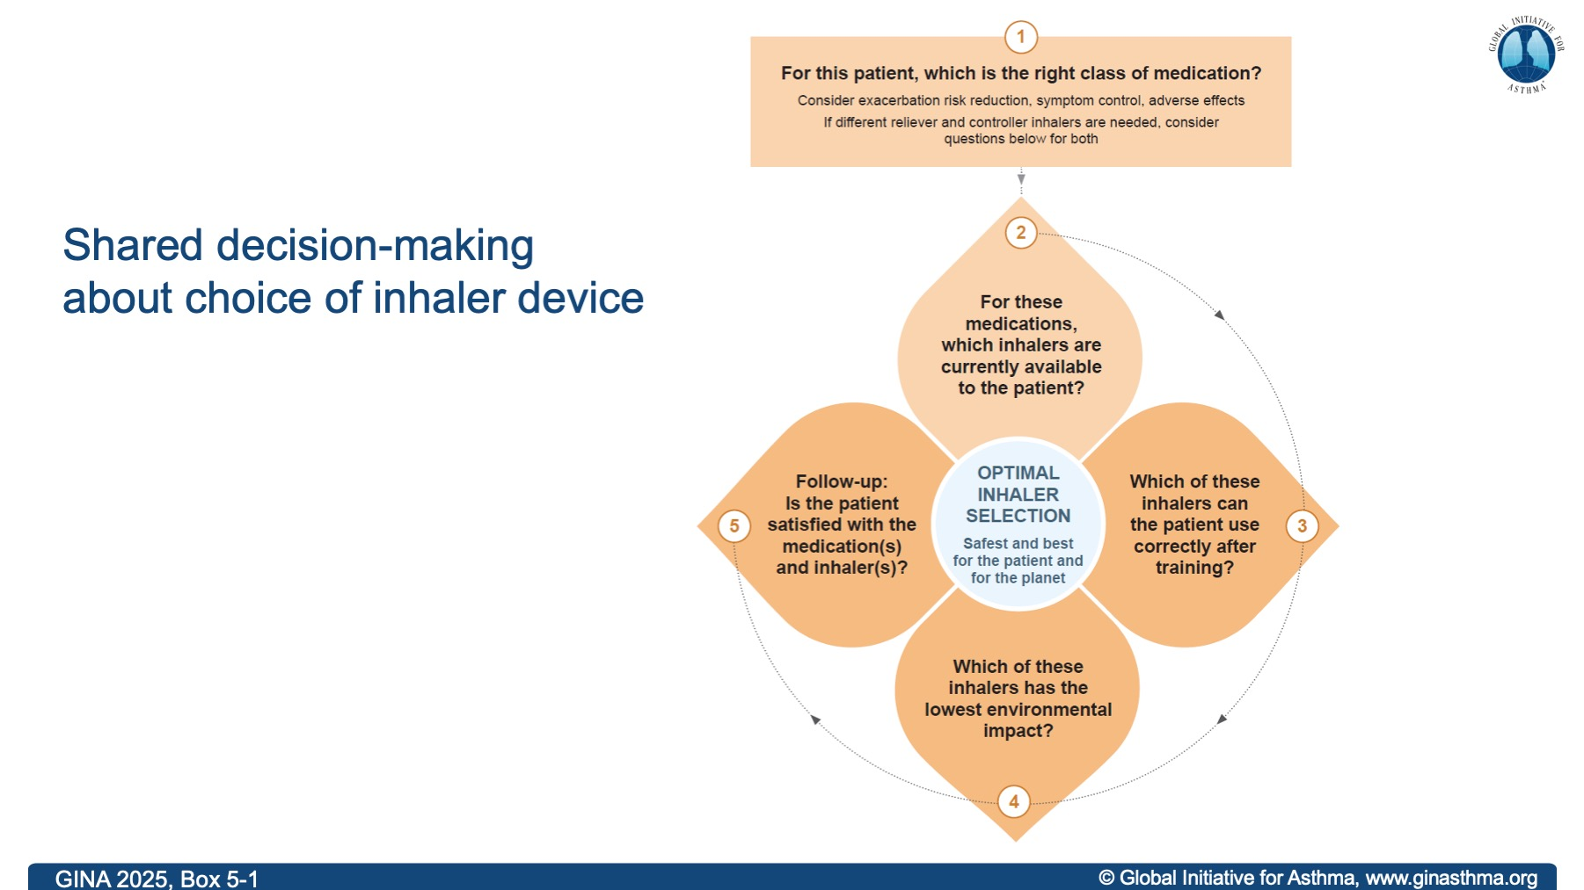
Notes:
For an individual patient, environmental impact of the inhaler is only relevant if the medication that the patient needs is available in more than one type of device and the patient can use both equally well!
Mention that some patients cannot use DPIs, e.g. young children, some elderly

Slide 22
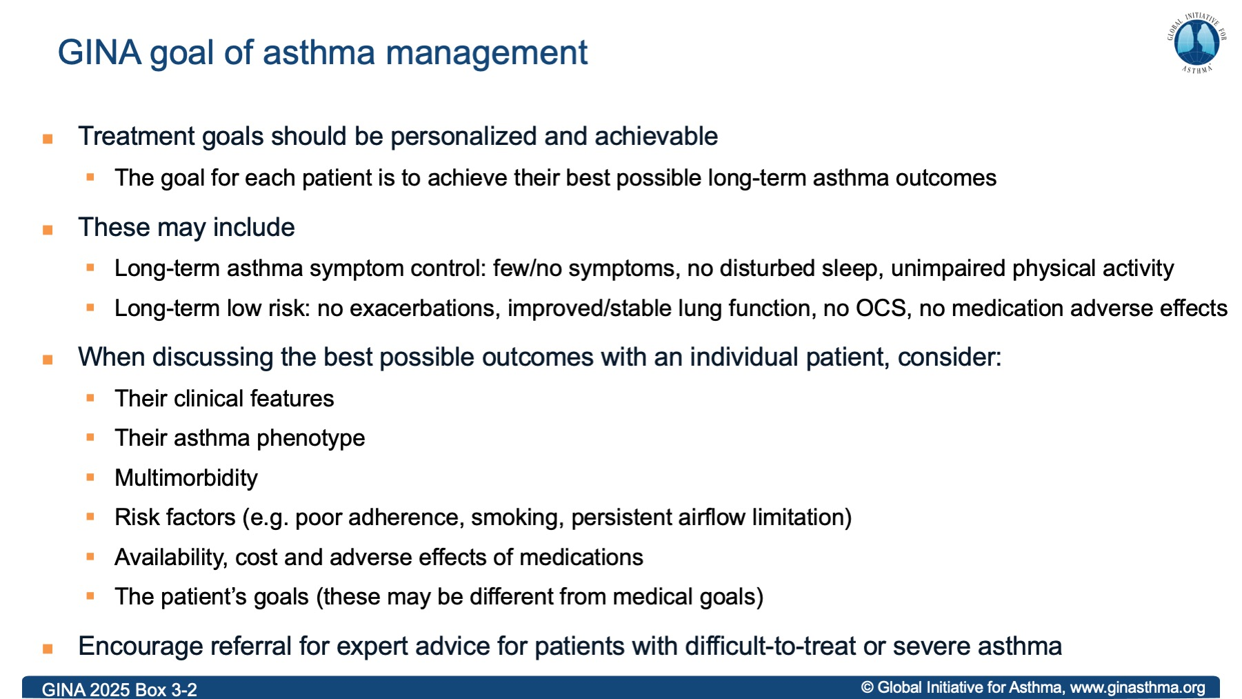

Slide 23
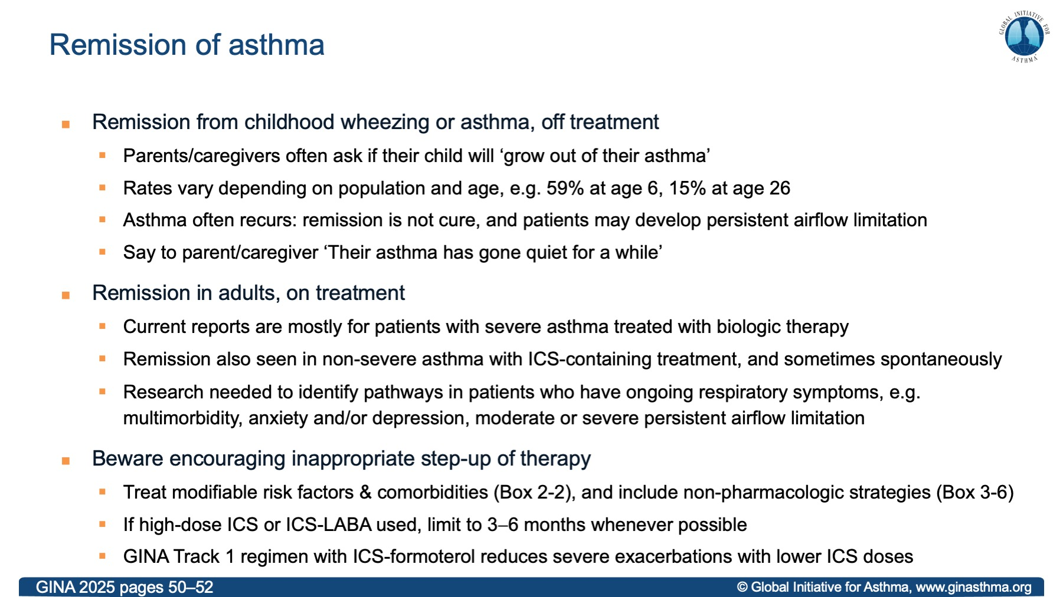

Slide 24
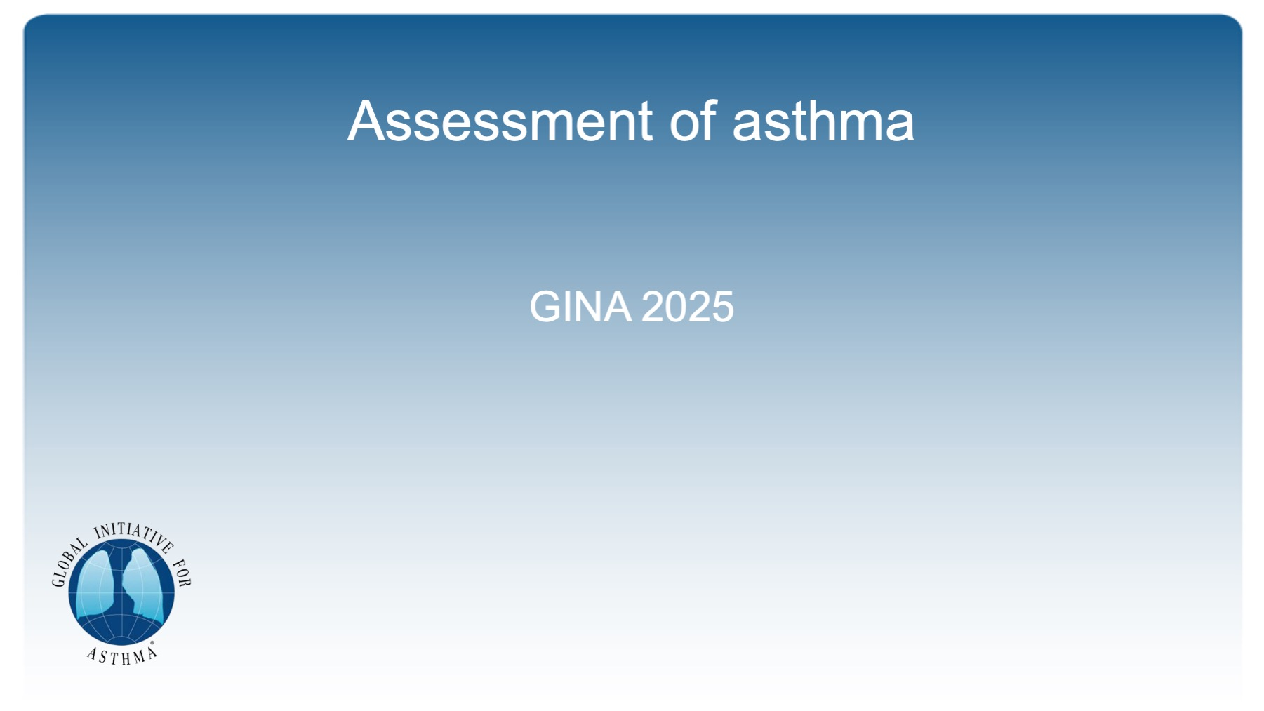
Assessment of asthma

Slide 25
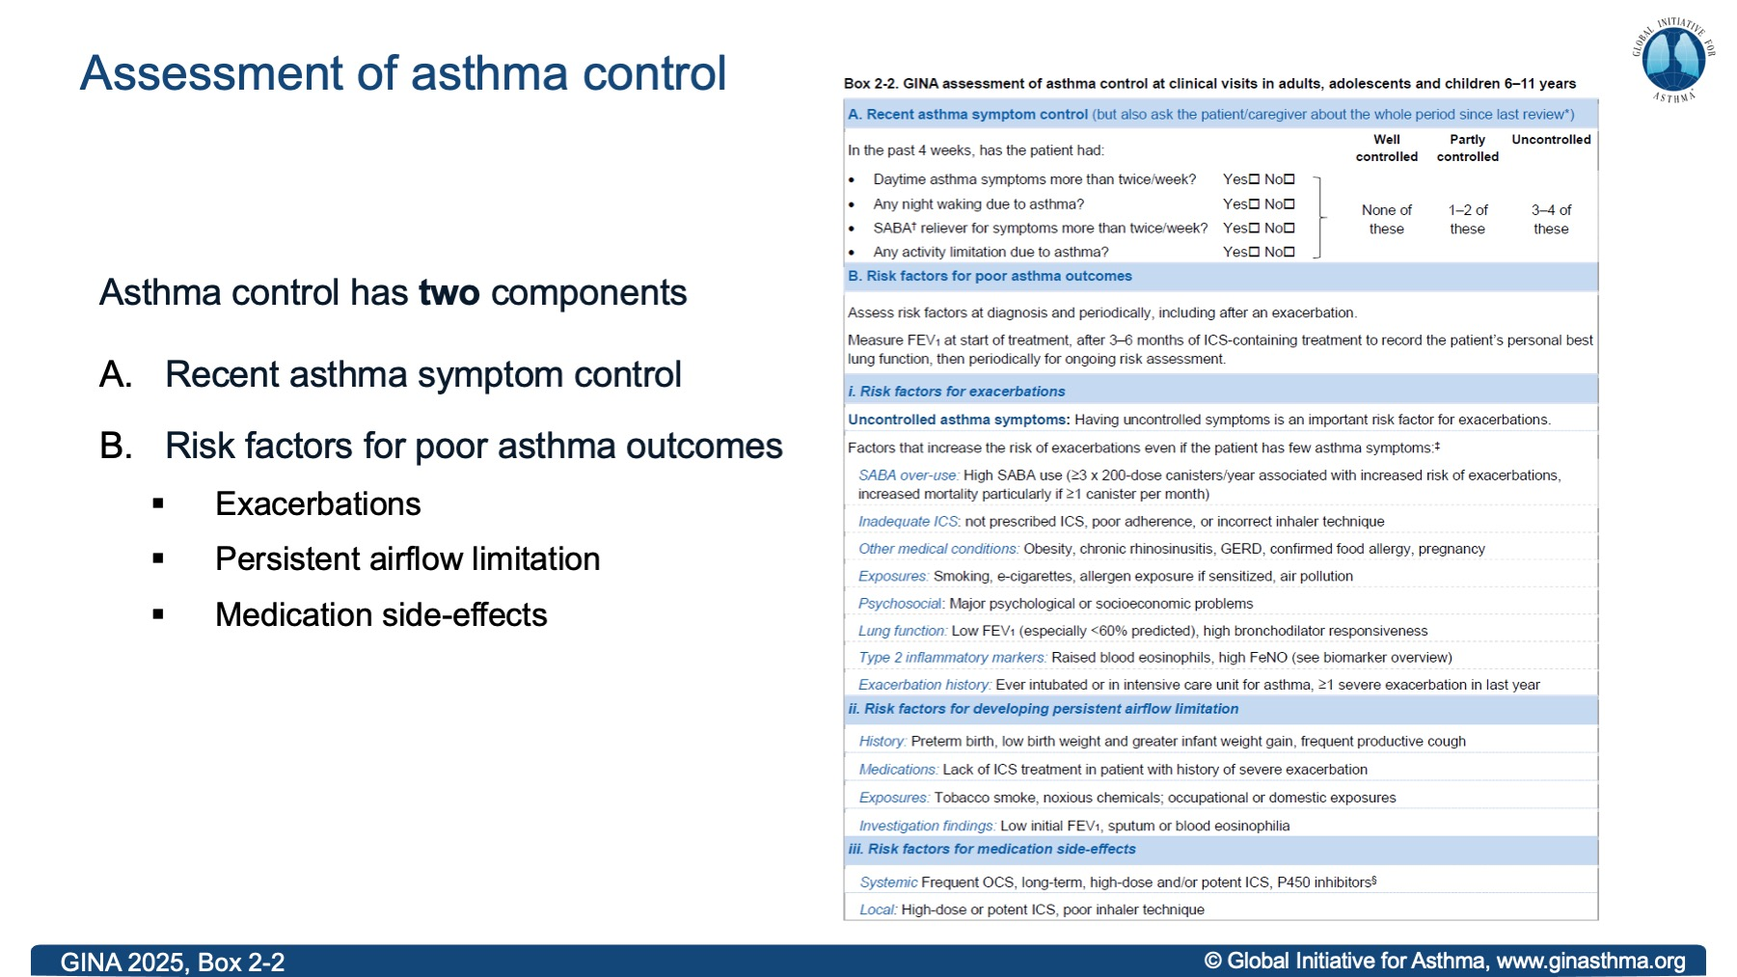

Slide 26
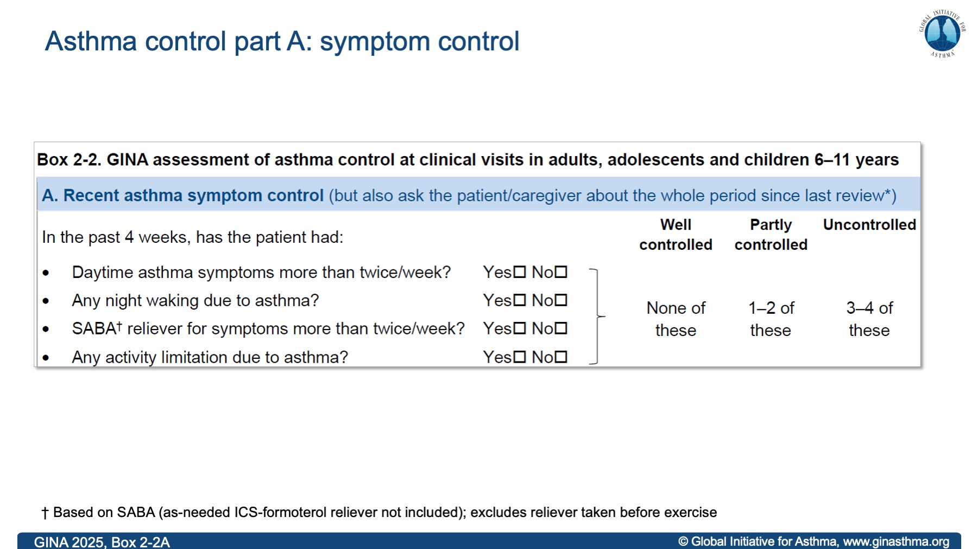

Slide 27
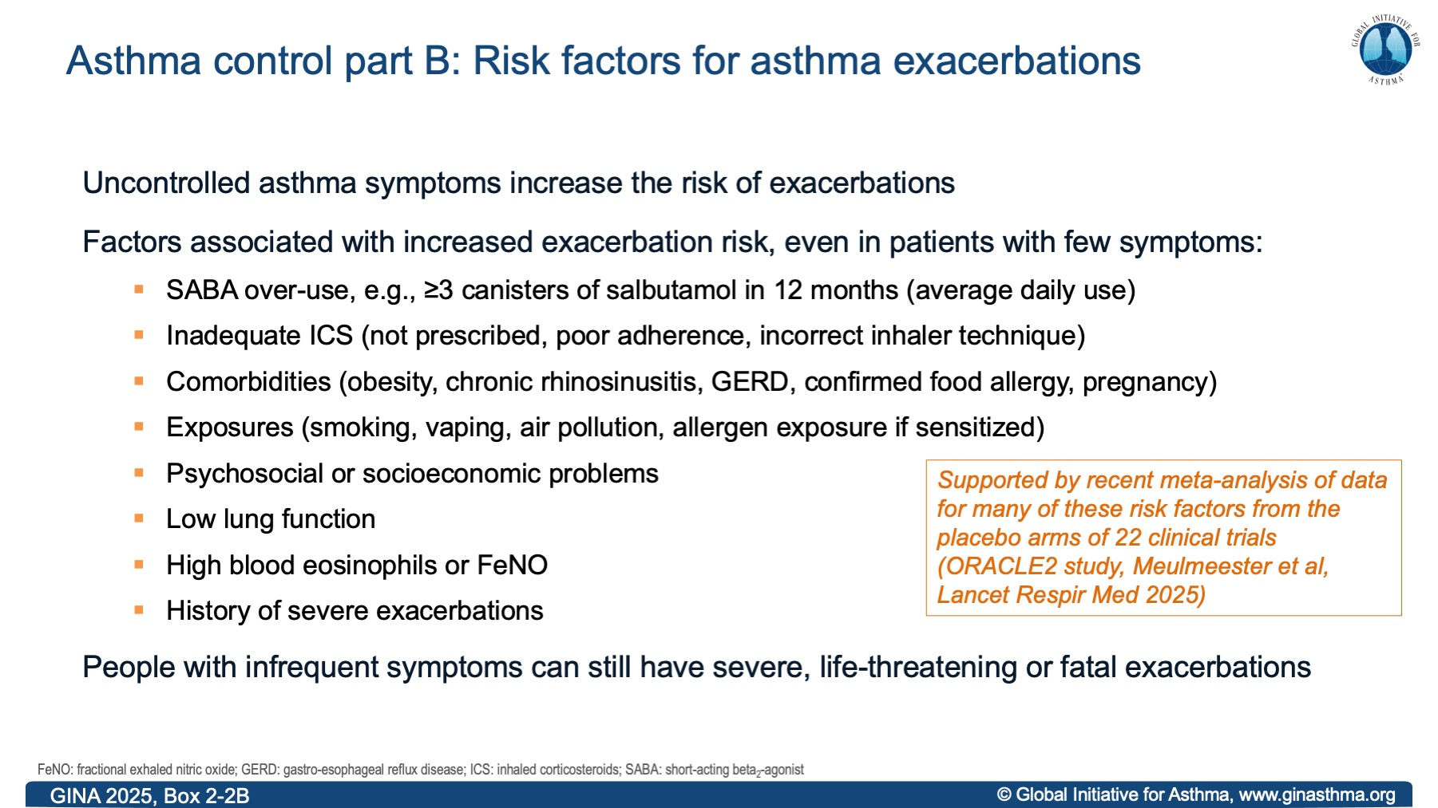
Notes:
SABA over-use was not assessed in ORACLE2

Slide 28
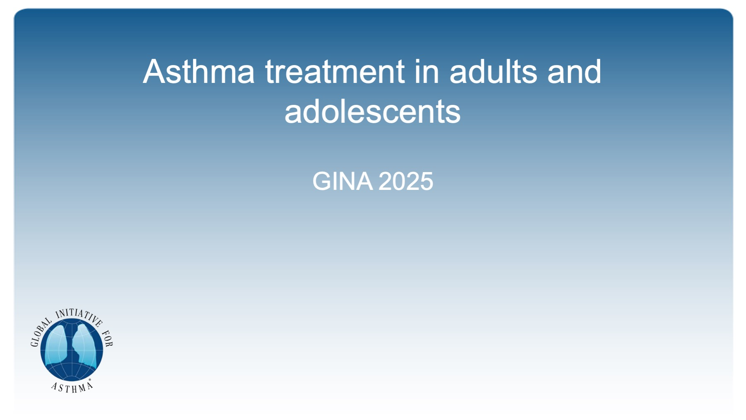
Asthma treatment in adults and adolescents

Slide 29
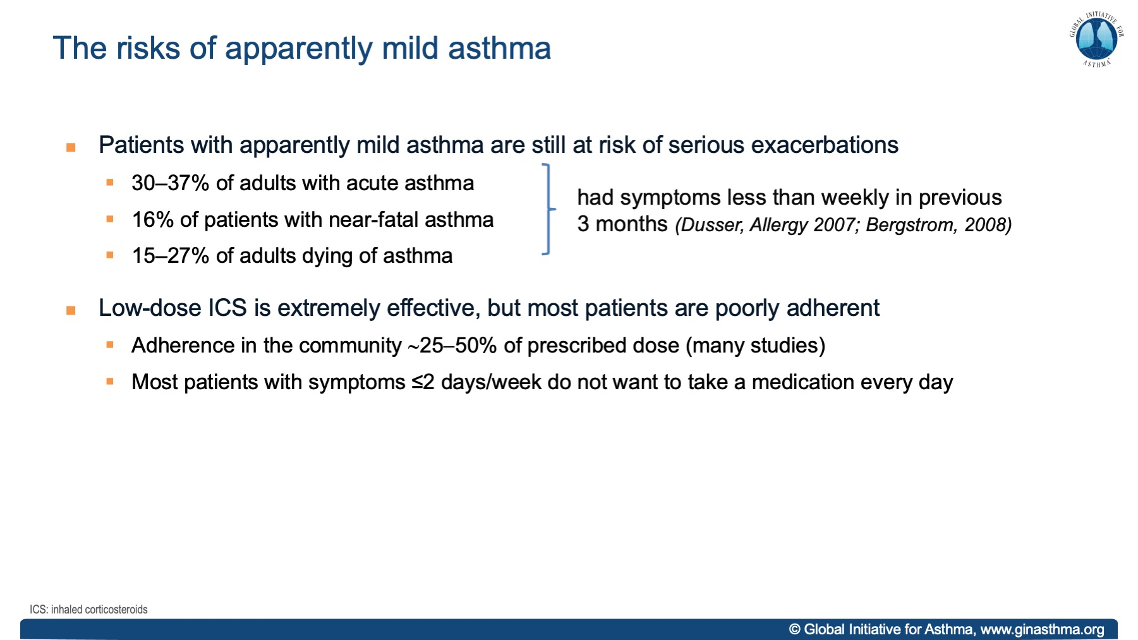
Notes:
Dusser D, Montani D, Chanez P, de Blic J, Delacourt C, Deschildre A, Devillier P, et al. Mild asthma: an expert review on epidemiology, clinical characteristics and treatment recommendations. Allergy 2007;62:591-604.
Bergström SE, Boman G, Eriksson L, et al., Asthma mortality among Swedish children and young adults, a 10-year study. Respir. Med., 2008. 102: 1335-41

Slide 30
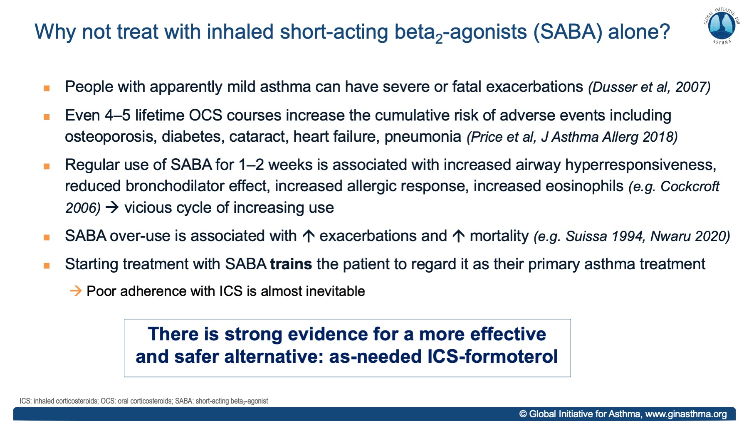

Slide 31
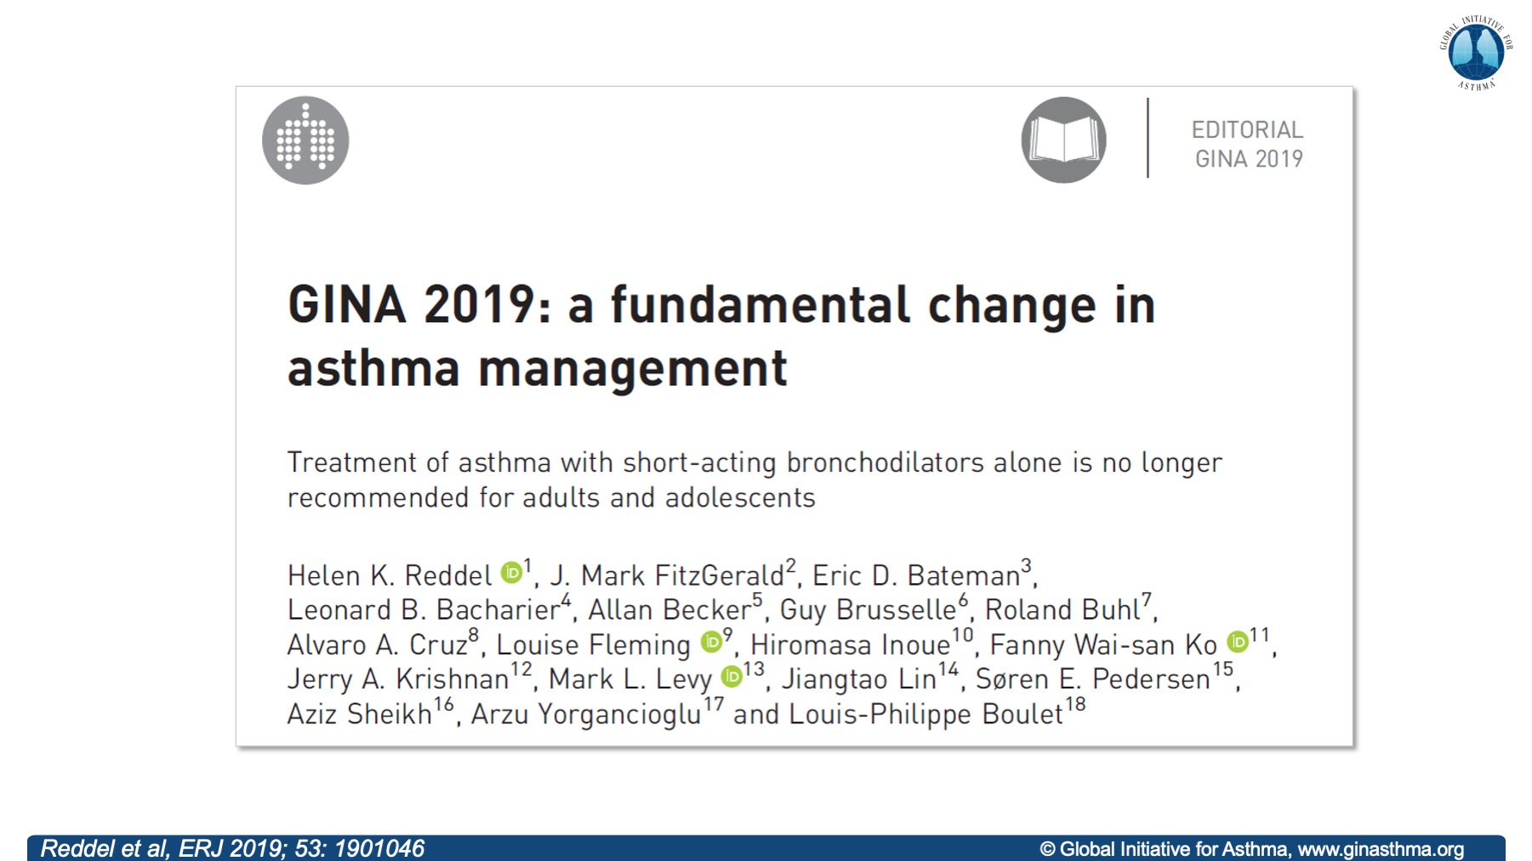
Notes:
This was subsequently extended to children 6−11 years

Slide 32
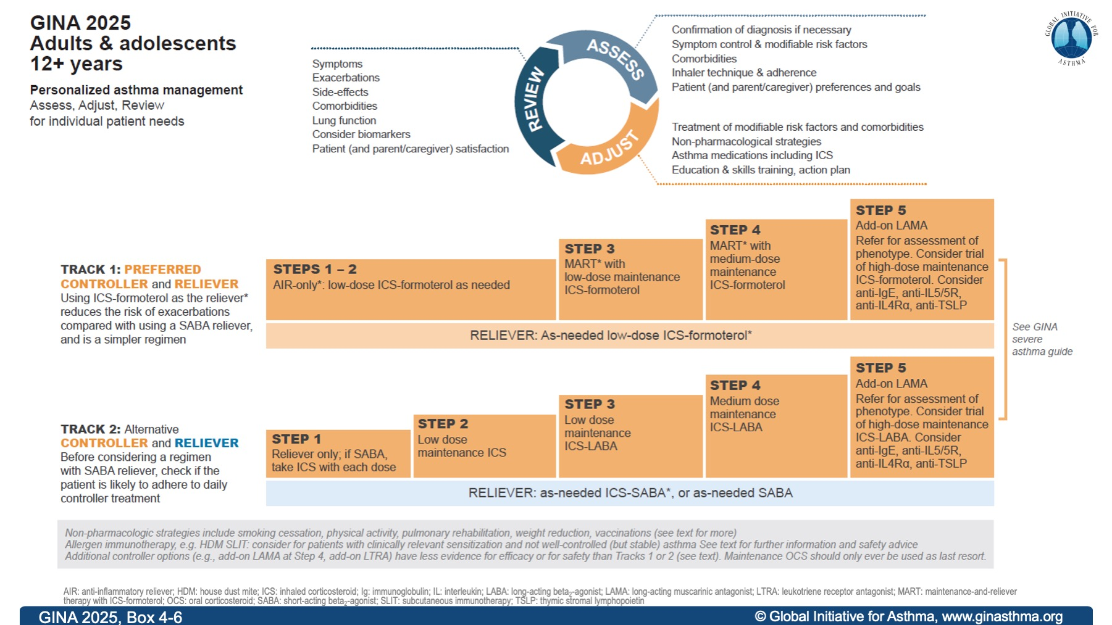

Slide 33
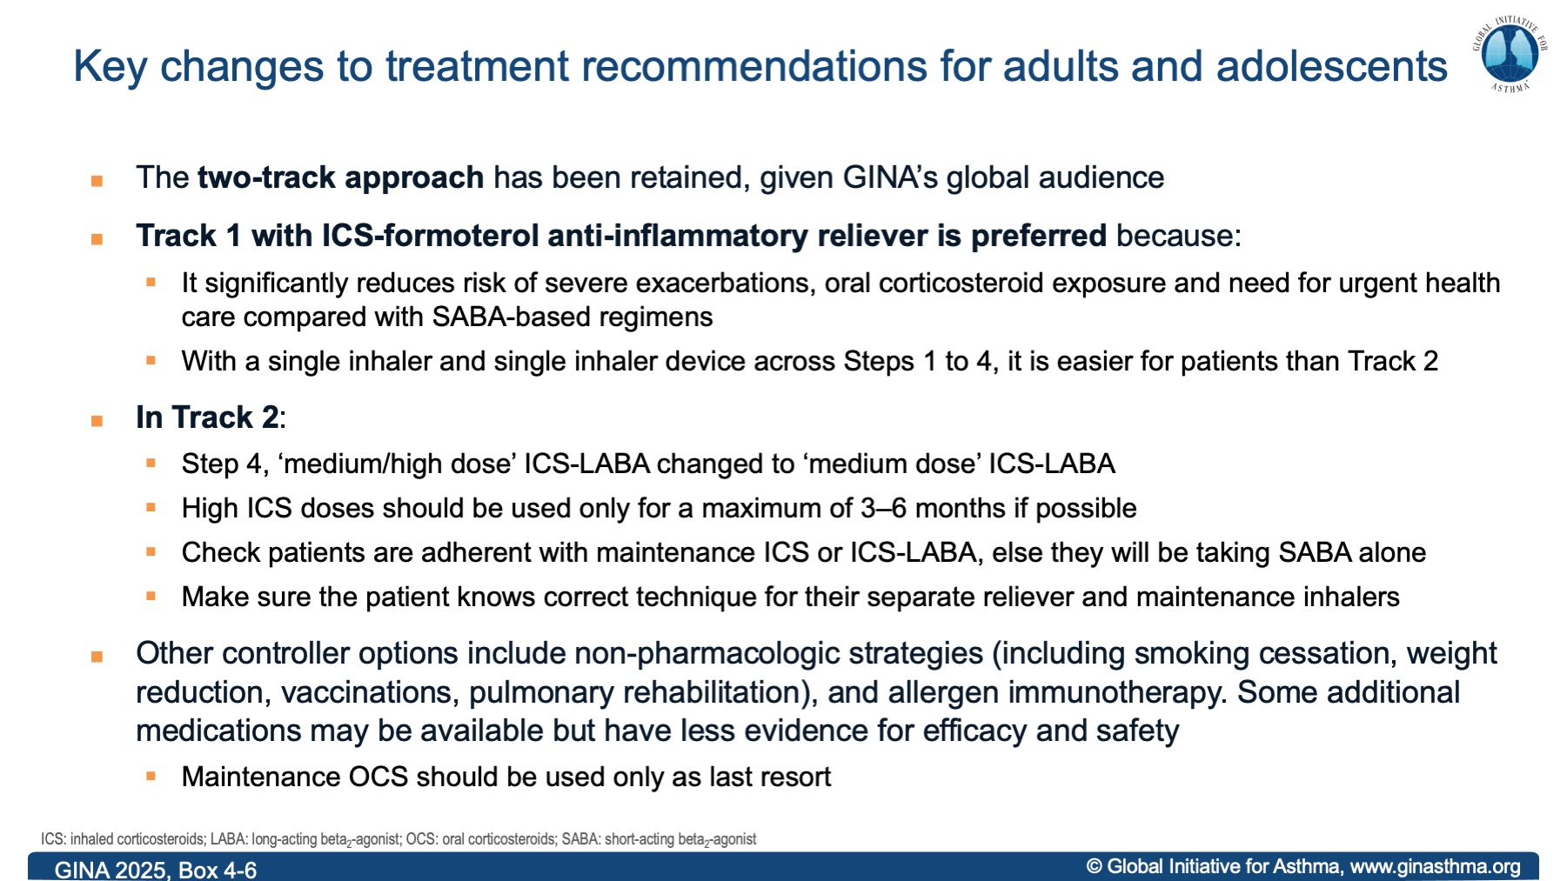

Slide 34
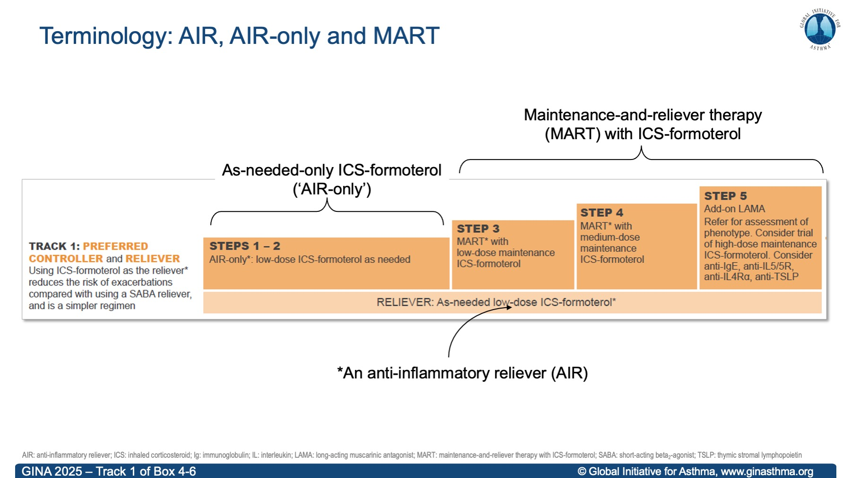

Slide 35
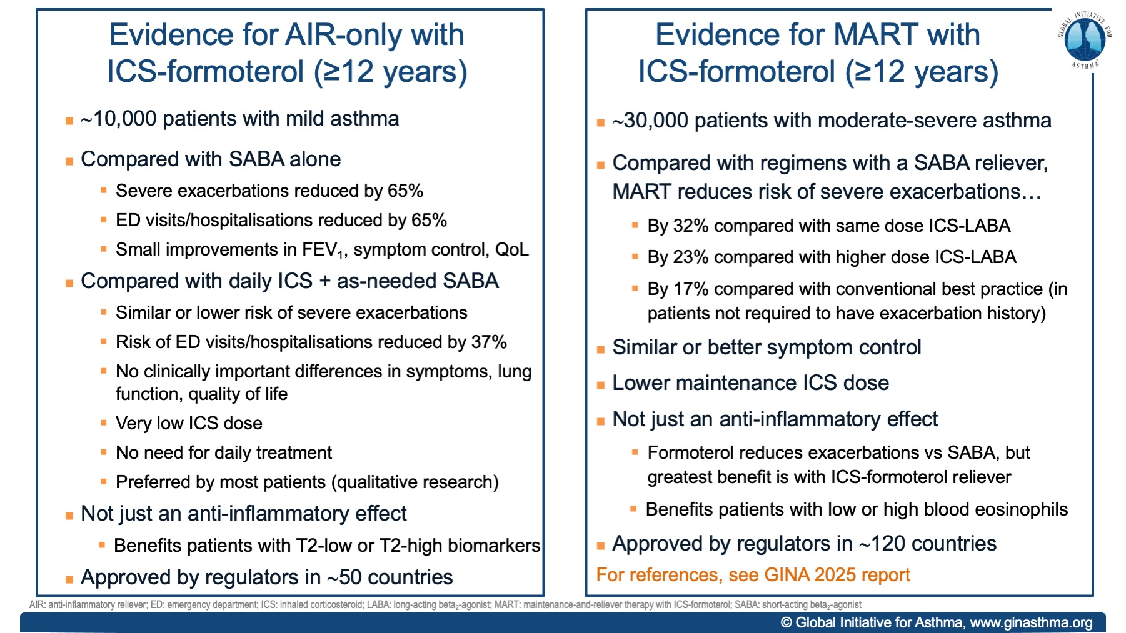

Slide 36
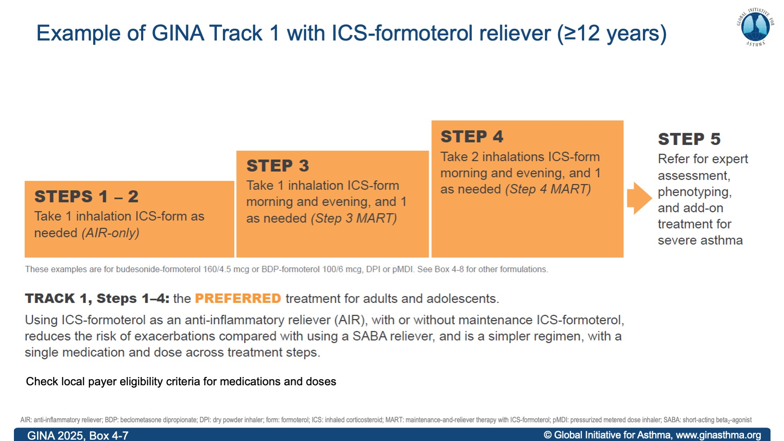

Slide 37
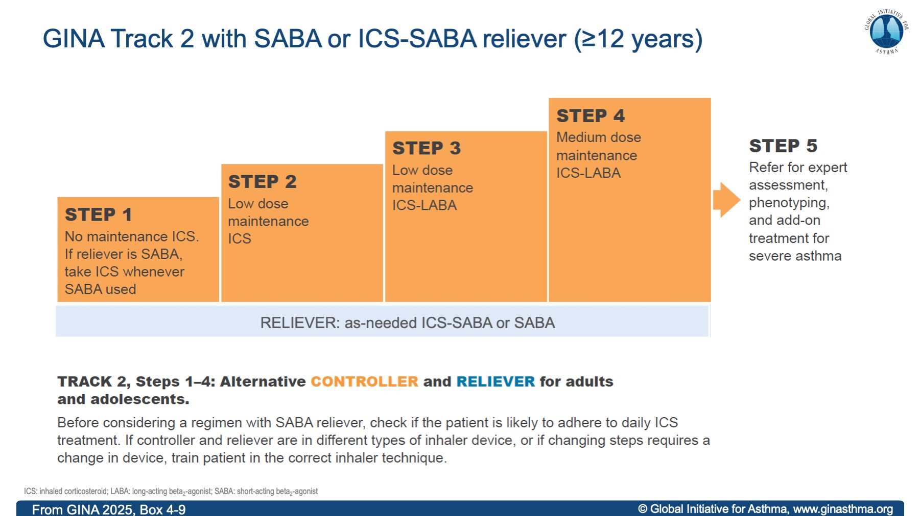

Slide 38
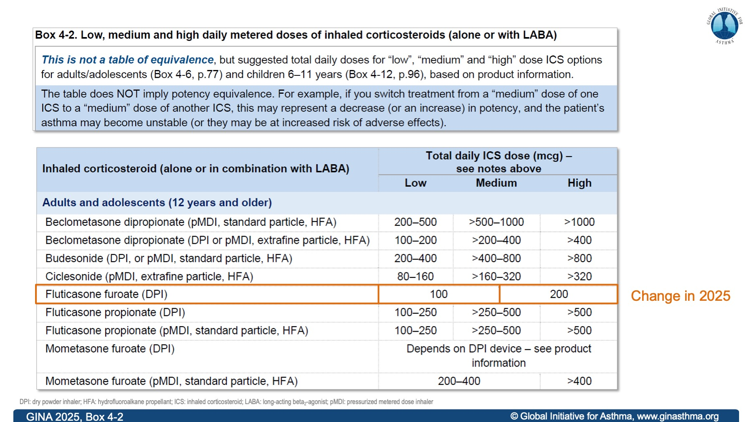

Slide 39
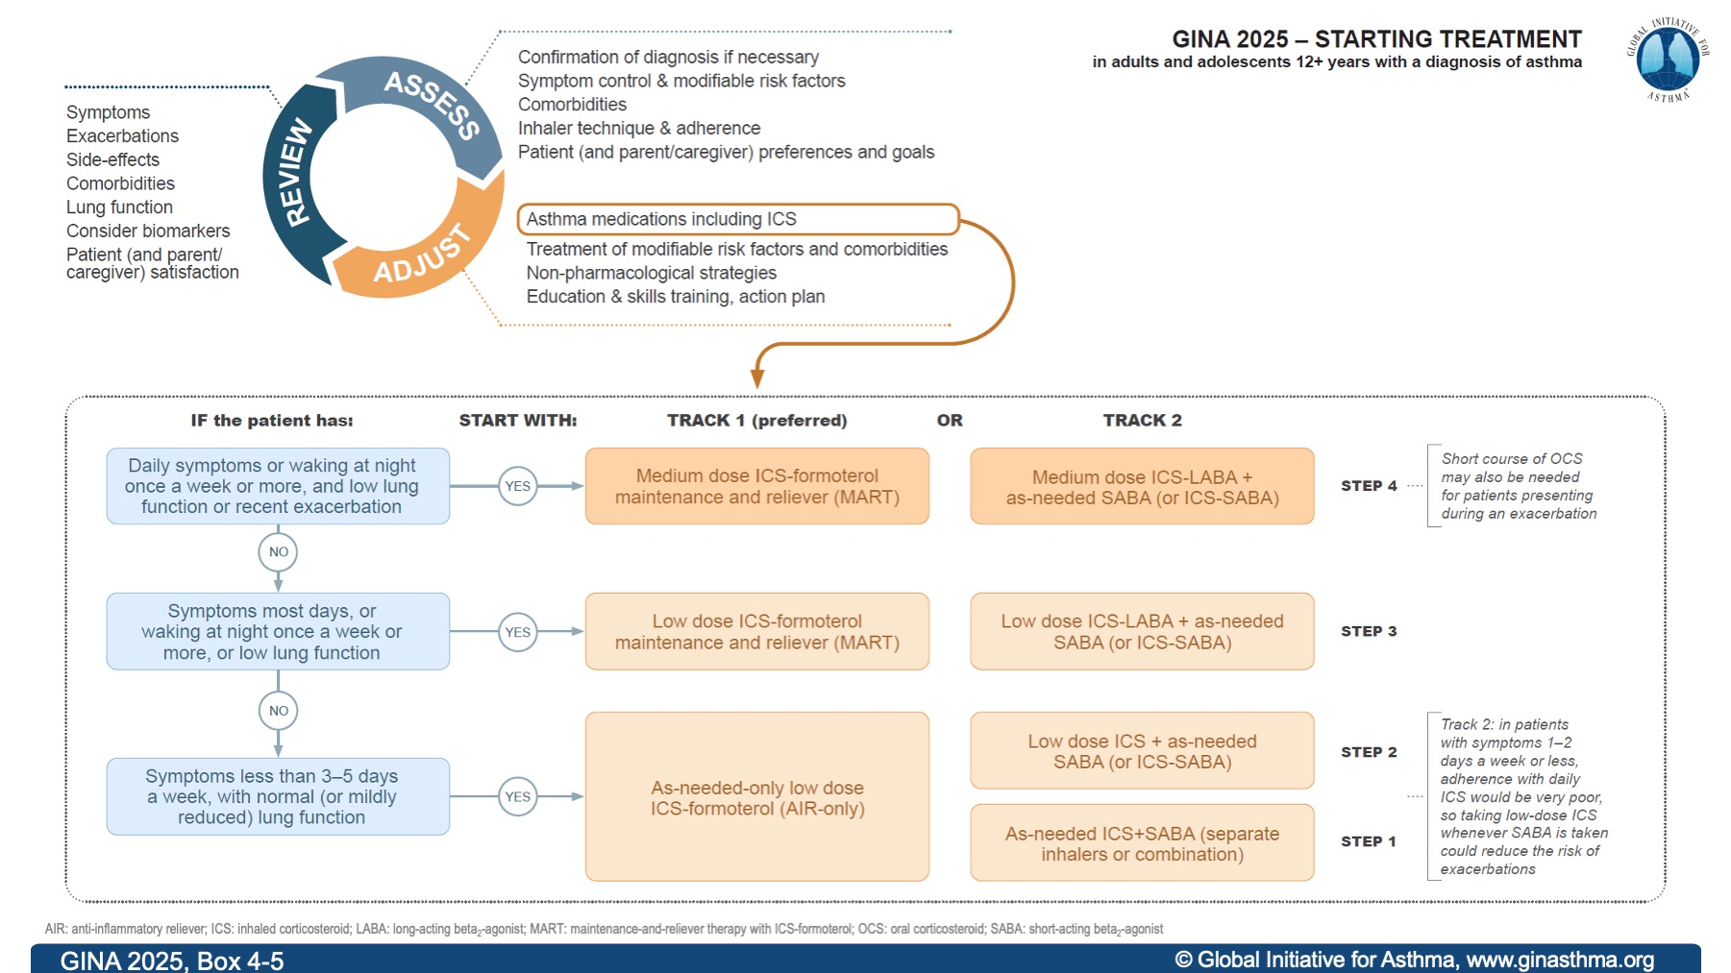

Slide 40

Children 6−11 years

Slide 41
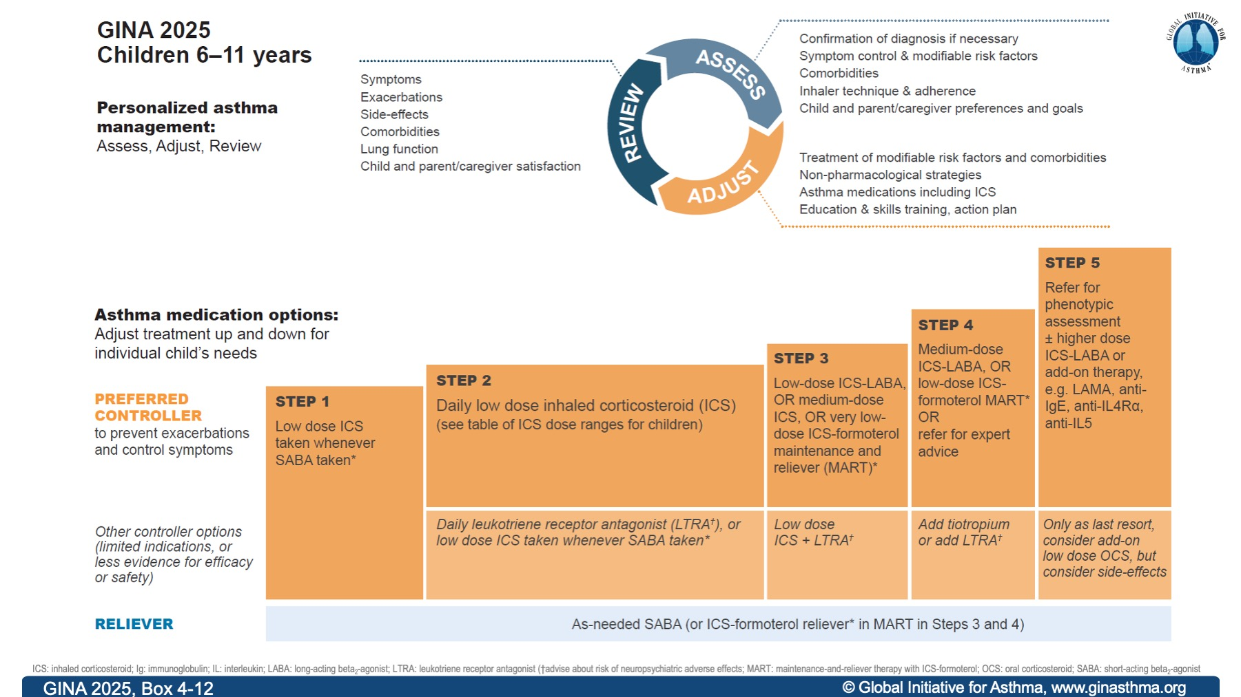
Notes:
No major changes since 2024: just reversal of the order of ‘refer for expert advice’ in Step 4 to avoid ambiguity.

Slide 42
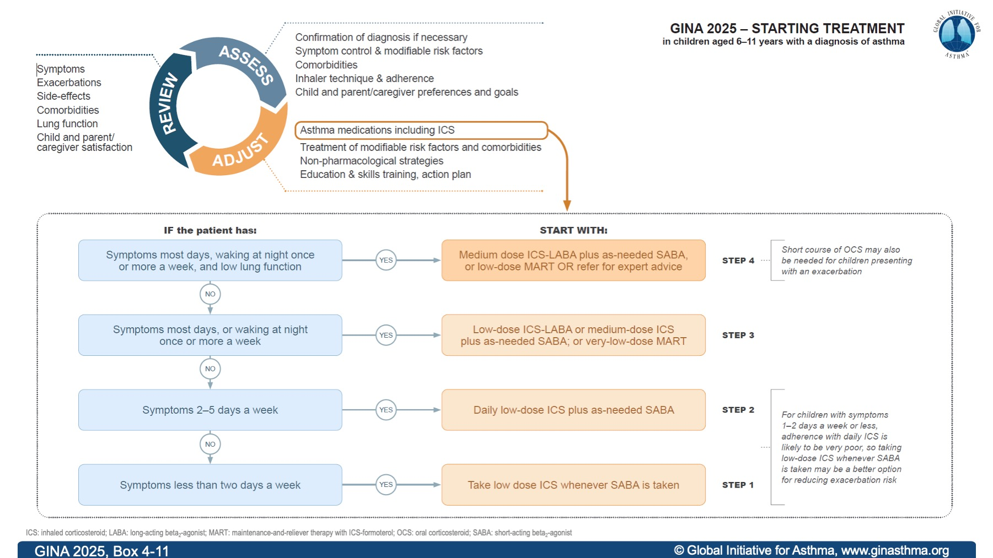

Slide 43
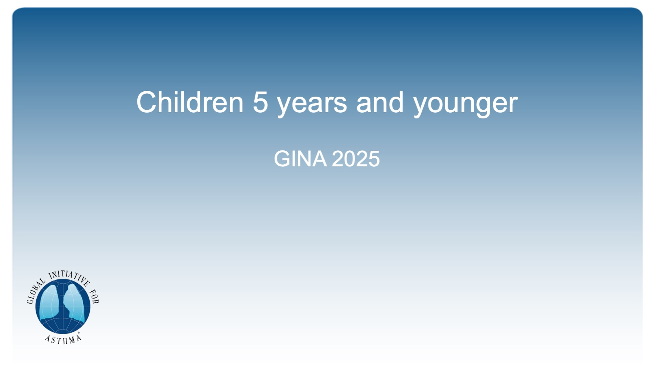
Children 5 years and younger

Slide 44
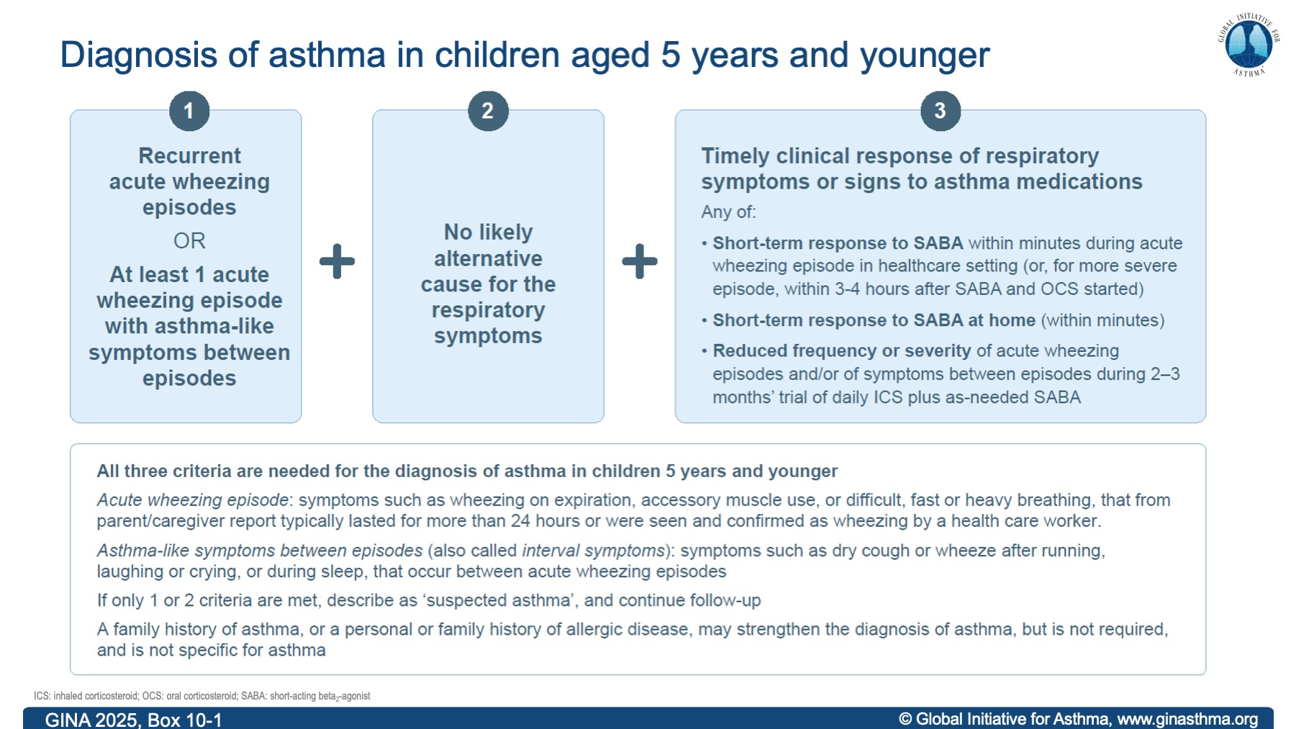
Notes:
November 2025: Definition of acute wheezing episode clarified; family history of asthma added in bottom line of the table

Slide 45
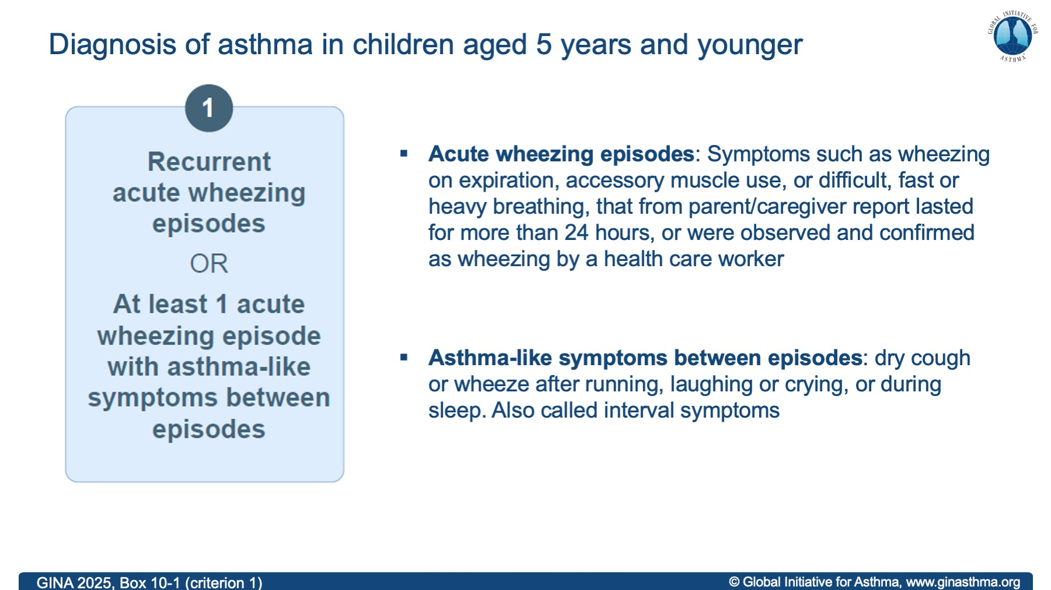
Notes:
November 2025: duration of 24 hours has been clarified – this is about past episodes reported by the parent or caregiver.

Slide 46
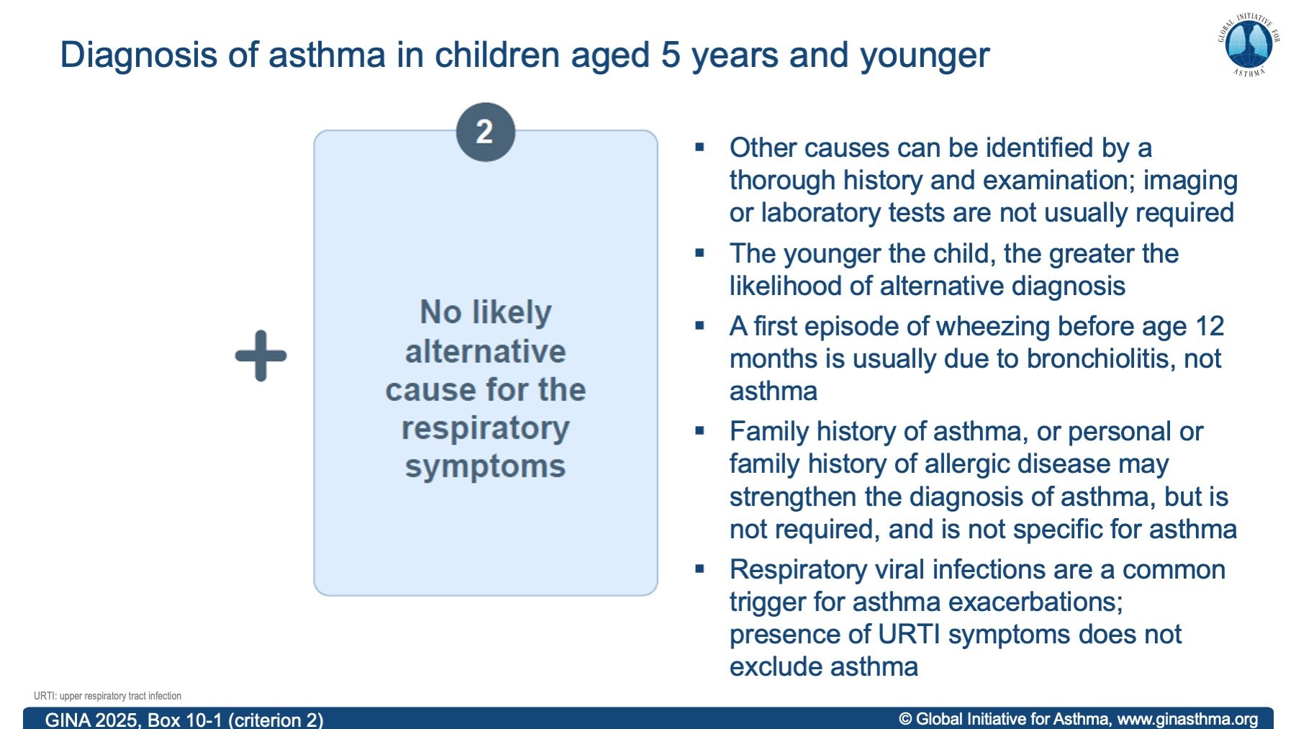
Notes:
November 2025: Text added for emphasis: Other causes can be identified by a thorough history and examination; imaging or laboratory tests are not usually required
Family history of asthma added in third bullet point

Slide 47
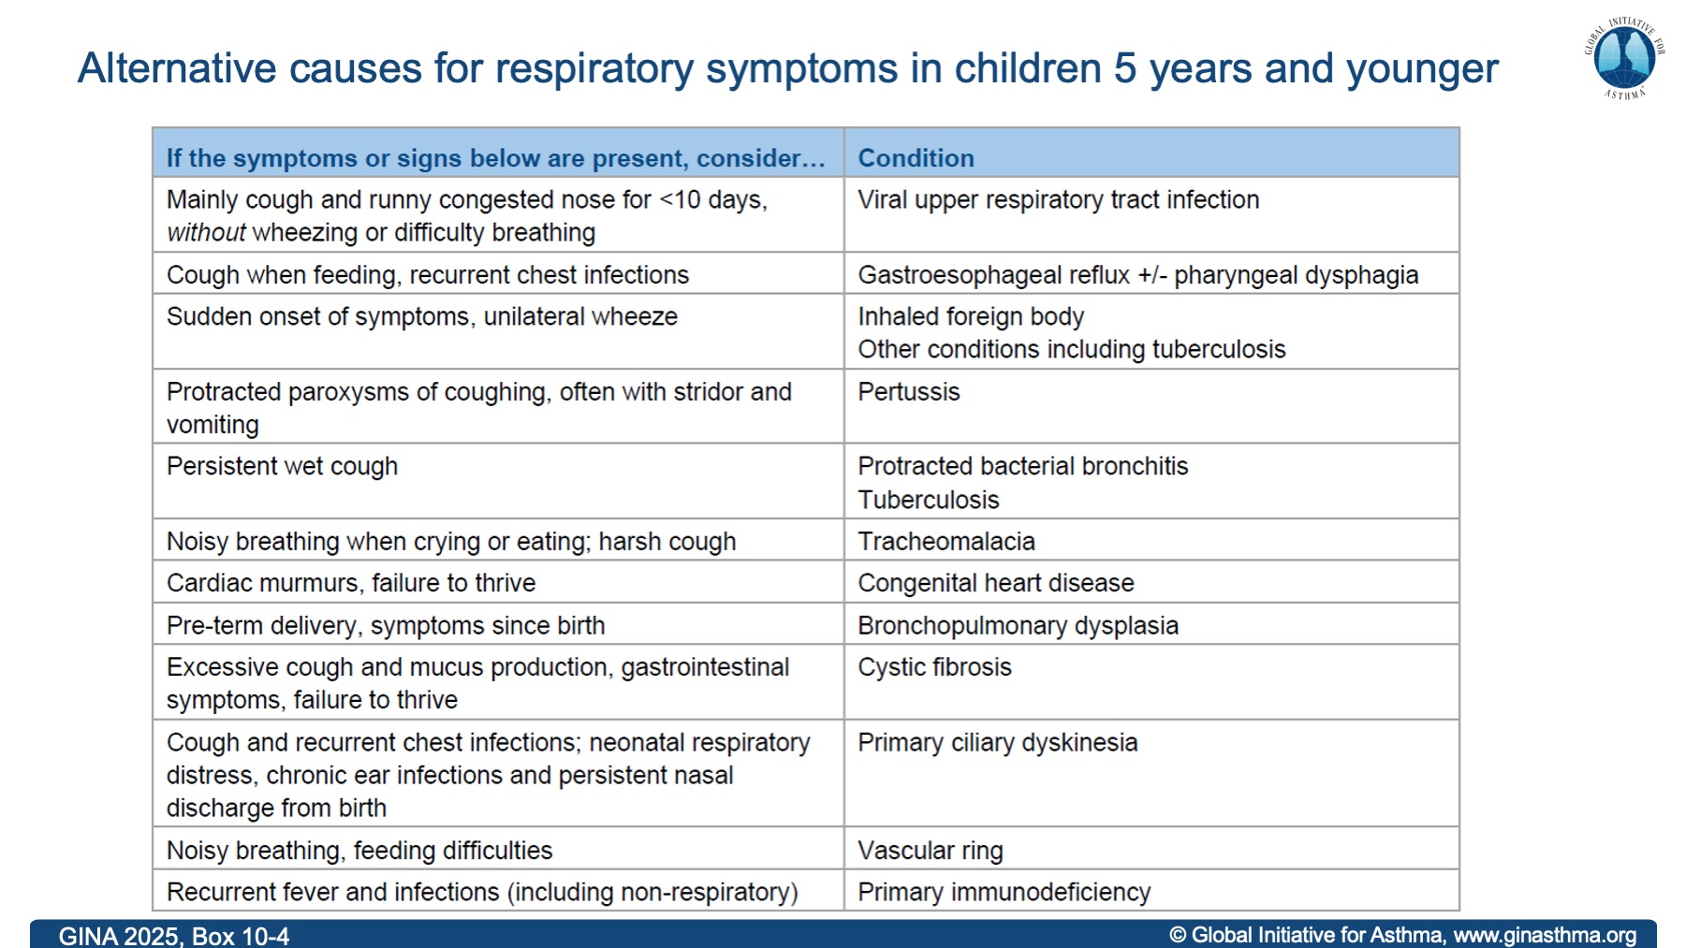

Slide 48
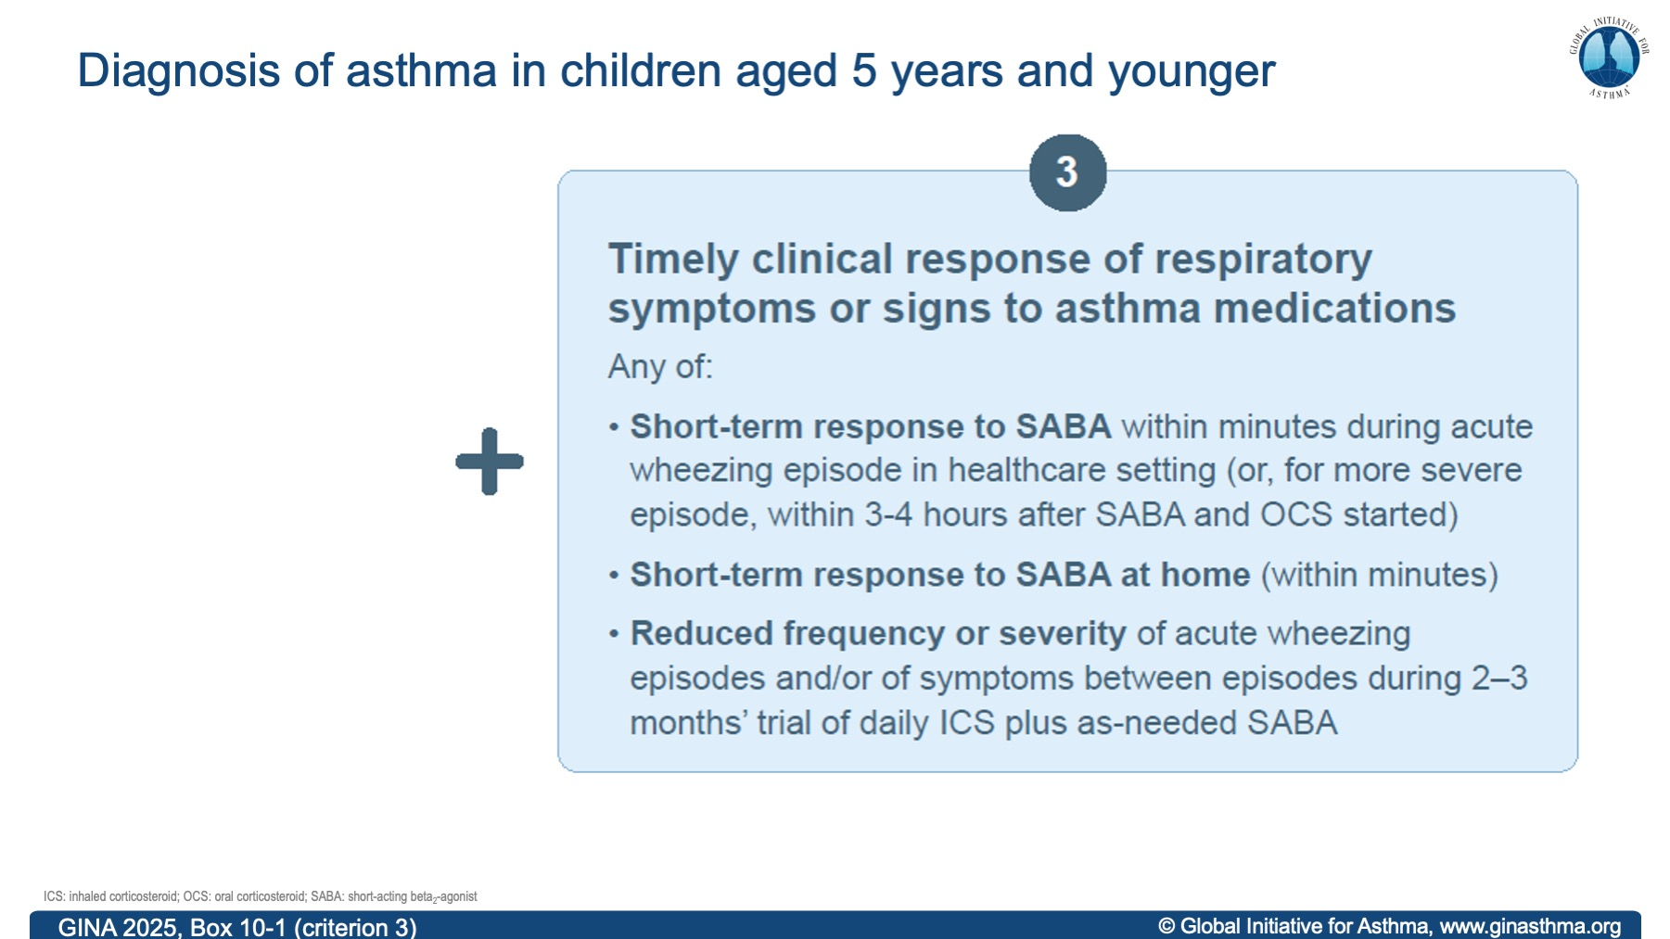
Notes:
Change in Nov 2025: bottom line: ‘…daily ICS plus as-needed SABA’

Slide 49
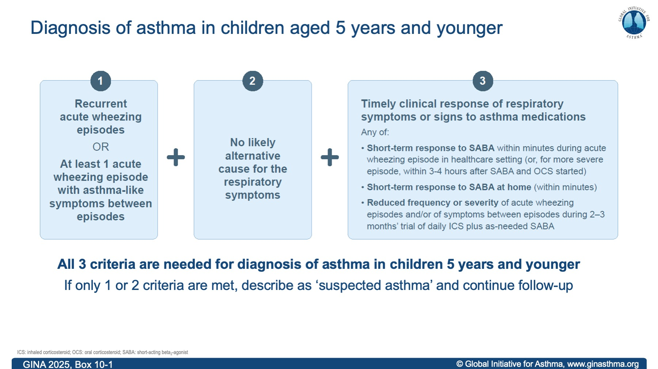

Slide 50
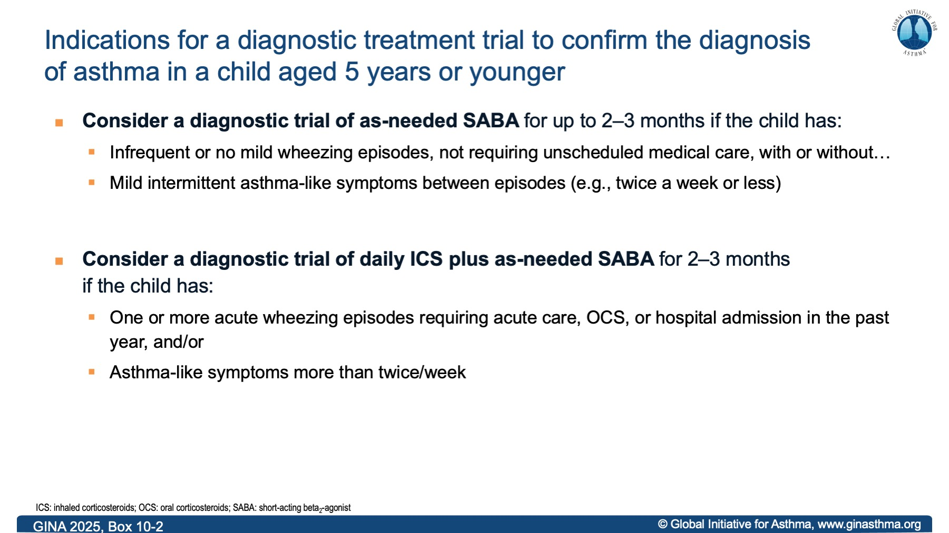
Notes:
November 2025: Edited to clarify that a trial of as-needed SABA is a diagnostic trial, for up to 2-3 months. Trial of daily ICS plus as-needed SABA is also a diagnostic trial.

Slide 51
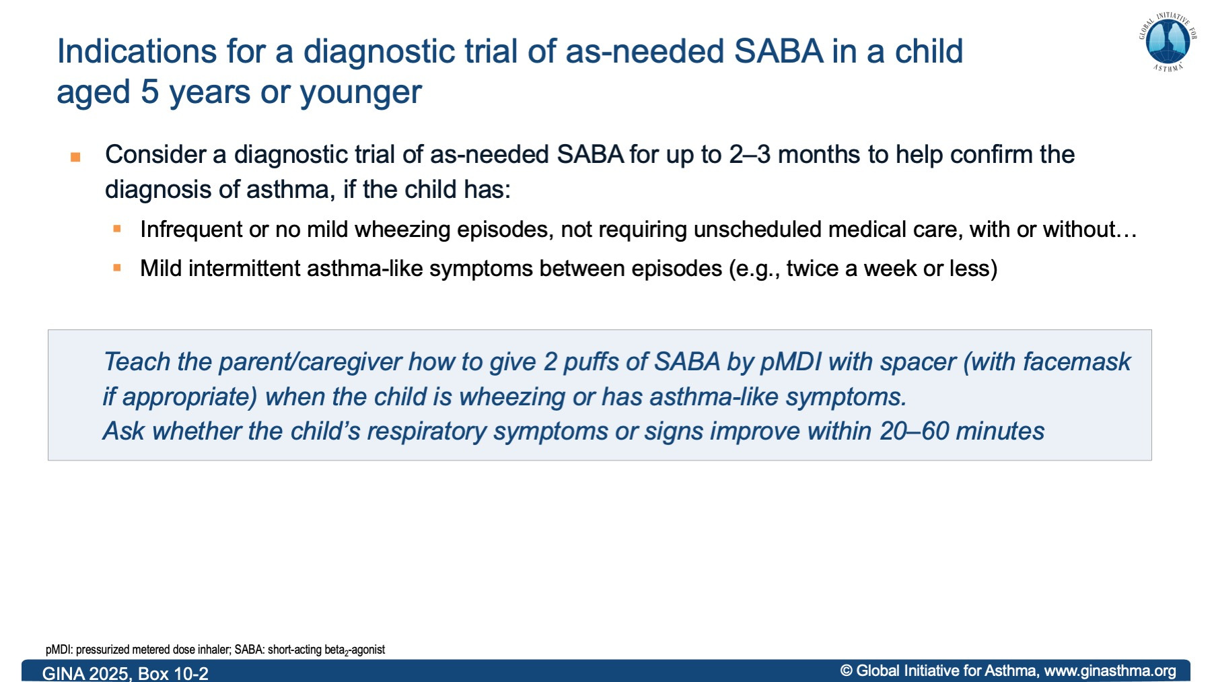
Notes:
November 2025: Edited to clarify that a trial of as-needed SABA would be a diagnostic trial, for up to 2-3 months

Slide 52


Slide 53


Slide 54

Difficult-to-treat and severe asthma

Slide 55


Slide 56


Slide 57


Slide 58


Slide 59


Slide 60


Slide 61


Slide 62

Asthma exacerbations

Slide 63


Slide 64


Slide 65


Slide 66


Slide 67


Slide 68

Extreme weather and asthma

Slide 69


Slide 70


Slide 71


GINA Resources
www.ginasthma.org
GINA Strategy Report 2025
GINA Summary Guide 2025
GINA Severe Asthma Guide 2025
GINA Slide Sets 2025
GINA Podcasts 2025
Commercial use requires permission under a written copyright agreement.
©Global Initiative for Asthma, www.ginasthma.org

