Slide 1


Slide 2
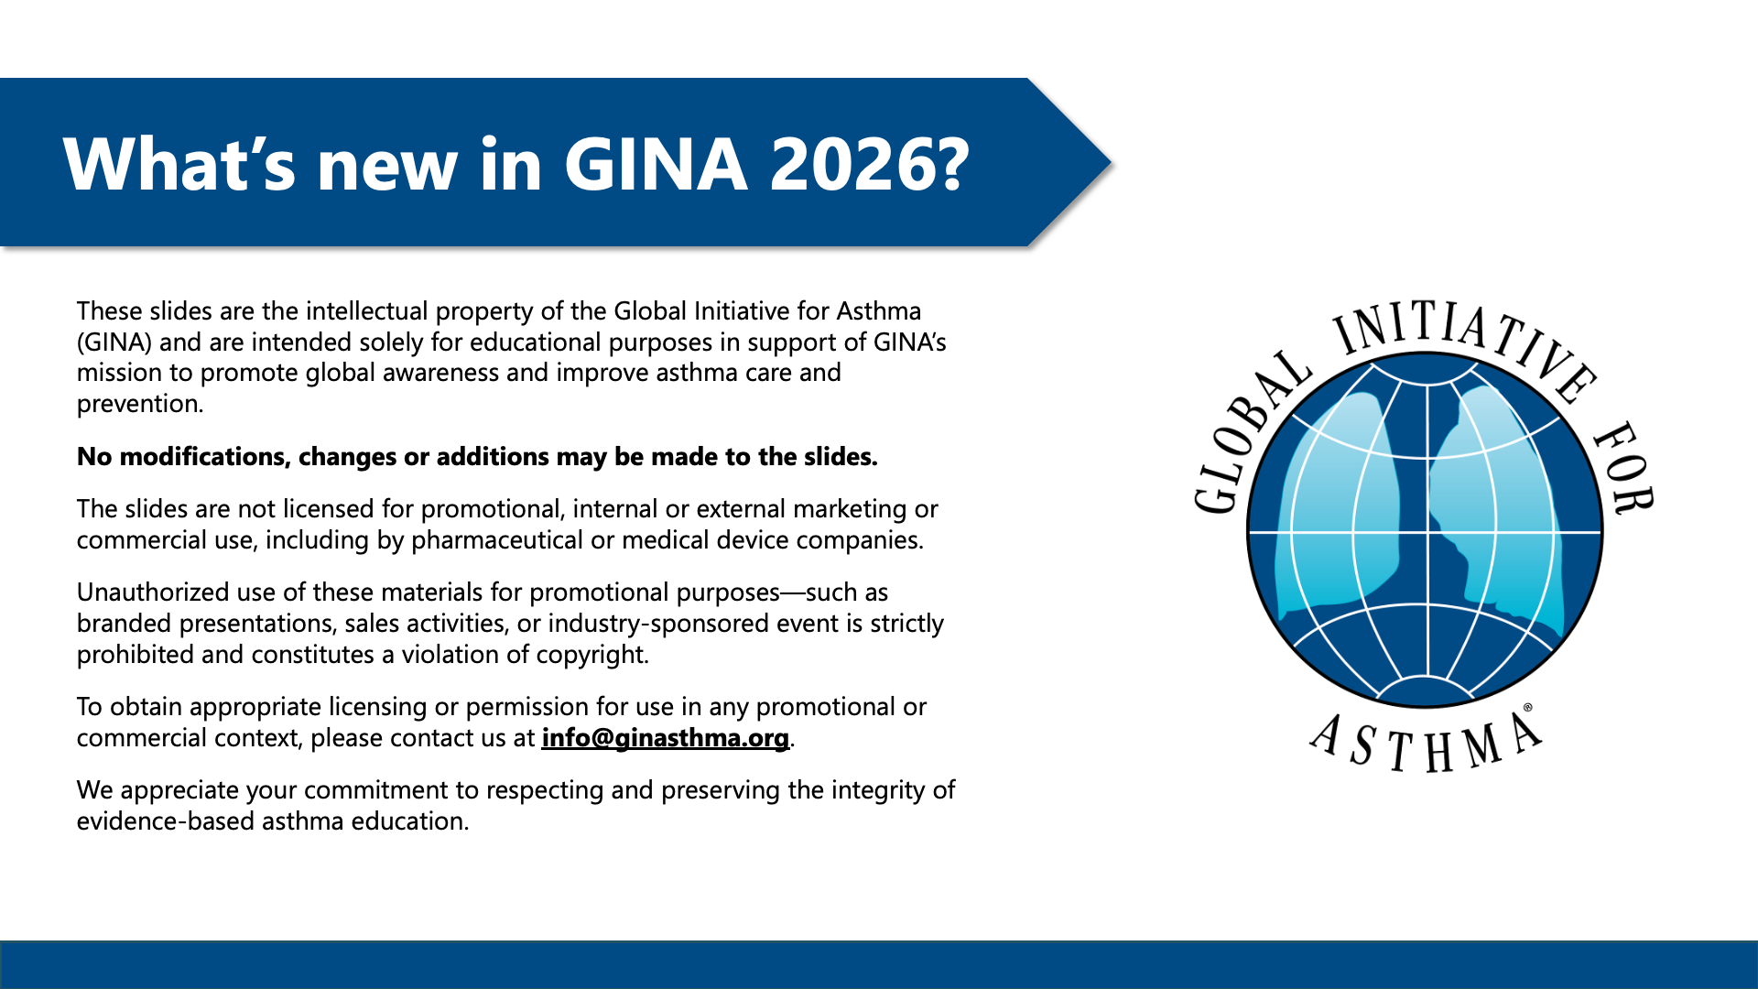

Slide 3
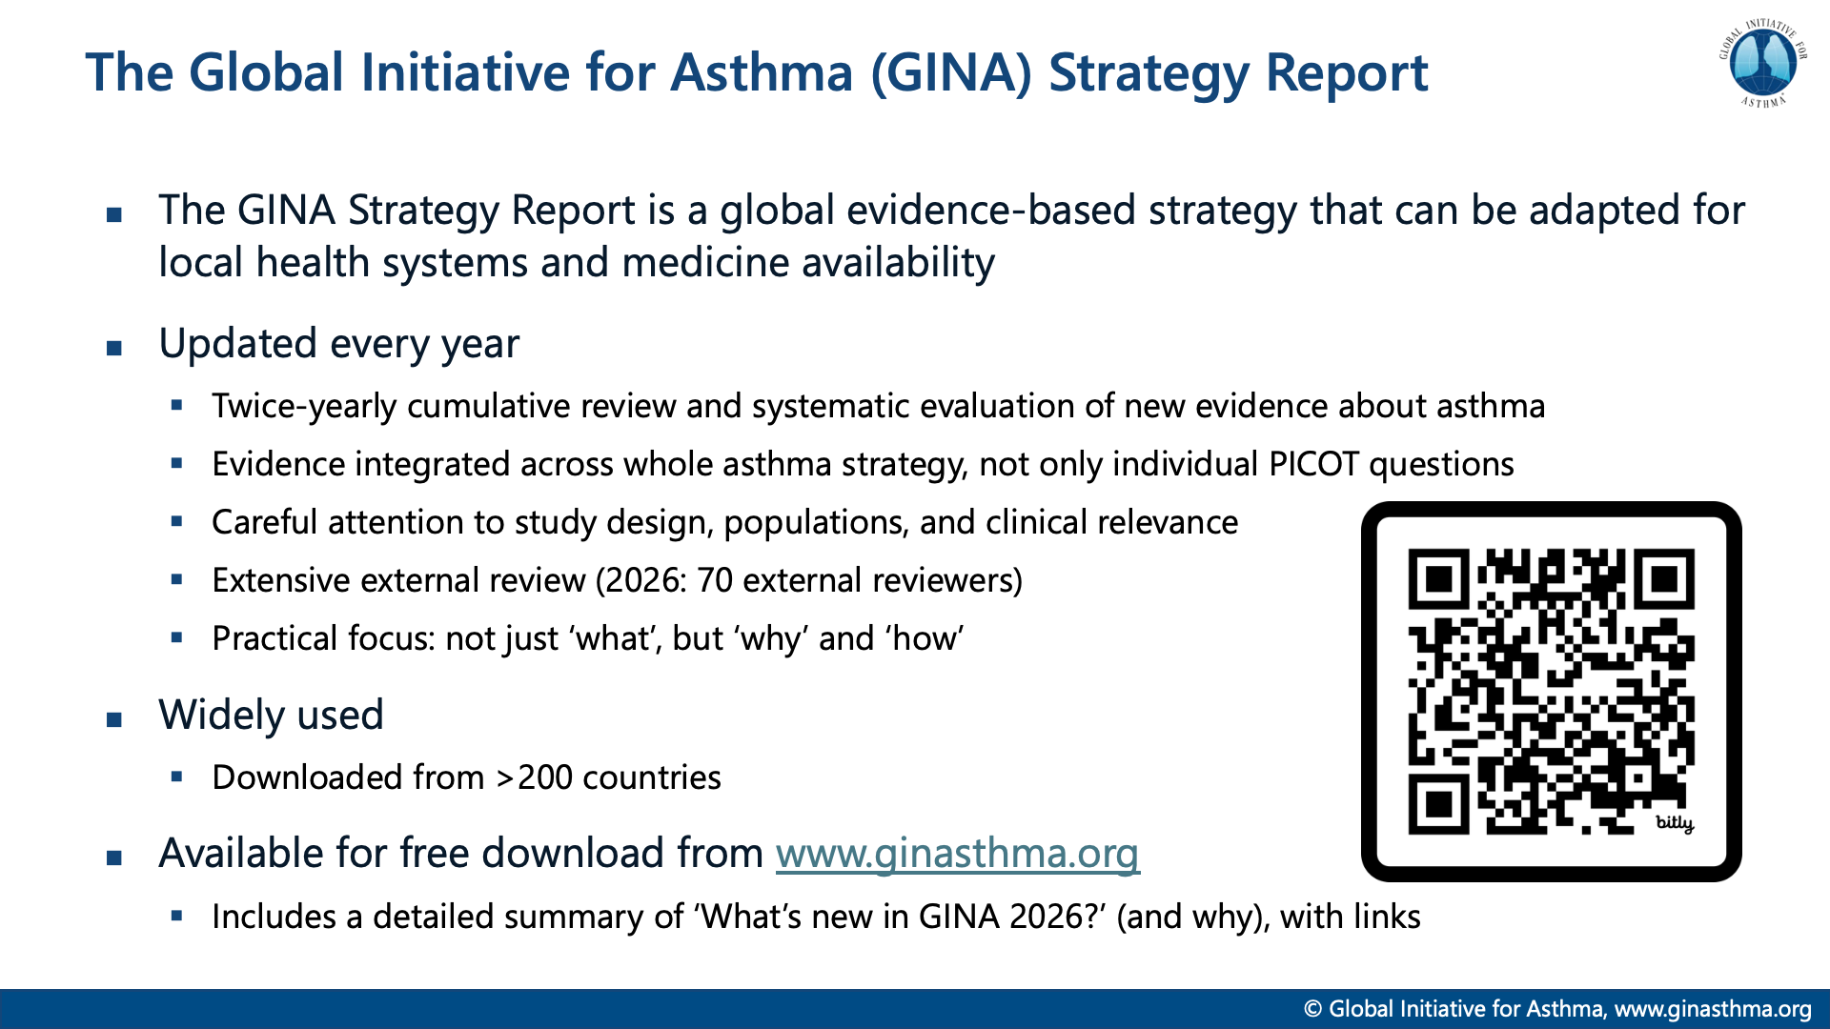

Slide 4
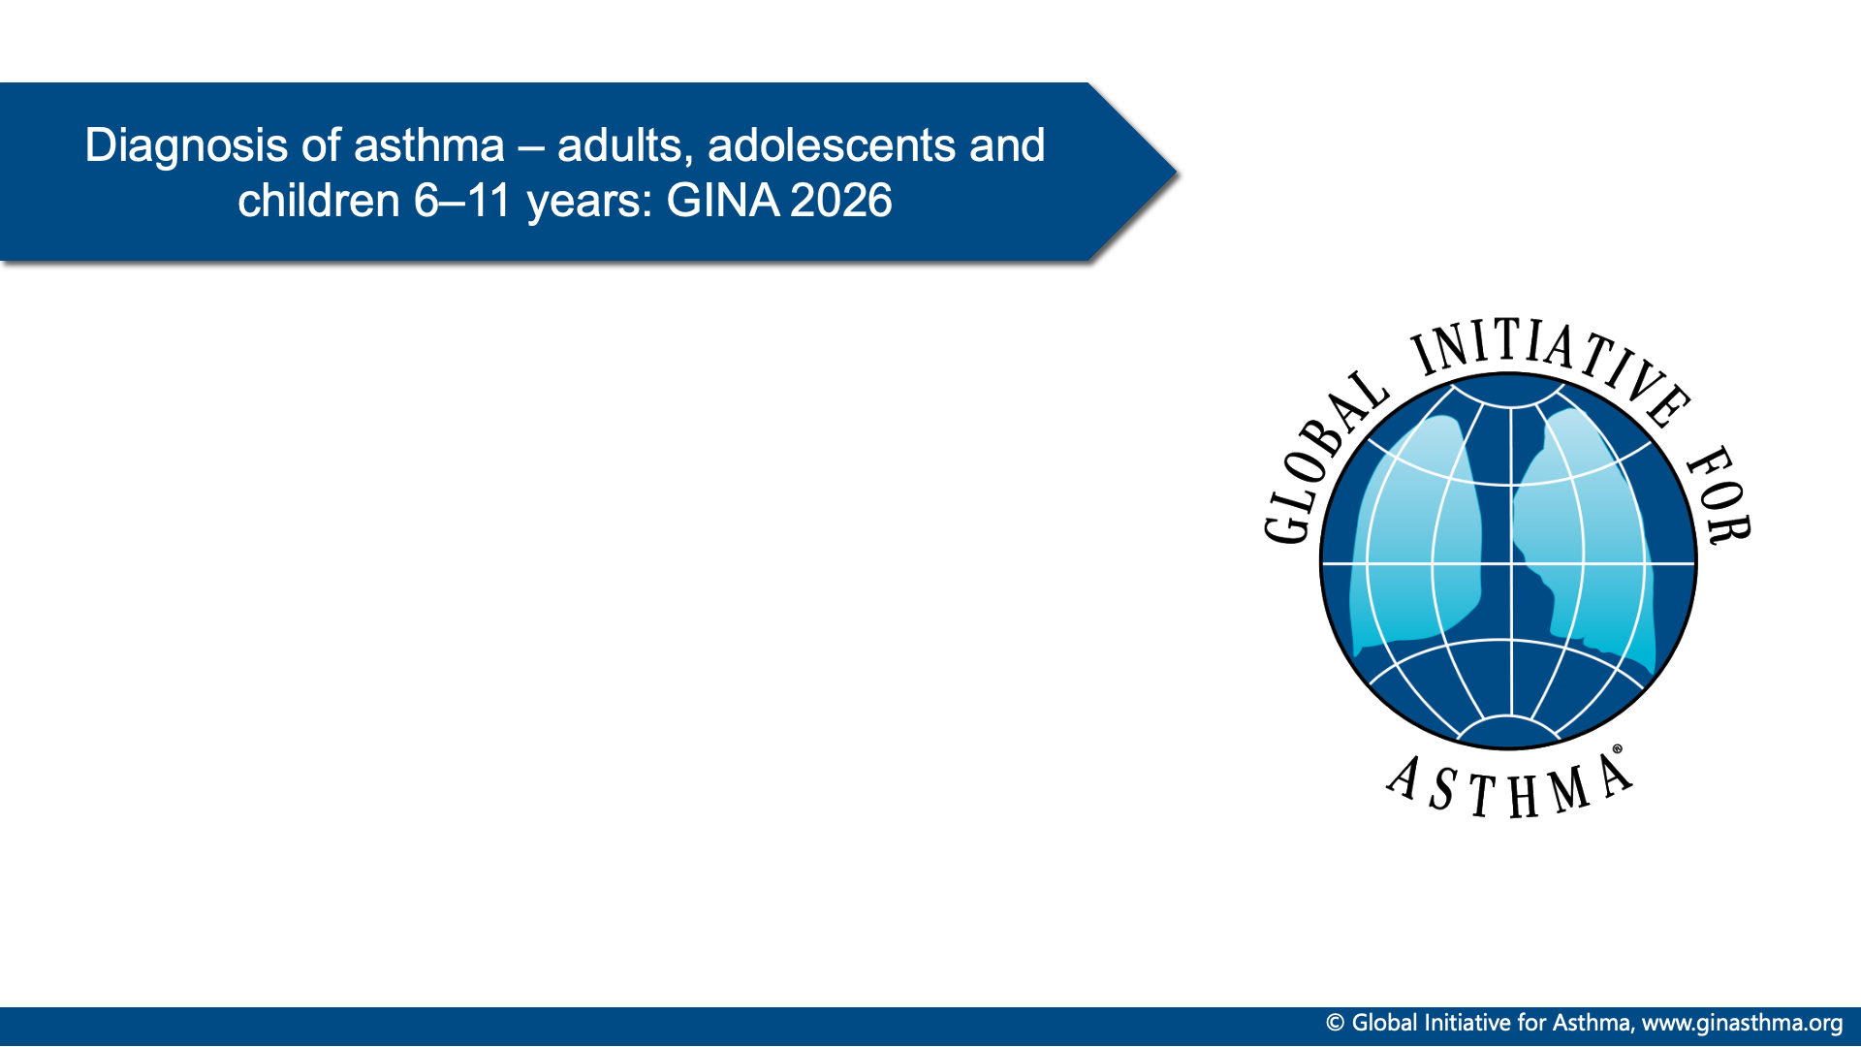

Slide 5
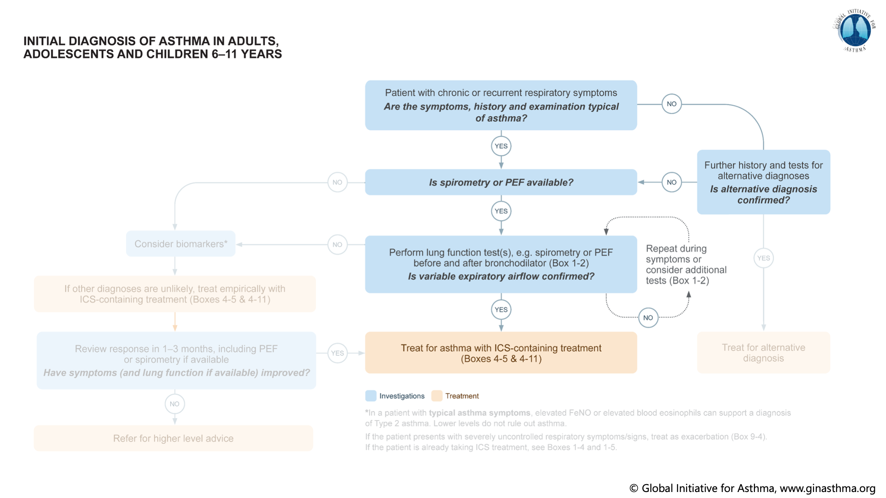
Notes:
This is v10 version

Slide 6
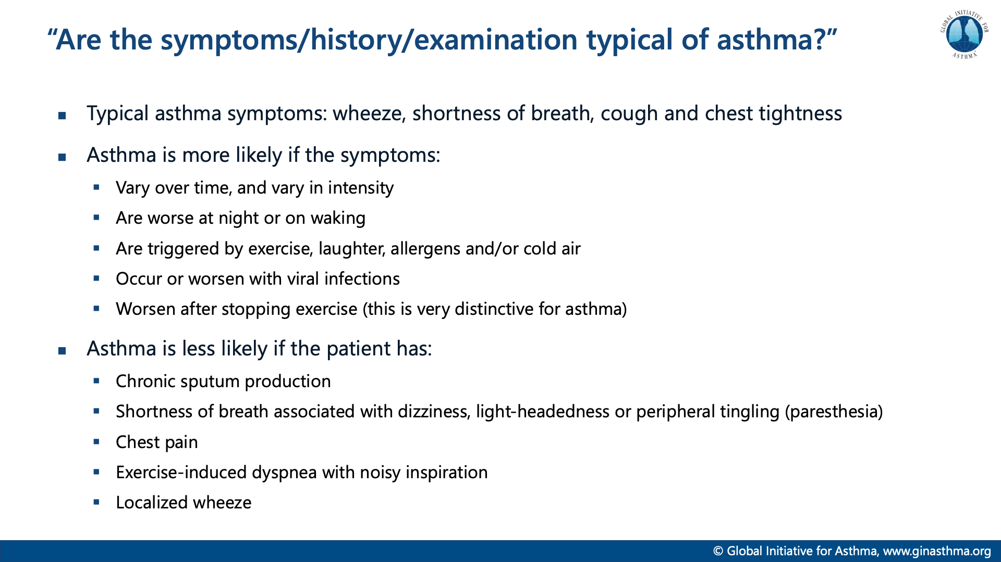

Slide 7
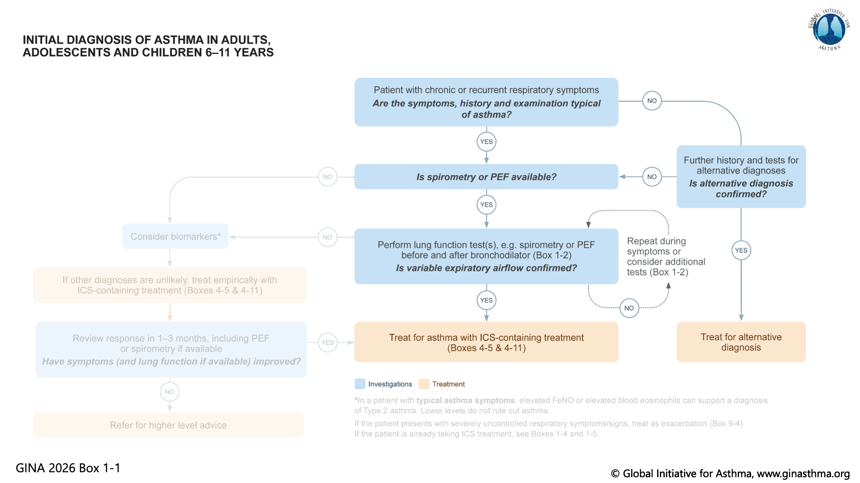
Notes:
This is v10 version

Slide 8
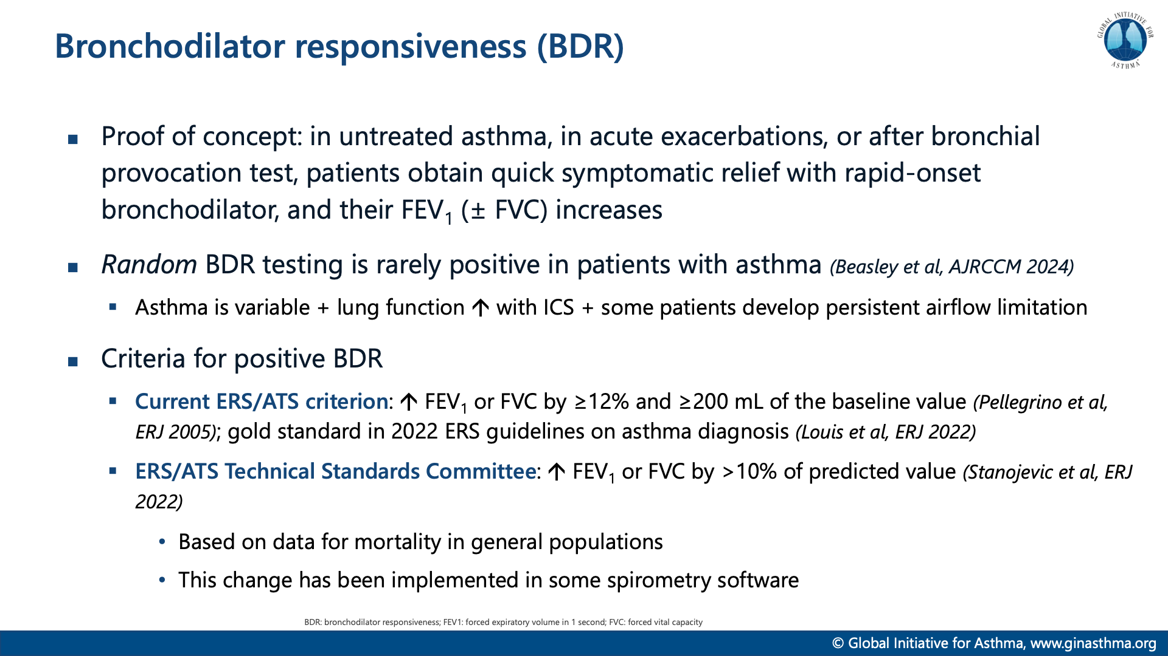

Slide 9
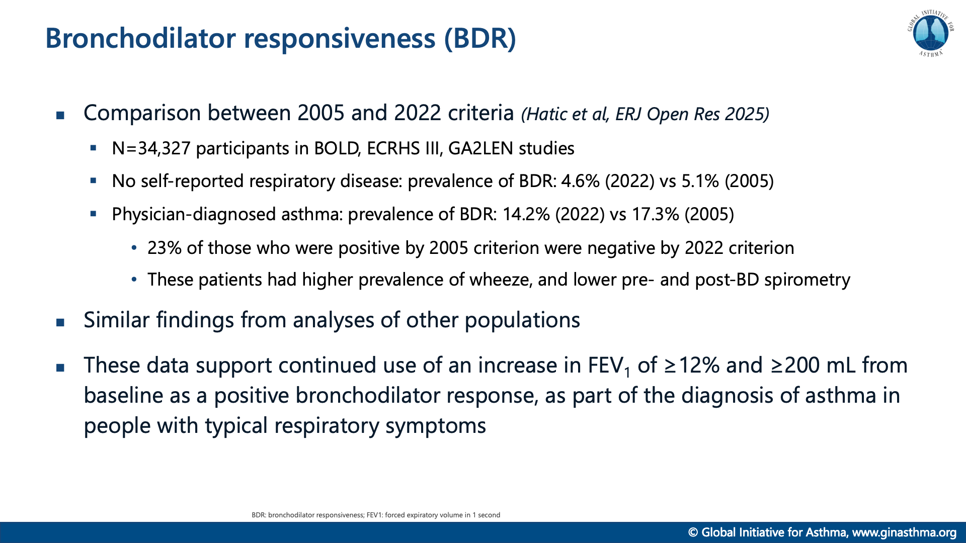

Slide 10
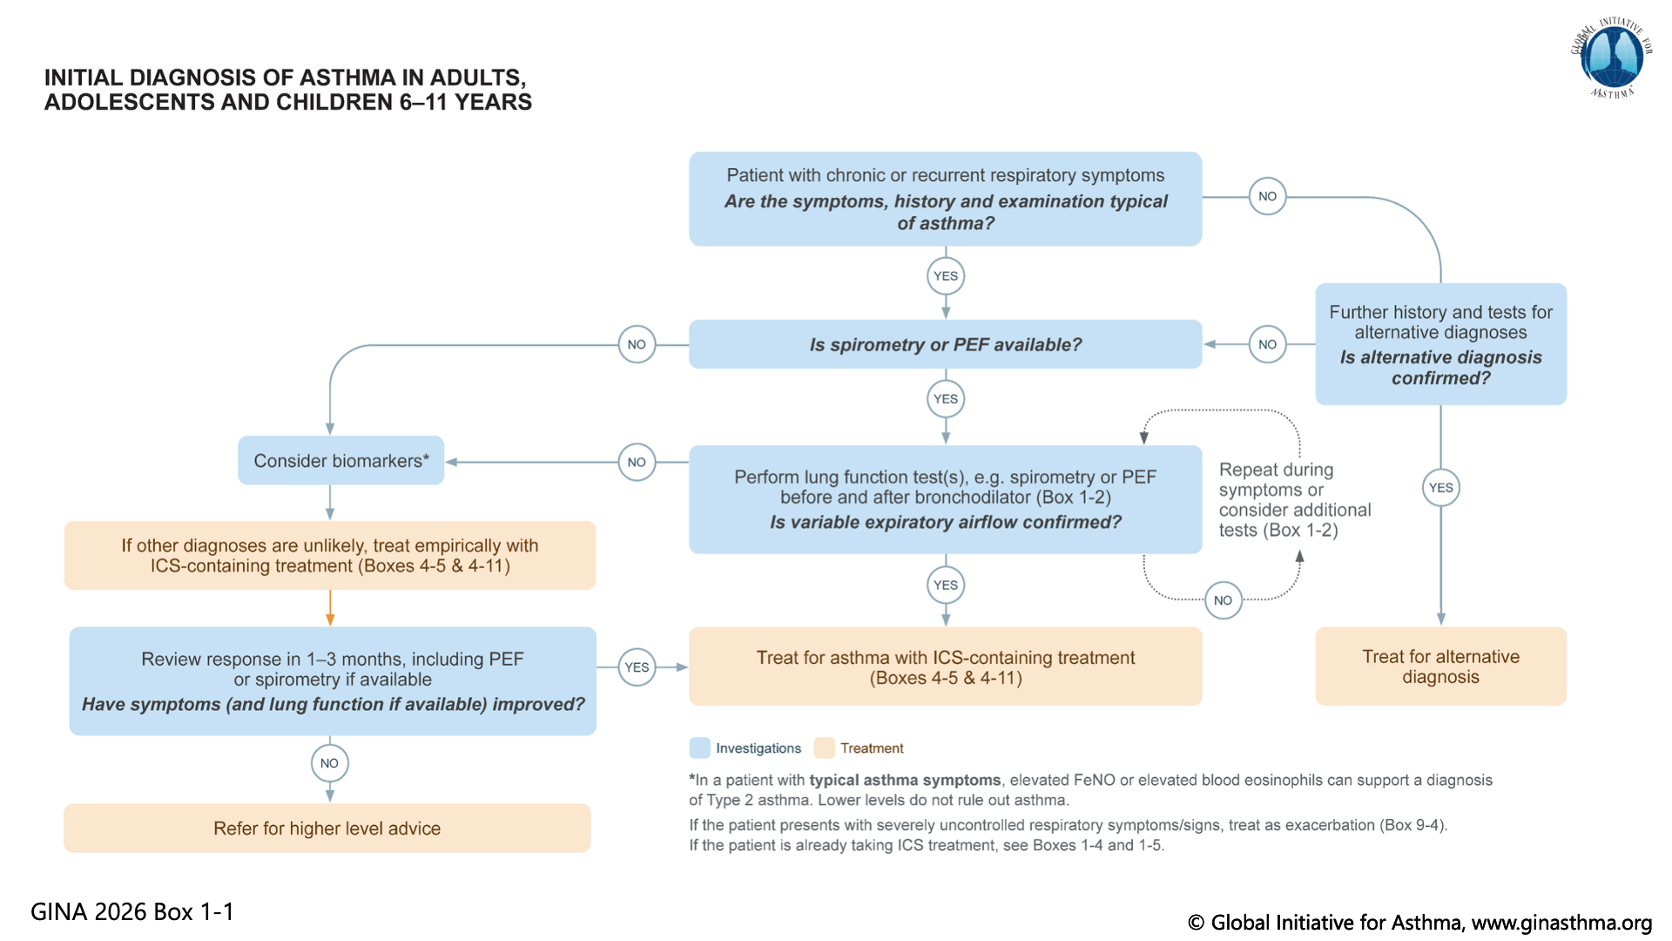
Notes:
This is v10 version

Slide 11
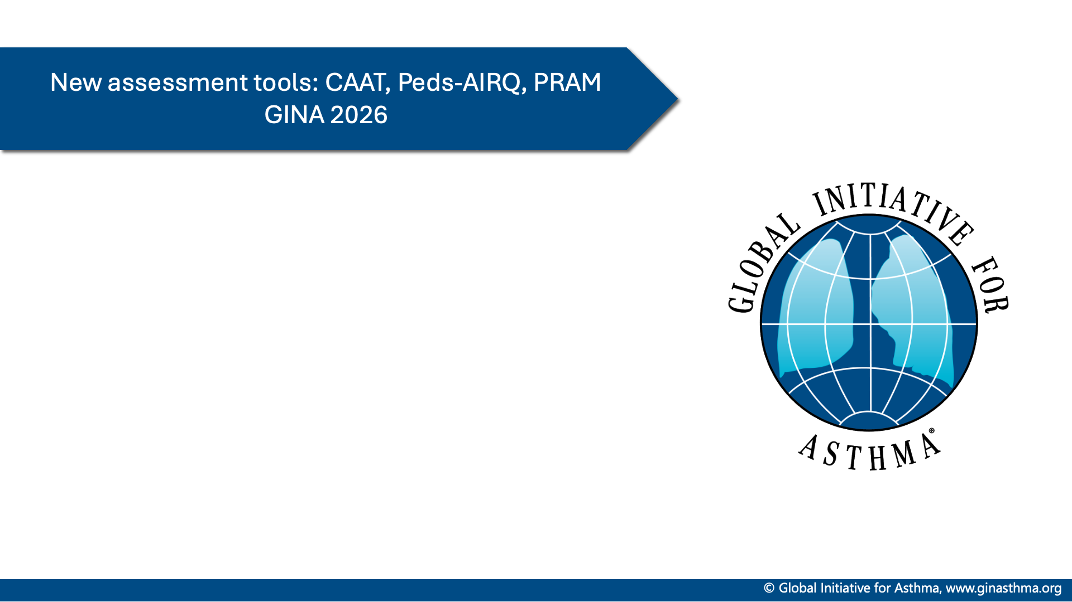

Slide 12
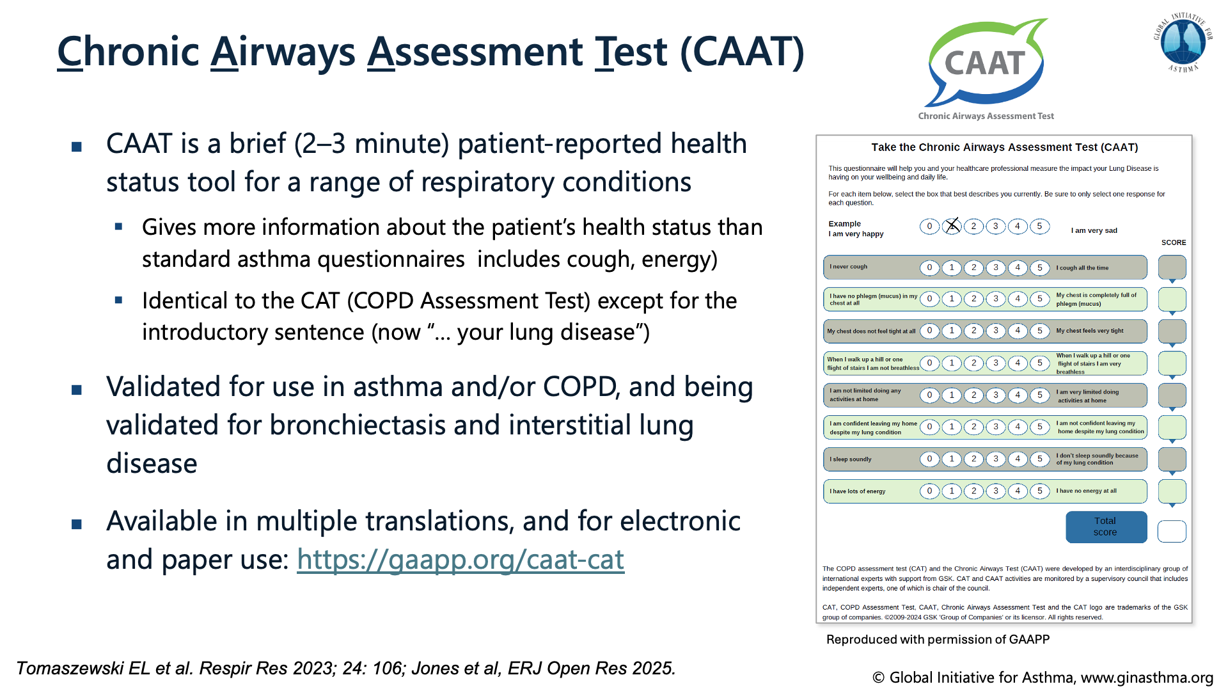

Slide 13
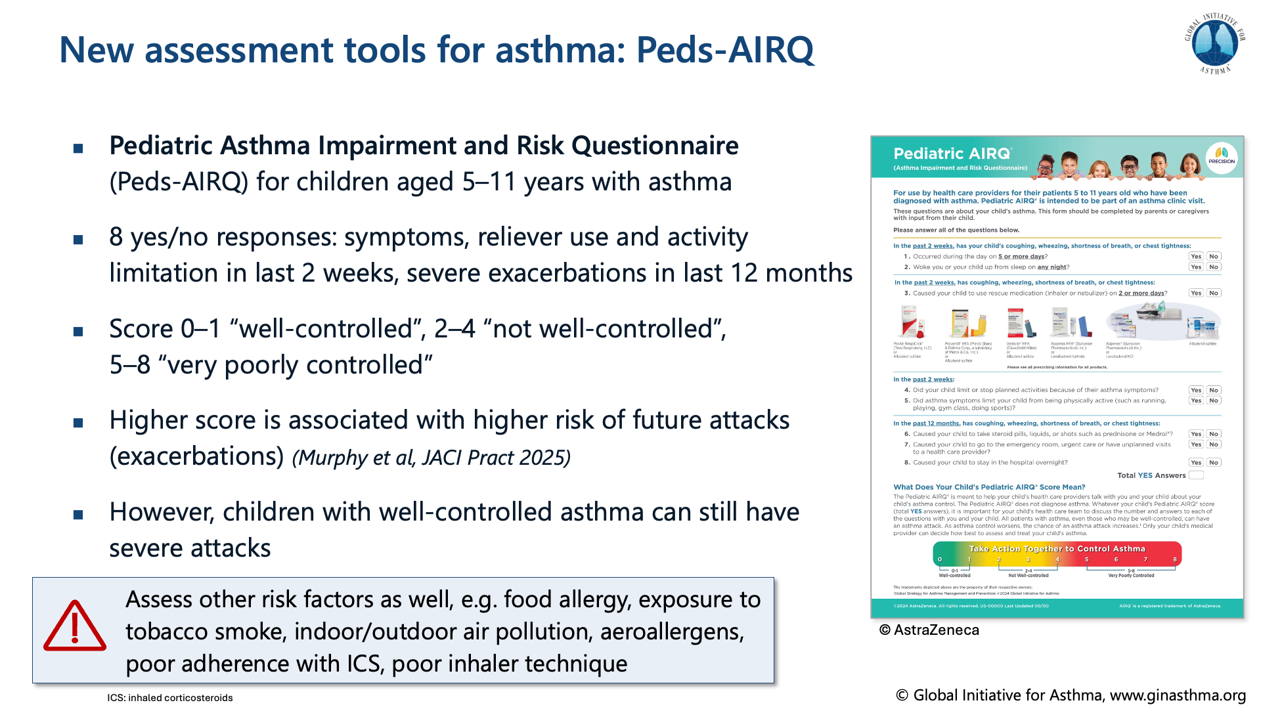
Notes:
Third parties are allowed to use the Peds-AIRQ free of charge

Slide 14
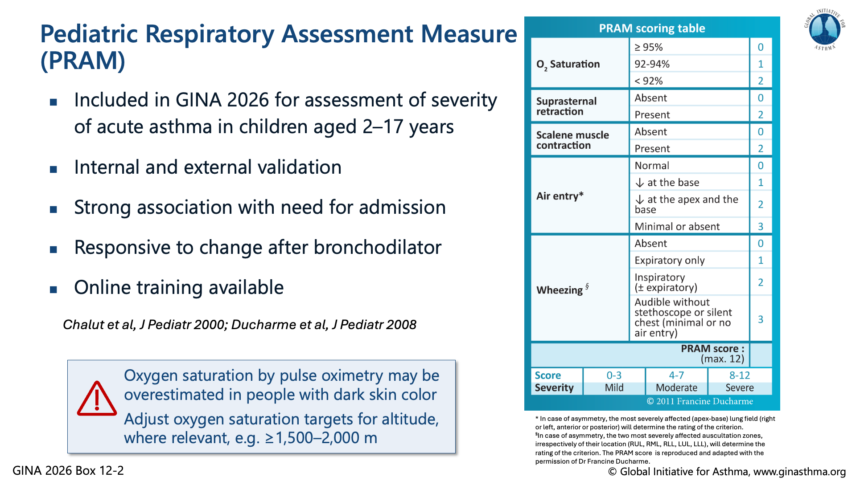
Notes:
References to be added

Slide 15
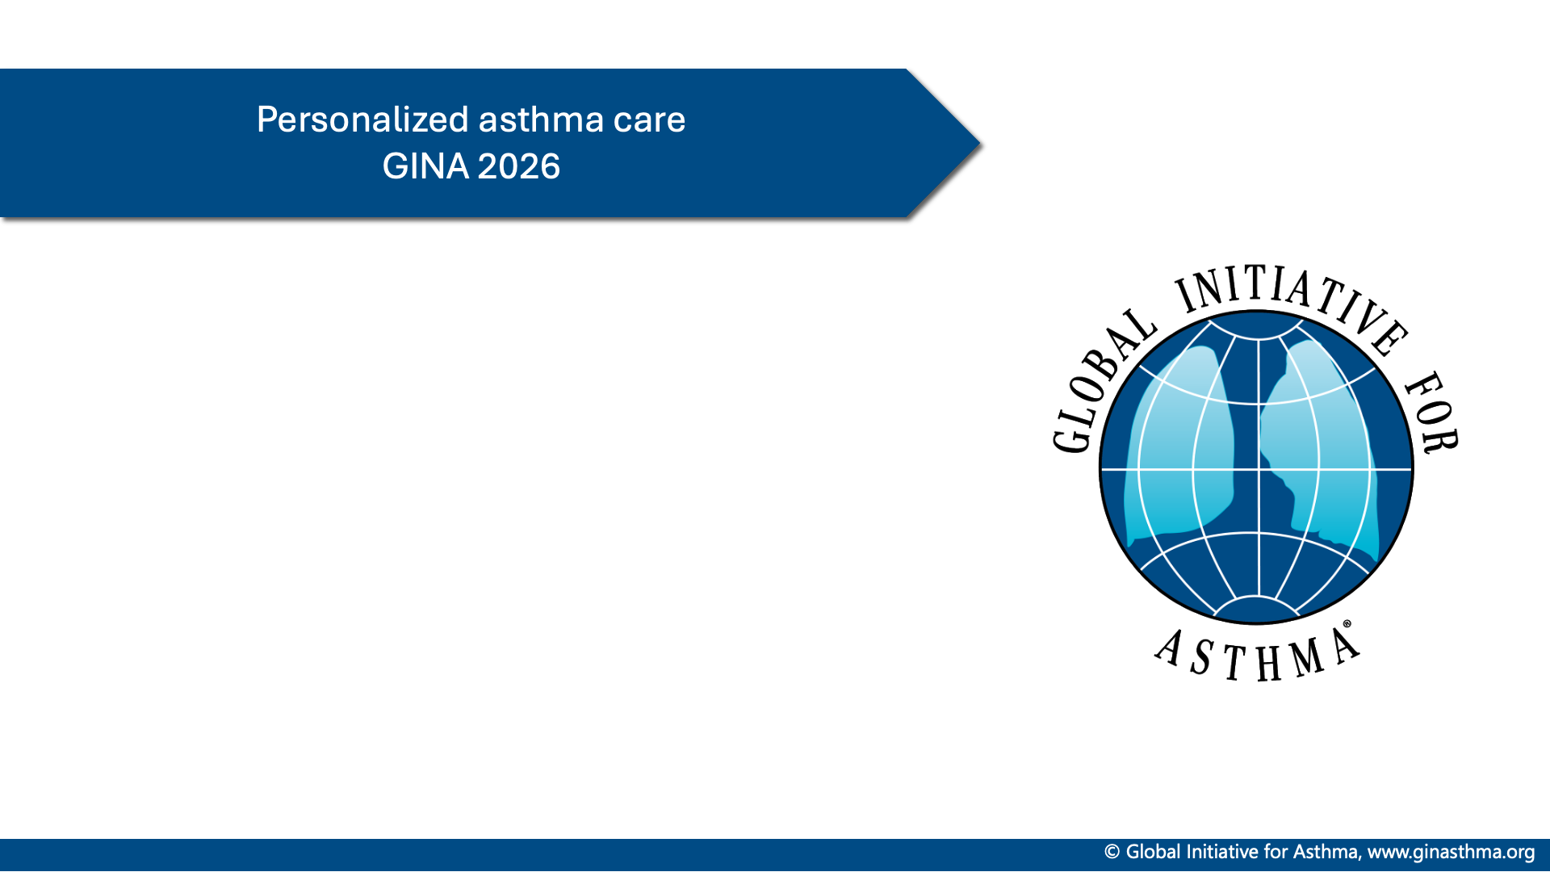

Slide 16
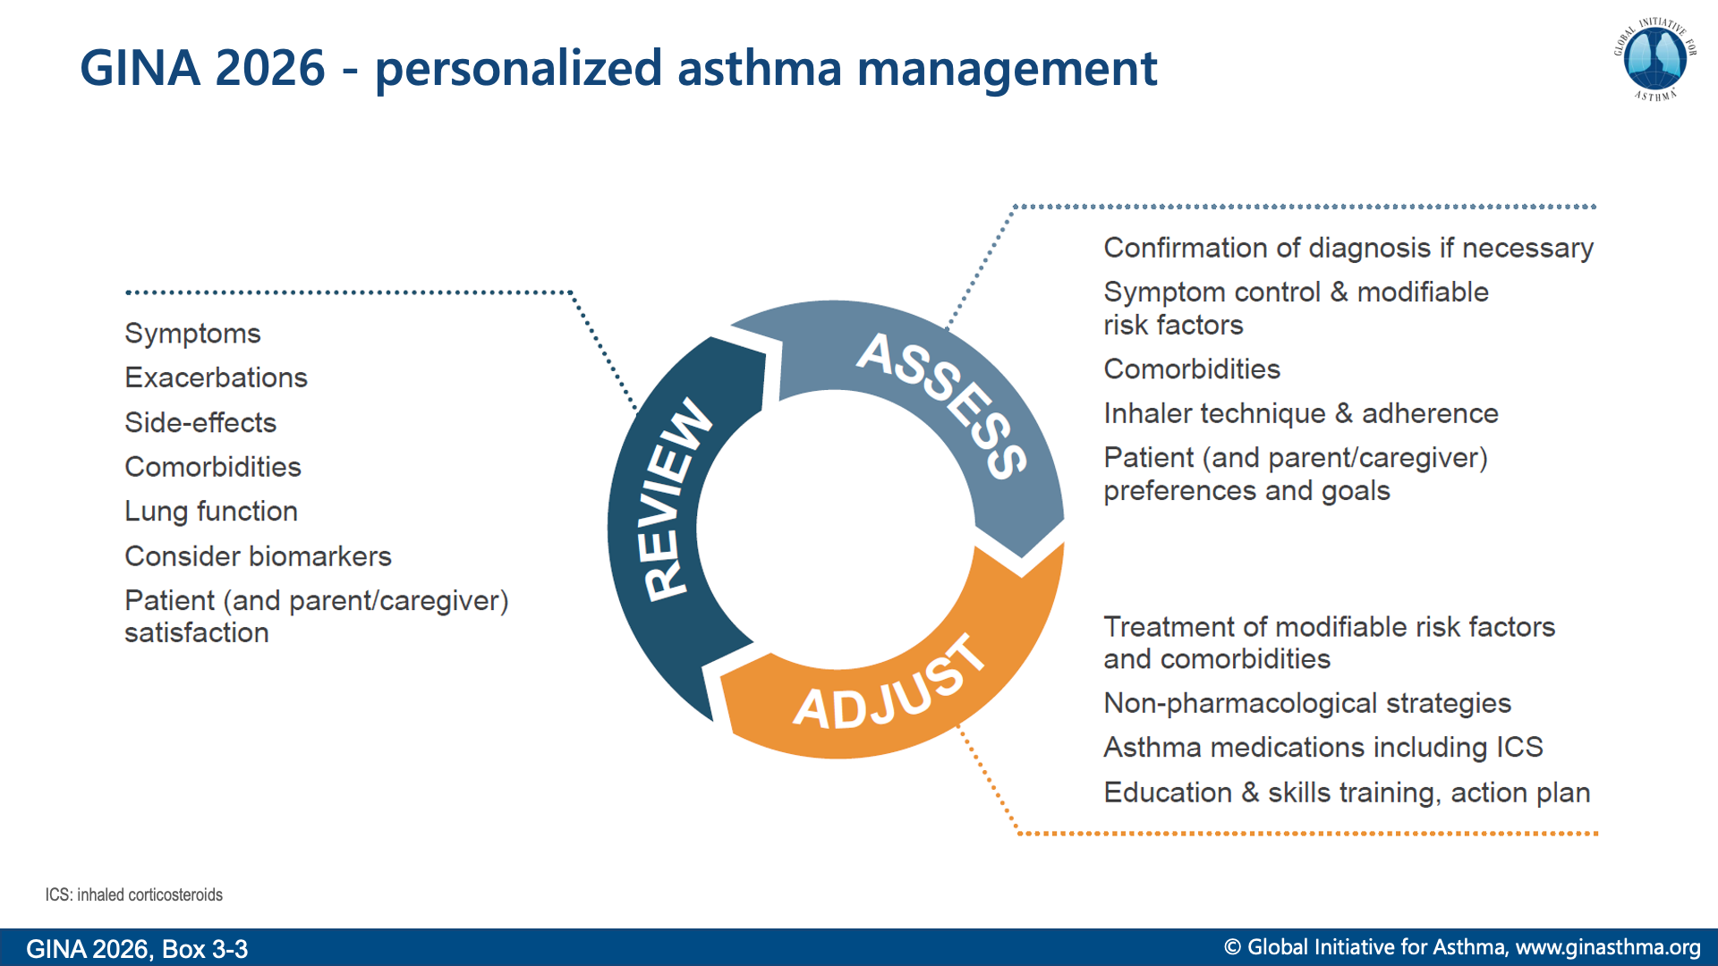
Notes:
Asthma treatment is not one-size-fits-all, and not just about medications
Explain that biomarkers are included in ‘Review response’ rather than earlier in the cycle, because they are most commonly elevated due to poor adherence and/or incorrect inhaler technique with ICS-containing medications; these problems are very common, and should be addressed first

Slide 17
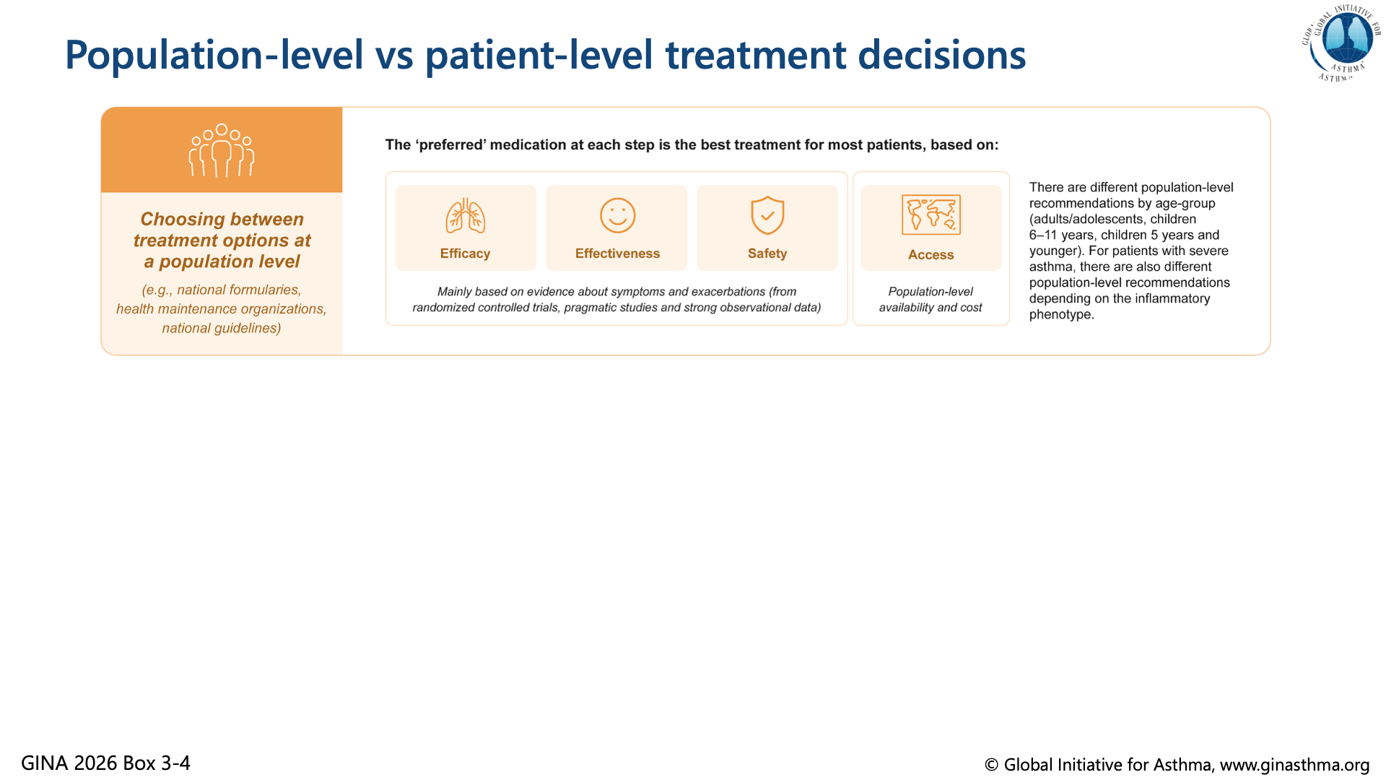

Slide 18


Slide 19
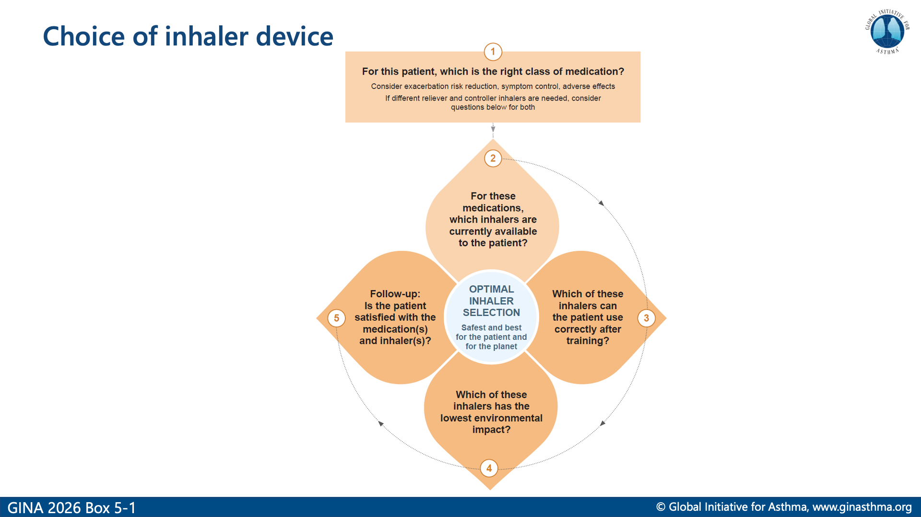
Notes:
For an individual patient, environmental impact of the inhaler is only relevant if the medication that the patient needs is available in more than one type of device and the patient can use both equally well!
Mention that some patients cannot use DPIs, e.g. young children, some elderly

Slide 20
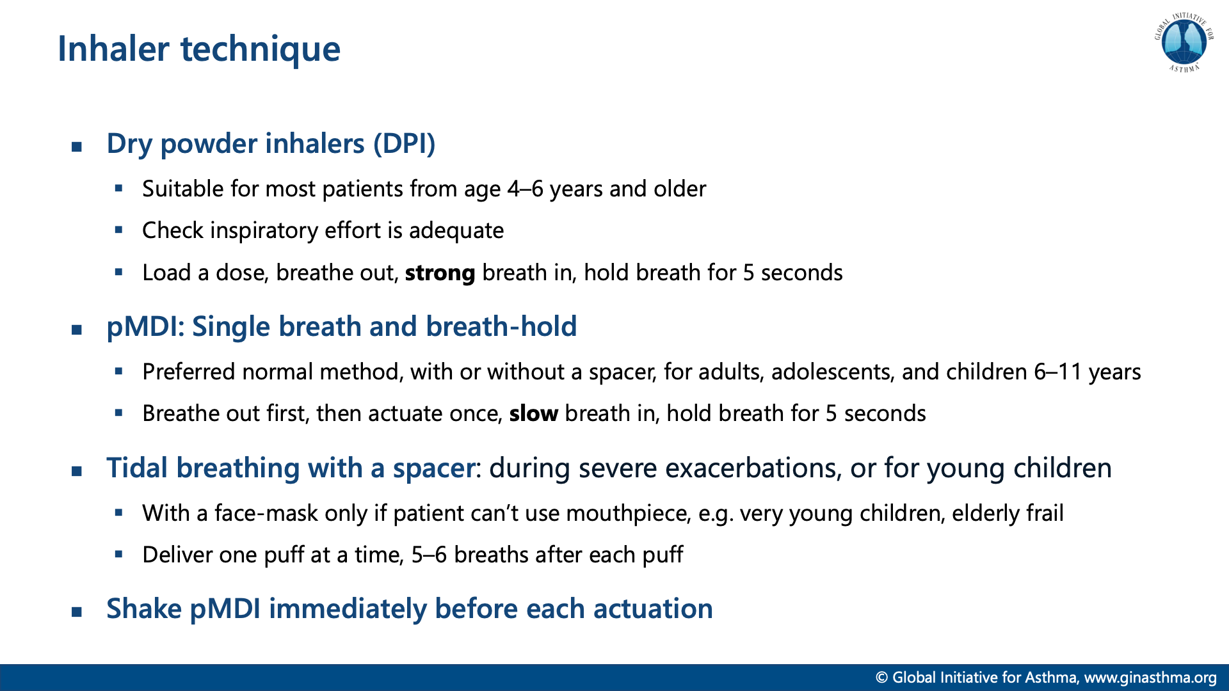

Slide 21
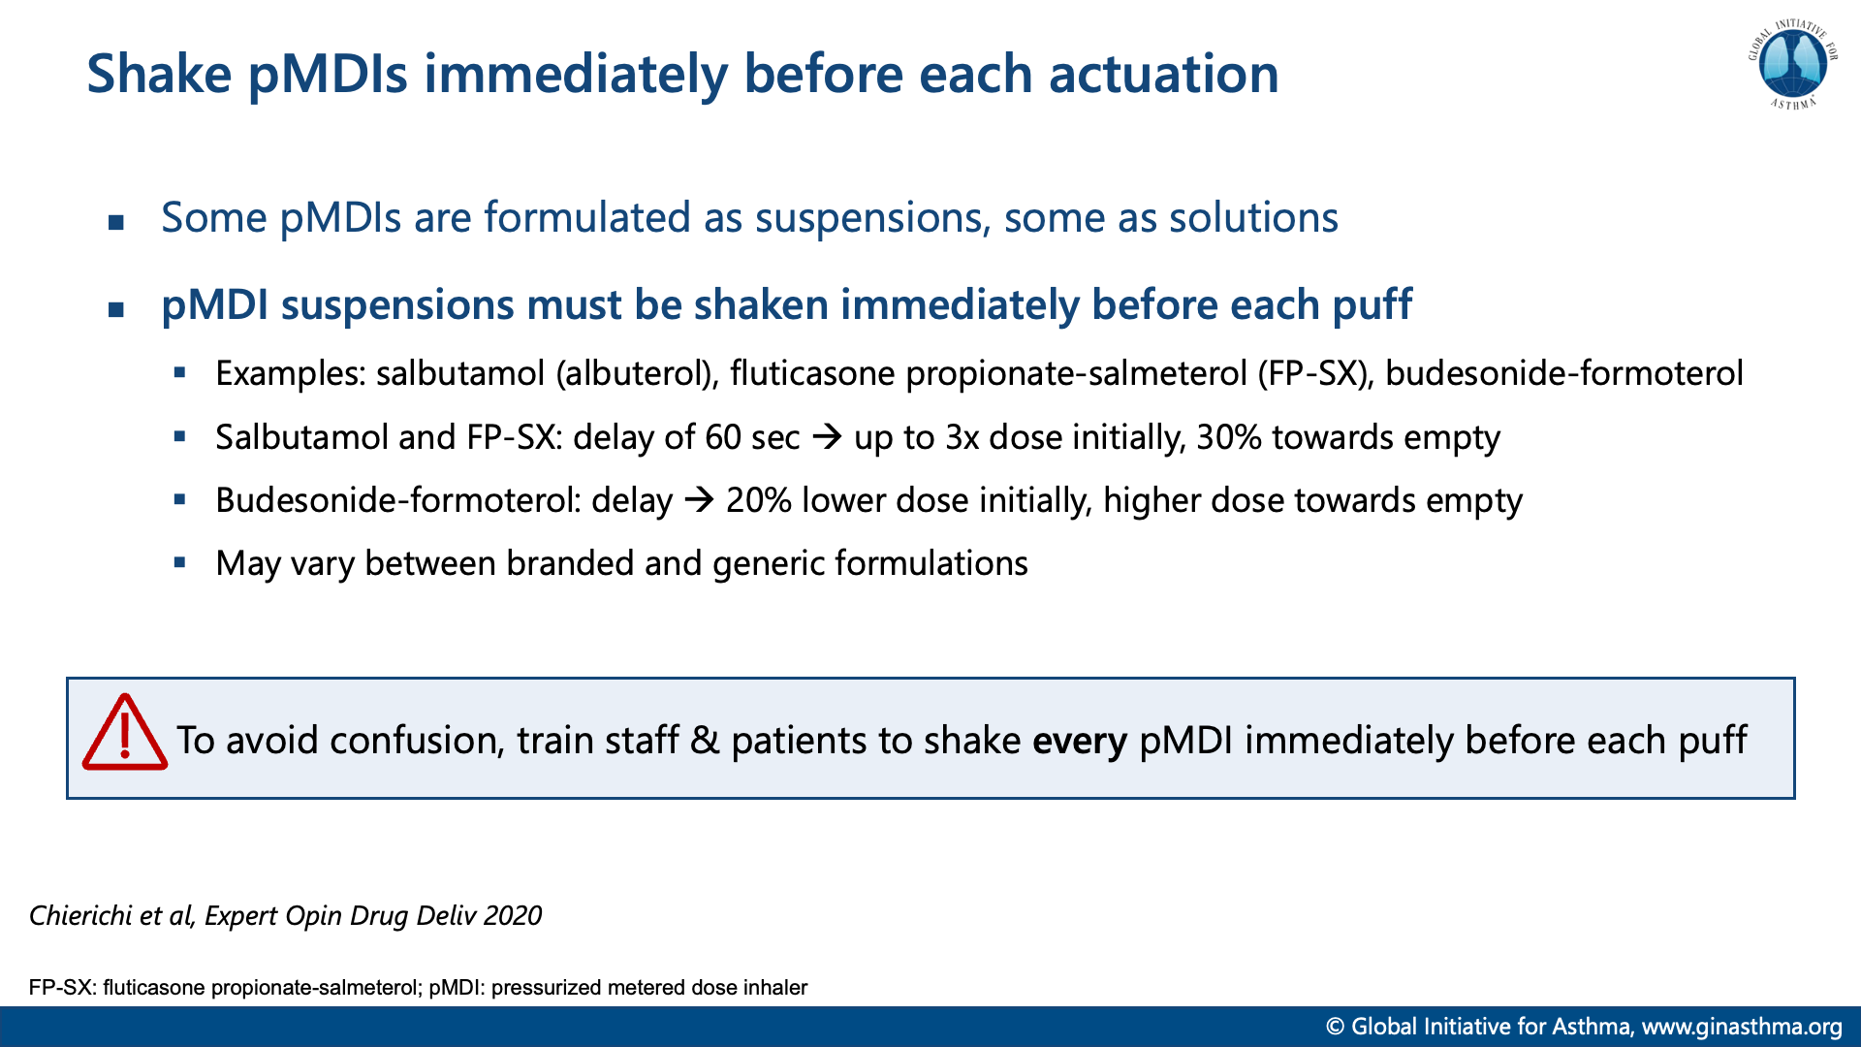

Slide 22


Slide 23
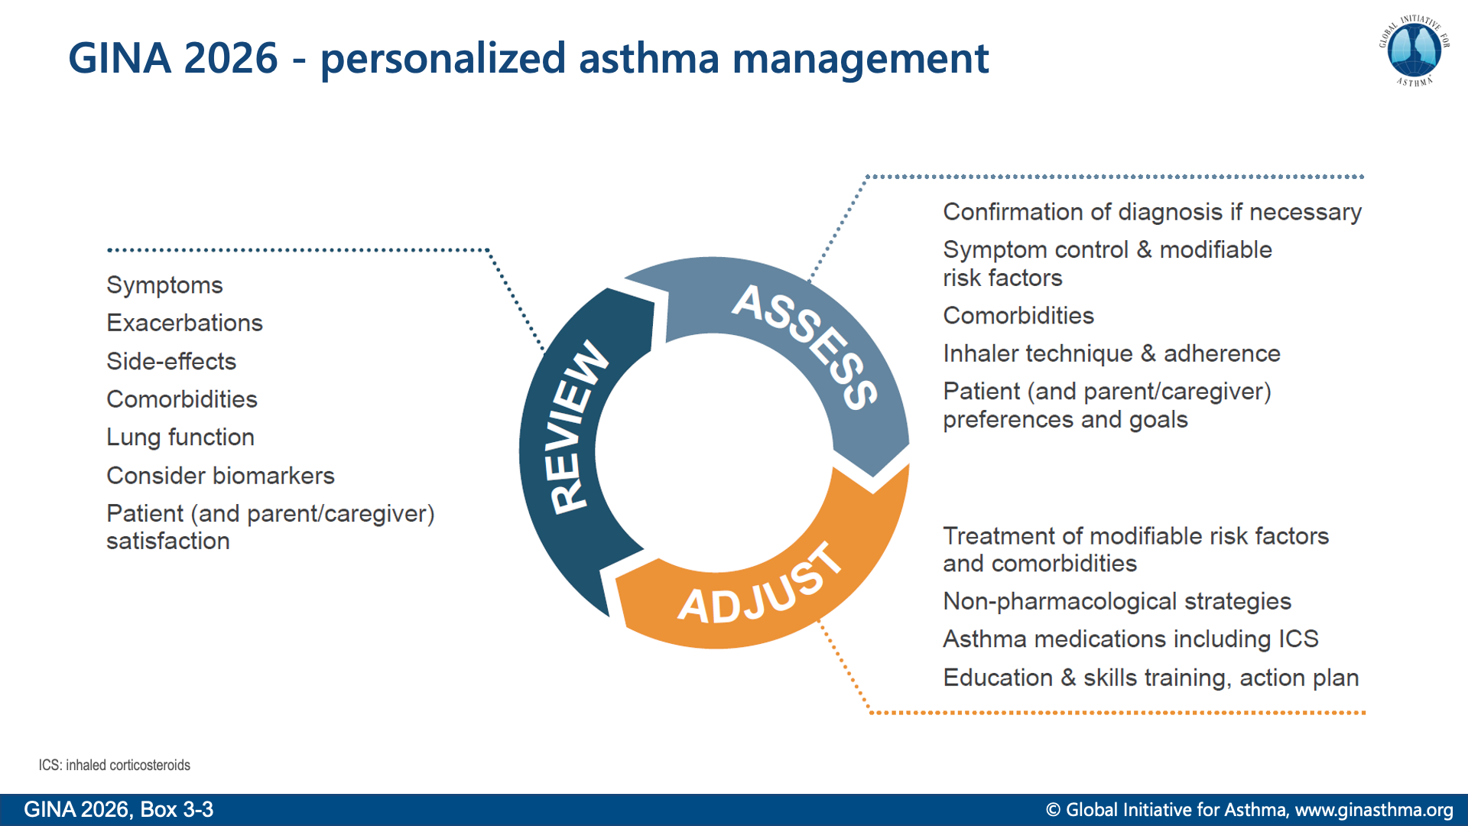
Notes:
Asthma treatment is not one-size-fits-all, and not just about medications
Explain that biomarkers are included in ‘Review response’ rather than earlier in the cycle, because they are most commonly elevated due to poor adherence and/or incorrect inhaler technique with ICS-containing medications; these problems are very common, and should be addressed first

Slide 24
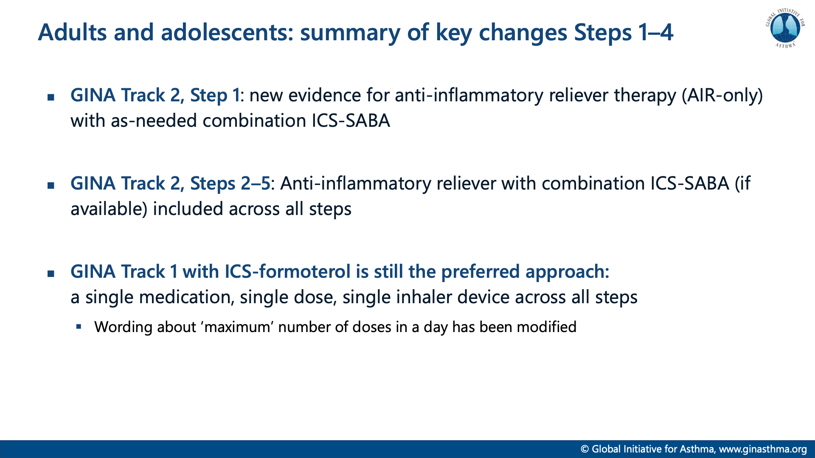

Slide 25
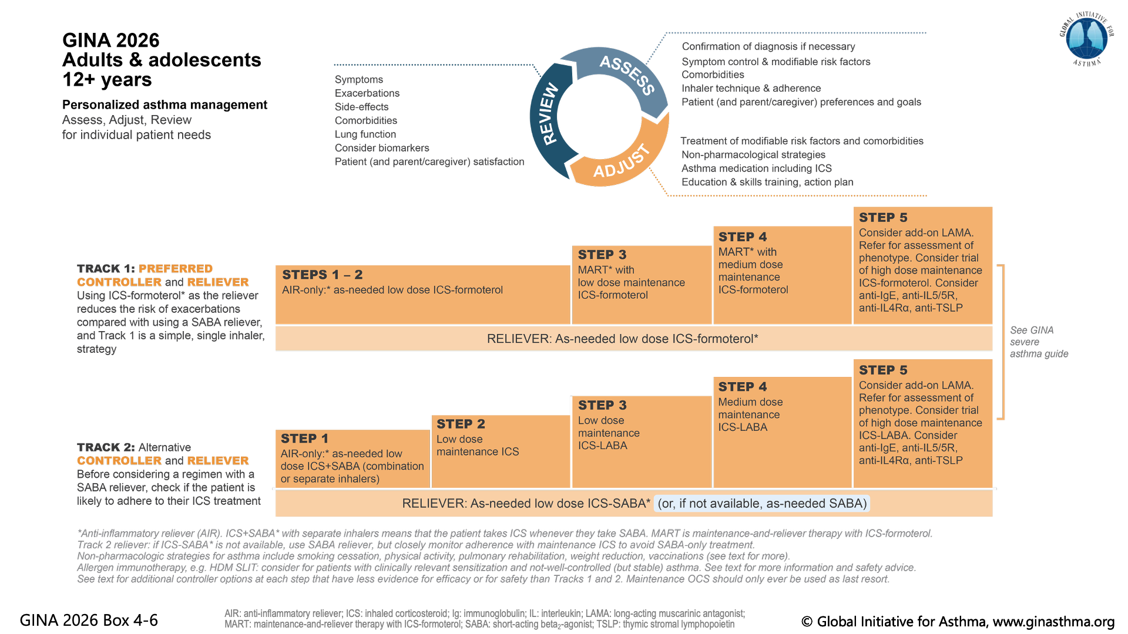

Slide 26
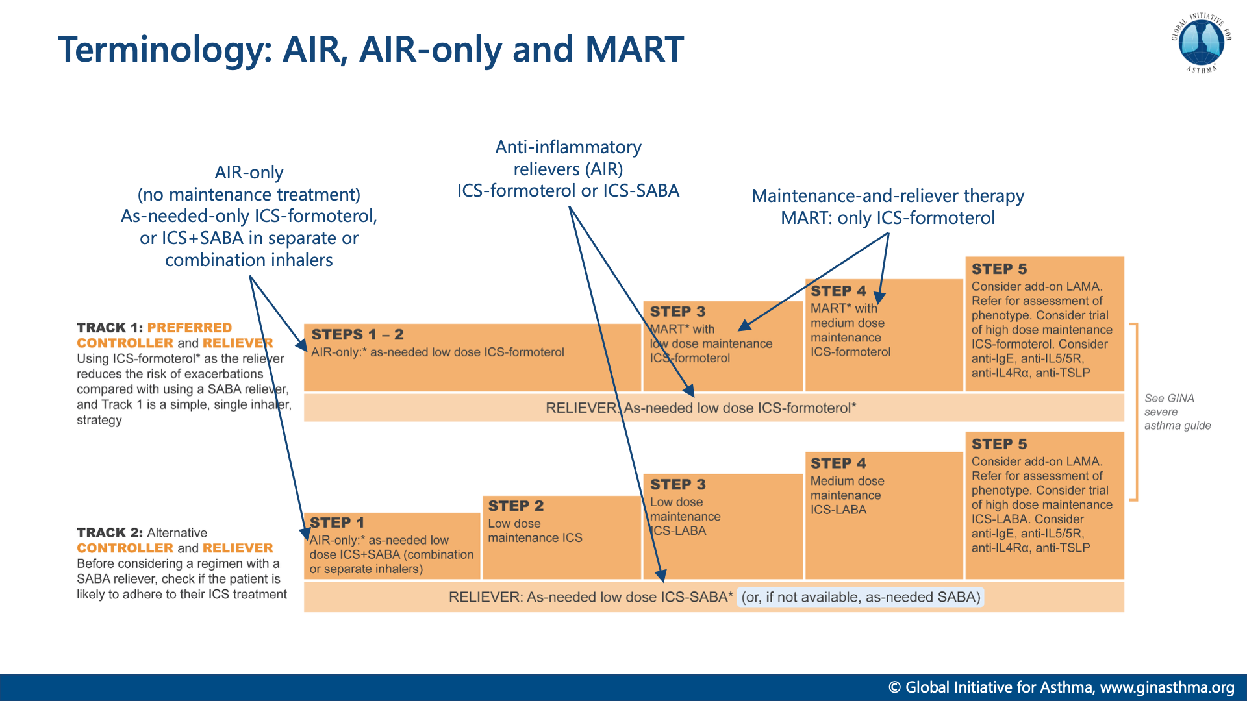

Slide 27
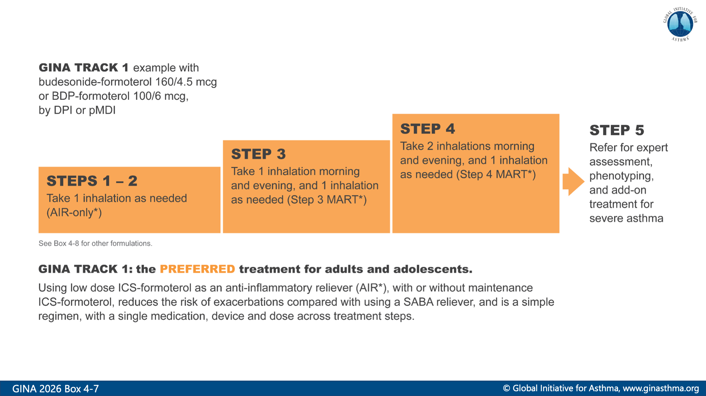

Slide 28
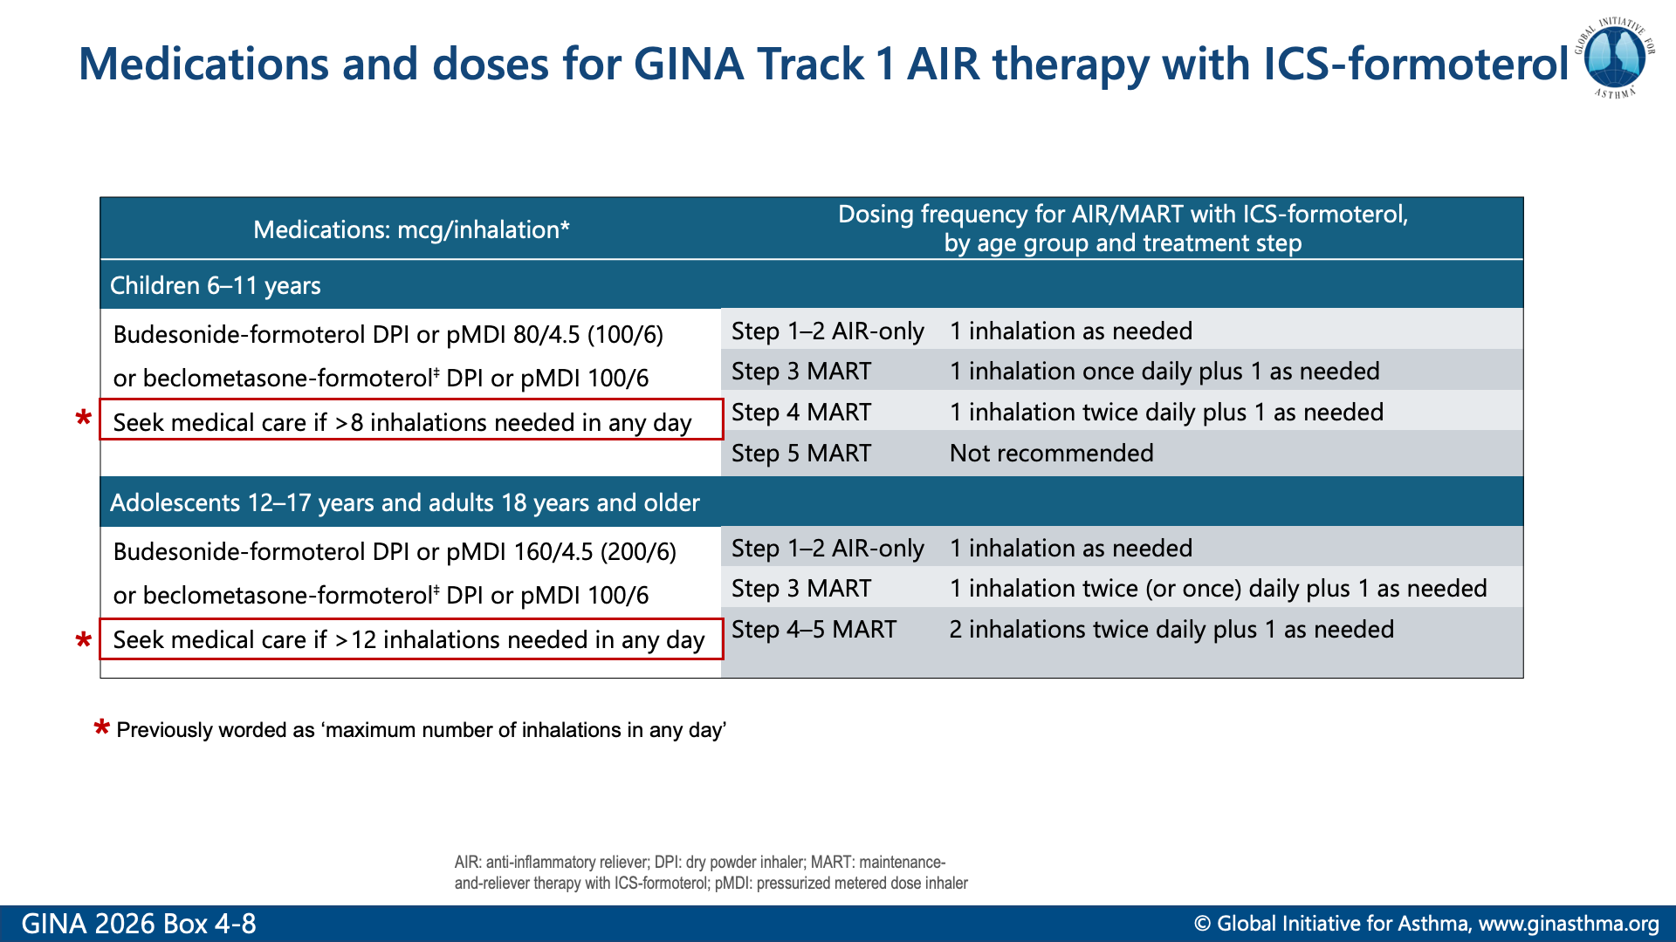

Slide 29
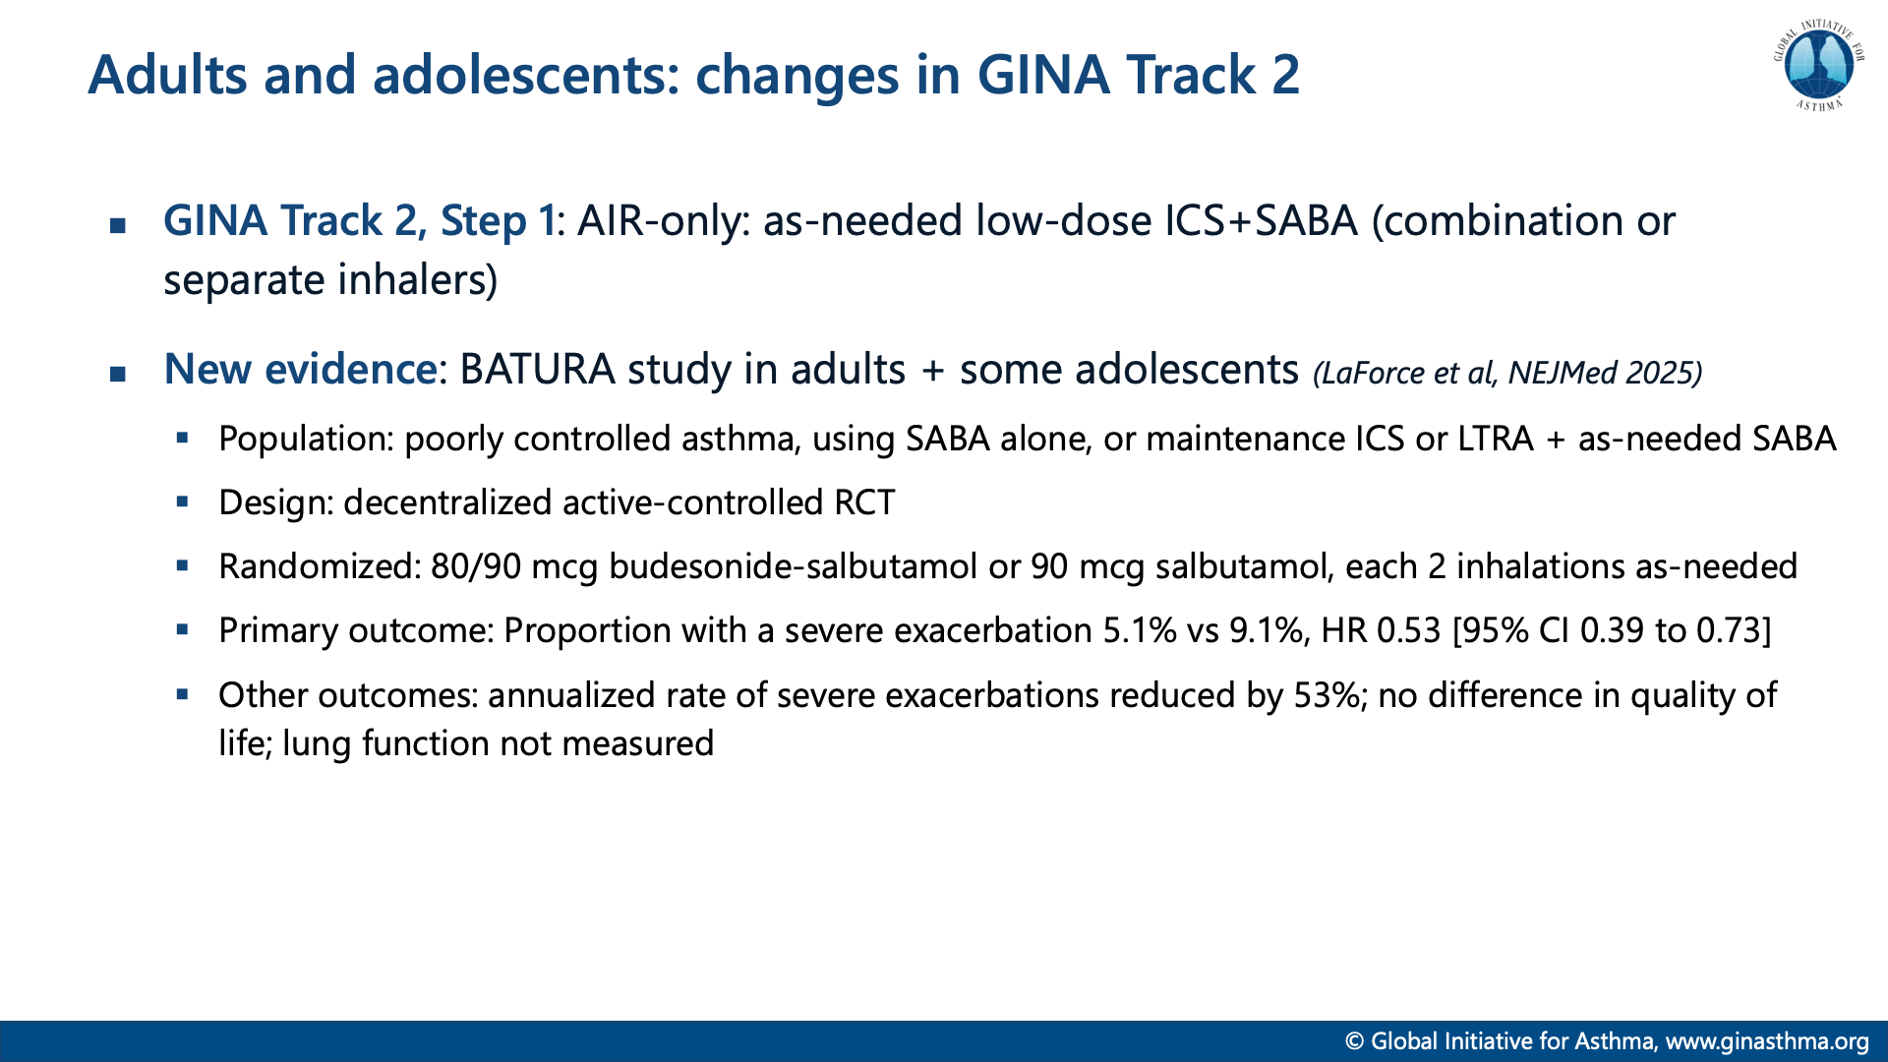

Slide 30
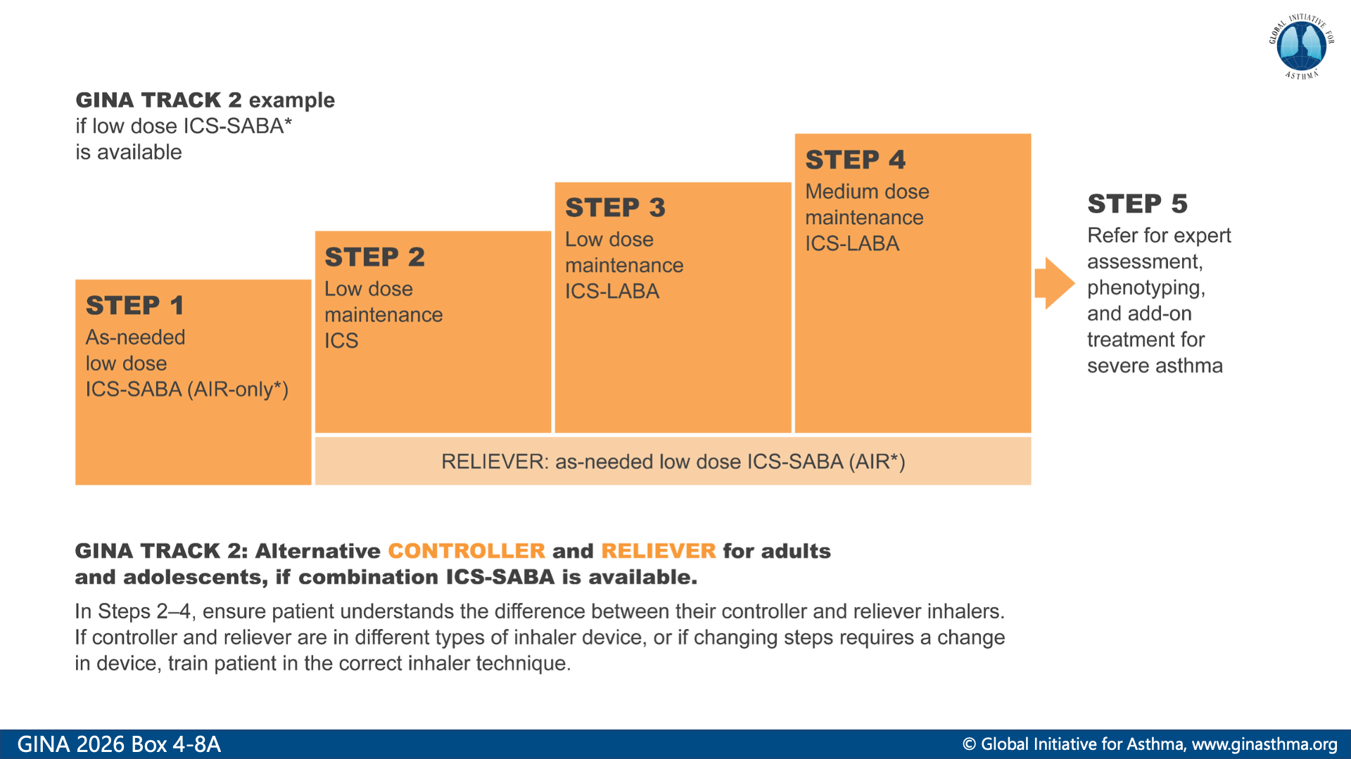

Slide 31
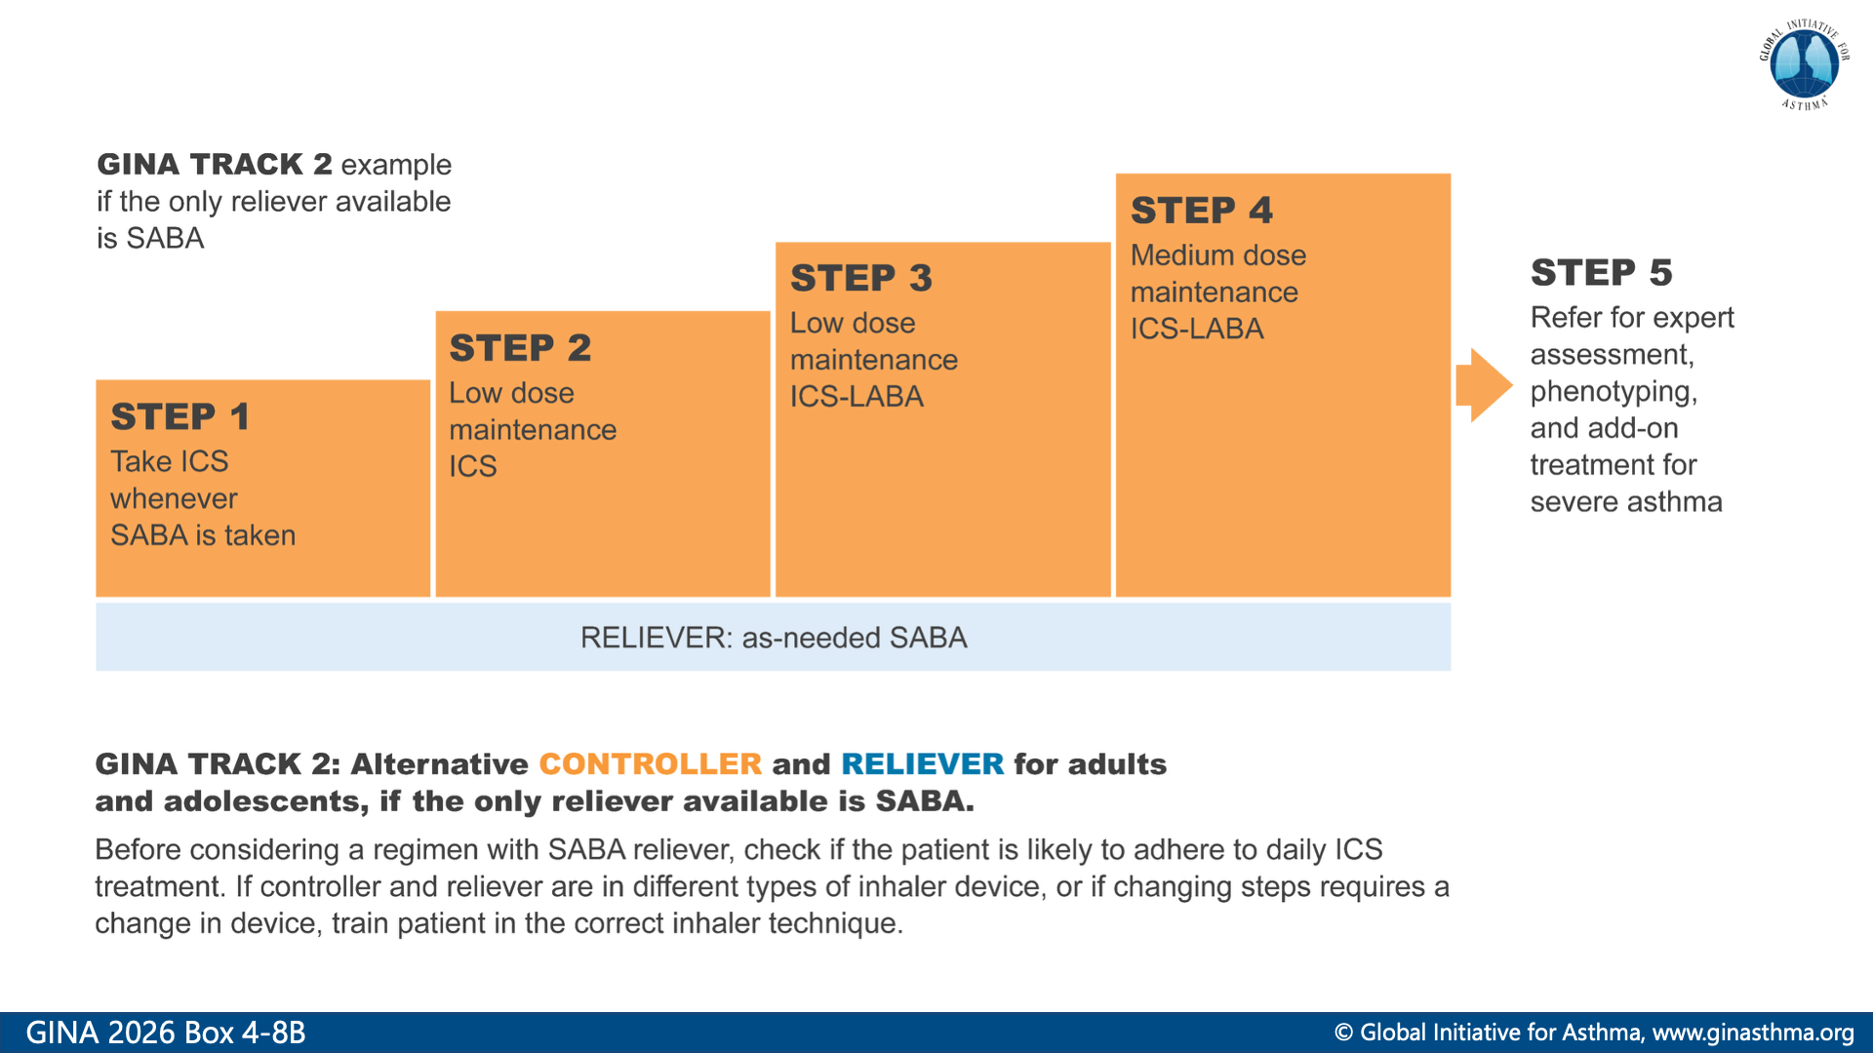

Slide 32
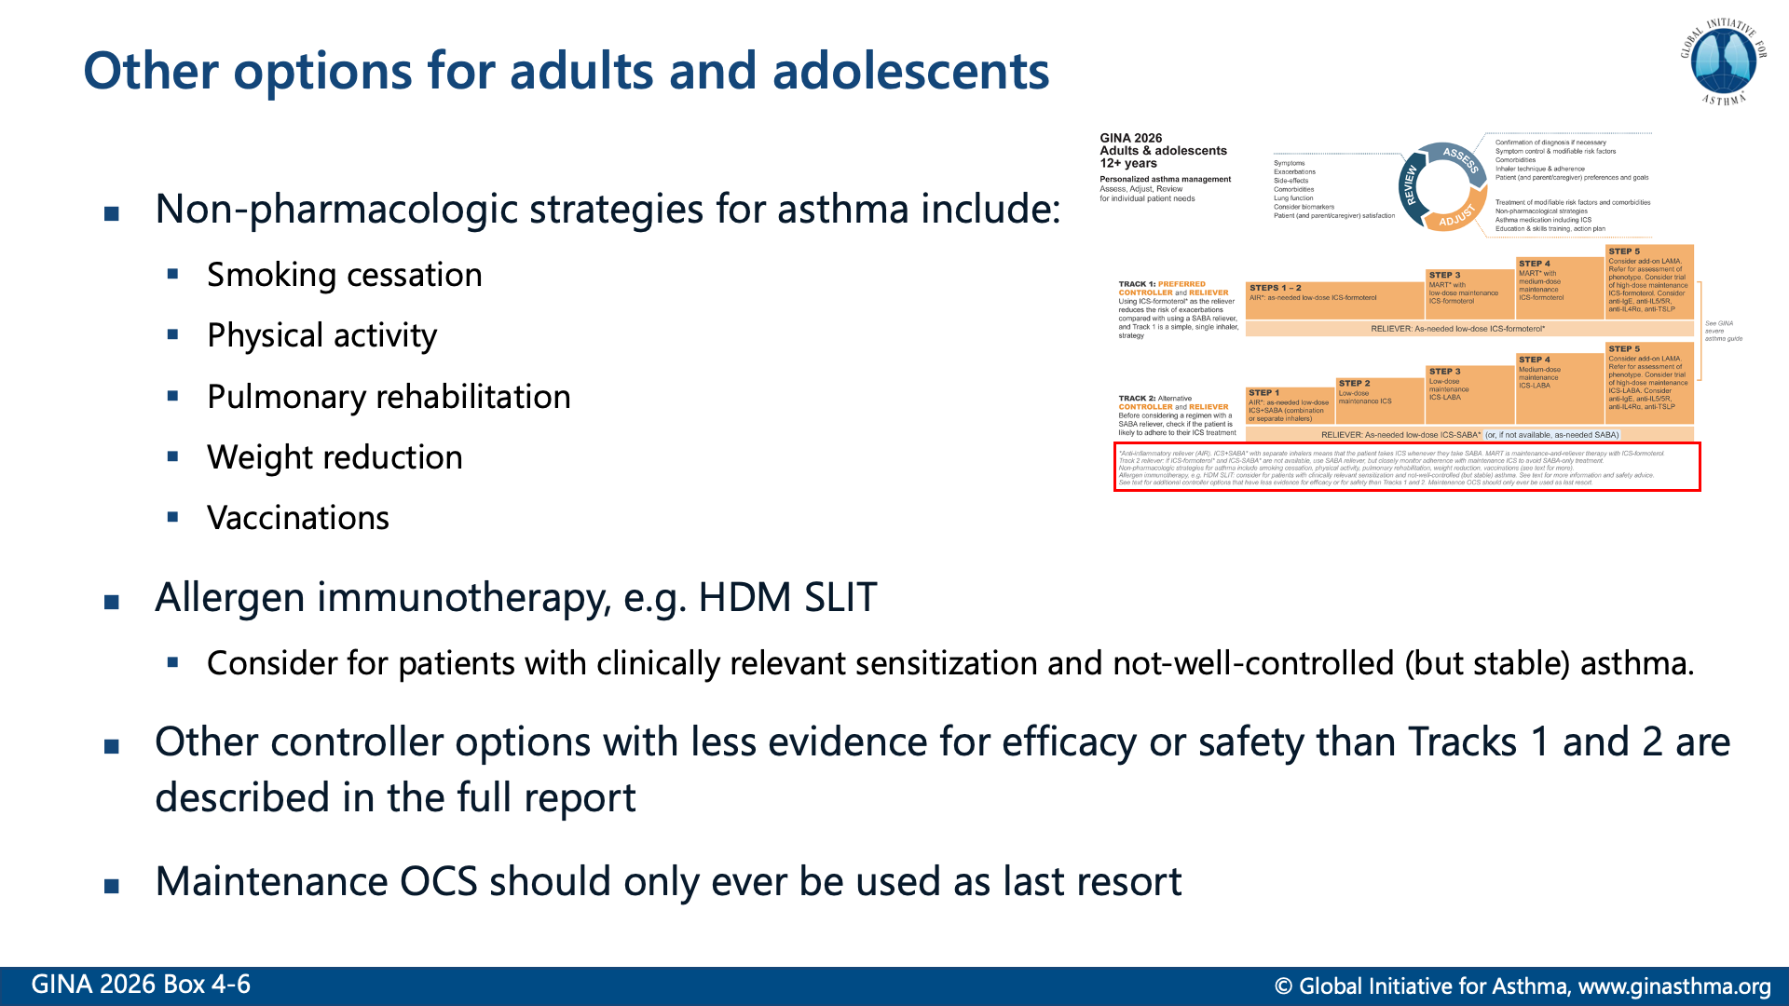

Slide 33
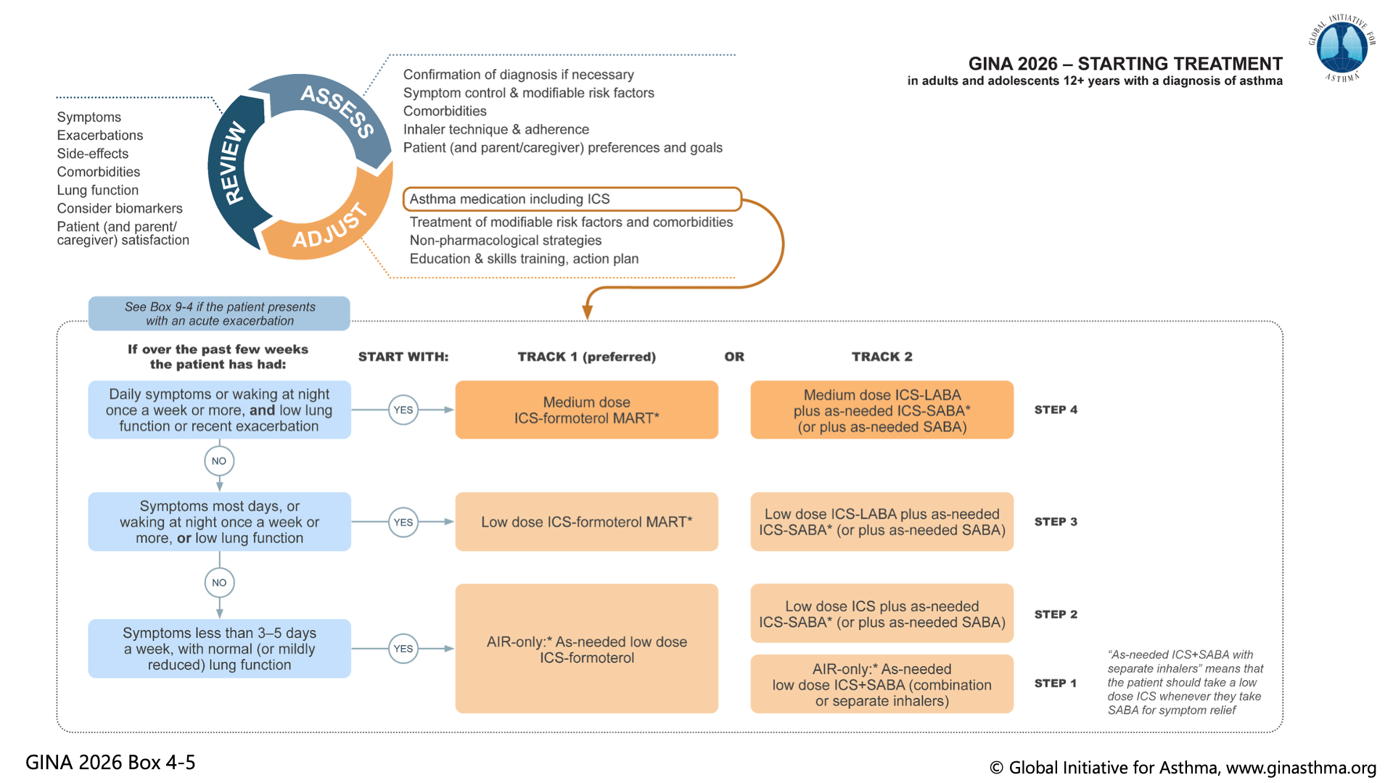

Slide 34


Slide 35
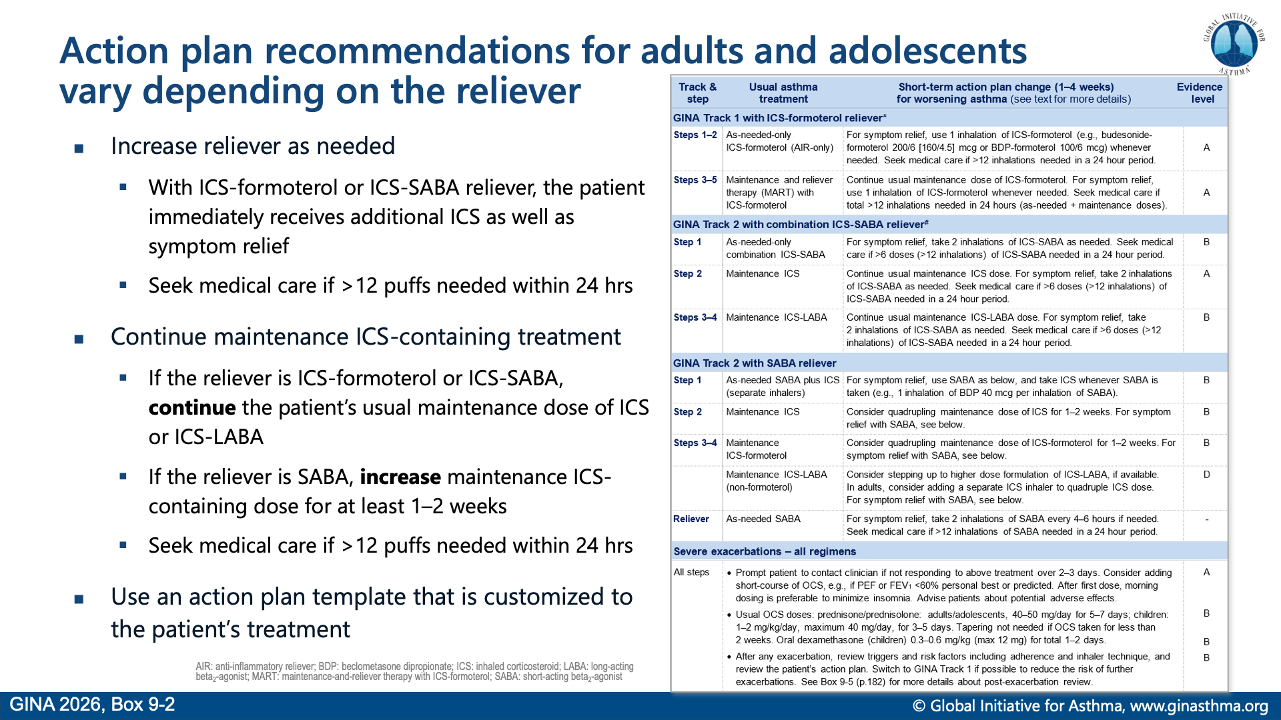

Slide 36
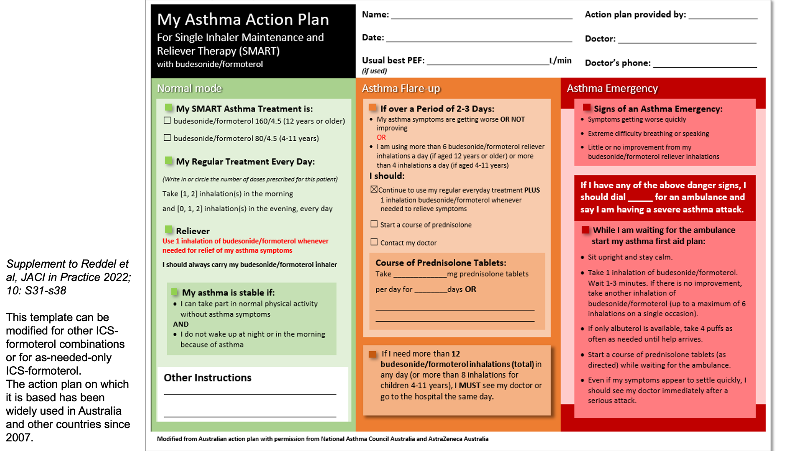

Slide 37
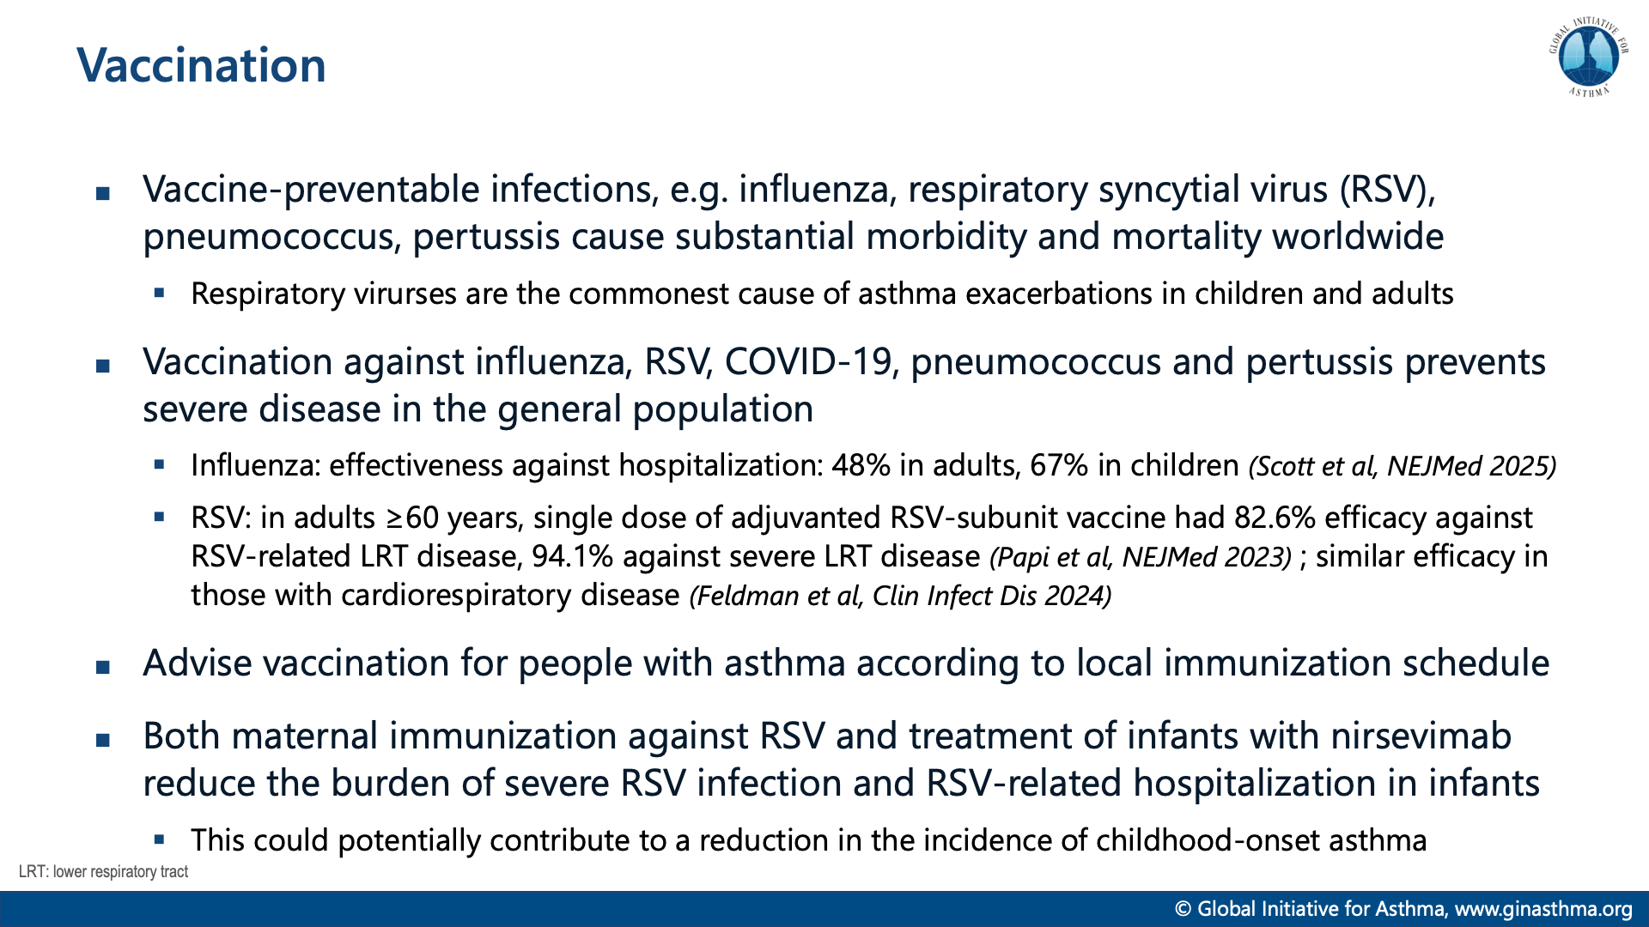

Slide 38


Slide 39
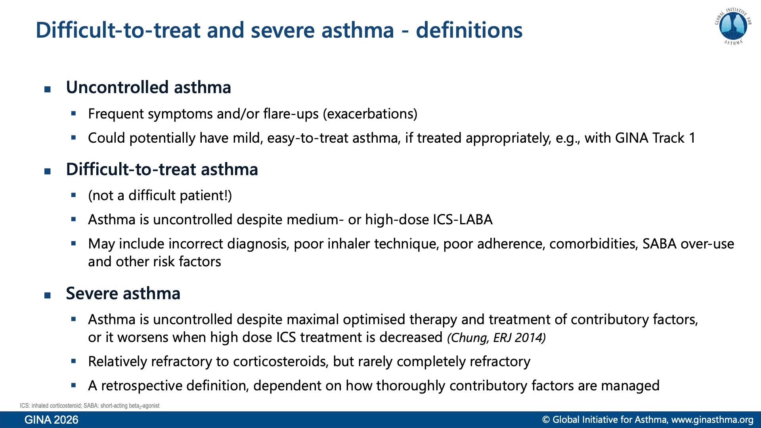

Slide 40
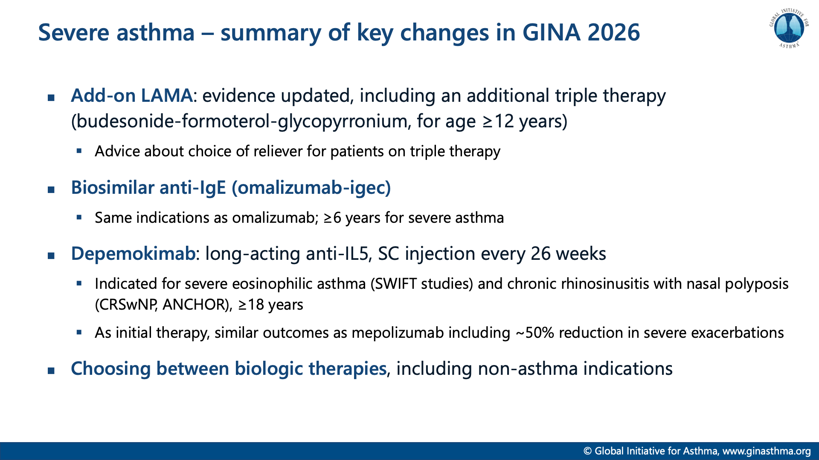

Slide 41
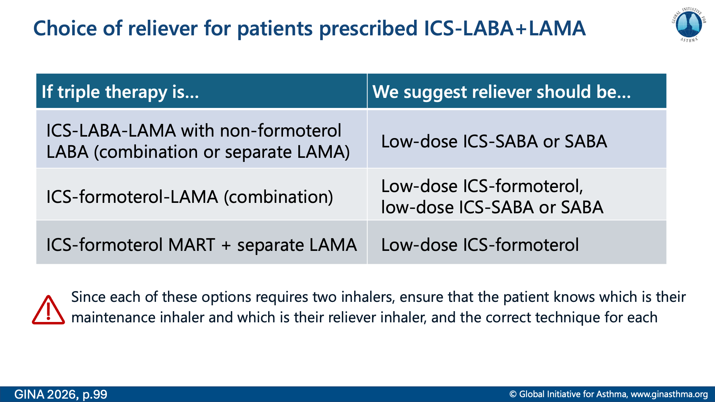

Slide 42
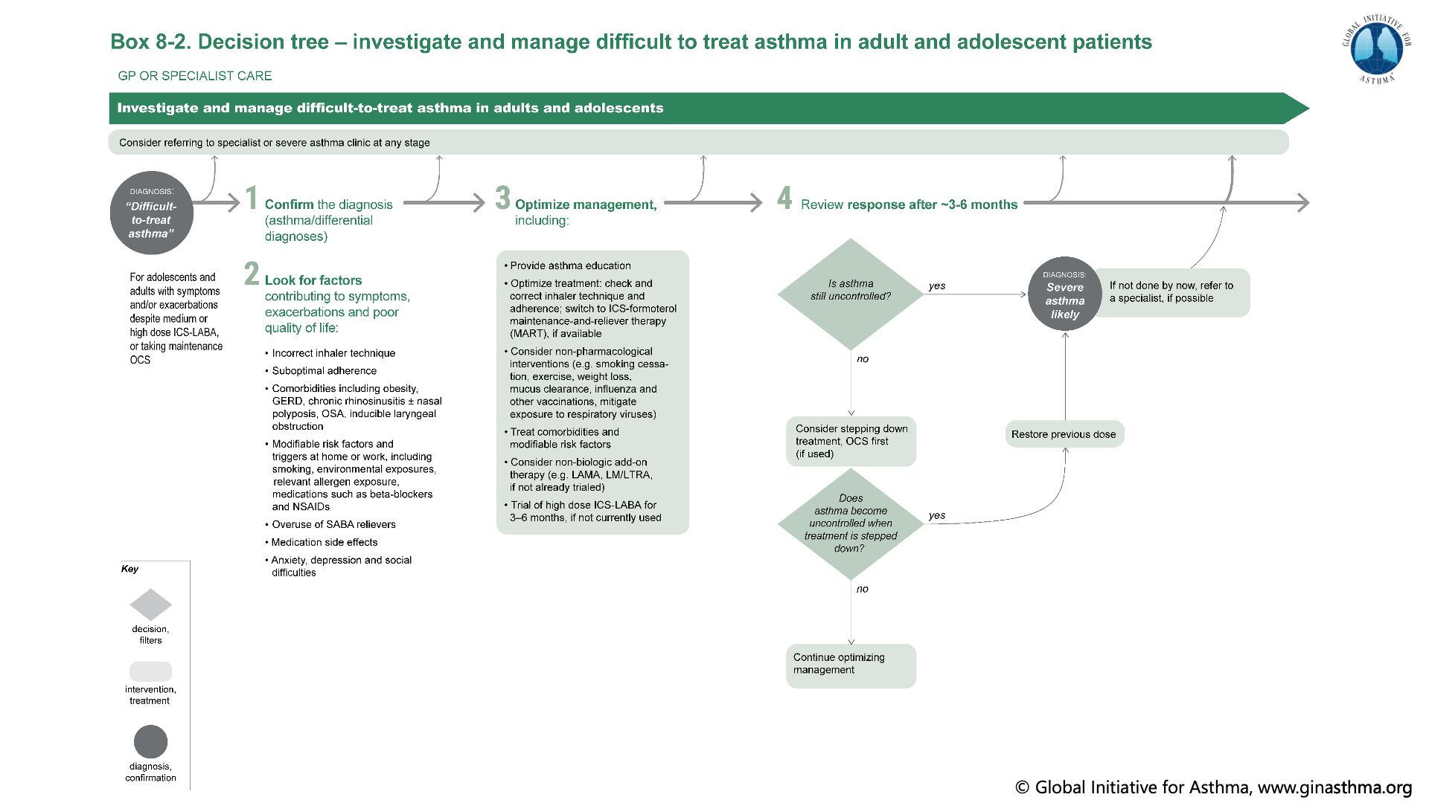

Slide 43
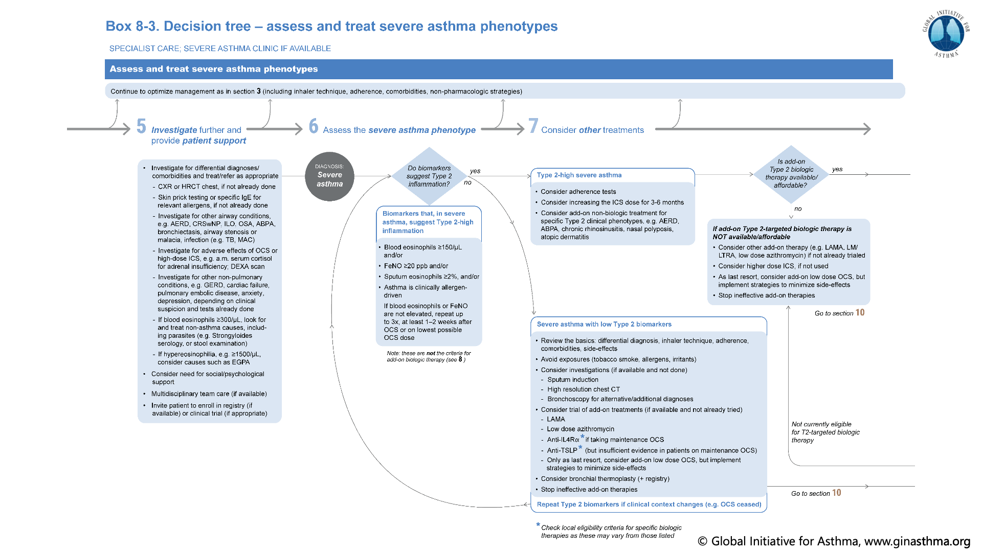

Slide 44
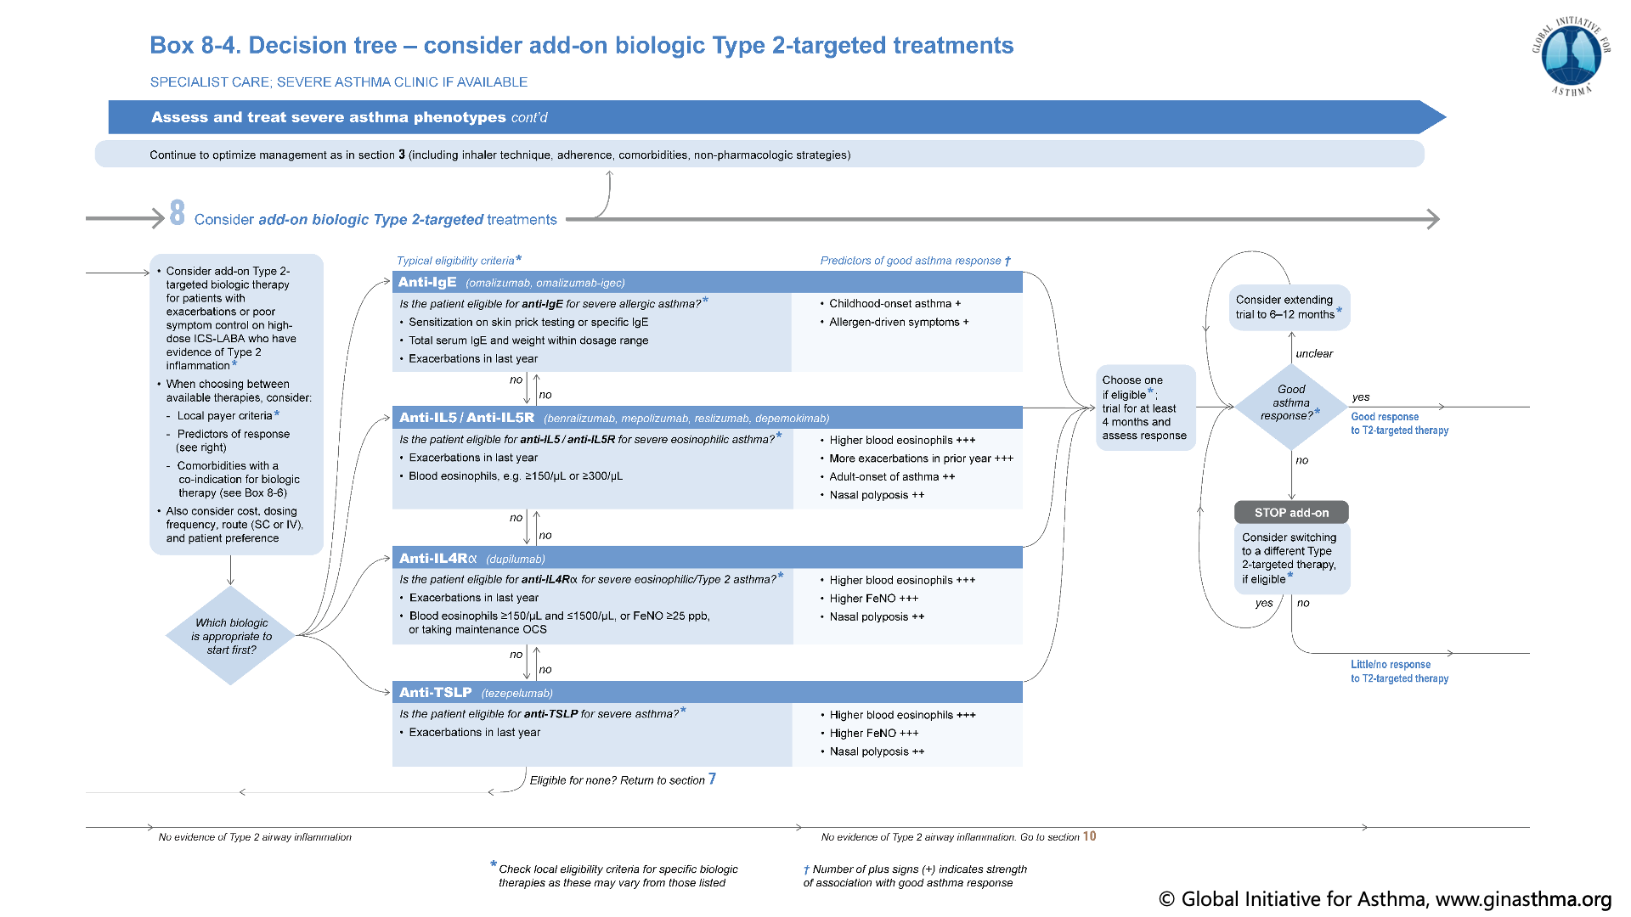

Slide 45
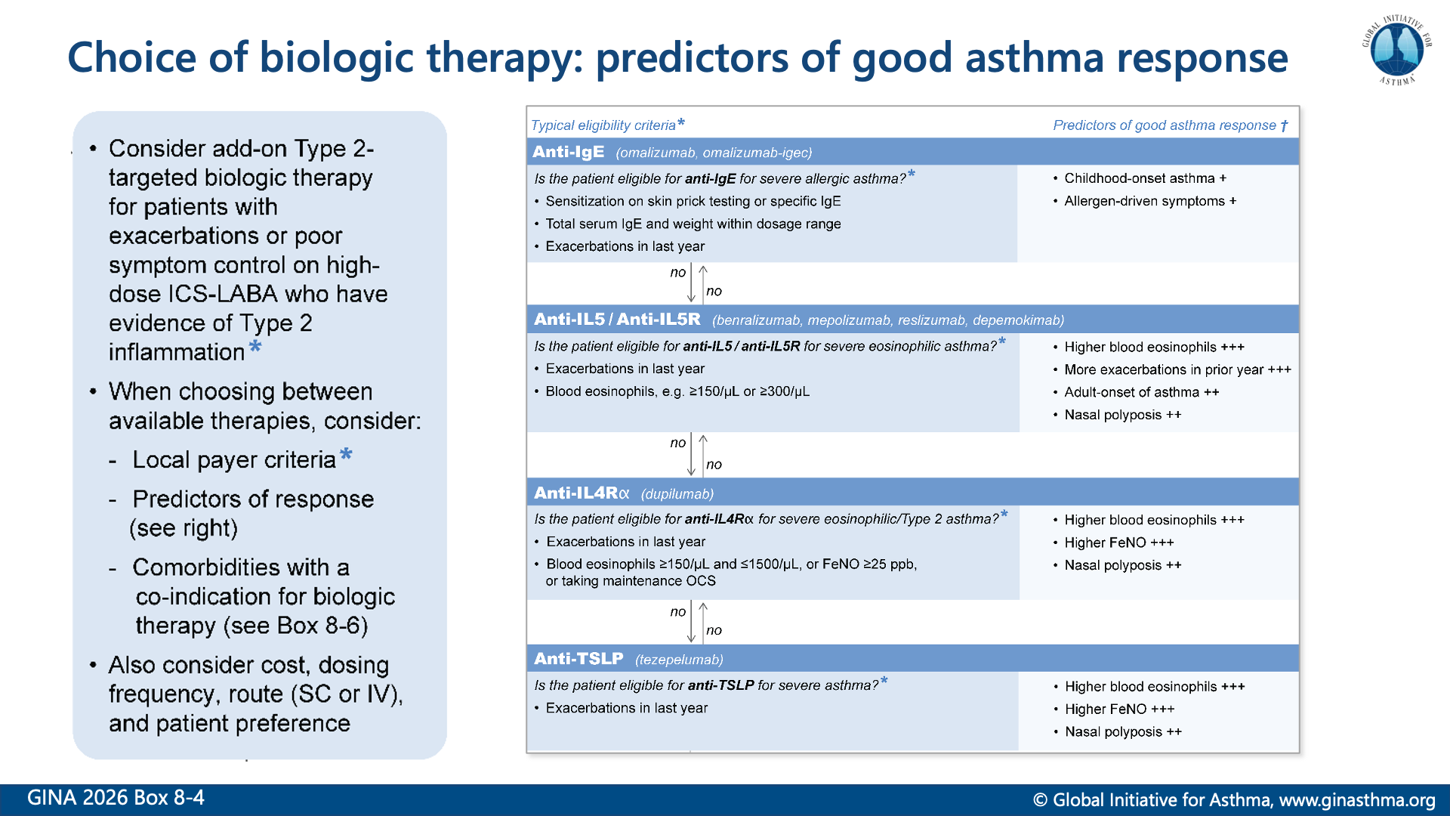

Slide 46
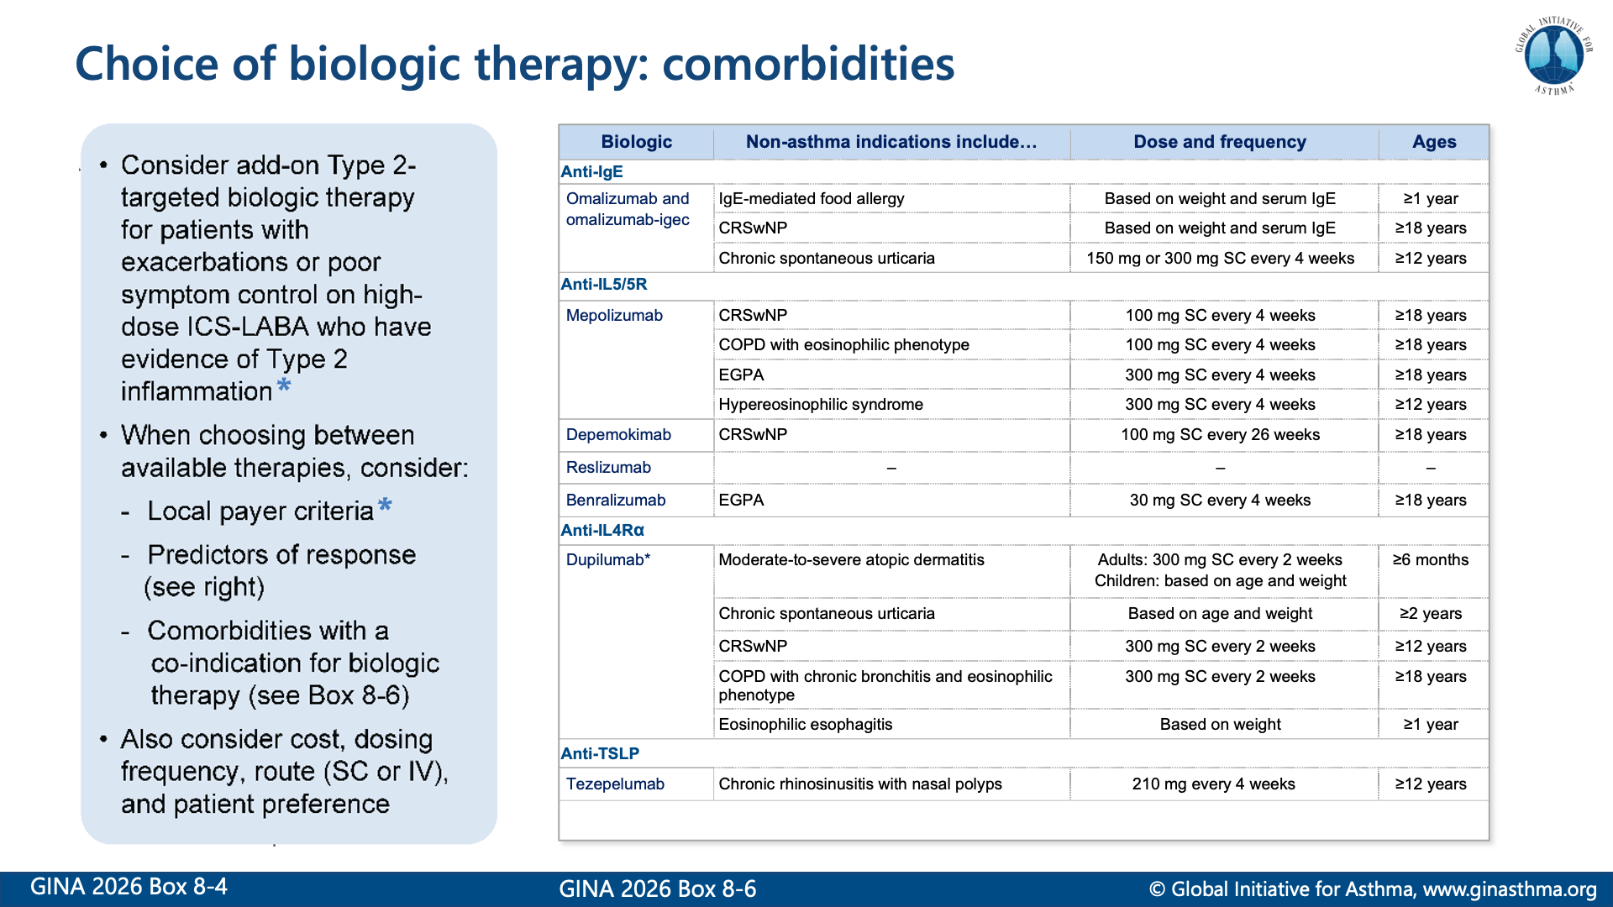

Slide 47
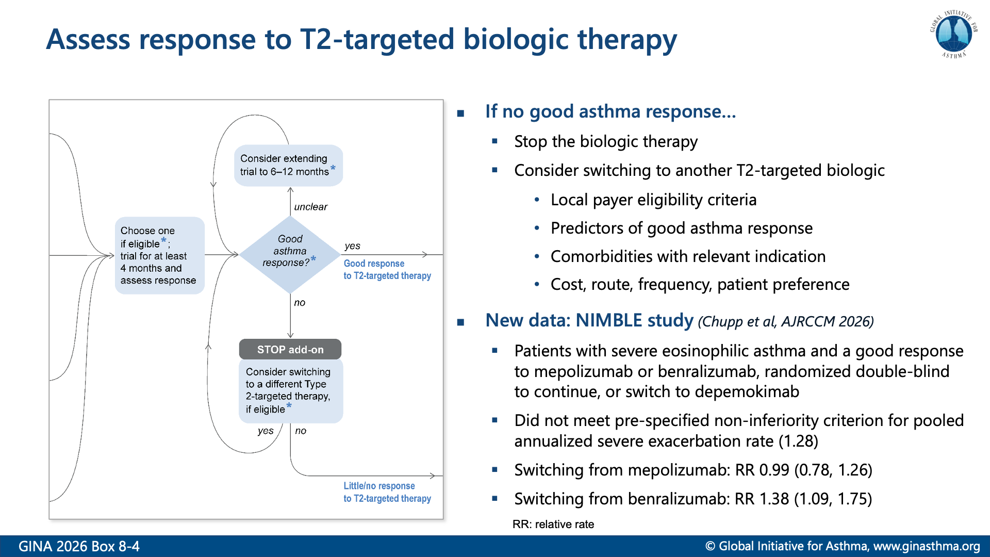

Slide 48
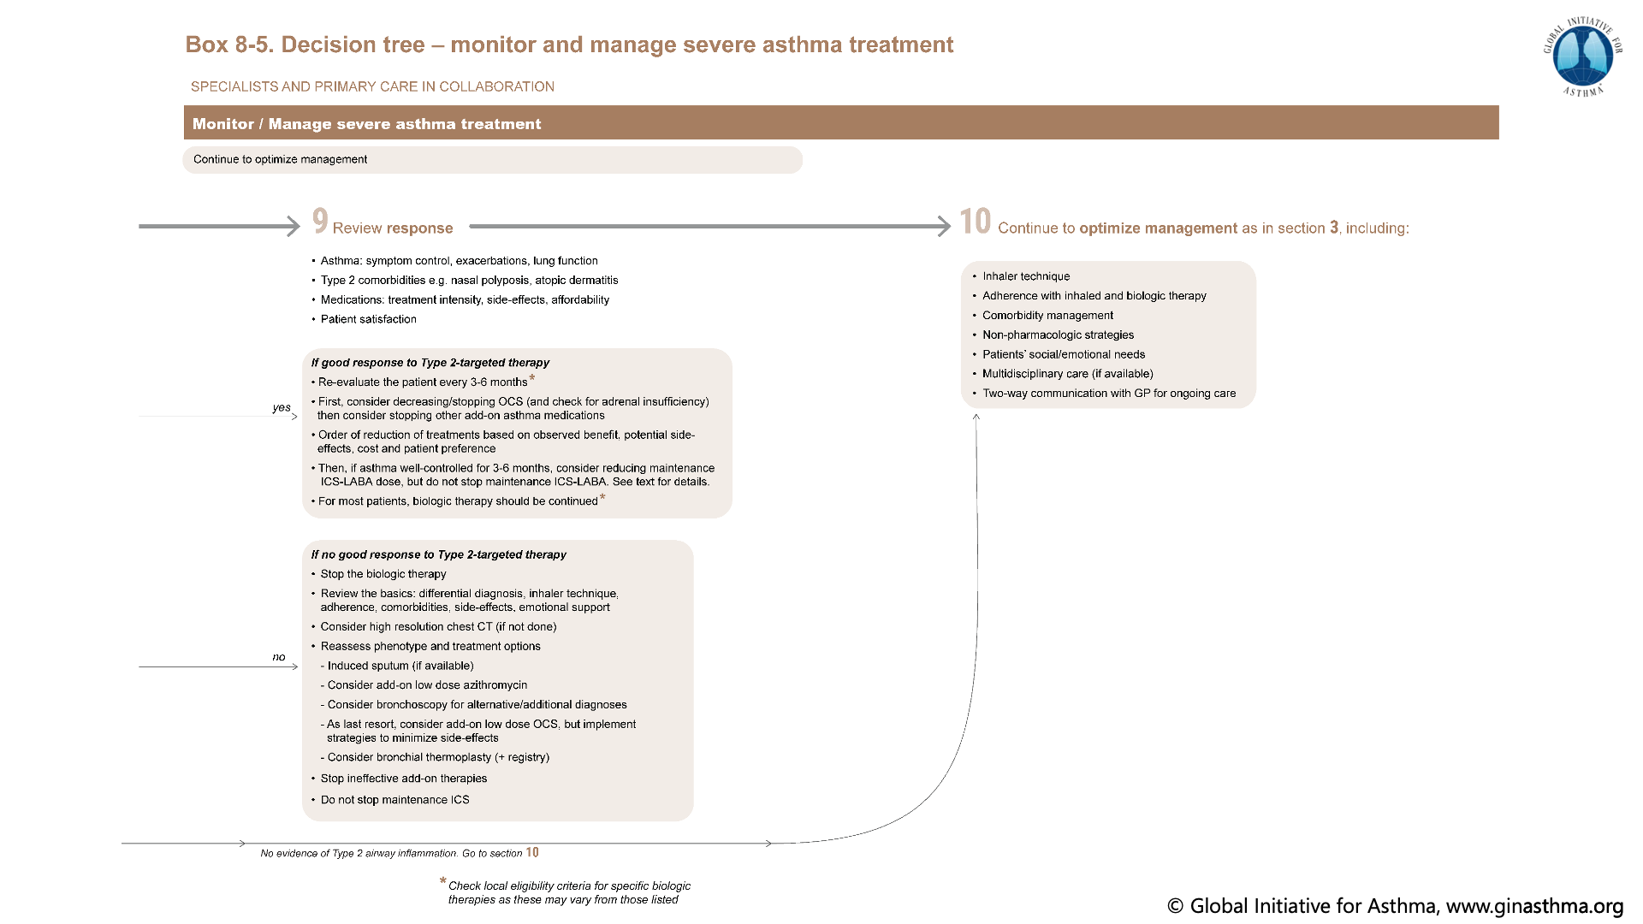

Slide 49
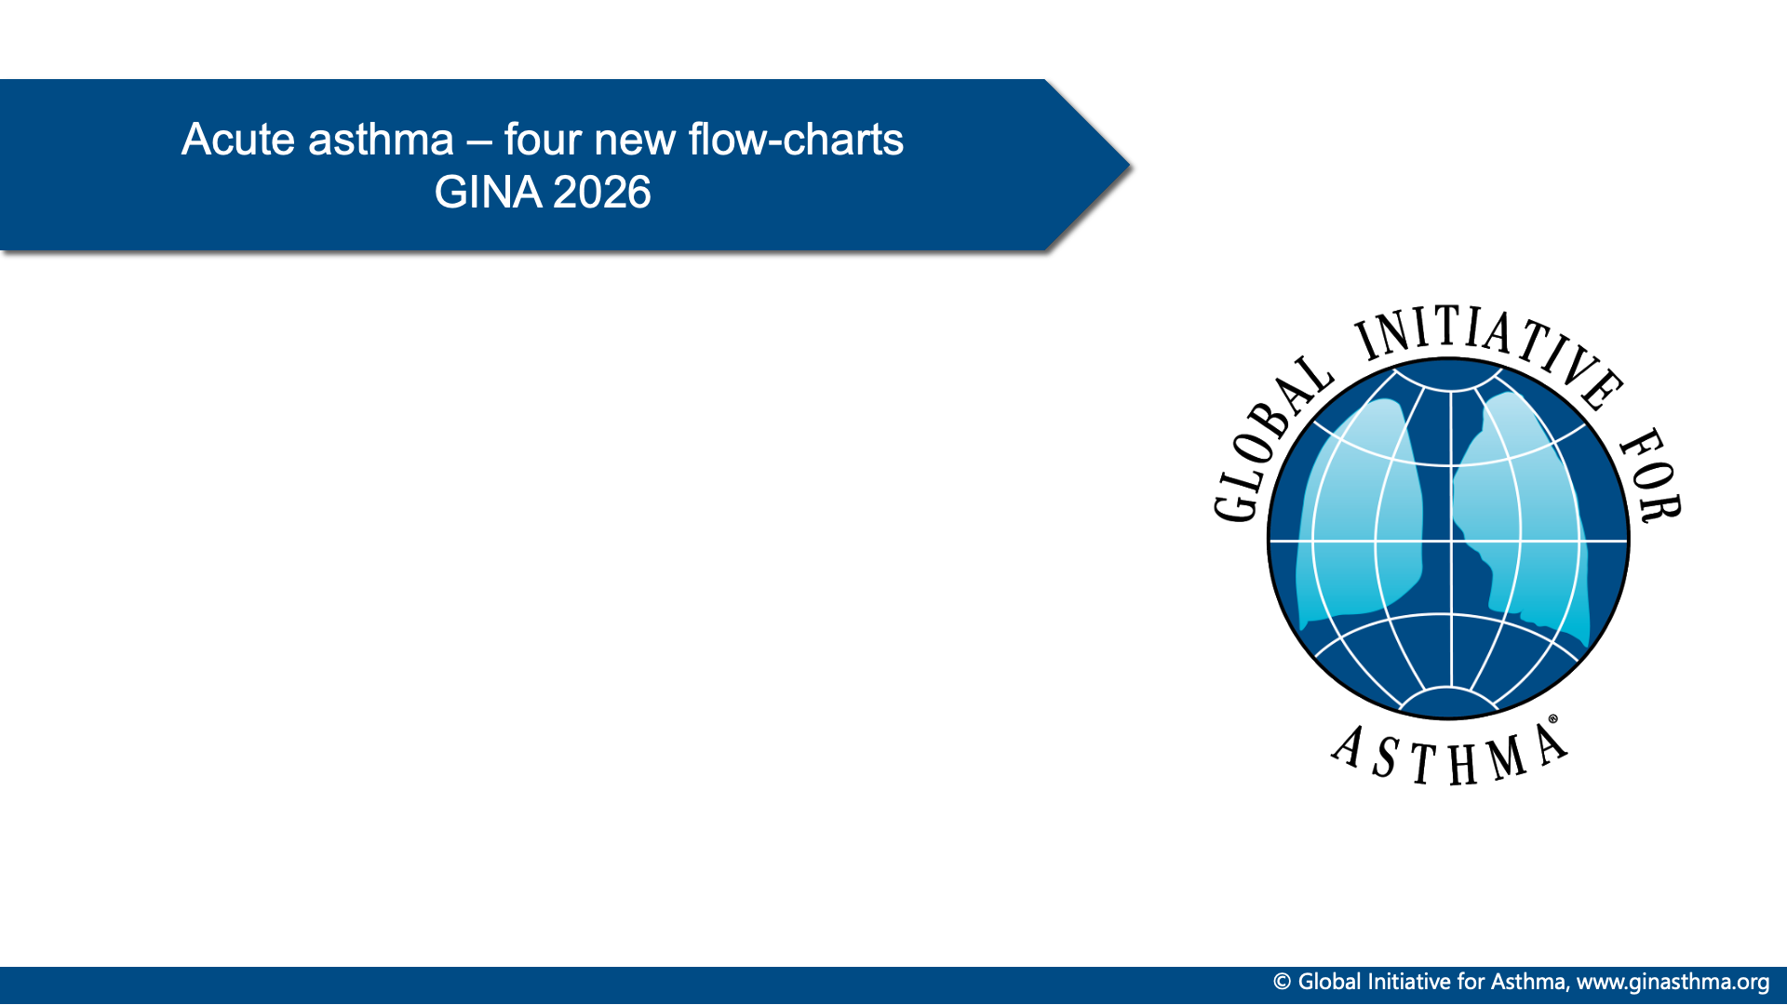

Slide 50
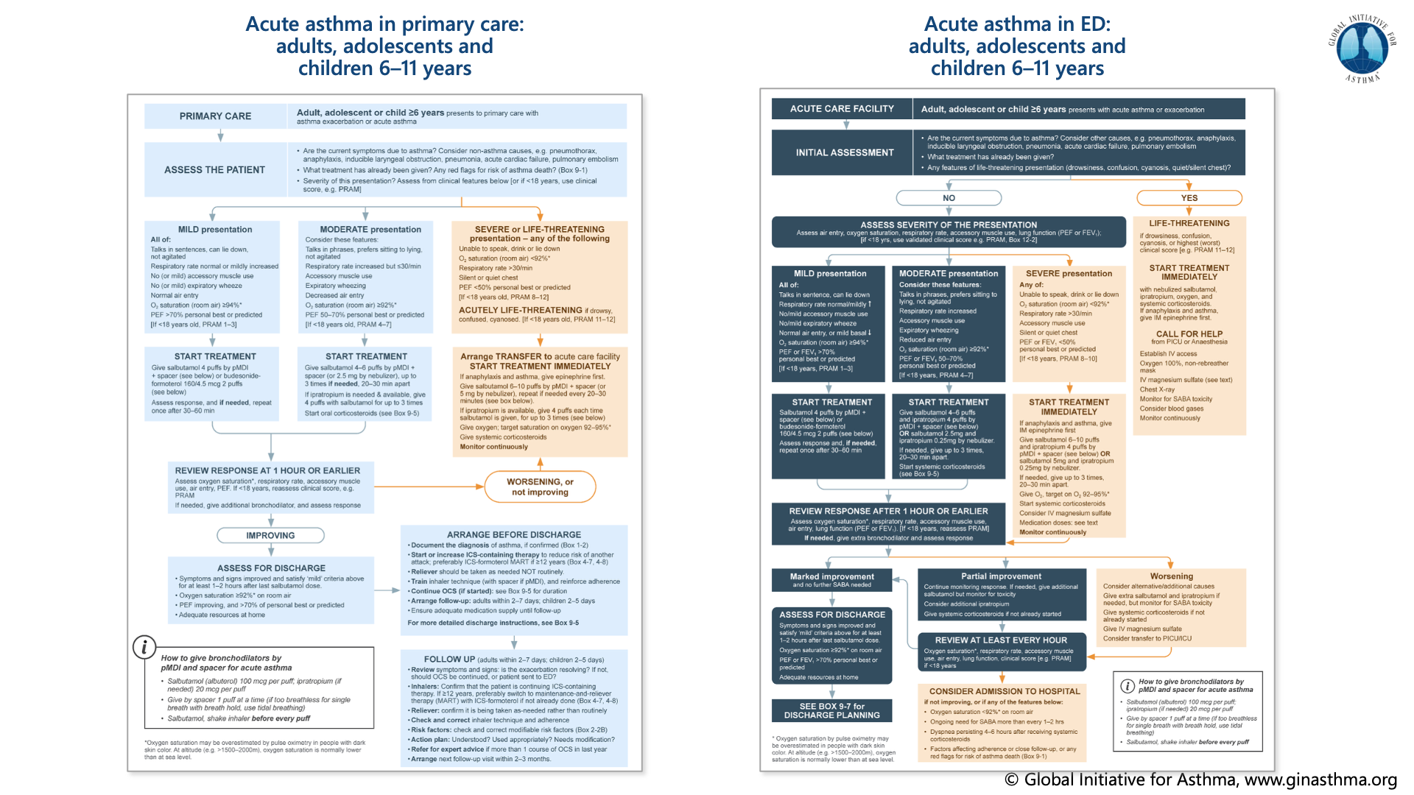

Slide 51
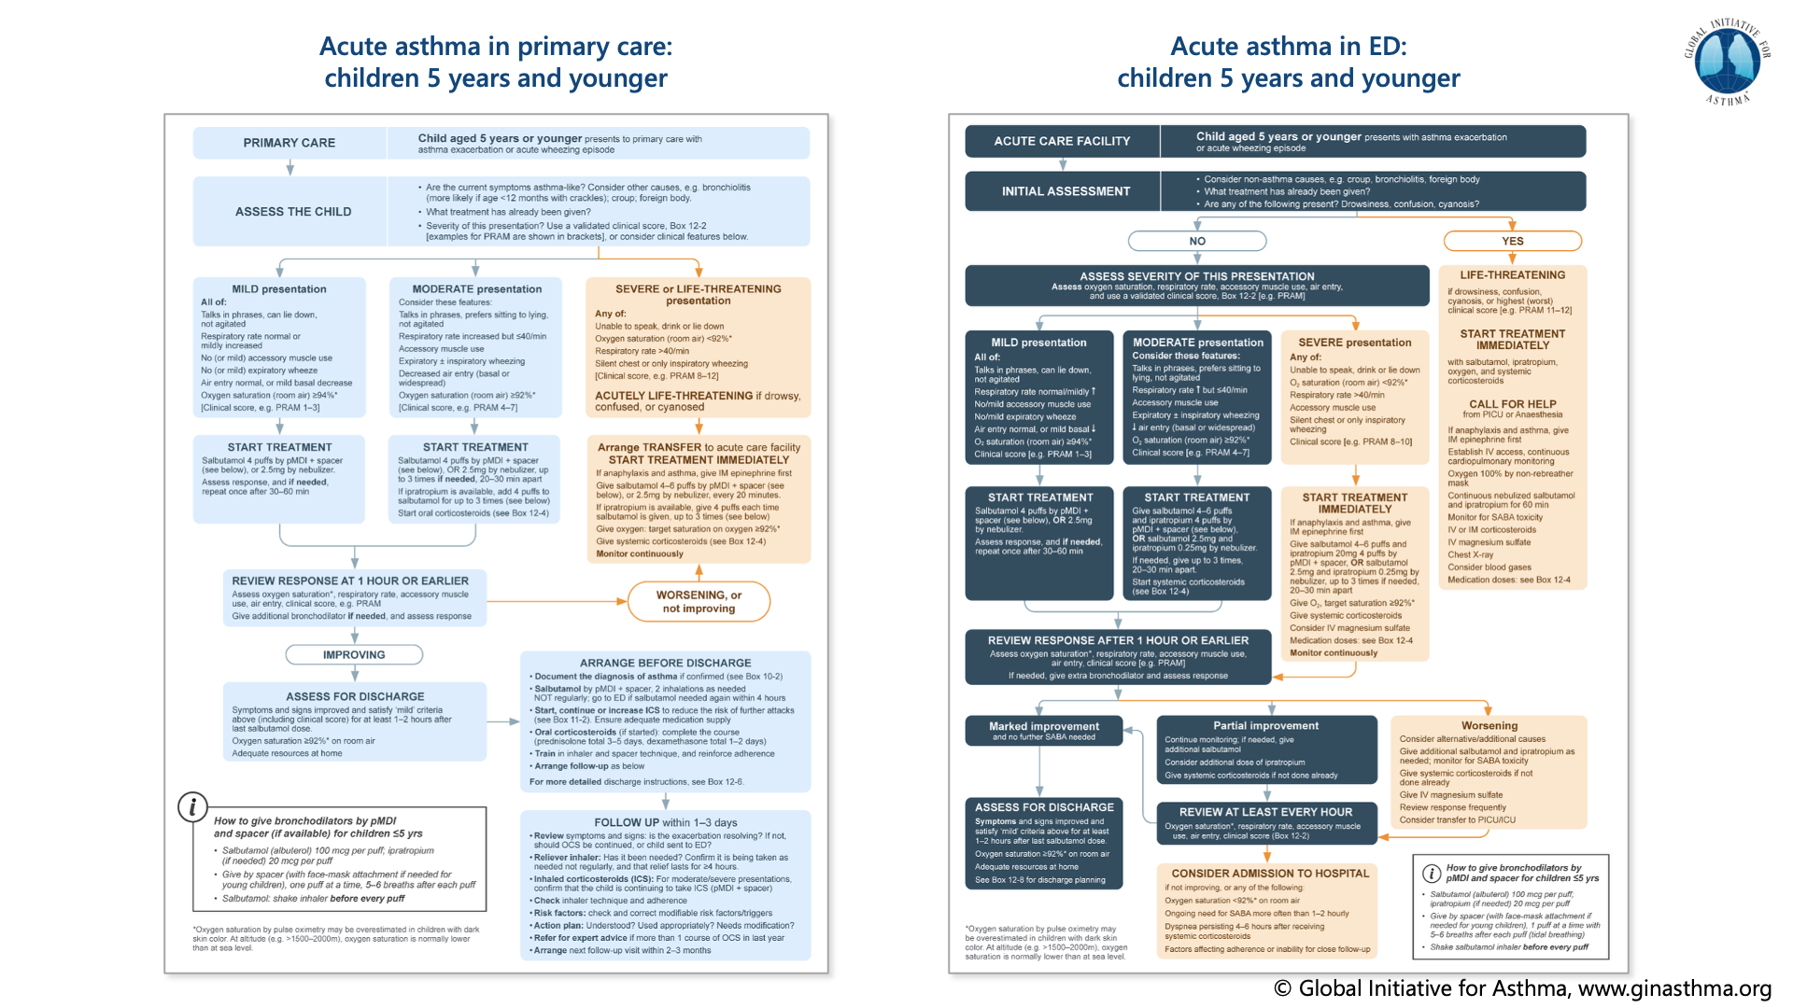

Slide 52


Slide 53
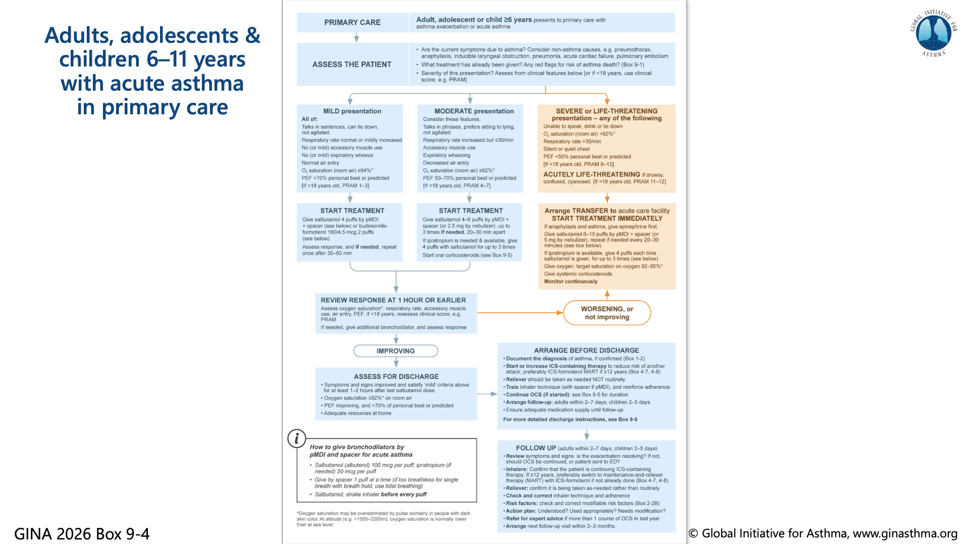

Slide 54
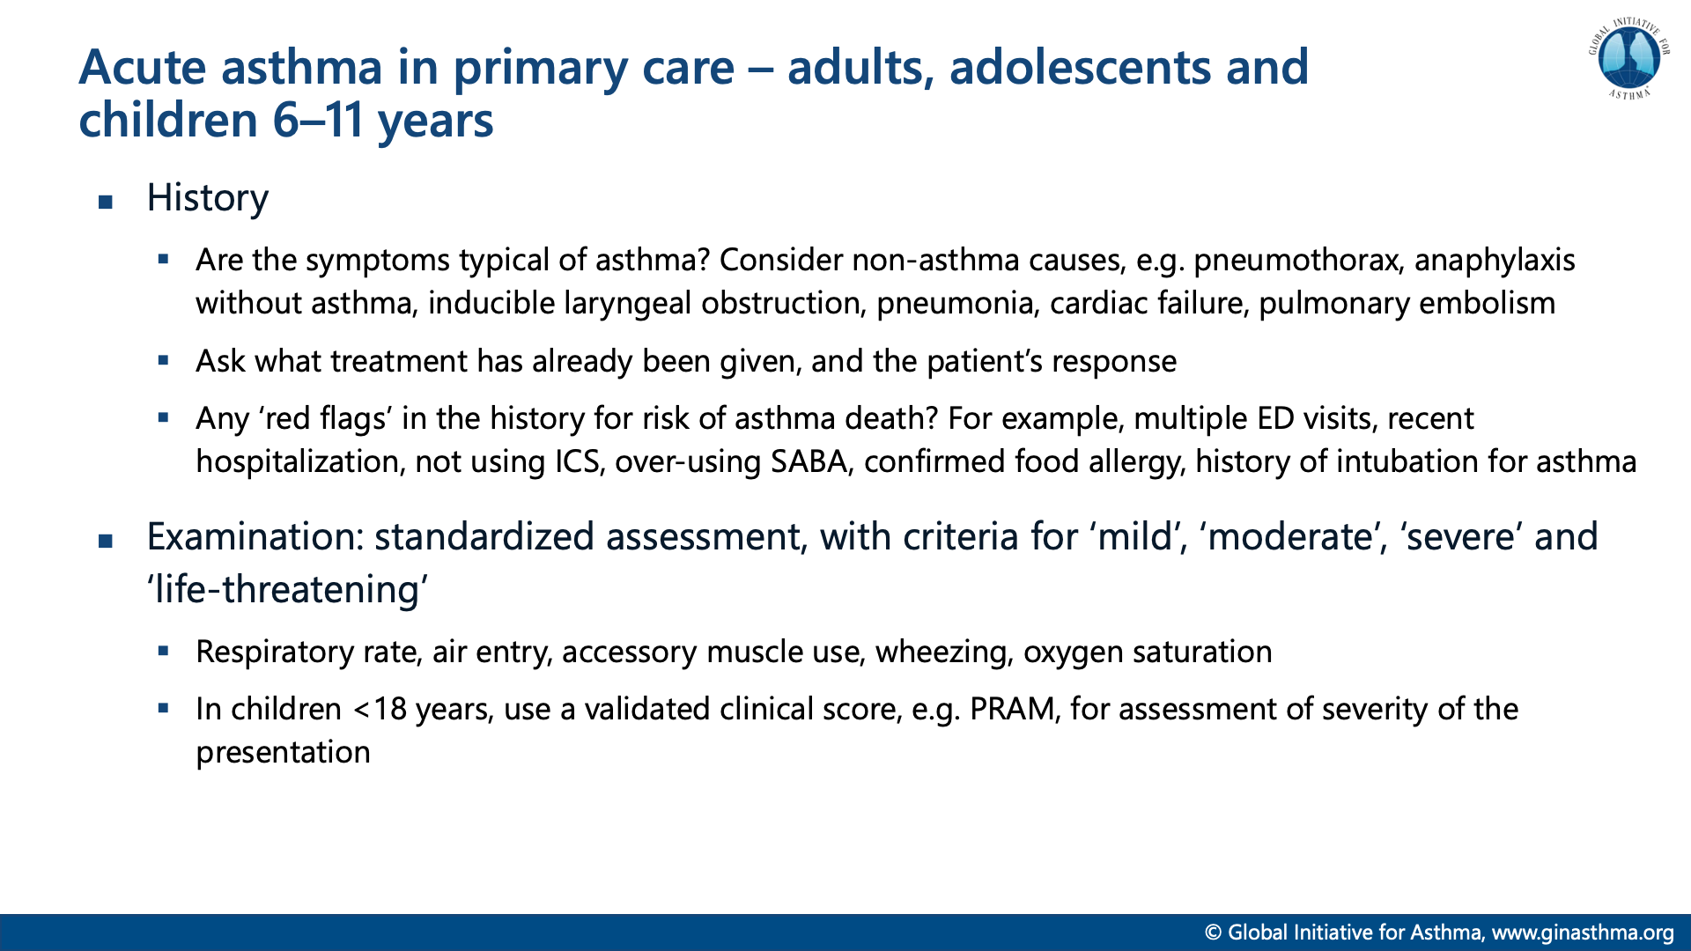

Slide 55
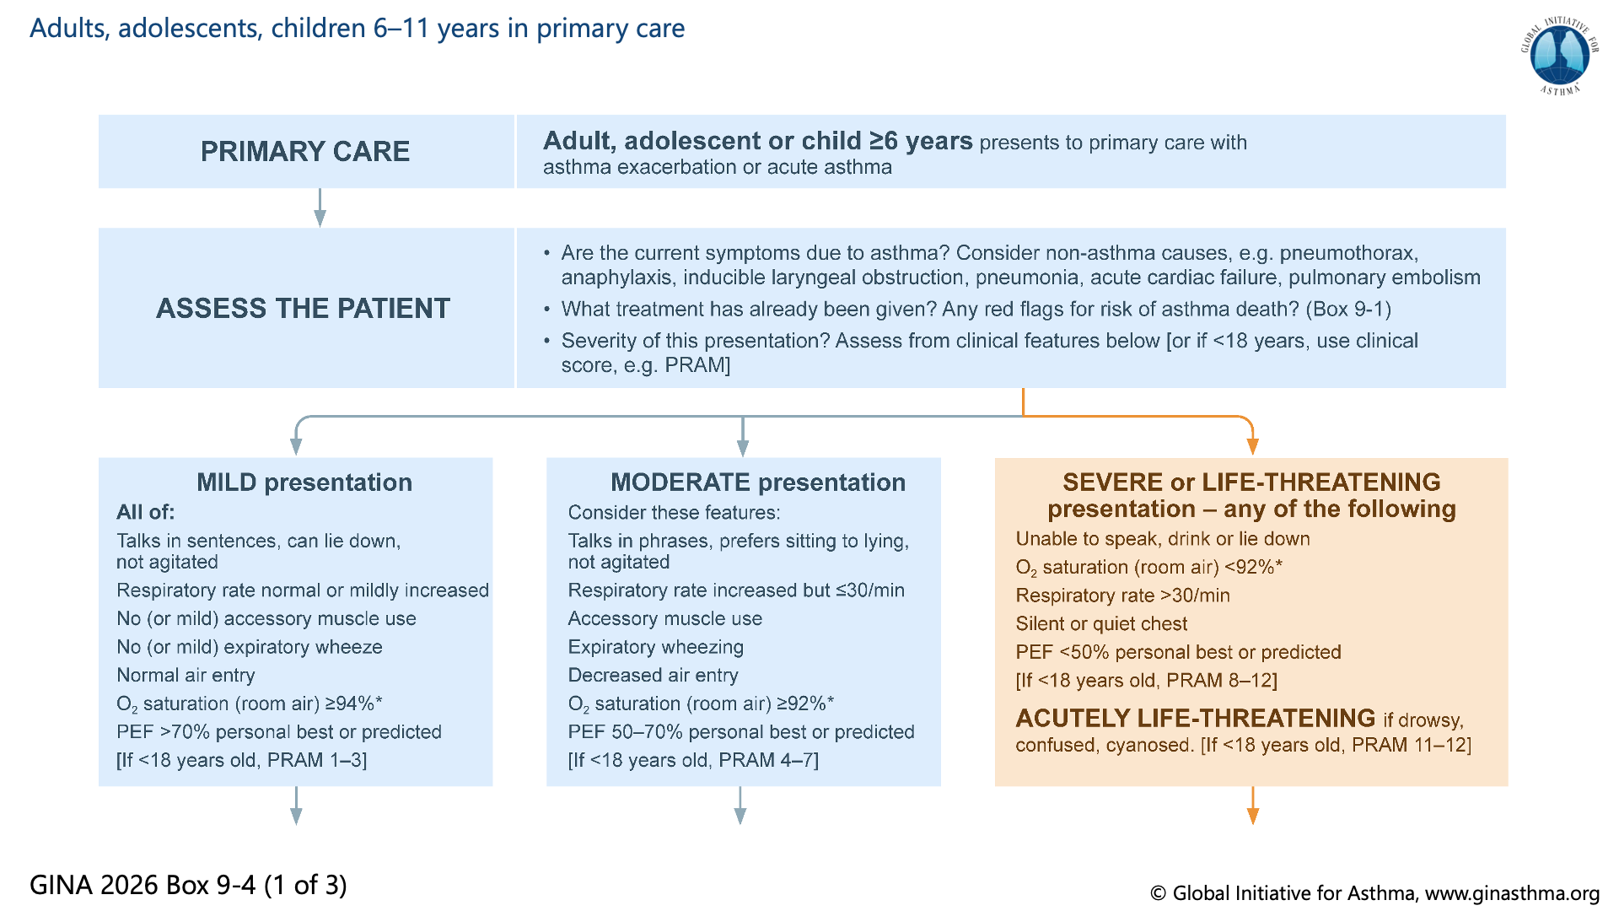

Slide 56
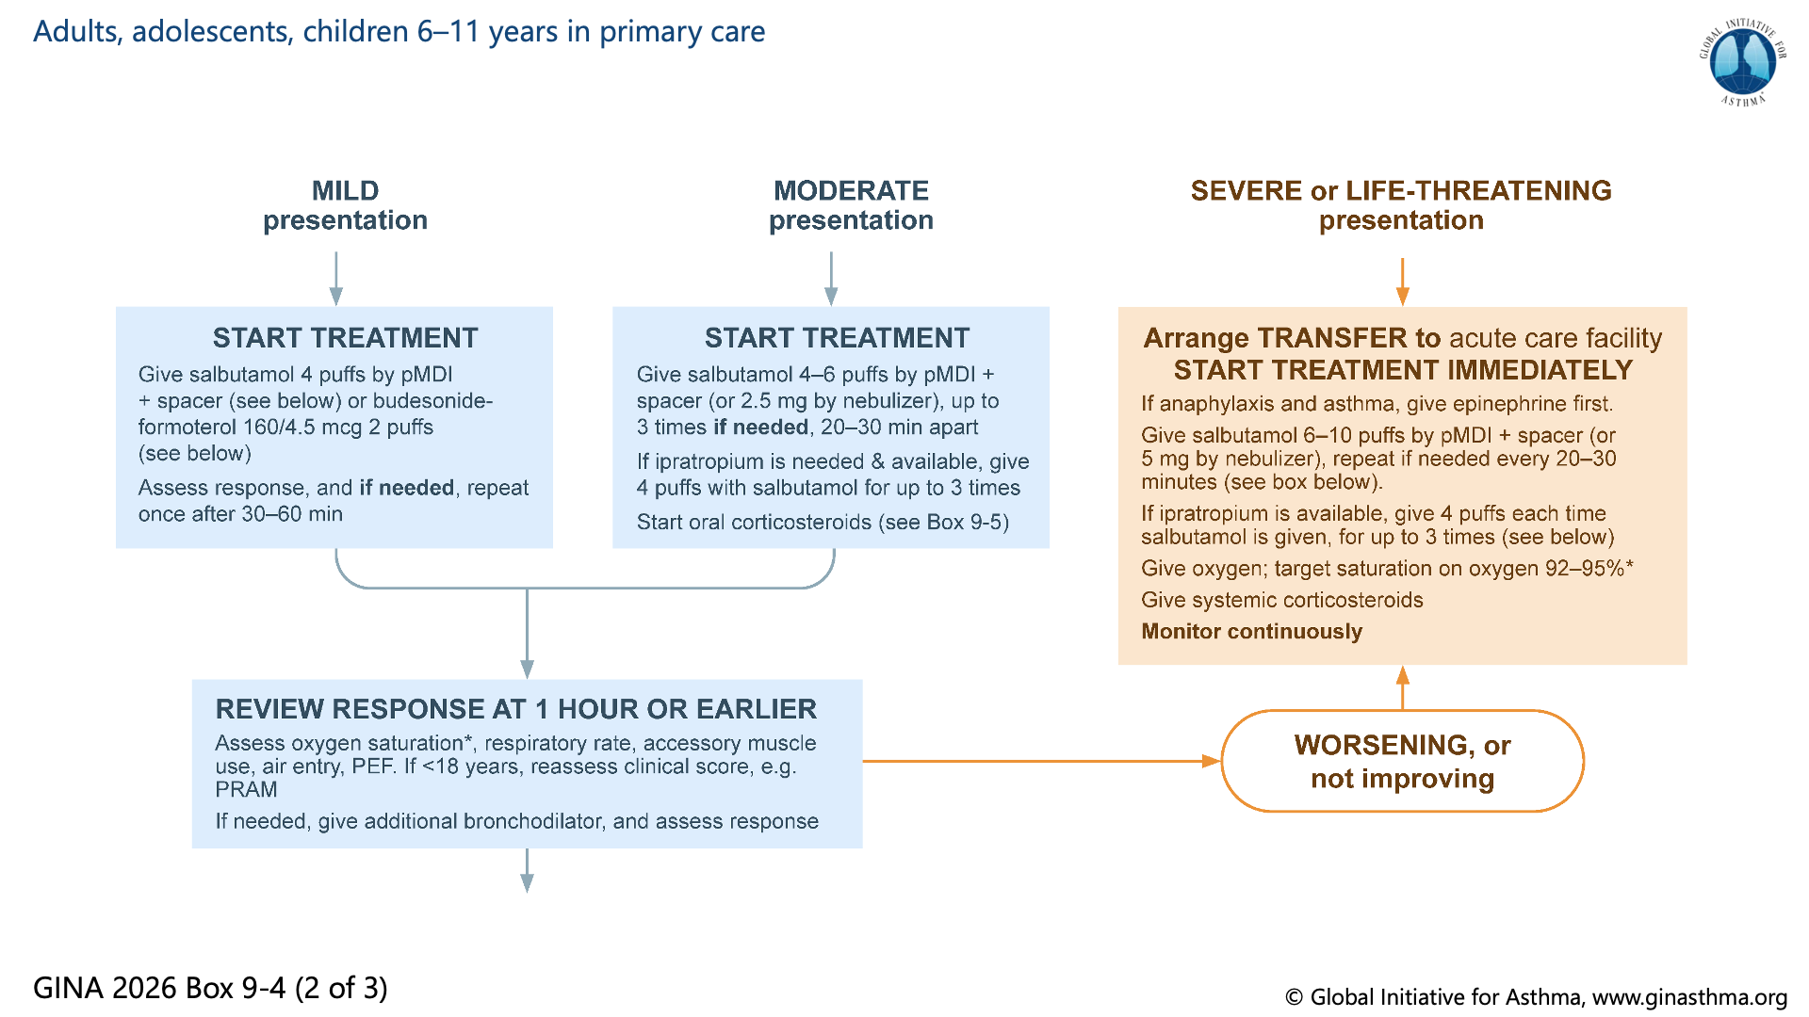

Slide 57


Slide 58


Slide 59


Slide 60


Slide 61


Slide 62


Slide 63


Slide 64


Slide 65


Slide 66


Slide 67


Slide 68

Notes:
Asthma treatment is not one-size-fits-all, and not just about medications
Explain that biomarkers are included in ‘Review response’ rather than earlier in the cycle, because they are most commonly elevated due to poor adherence and/or incorrect inhaler technique with ICS-containing medications; these problems are very common, and should be addressed first

Slide 69


Slide 70


Slide 71


Slide 72


Slide 73


Slide 74


Slide 75


Slide 76


Slide 77


Slide 78


Slide 79


Slide 80

Notes:
References to be added

Slide 81


Slide 82


Slide 83


Slide 84


Slide 85


Slide 86


Slide 87


Slide 88


Slide 89


Slide 90


Slide 91


Slide 92


Slide 93


Slide 94


Slide 95


Slide 96


