Slide 1
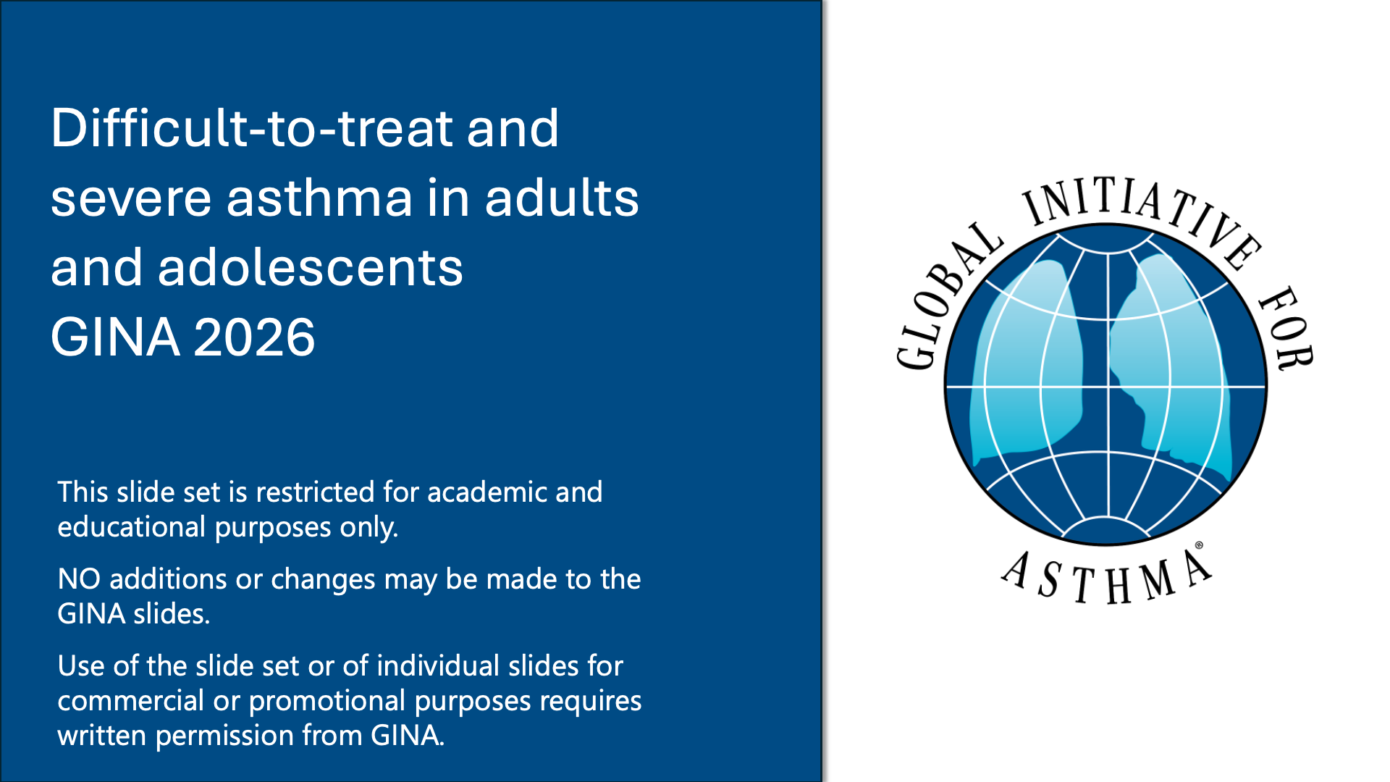

Slide 2
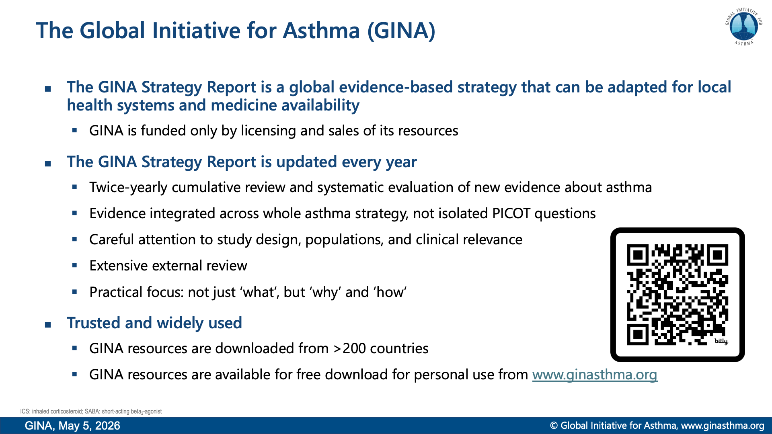

Slide 3
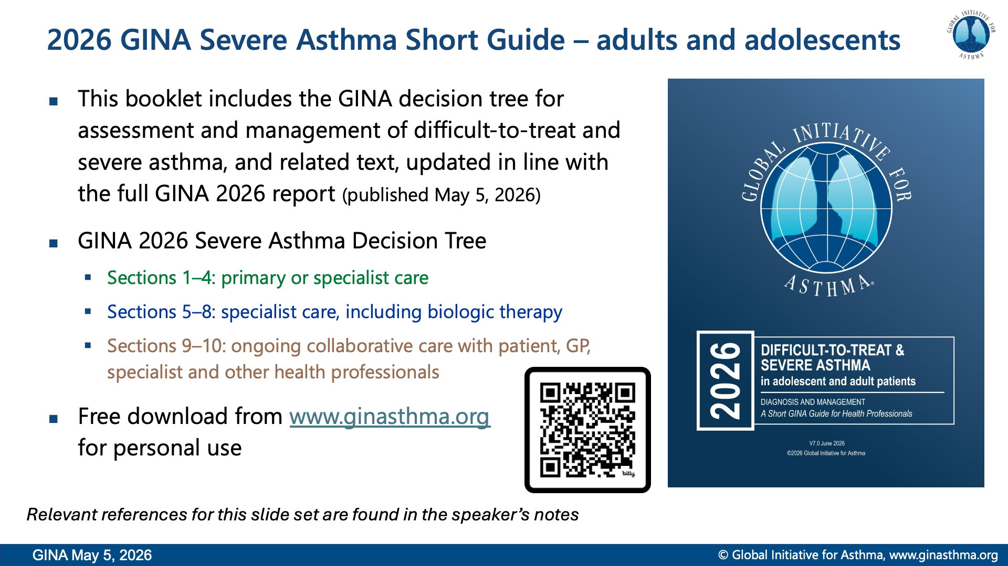

Slide 4
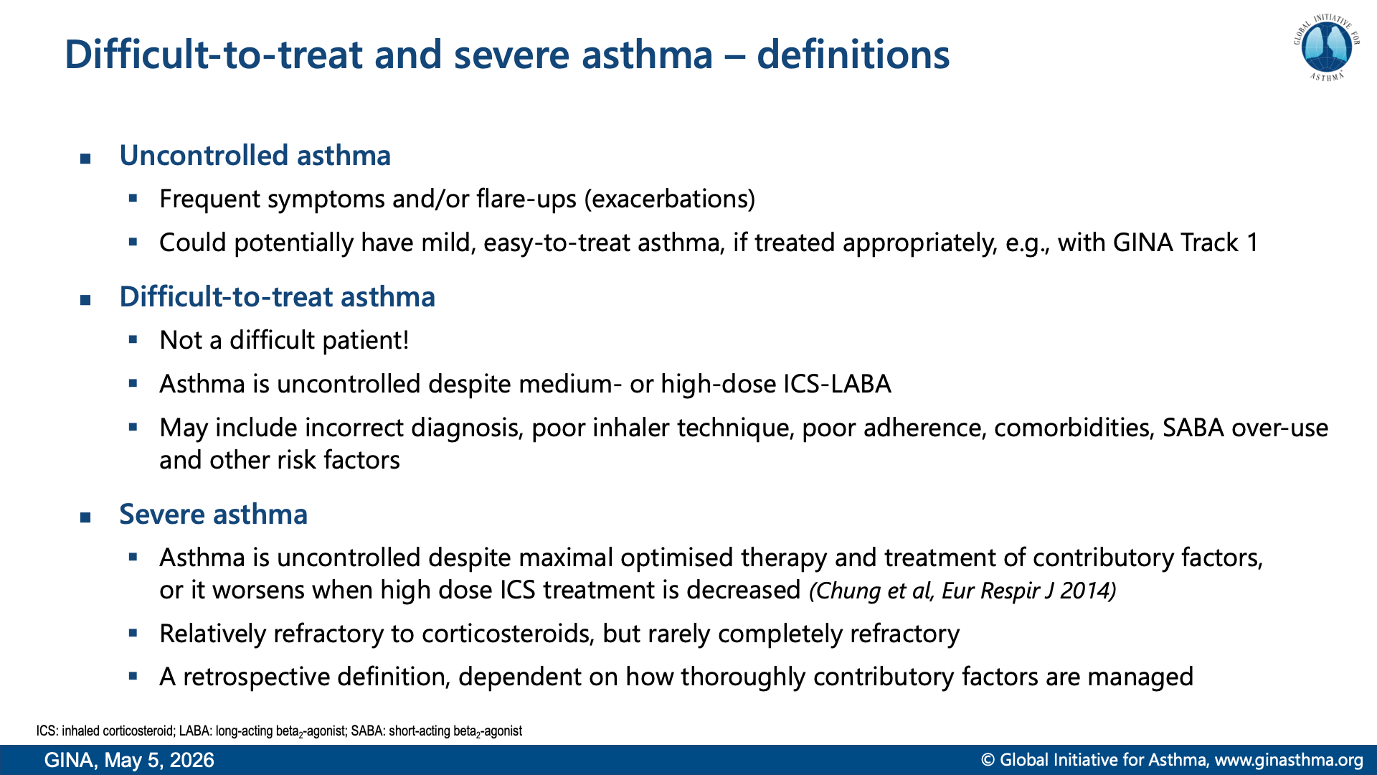
Notes:
Chung KF, Wenzel SE, Brozek JL, et al. International ERS/ATS guidelines on definition, evaluation and treatment of severe asthma. Eur Respir J 2014; 43: 343-373.

Slide 5
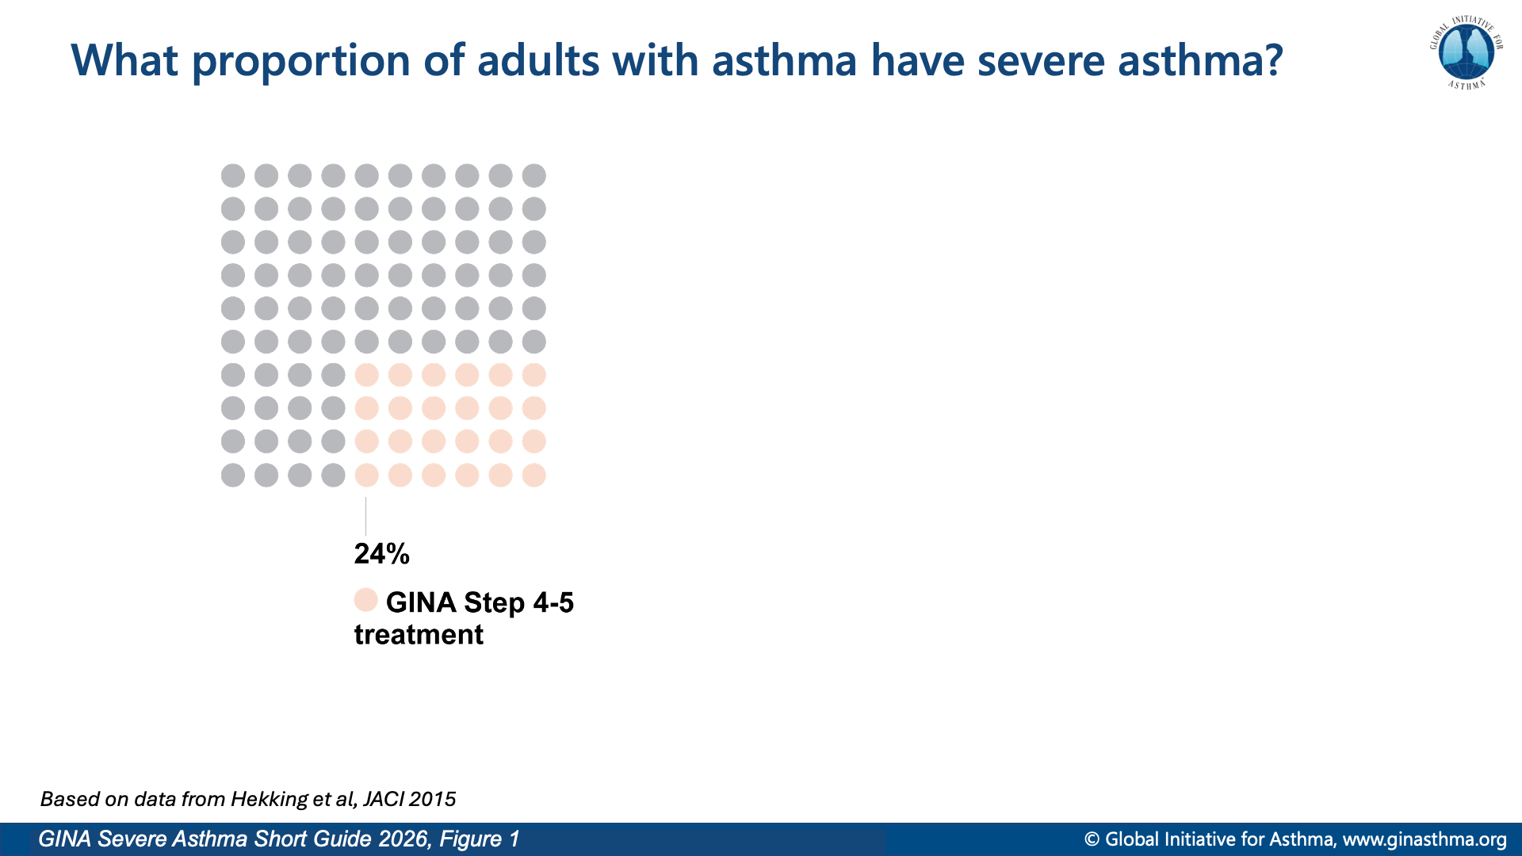
Notes:
Hekking P, Wener R, Amelink M, et al. The prevalence of severe refractory asthma. J Allergy Clin Immunol 2015; 135: 896-902.

Slide 6
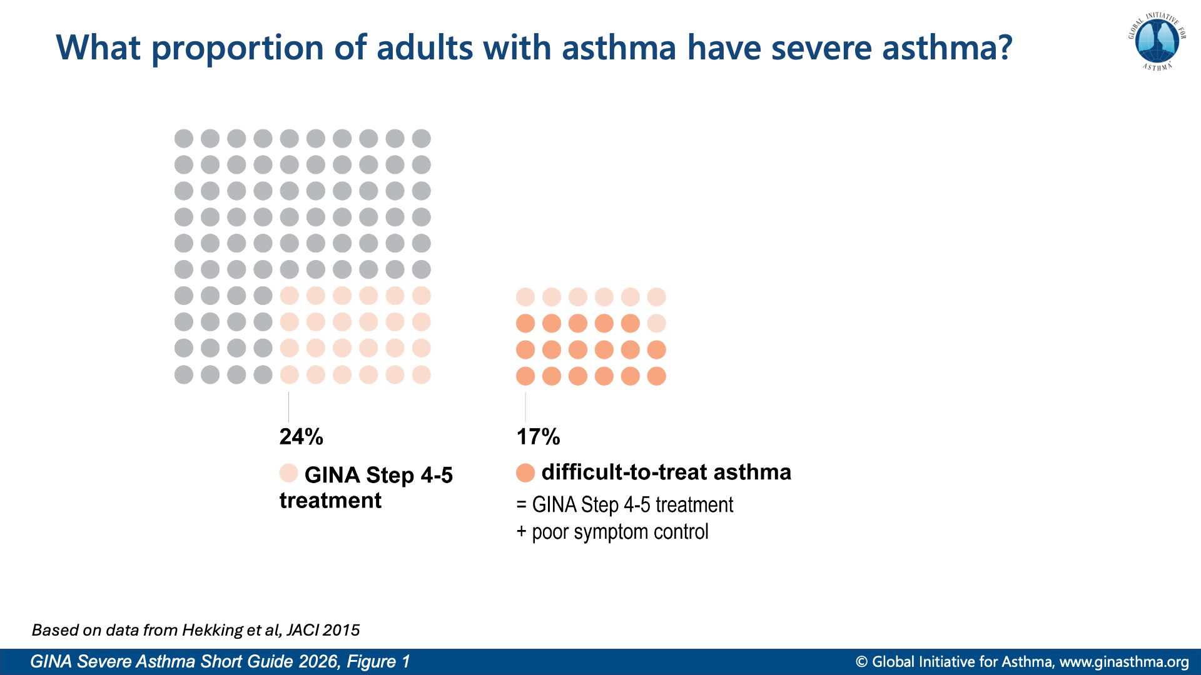
Notes:
Hekking P, Wener R, Amelink M, et al. The prevalence of severe refractory asthma. J Allergy Clin Immunol 2015; 135: 896-902.

Slide 7
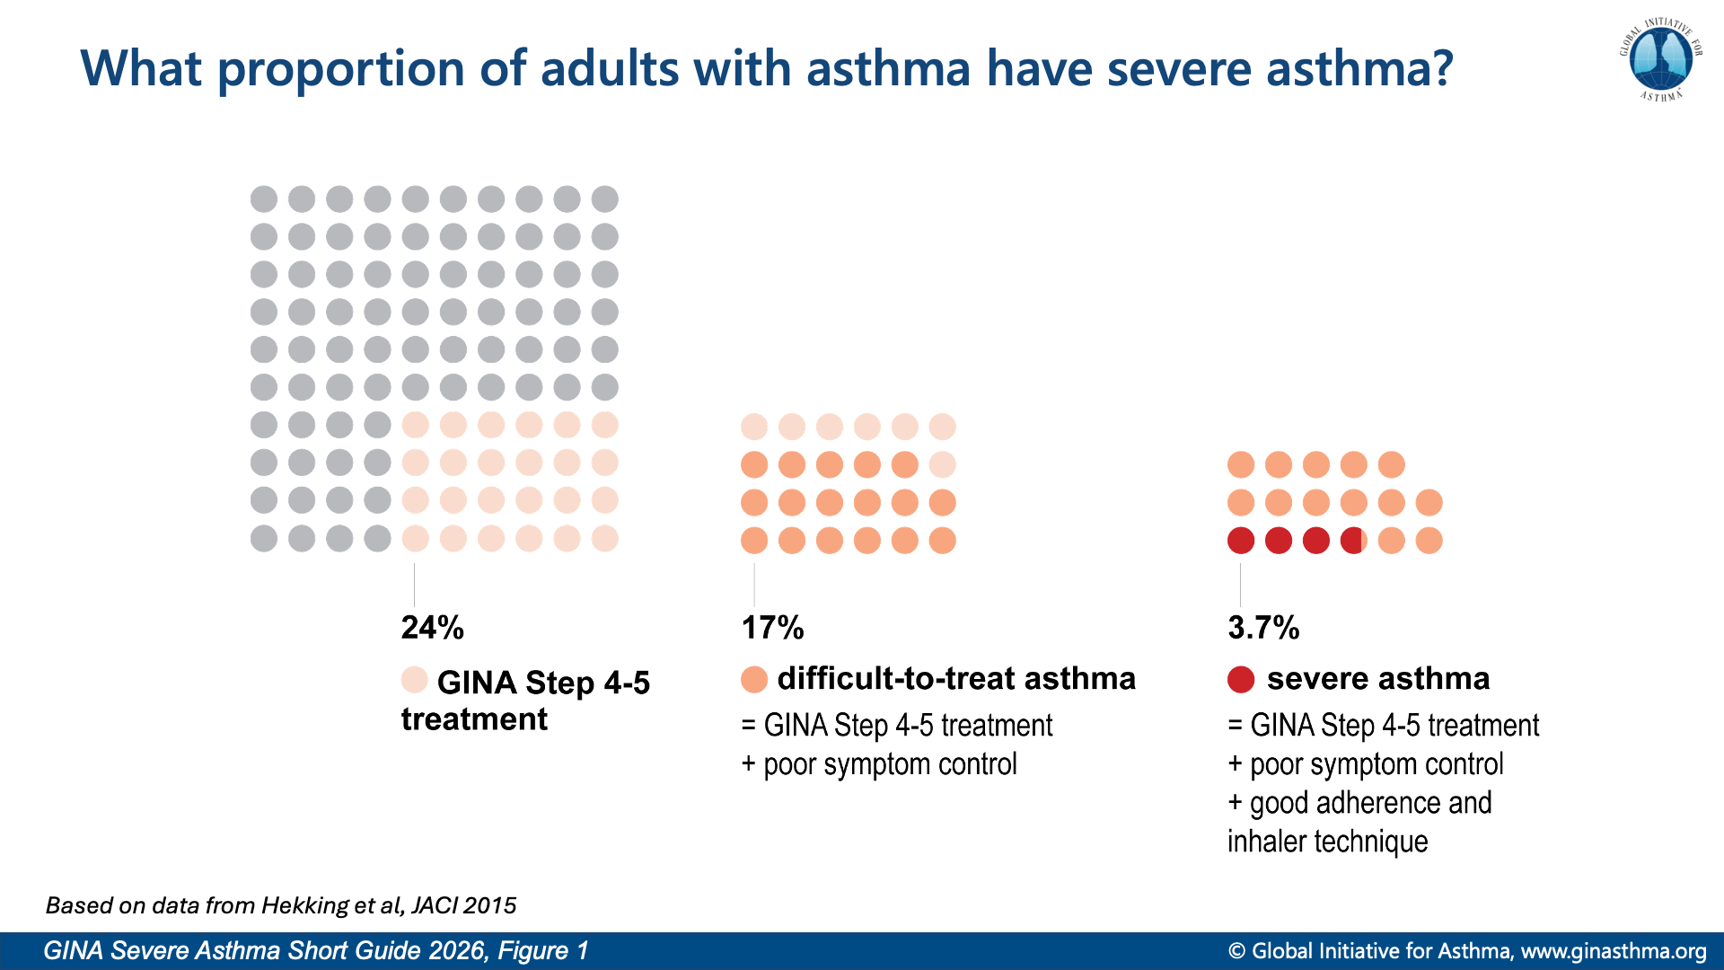
Notes:
Hekking P, Wener R, Amelink M, et al. The prevalence of severe refractory asthma. J Allergy Clin Immunol 2015; 135: 896-902.

Slide 8
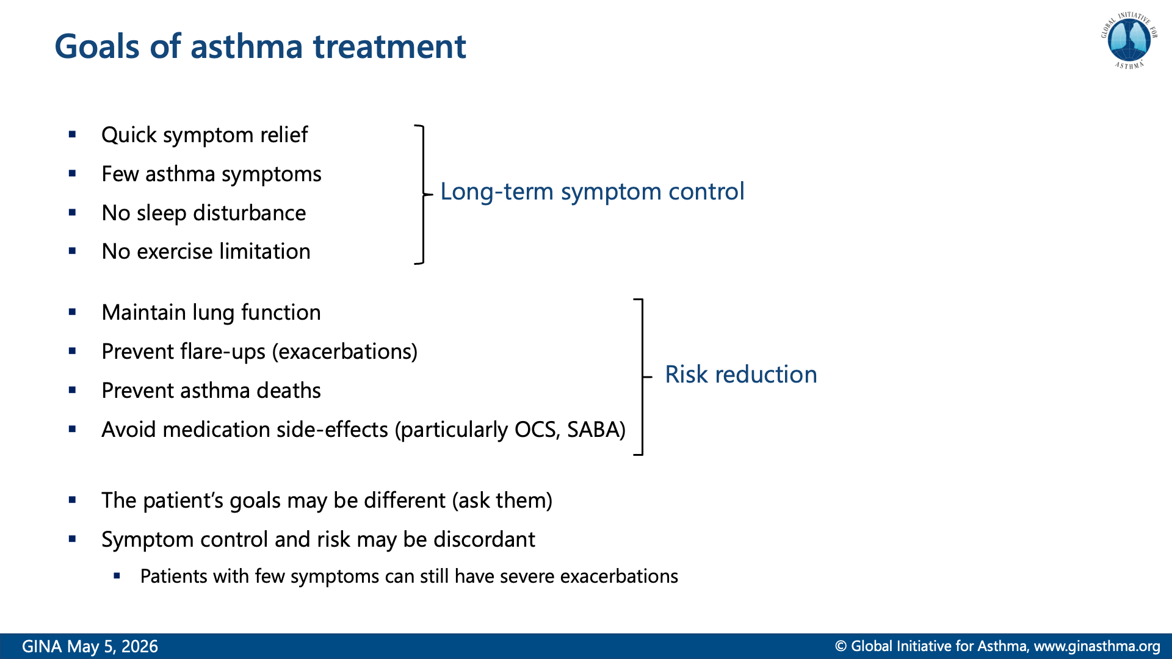

Slide 9
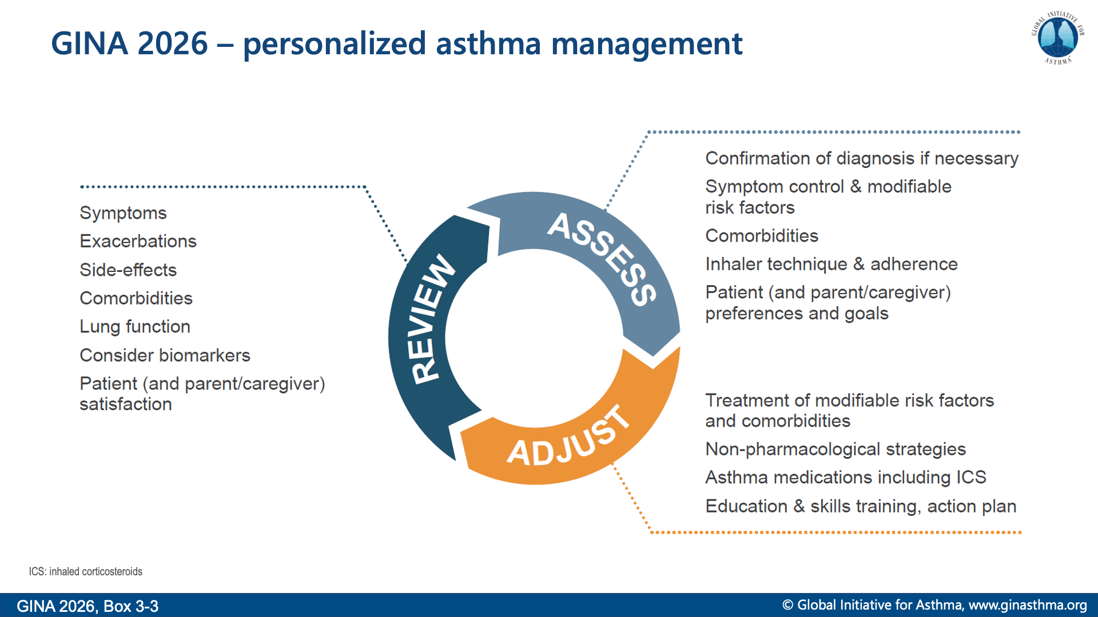
Notes:
Asthma treatment is not one-size-fits-all, and not just about medications

Slide 10
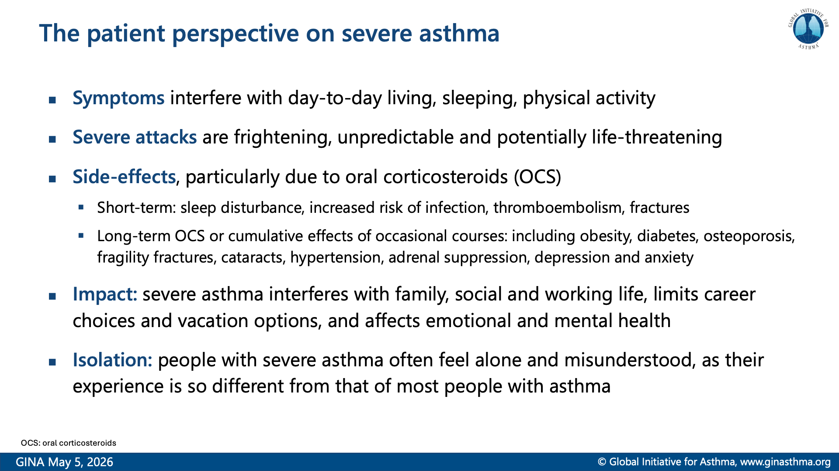
Notes:
Lefebvre P, Duh MS, Lafeuille M-H, et al. Acute and chronic systemic corticosteroid–related complications in patients with severe asthma. J Allergy Clin Immunol 2015; 136: 1488-1495.
Chalitsios CV, McKeever TM, Shaw DE. Incidence of osteoporosis and fragility fractures in asthma: a UK population-based matched cohort study. Eur Respir J 2021; 57: 2001251.
Foster JM, McDonald VM, Guo M, et al. “I have lost in every facet of my life”: the hidden burden of severe asthma. Eur Respir J 2017; 50: 1700765.
Waljee AK, Rogers MA, Lin P, et al. Short term use of oral corticosteroids and related harms among adults in the United States: population based cohort study. BMJ 2017; 357: j1415.

Slide 11
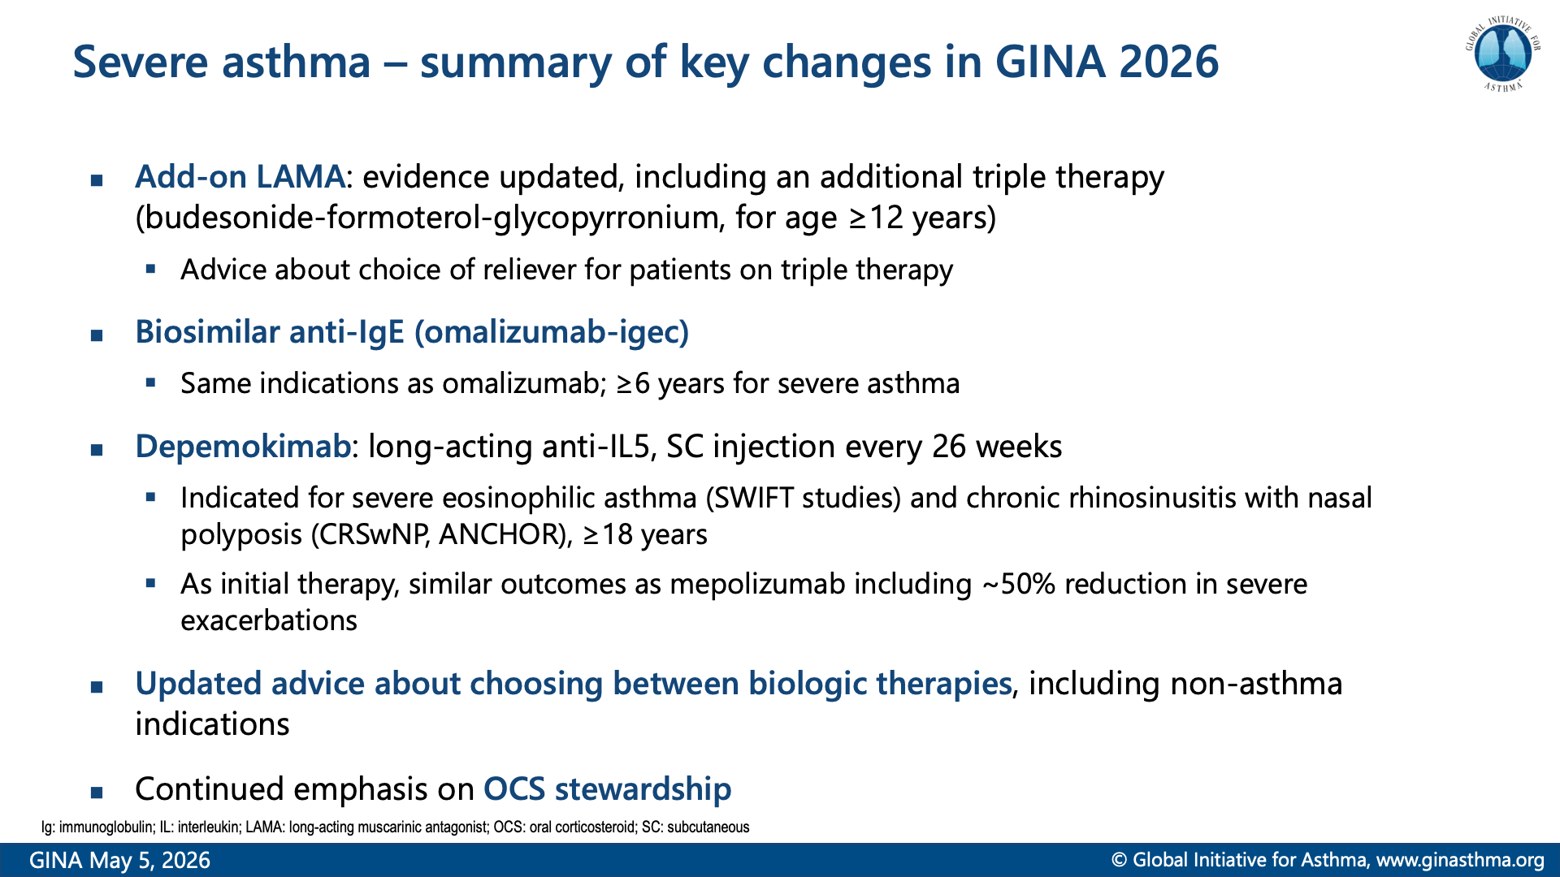
Notes:
Jackson DJ, Wechsler ME, Jackson DJ, et al. Twice-yearly depemokimab in severe asthma with an eosinophilic phenotype. N Engl J Med 2024; 391: 2337-2349.
Gevaert P, Desrosiers M, Cornet M, et al. Efficacy and safety of twice per year depemokimab in chronic rhinosinusitis with nasal polyps (ANCHOR-1 and ANCHOR-2): phase 3, randomised, double-blind, parallel trials. Lancet 2025; 405: 911-926.

Slide 12
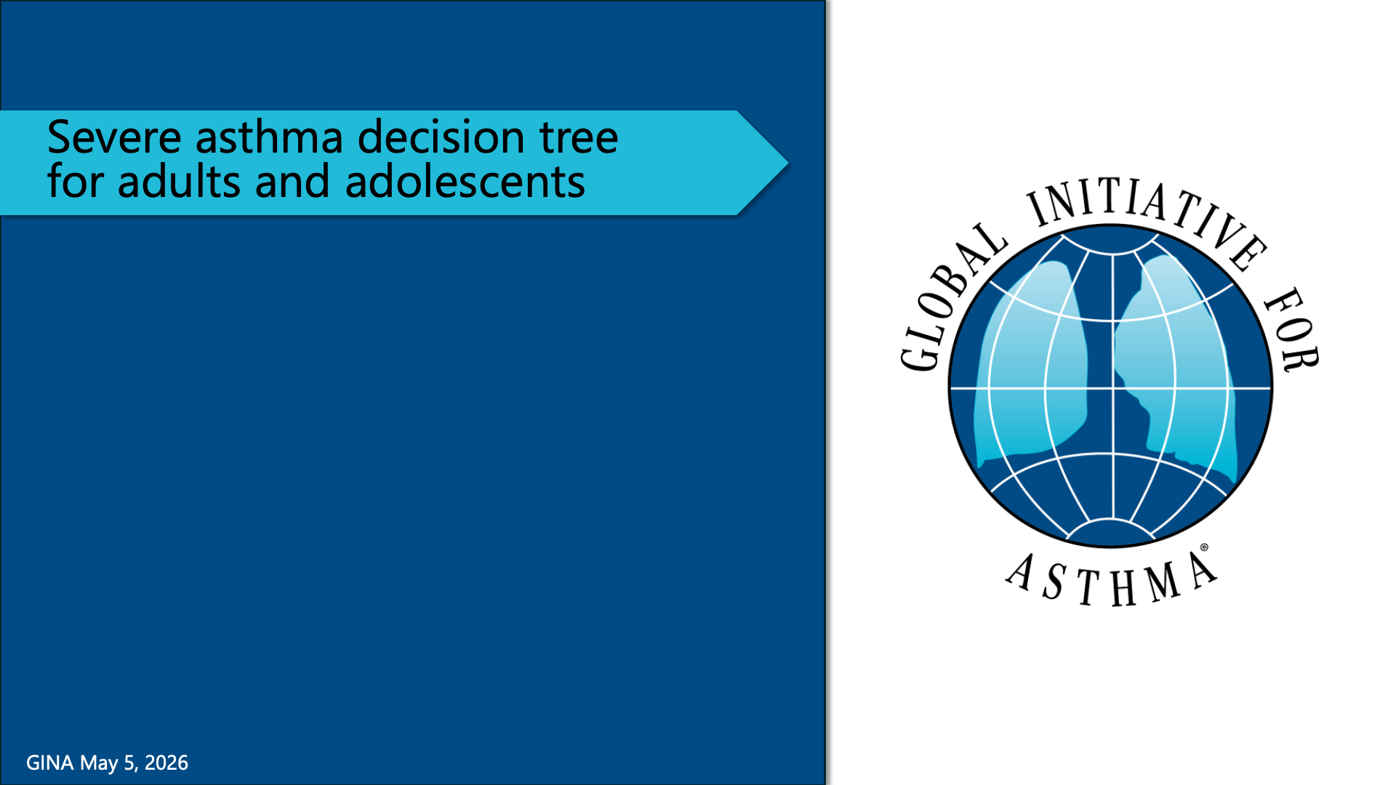

Slide 13
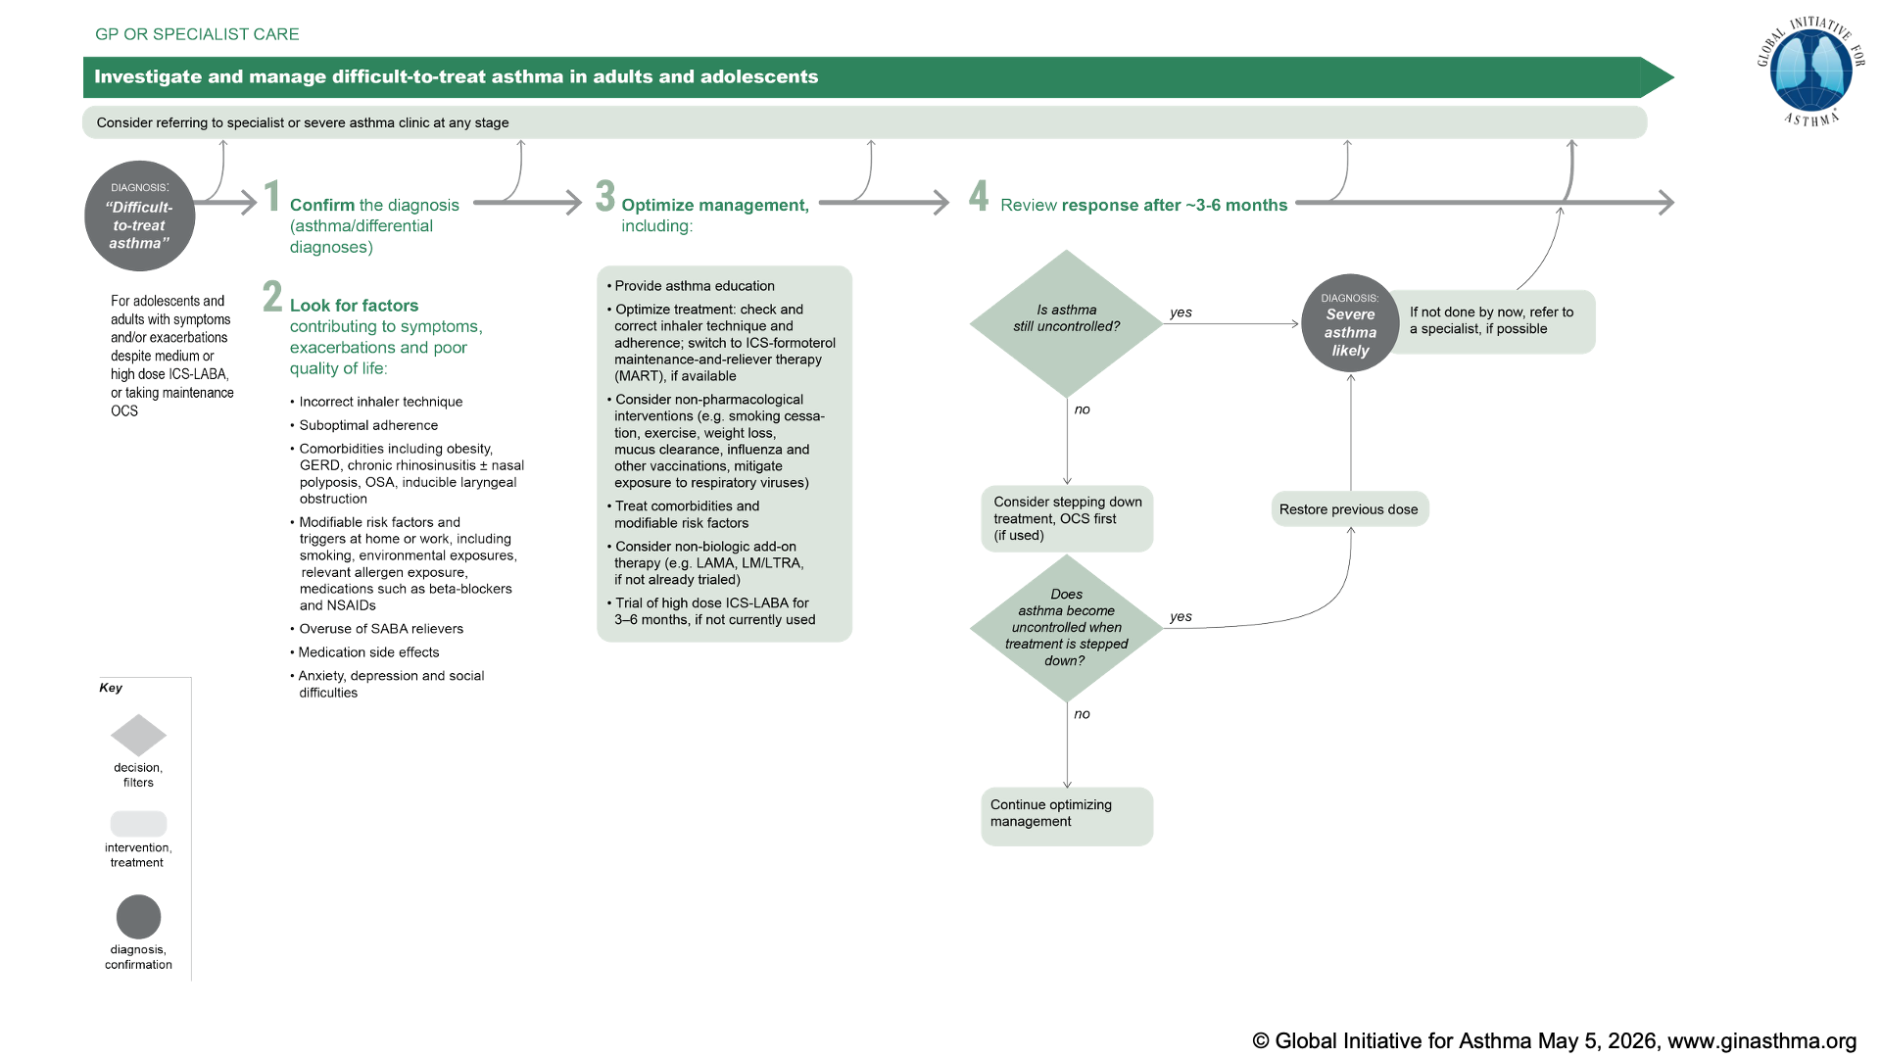
Notes:
NOTE: this slide is just to show the overall orientation; abbreviations are shown on the following pop-out slides

Slide 14
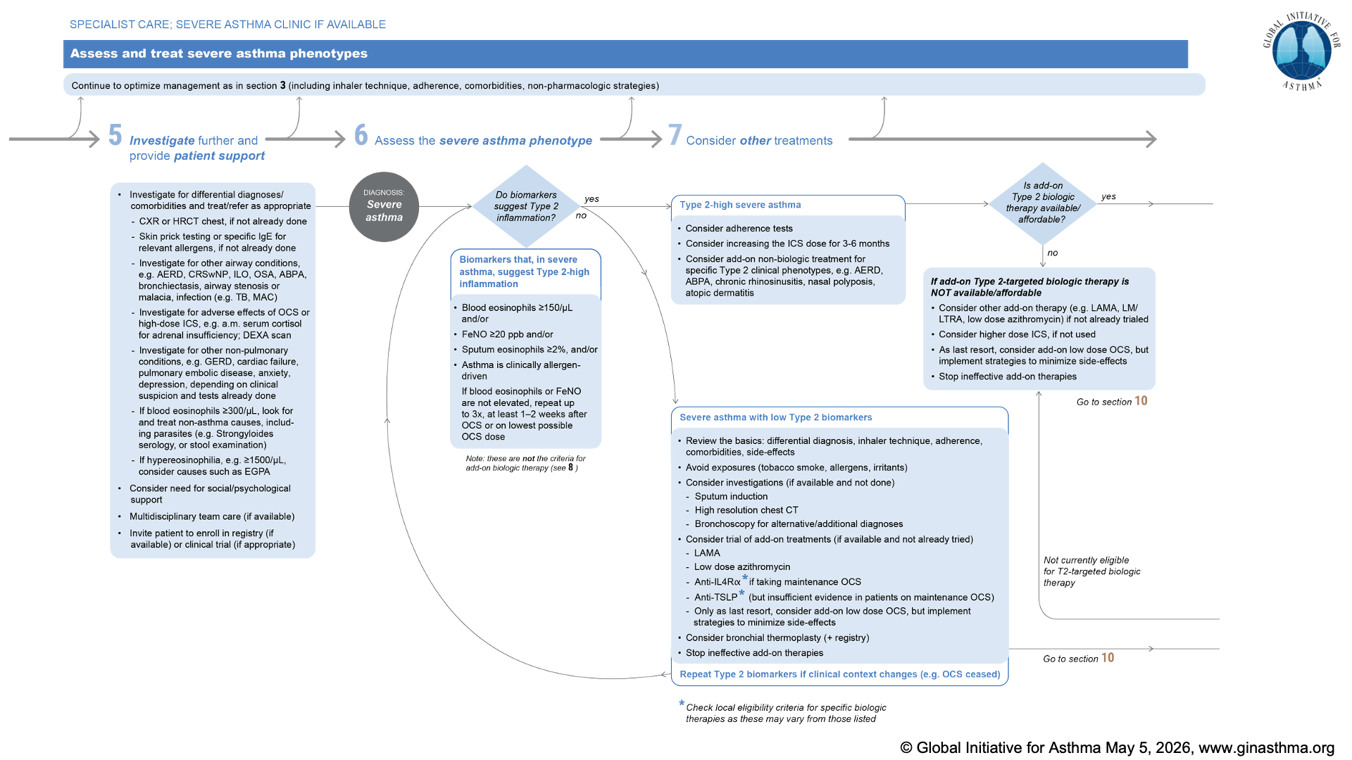
Notes:
NOTE: this slide is just to show the overall orientation; abbreviations are shown on the following pop-out slides

Slide 15
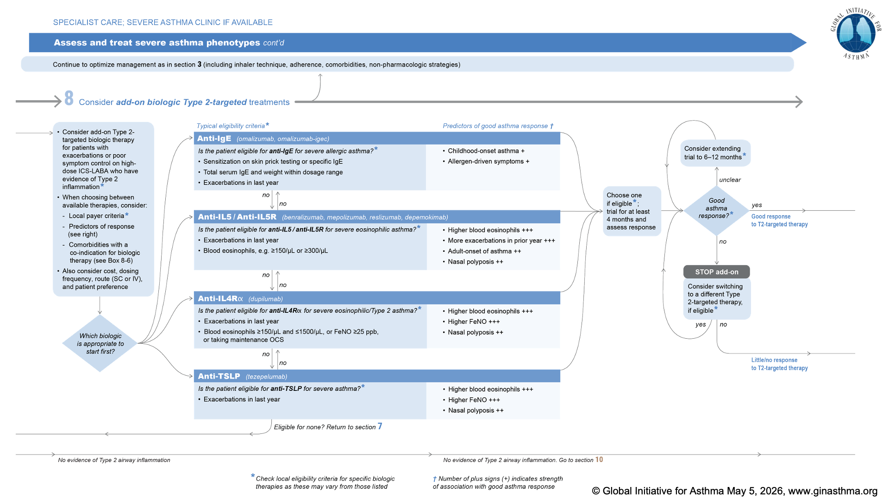
Notes:
NOTE: this slide is just to show the overall orientation; abbreviations are shown on the following pop-out slides

Slide 16
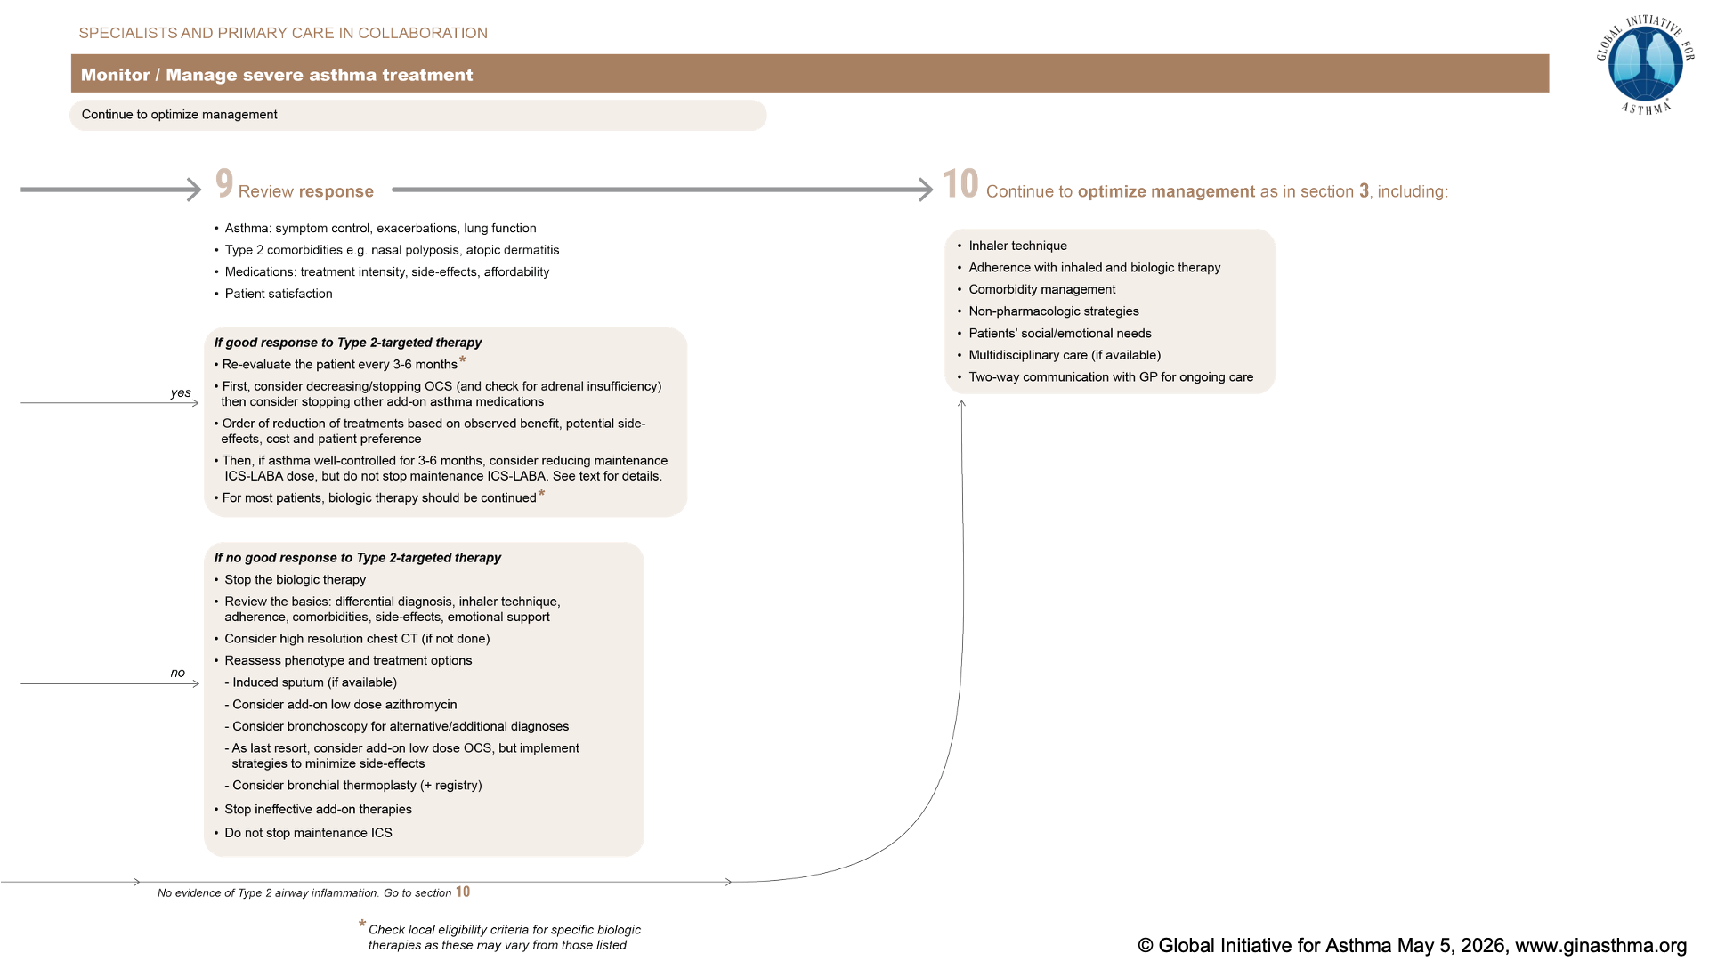
Notes:
NOTE: this slide is just to show the overall orientation; abbreviations are shown on the following pop-out slides

Slide 17
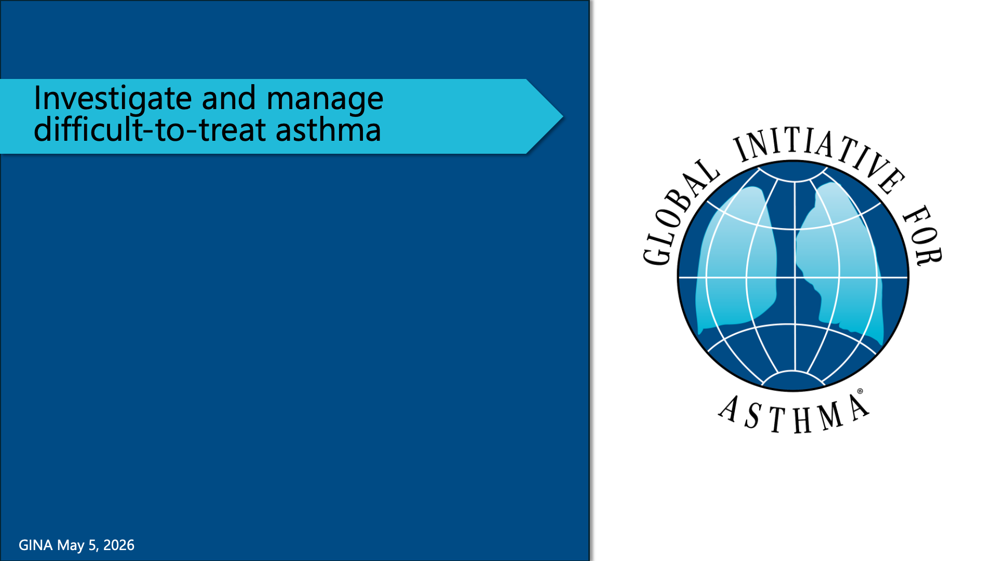

Slide 18
Notes:
NOTE: this slide is just to show the overall orientation; abbreviations are shown on the following pop-out slides

Slide 19


Slide 20
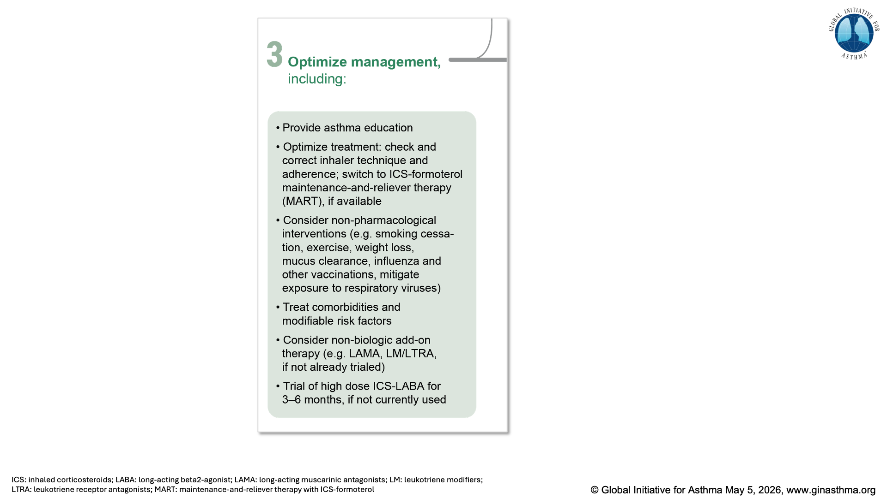

Slide 21
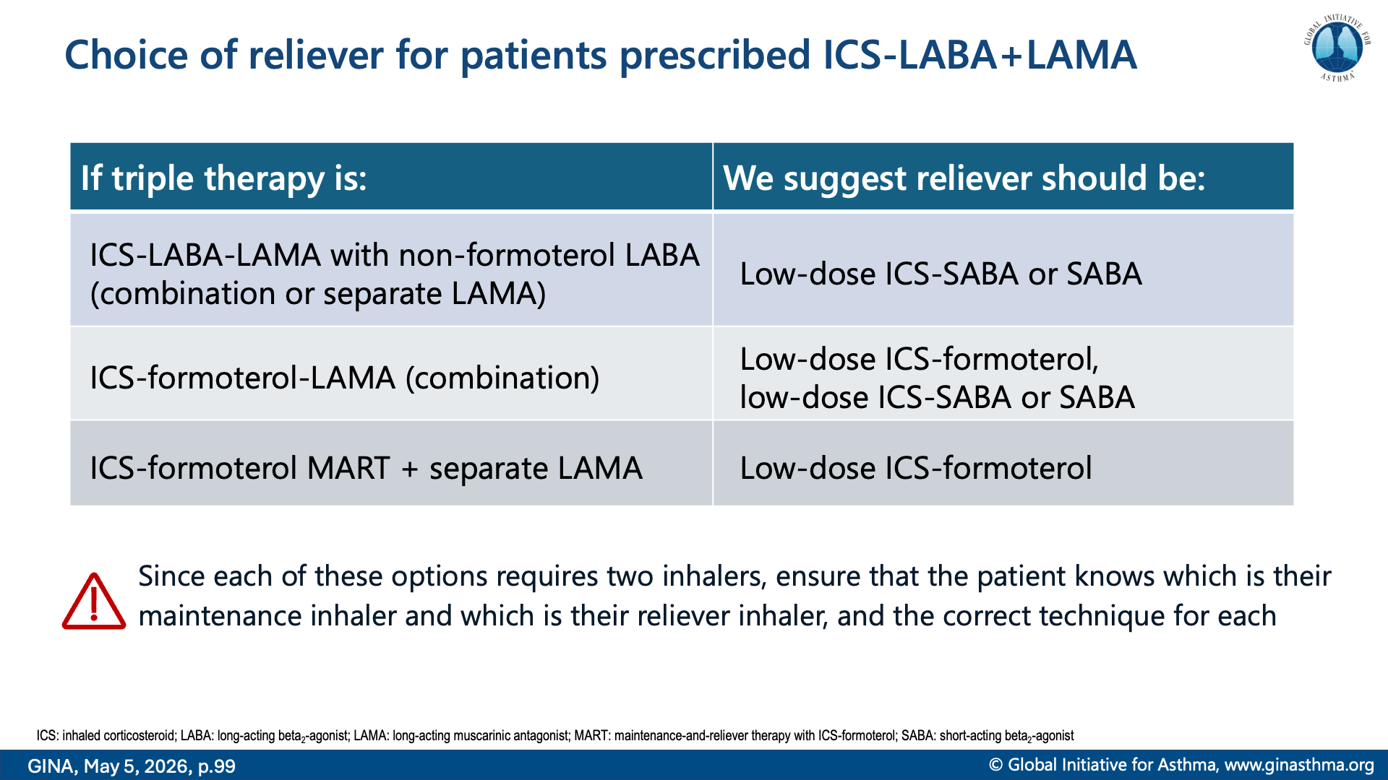

Slide 22
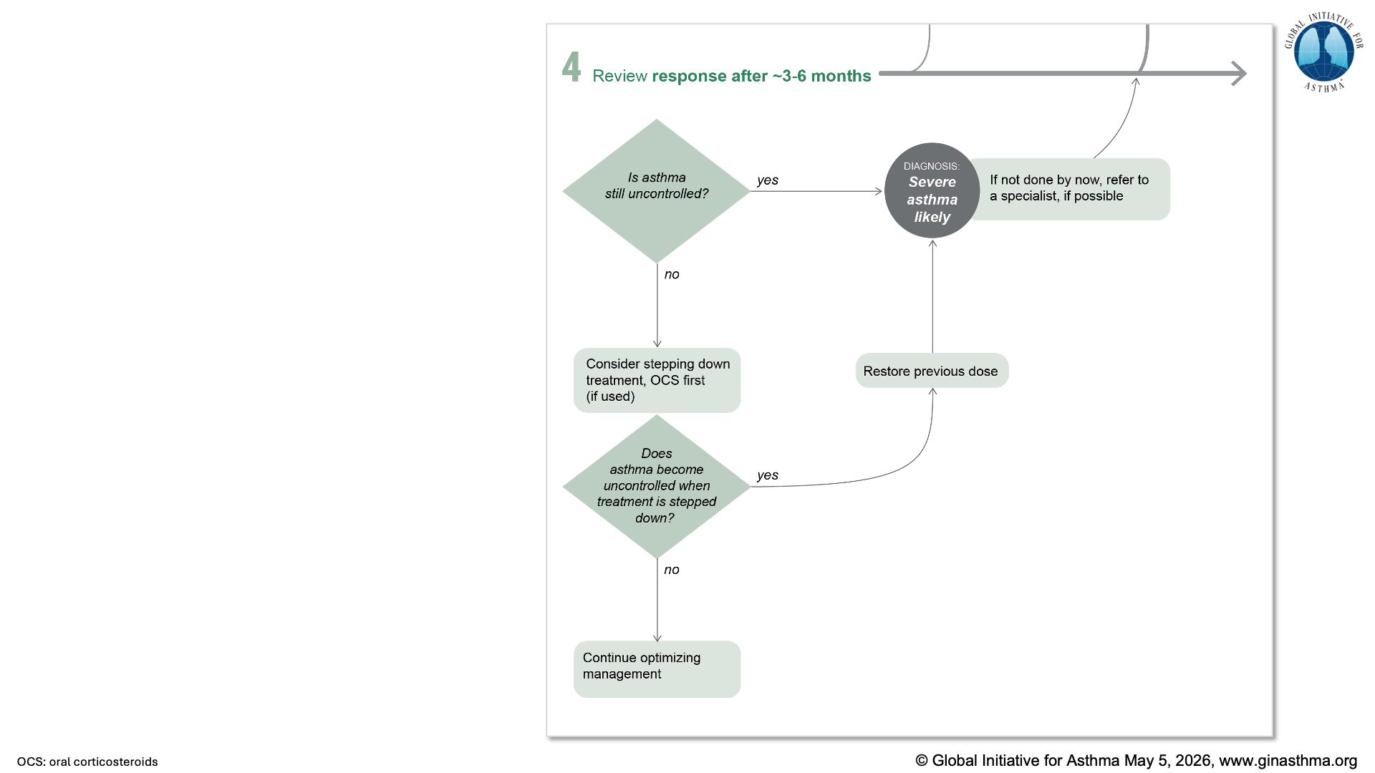

Slide 23
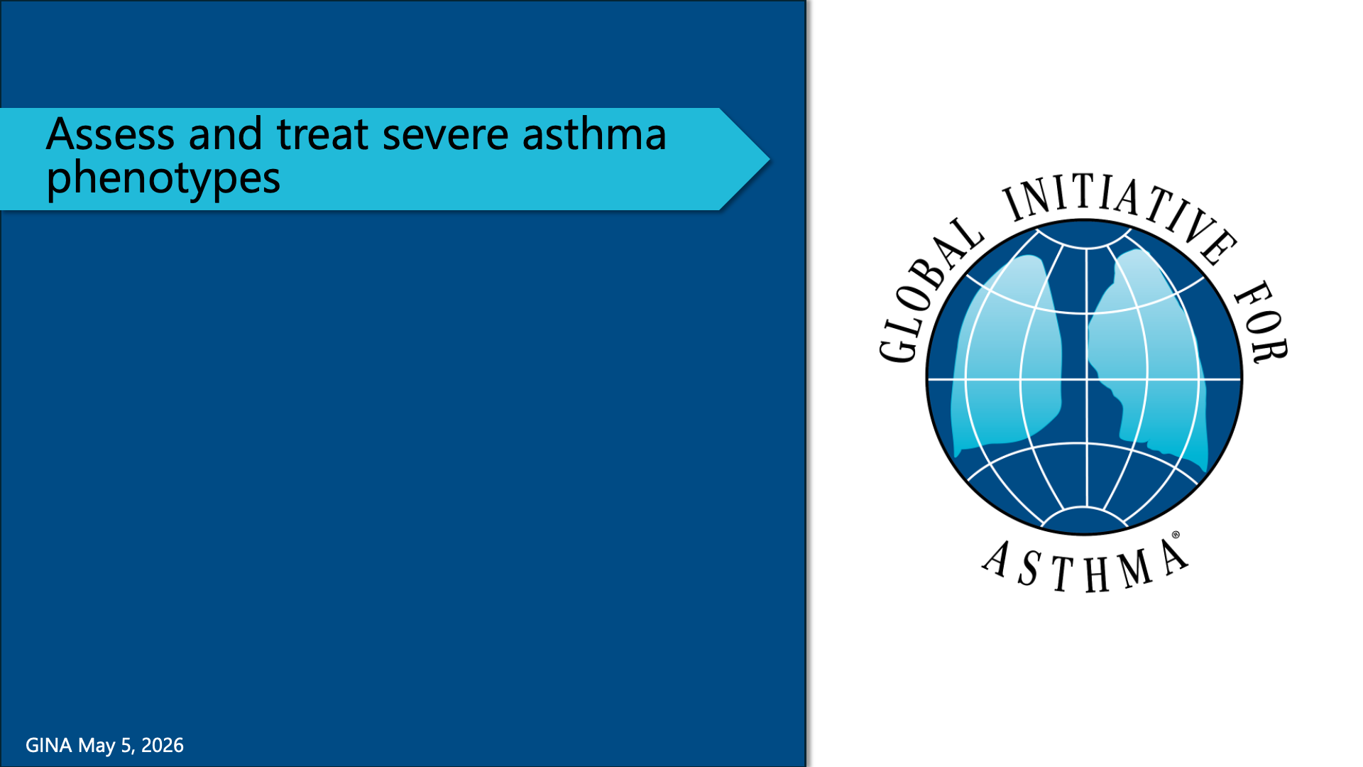

Slide 24
Notes:
NOTE: this slide is just to show the overall orientation; abbreviations are shown on the following pop-out slides

Slide 25
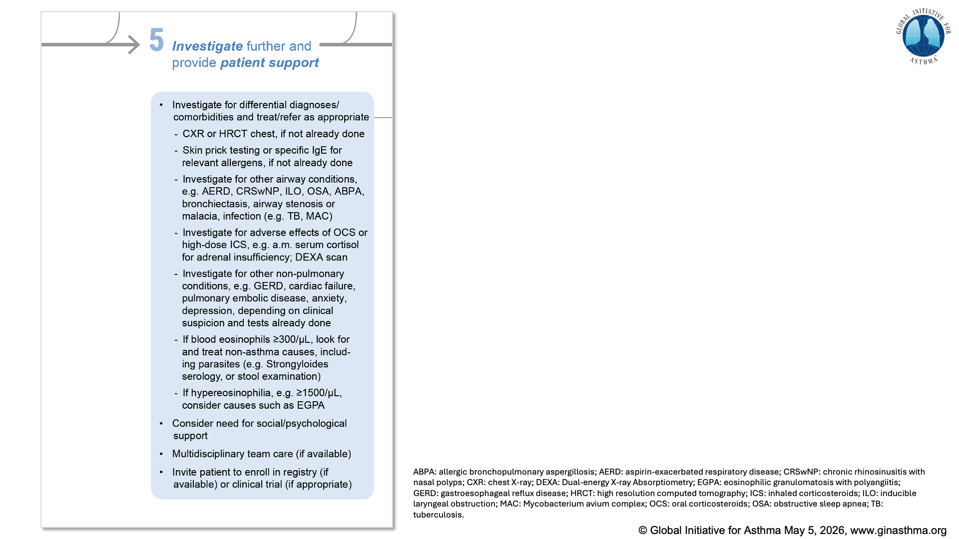

Slide 26
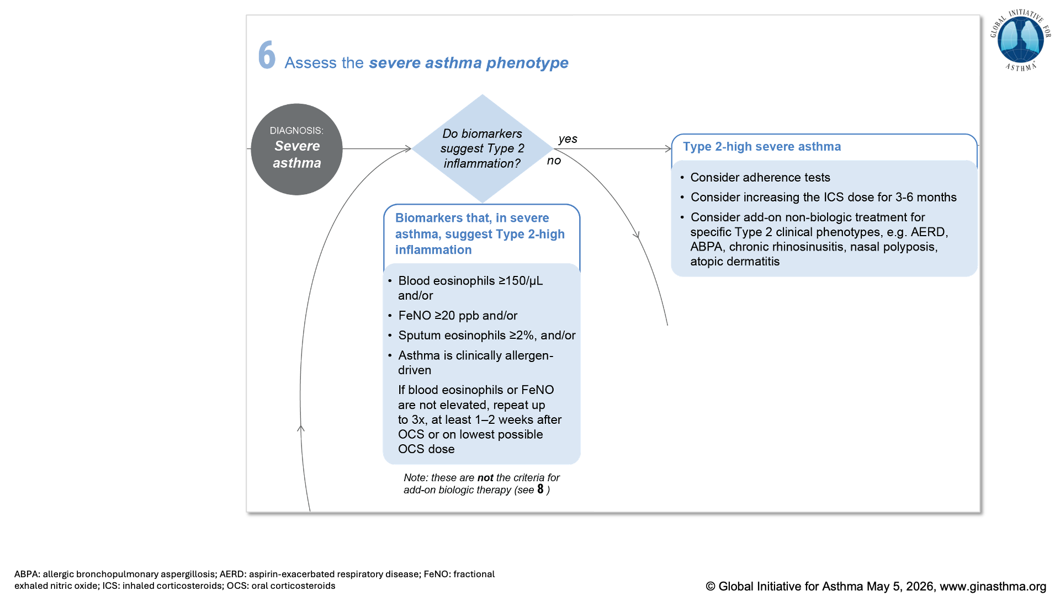

Slide 27
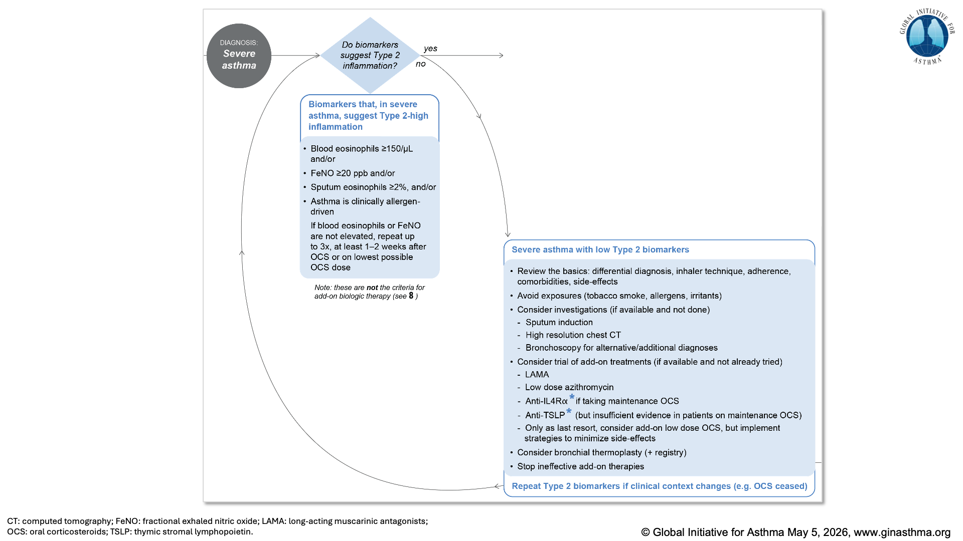

Slide 28
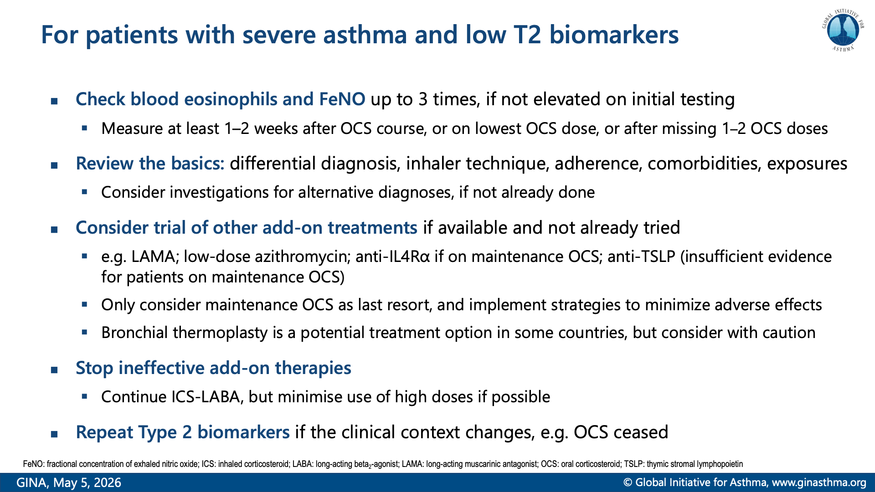
Notes:
Sobieraj DM, Baker WL, Nguyen E, et al. Association of inhaled corticosteroids and long-acting muscarinic antagonists with asthma control in patients with uncontrolled, persistent asthma: a systematic review and meta-analysis. JAMA 2018; 319: 1473-1484.
Kim LH, Saleh C, Whalen-Browne A, et al. Triple vs dual inhaler therapy and asthma outcomes in moderate to severe asthma: a systematic review and meta-analysis. JAMA 2021; 325: 2466-2479. 41.
Oba Y, Anwer S, Maduke T, et al. Effectiveness and tolerability of dual and triple combination inhaler therapies compared with each other and varying doses of inhaled corticosteroids in adolescents and adults with asthma: a systematic review and network meta-analysis. Cochrane Database Syst Rev 2022; 12: CD013799.
Gibson PG, Yang IA, Upham JW, et al. Effect of azithromycin on asthma exacerbations and quality of life in adults with persistent uncontrolled asthma (AMAZES): a randomised, double-blind, placebo-controlled trial. Lancet 2017; 390: 659-668.
Brusselle GG, Vanderstichele C, Jordens P, et al. Azithromycin for prevention of exacerbations in severe asthma (AZISAST): a multicentre randomised double-blind placebo-controlled trial. Thorax 2013; 68: 322-329.
Castro M, Rubin AS, Laviolette M, et al. Effectiveness and safety of bronchial thermoplasty in the treatment of severe asthma: a multicenter, randomized, double-blind, sham-controlled clinical trial. Am J Respir Crit Care Med 2010; 181: 116-124. 45.
Chaudhuri R, Rubin A, Sumino K, et al. Safety and effectiveness of bronchial thermoplasty after 10 years in patients with persistent asthma (BT10+): a follow-up of three randomised controlled trials. Lancet Respir Med 2021; 9: 457-466.

Slide 29
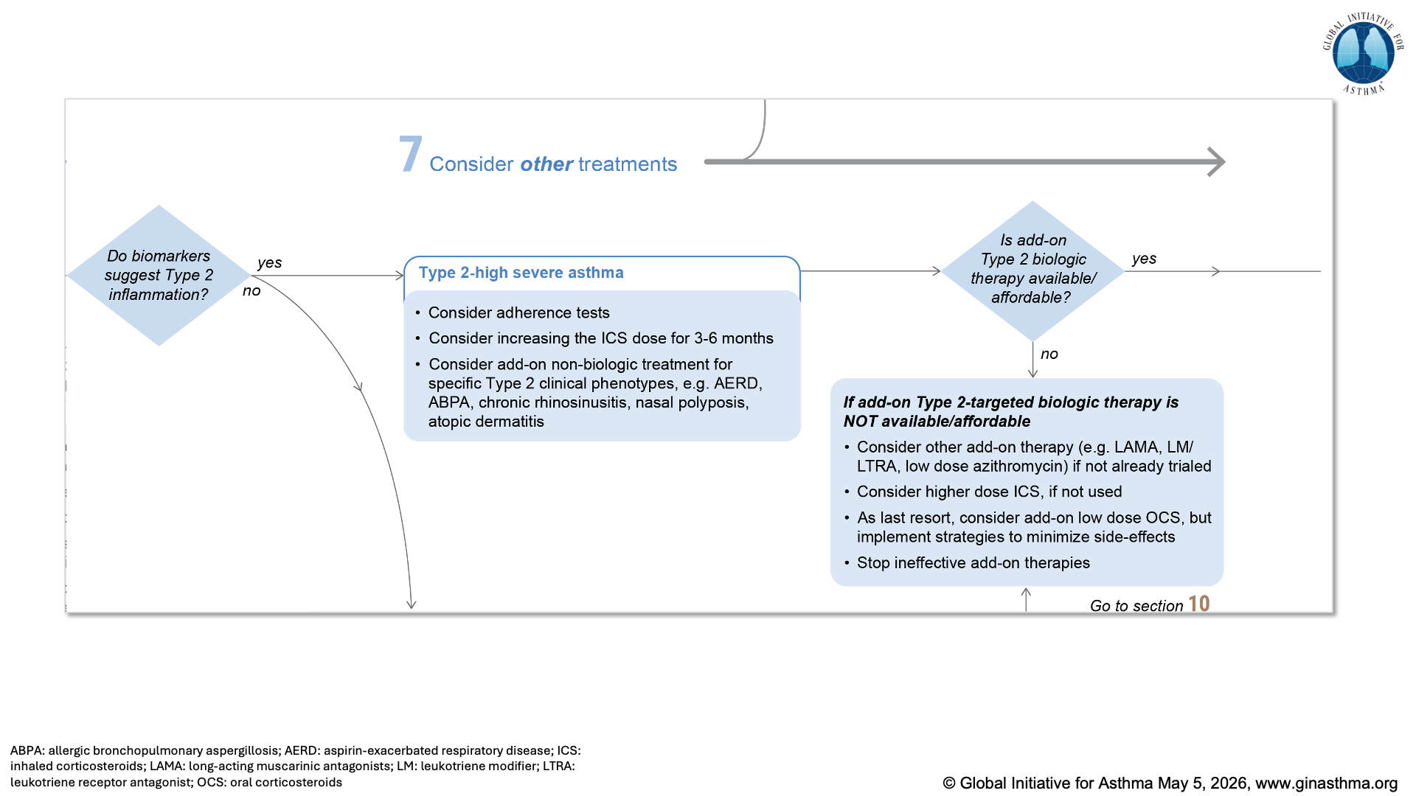

Slide 30
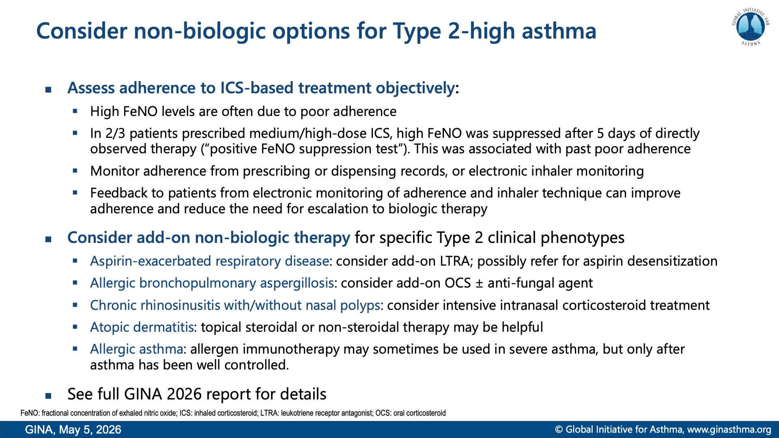
Notes:
Heaney LG, Busby J, Bradding P, et al. Remotely monitored therapy and nitric oxide suppression identifies nonadherence in severe asthma. Am J Respir Crit Care Med 2019; 199: 454-464
McNicholl DM, Stevenson M, McGarvey LP, et al. The utility of fractional exhaled nitric oxide suppression in the identification of nonadherence in difficult asthma. Am J Respir Crit Care Med 2012; 186: 1102-1108.
Hale EM, Greene G, Mulvey C, et al. Use of digital measurement of medication adherence and lung function to guide the management of uncontrolled asthma (INCA Sun): a multicentre, single-blinded, randomised clinical trial. Lancet Respir Med 2023; 11: 591-601.

Slide 31


Slide 32
Notes:
NOTE: this slide is just to show the overall orientation; abbreviations are shown on the following pop-out slides

Slide 33
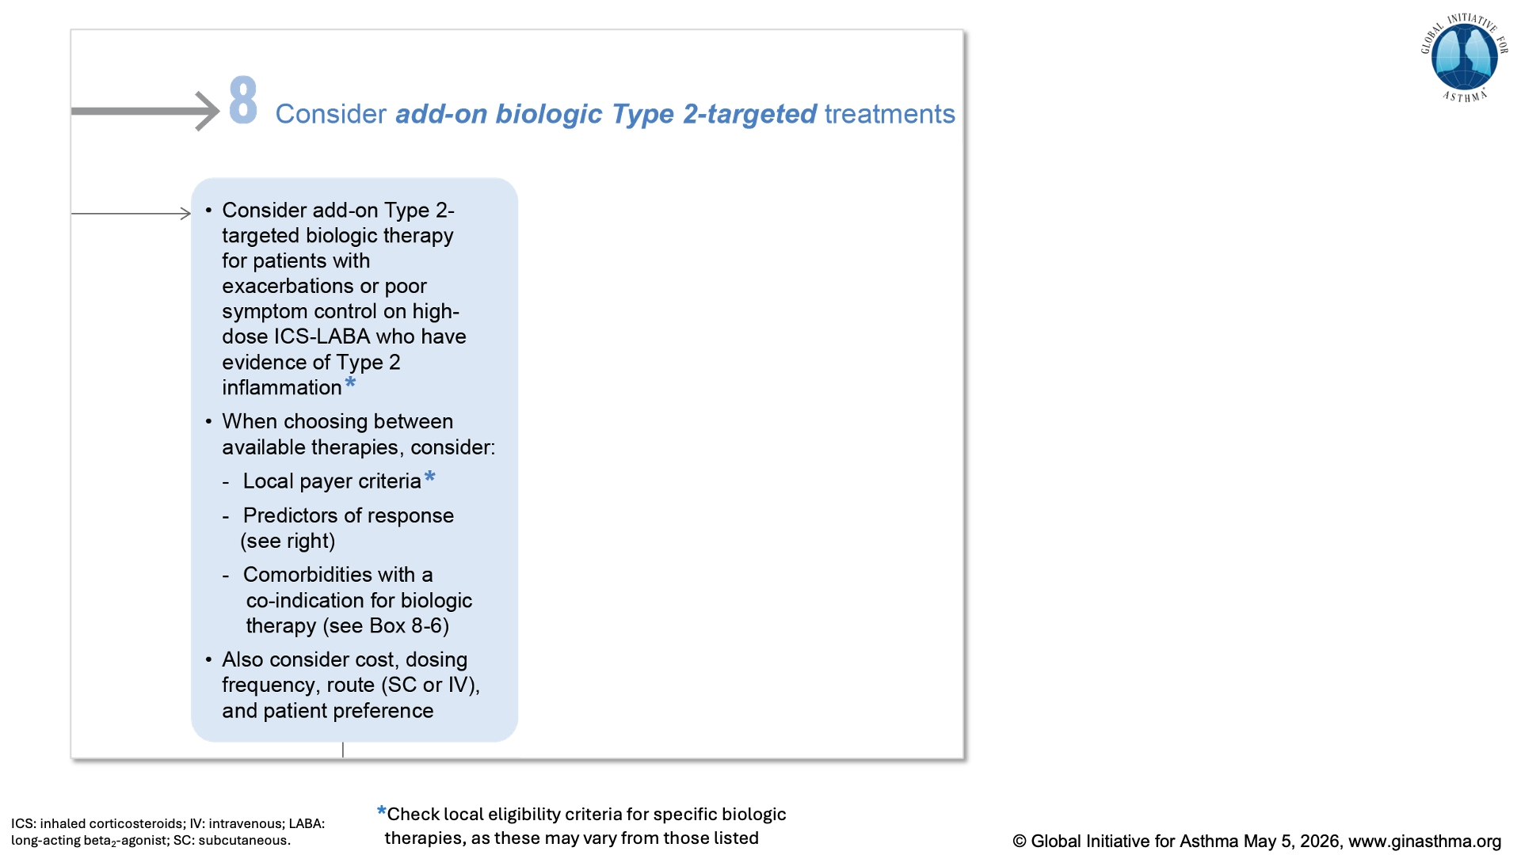

Slide 34
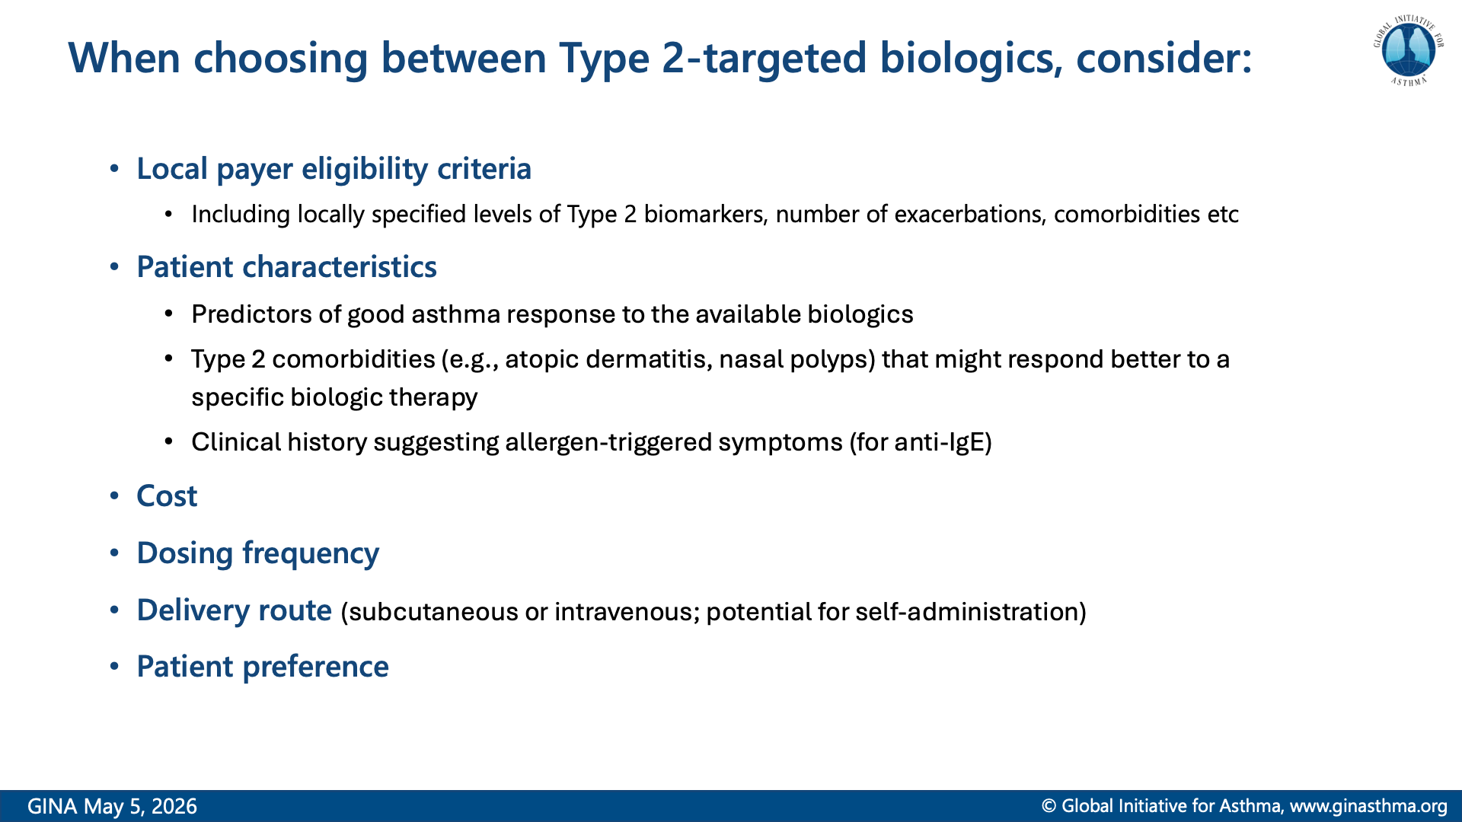

Slide 35
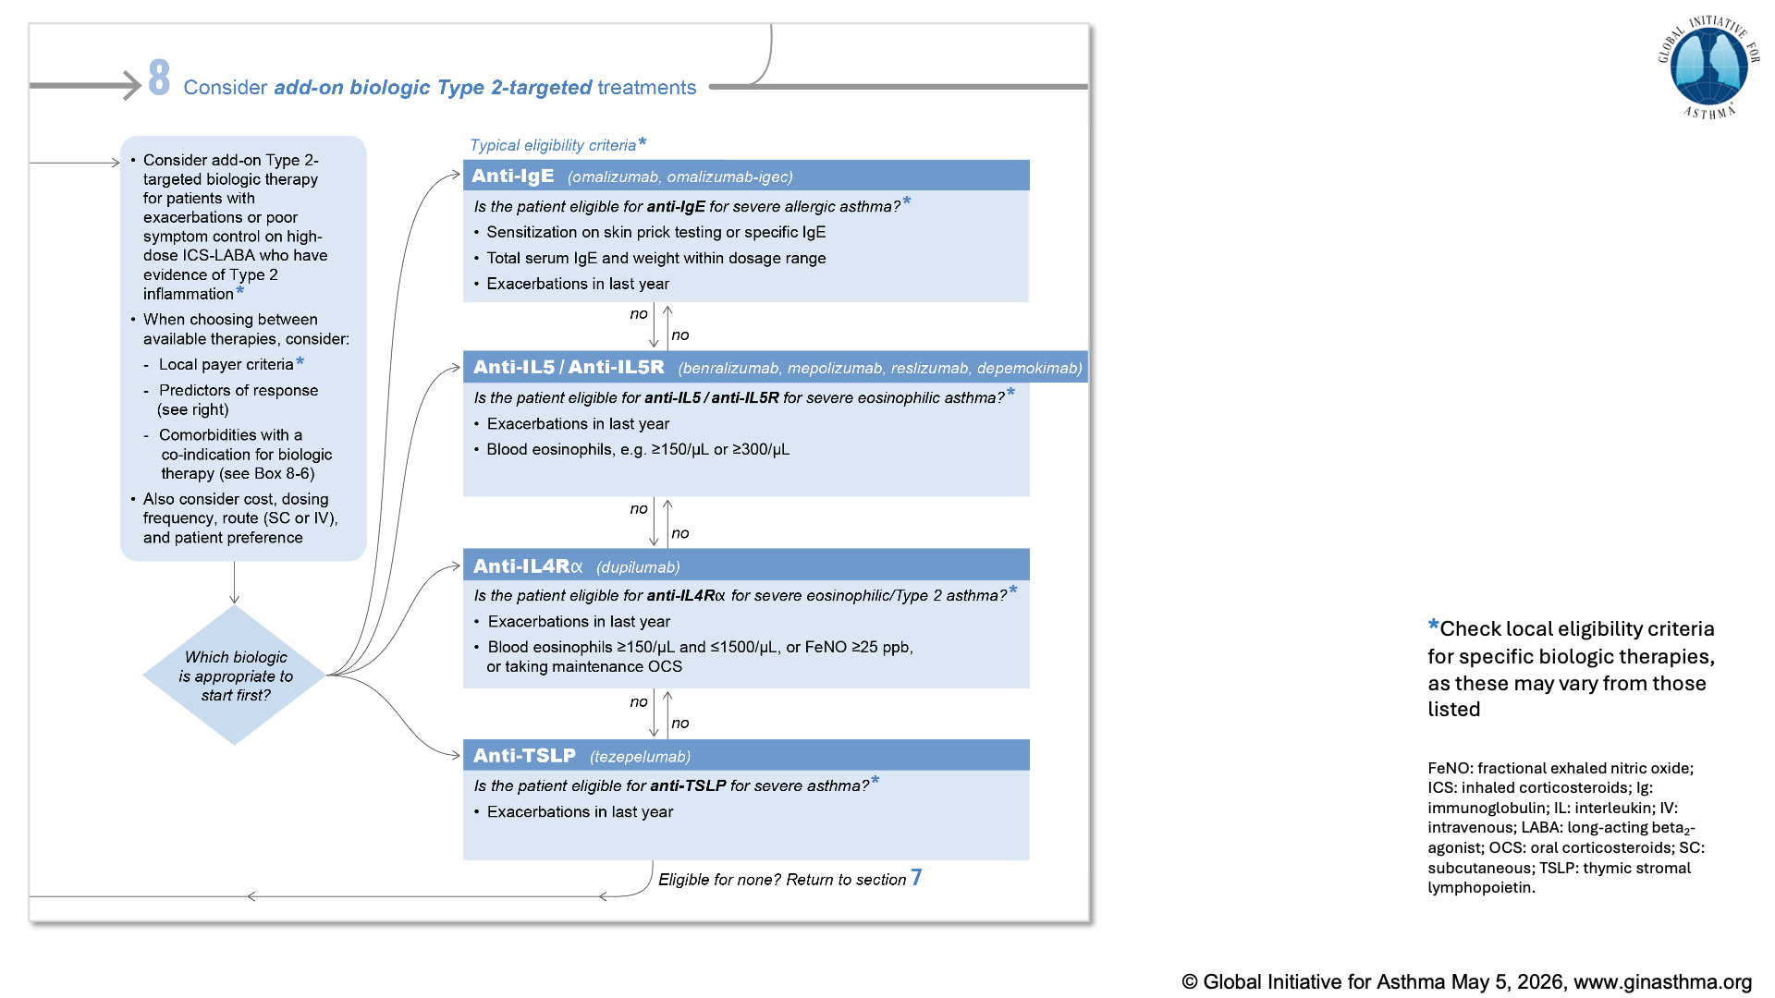

Slide 36
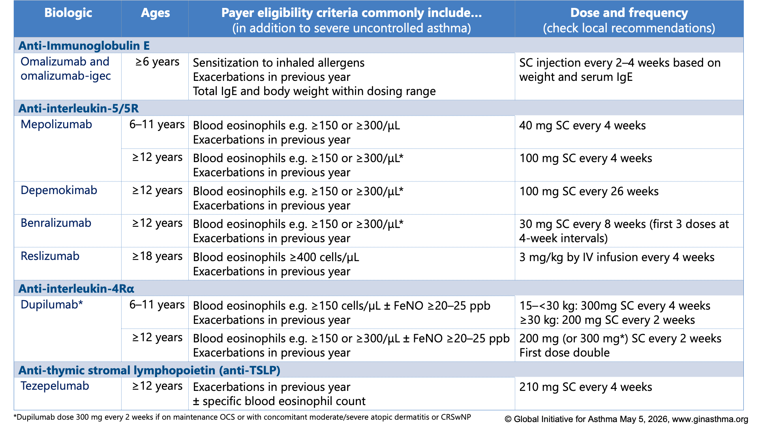

Slide 37
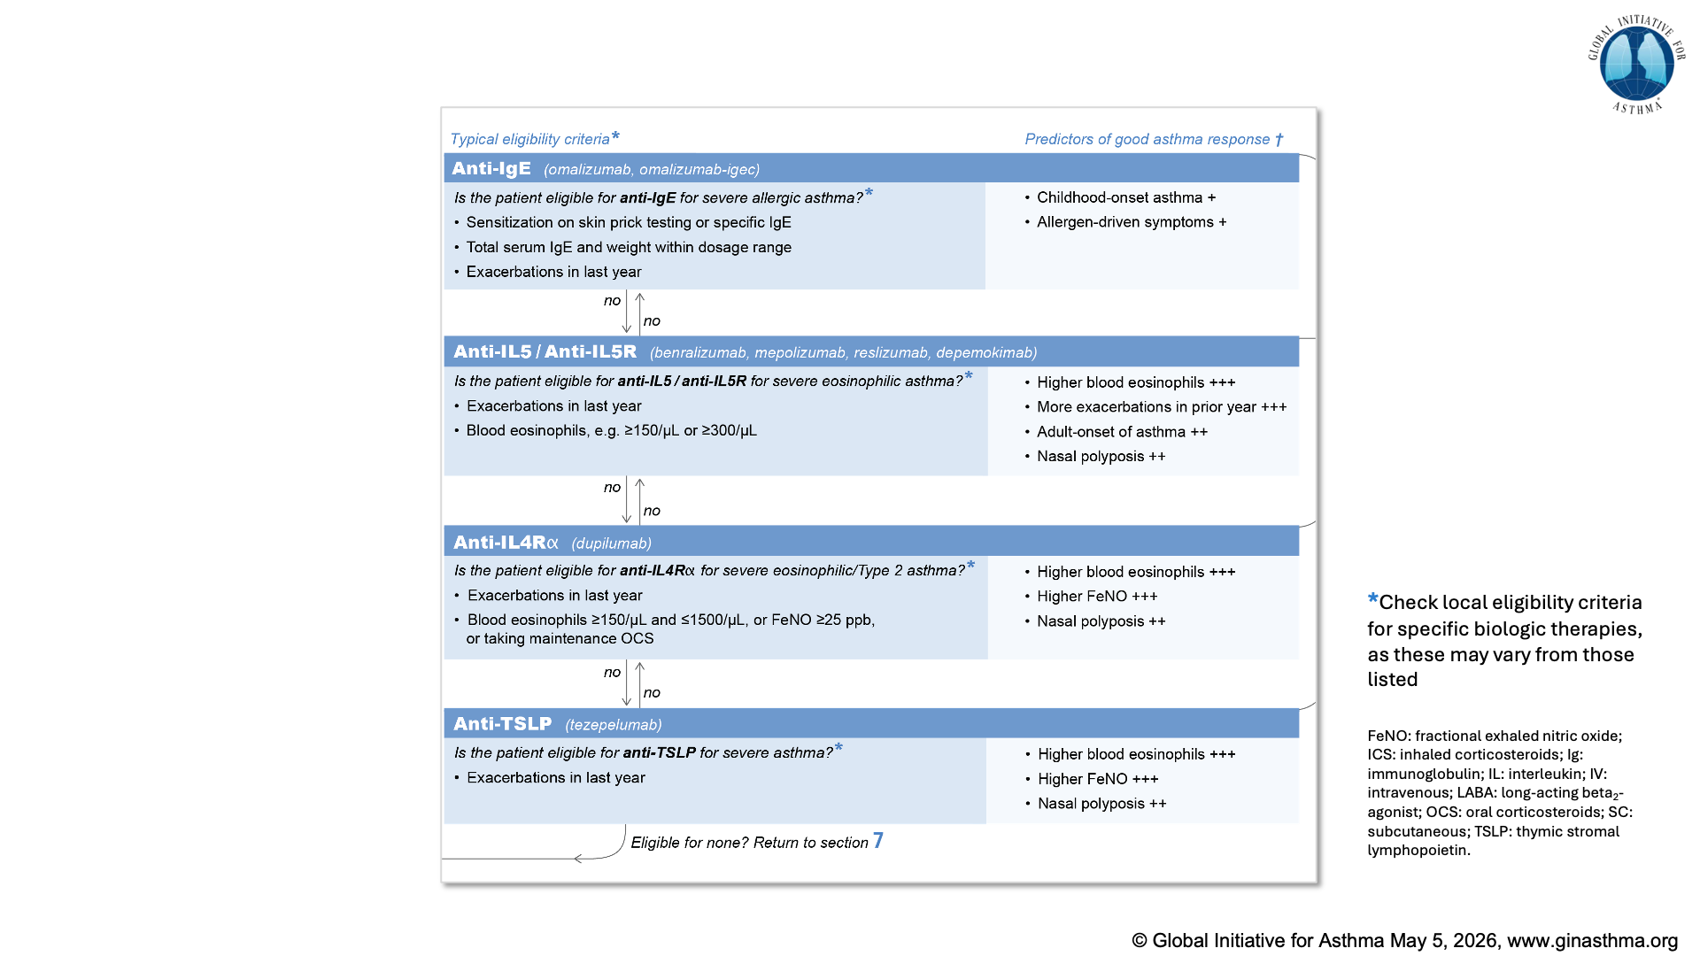

Slide 38
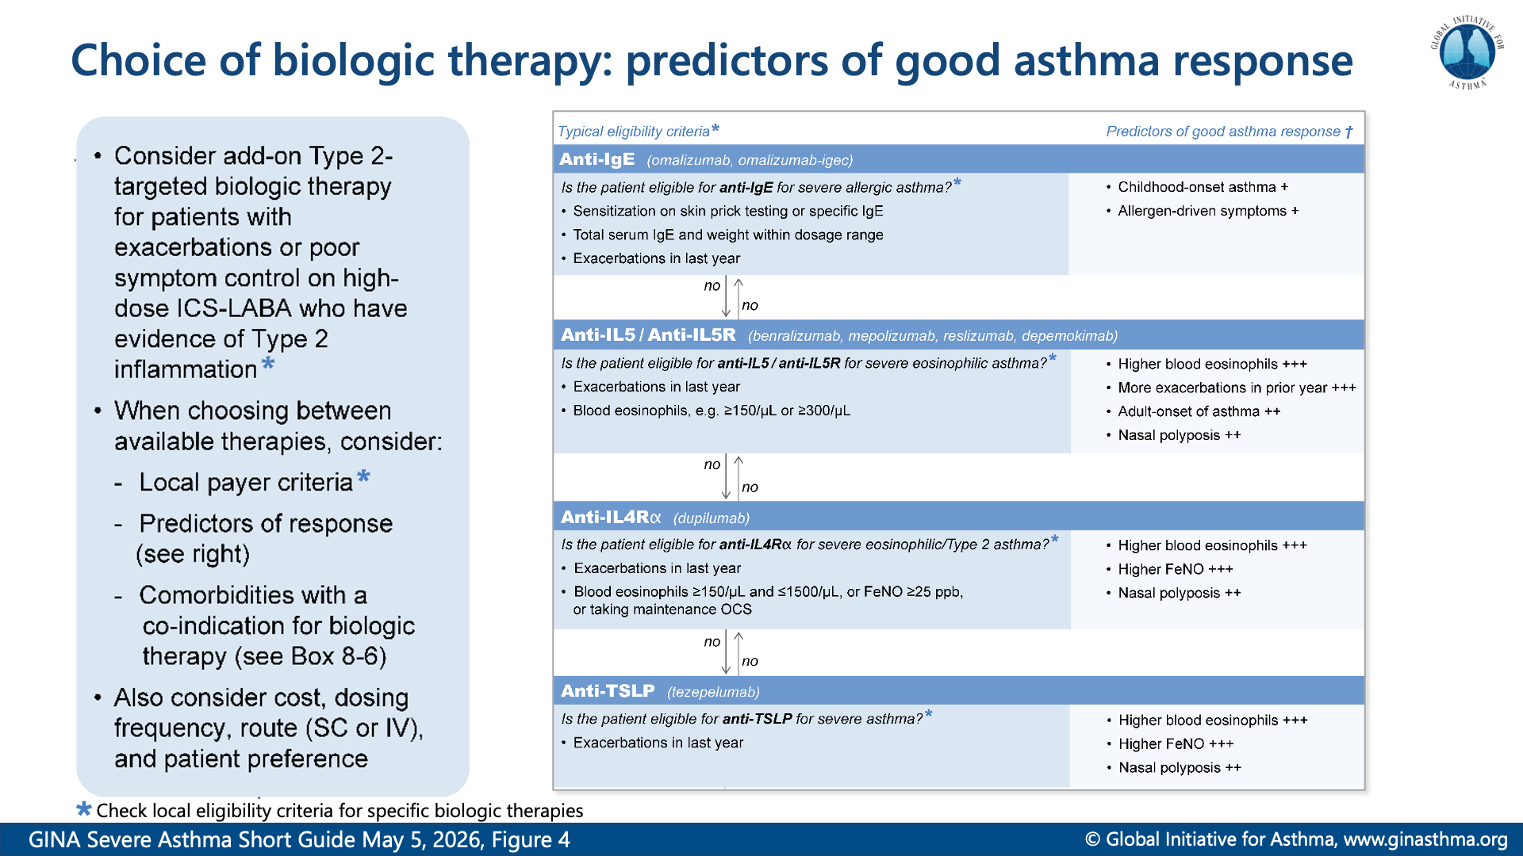

Slide 39
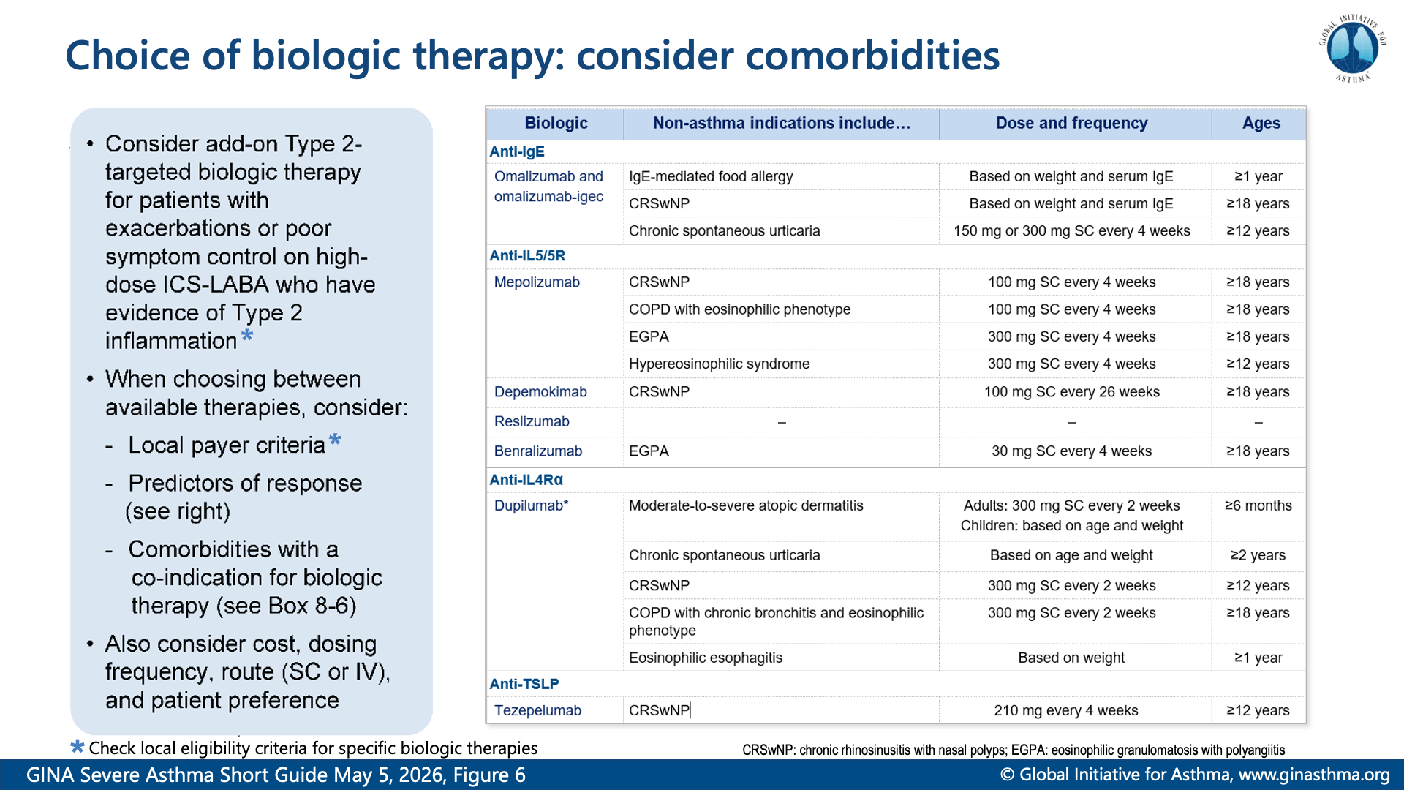

Slide 40
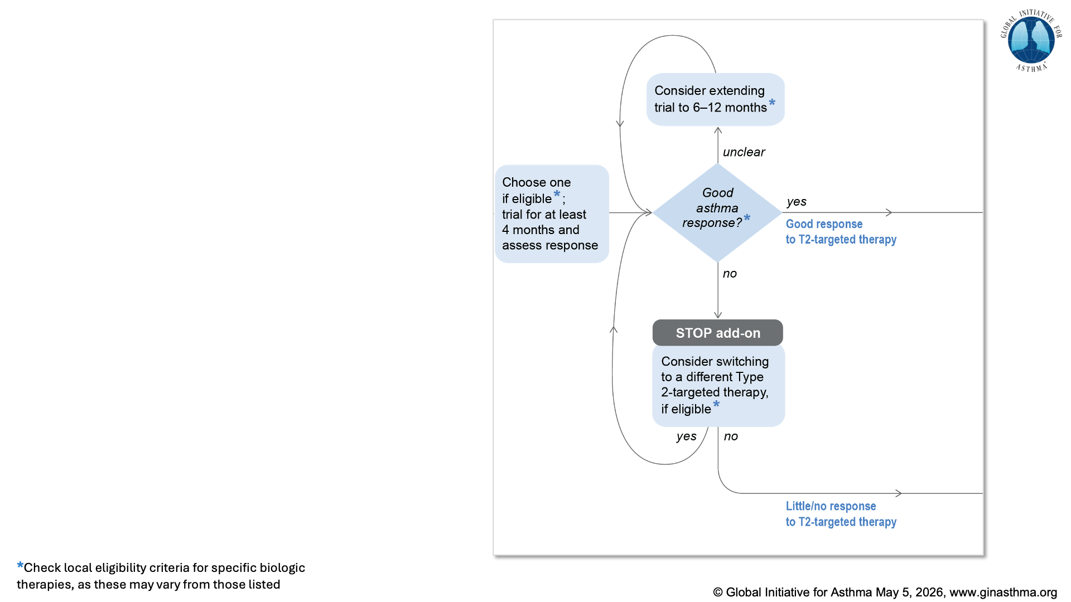

Slide 41
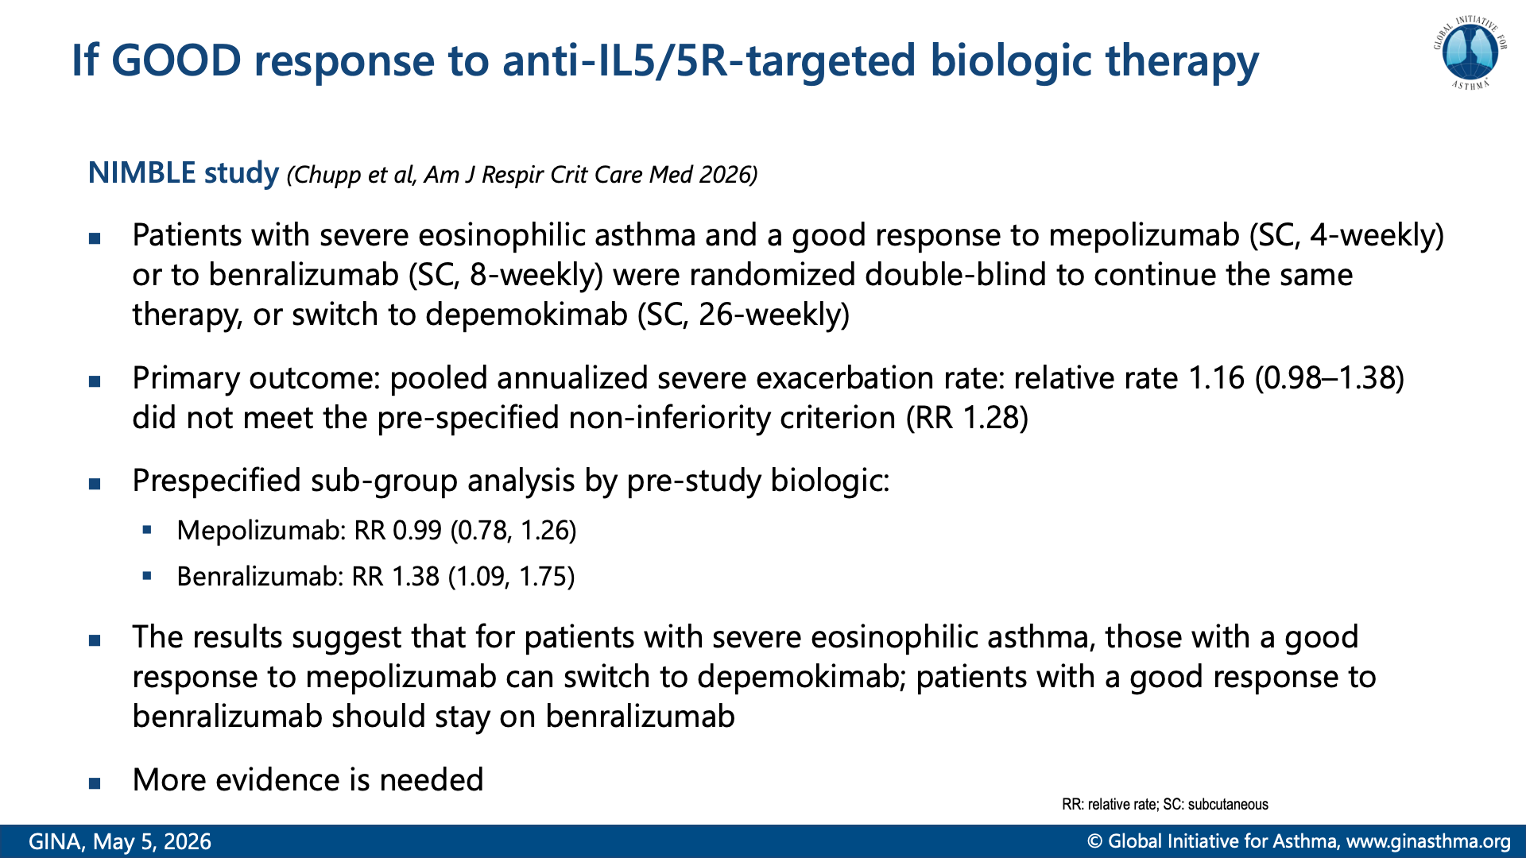
Notes:
Chupp G, Nagase H, Skowasch D, et al. Switching to twice-yearly depemokimab from mepolizumab/benralizumab in severe asthma: A multicenter, randomized, double-blind, Phase 3A Clinical Trial (NIMBLE). Am J Respir Crit Care Med 2026; 212: 921-935.

Slide 42
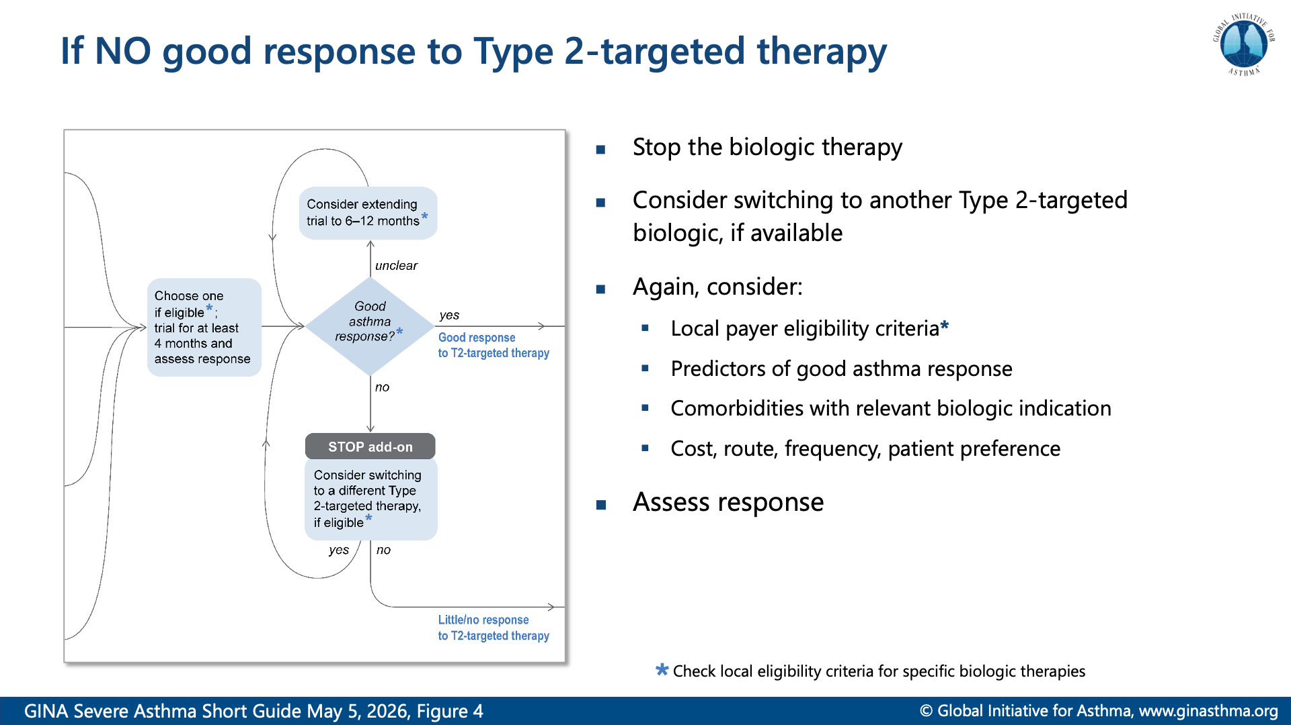

Slide 43
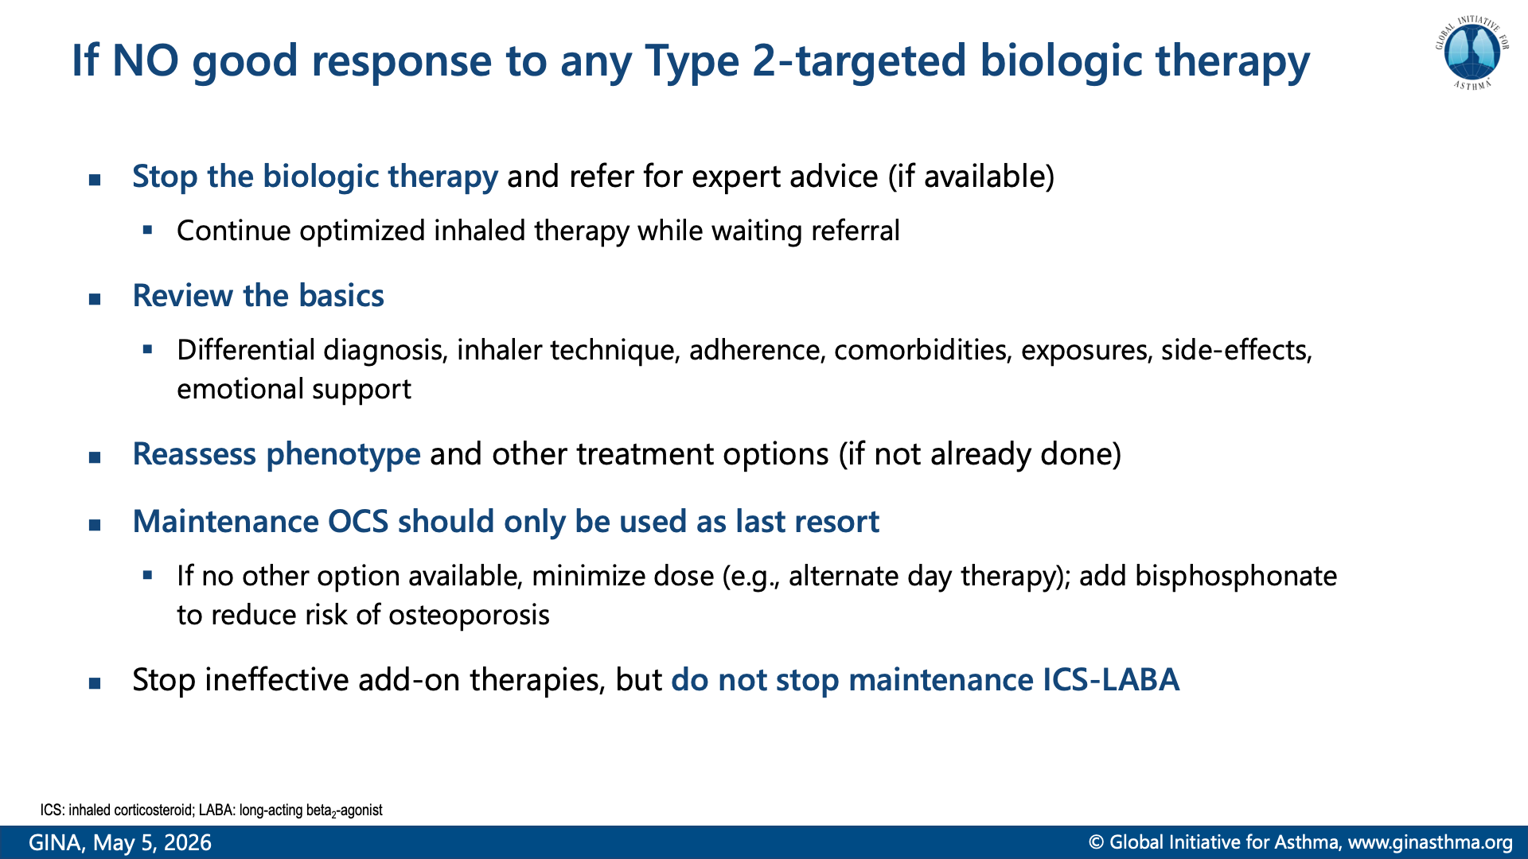

Slide 44
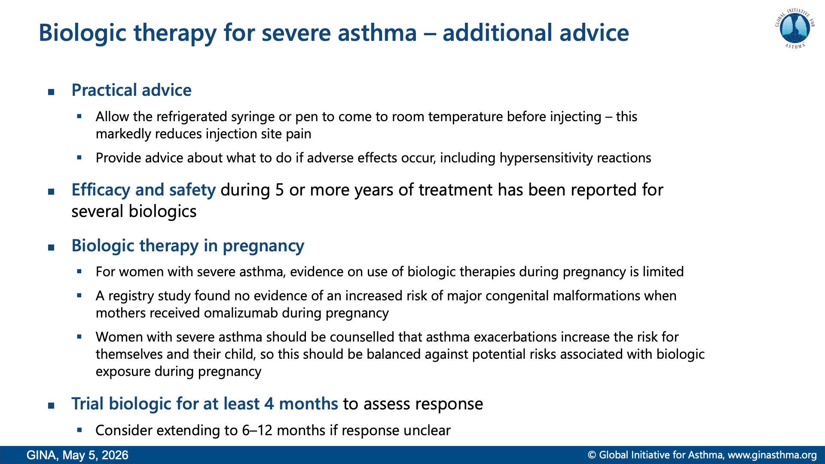
Notes:
Namazy J, Cabana MD, Scheuerle AE, et al. The Xolair Pregnancy Registry (EXPECT): the safety of omalizumab use during pregnancy. J Allergy Clin Immunol 2015; 135: 407-412.

Slide 45
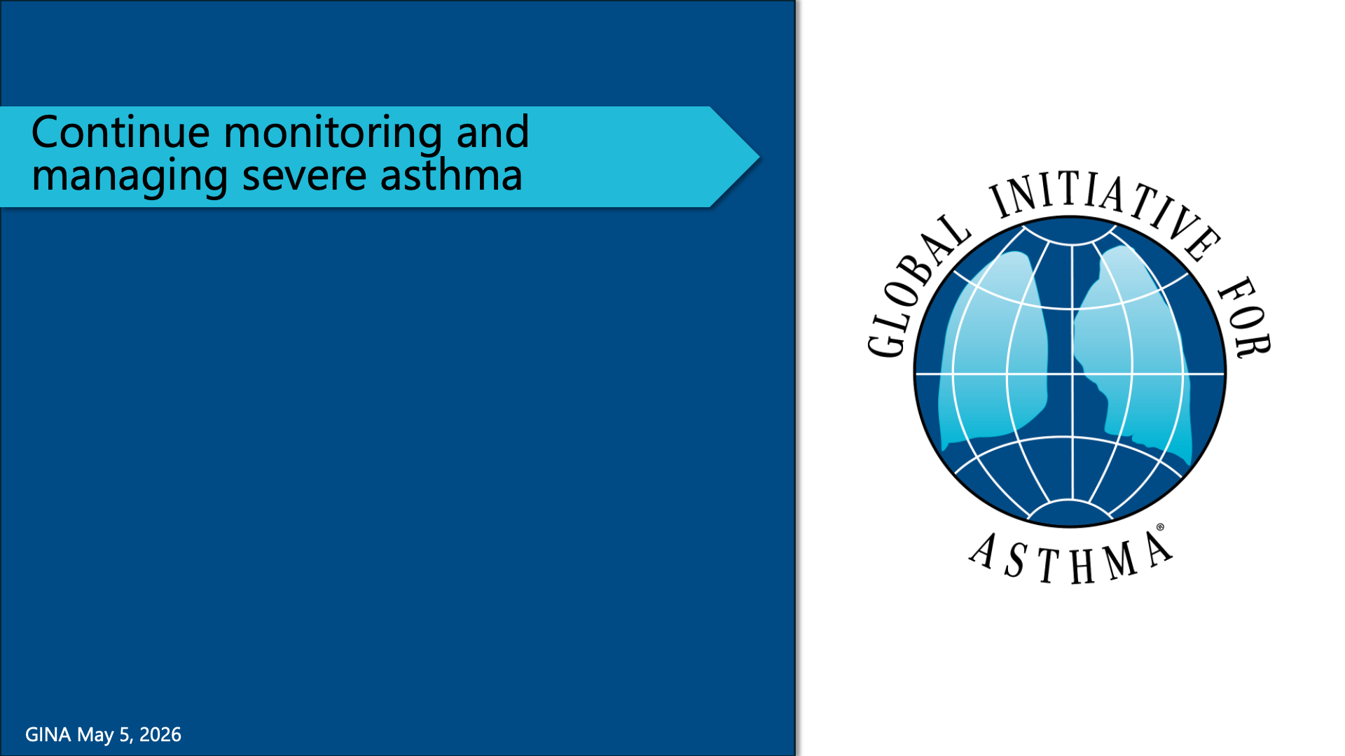

Slide 47
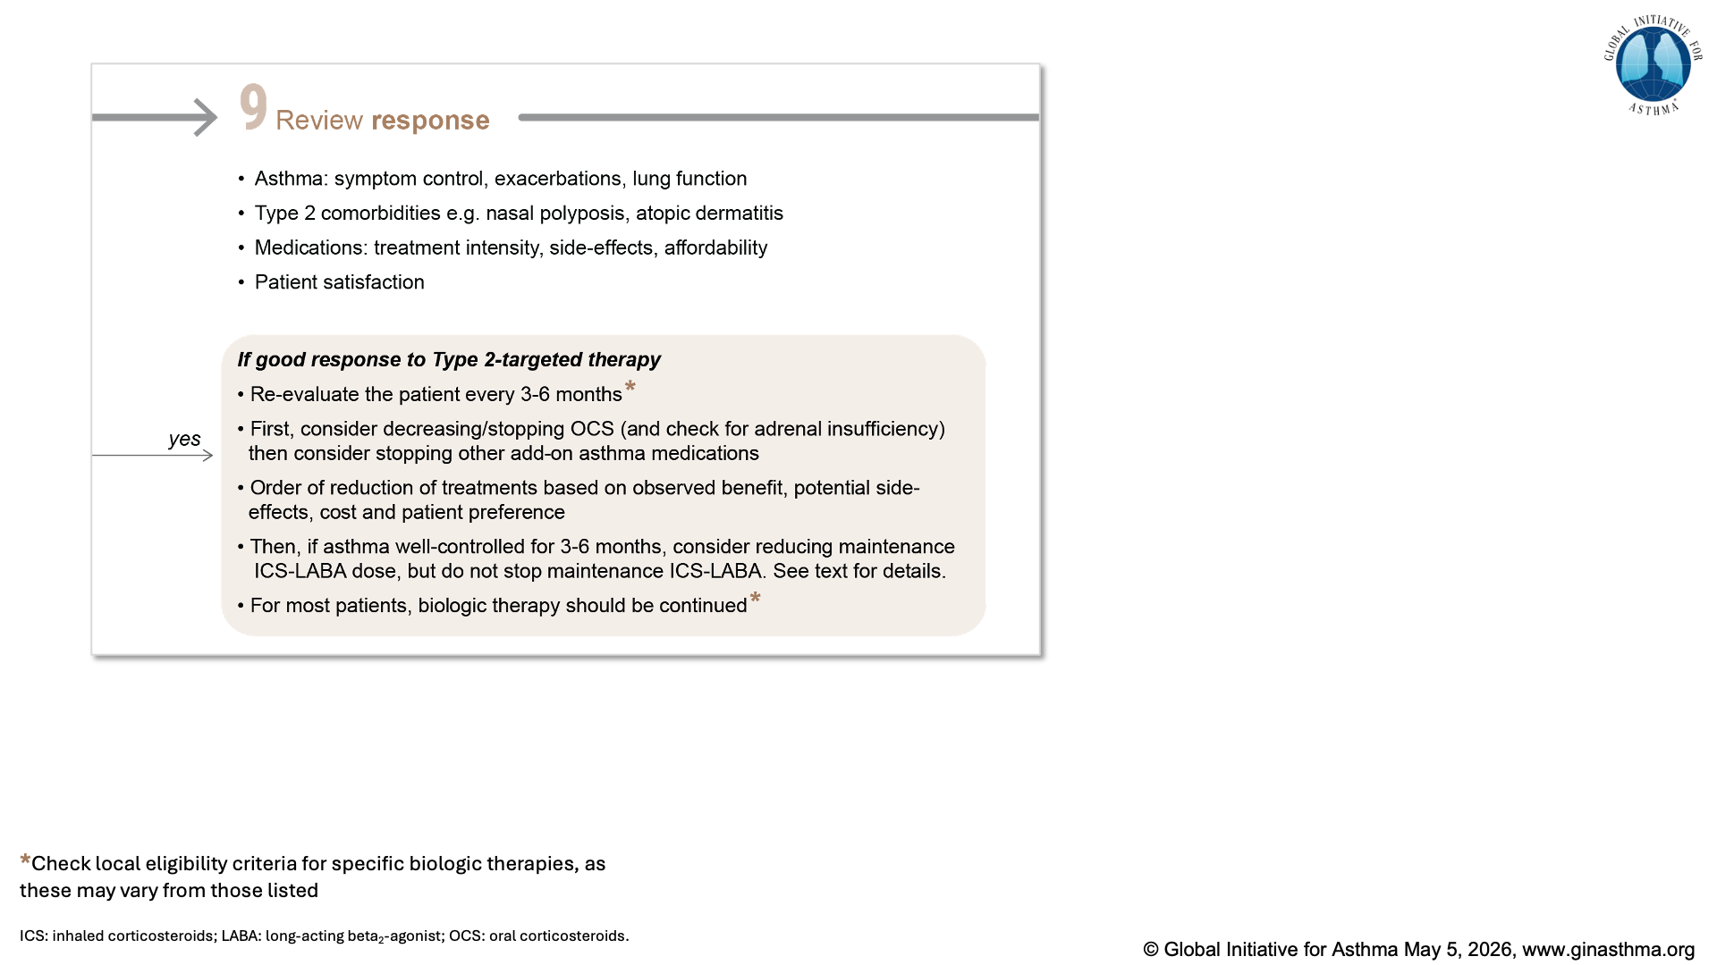

Slide 48
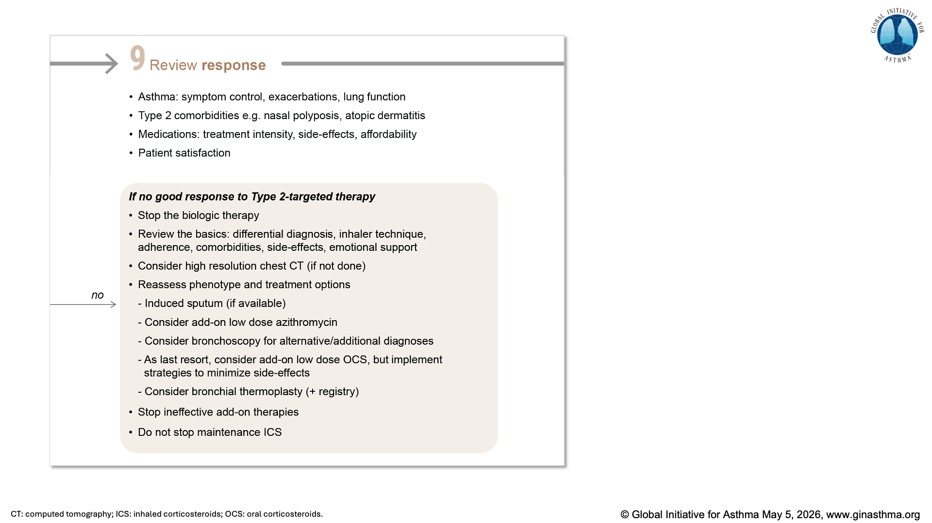

Slide 49
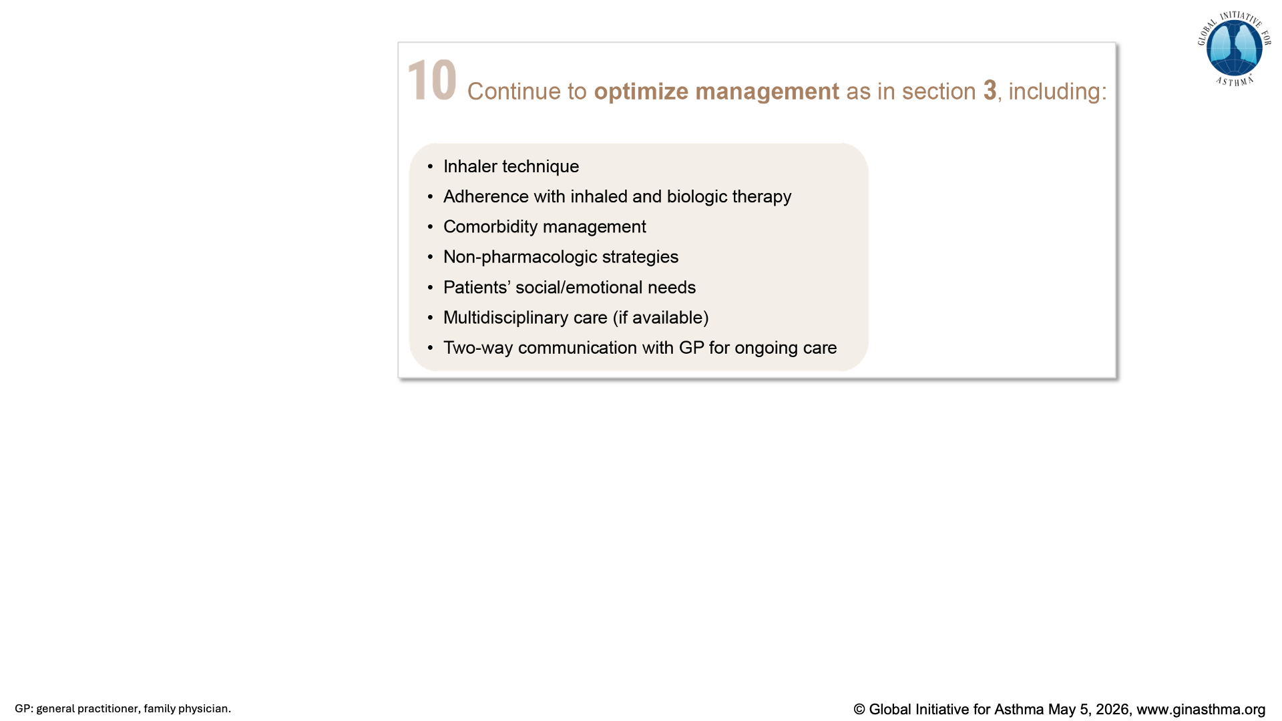

Slide 50
